Slide 2
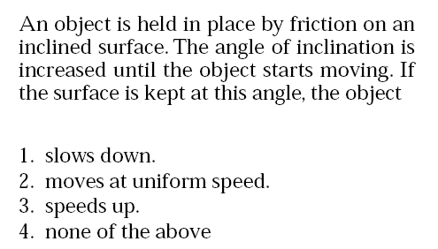
Answer: 3 If the object starts to move then there must be a net force down the incline. This net force will continue to accelerate the object.

Slide 3
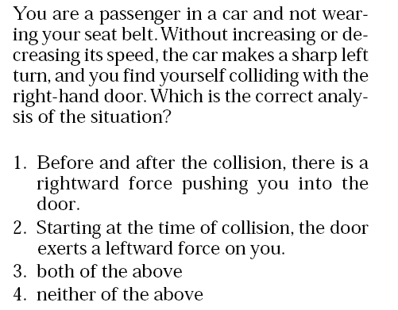
Answer: 2 You collide with the door because you tend to travel in a straight line while the car turns left. Only when the door exerts the leftward force on you do you start to turn with the car.

Slide 4

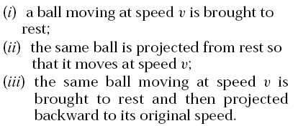

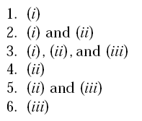
Answer: 6
Momentum is a vector

Slide 5
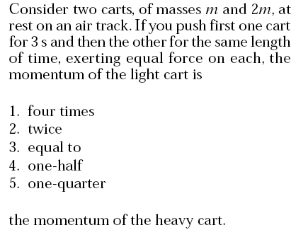
Answer: 3 Force * time interval = change in momentum

Slide 6
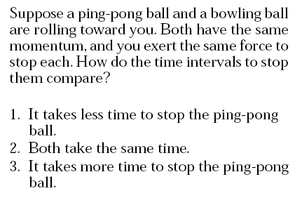
Answer: 2 Force * time interval = change in momentum

Slide 7
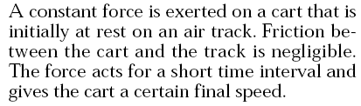

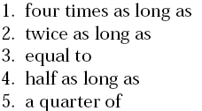


Answer: 2 Force * time interval = change in momentum
= mass * change in velocity

Slide 8
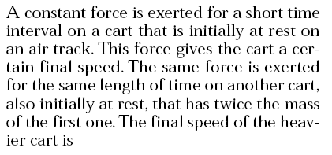
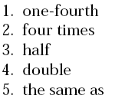


Answer: 3 Force * time interval = change in momentum
= mass * change in velocity

