Slide 1
Suppose you carry a heavy box up a hill with a certain steepness and height as shown below . You then release the box at the top of the hill so that it slides down to the bottom of the hill and reaches a particular speed and kinetic energy (KE). There is no friction that acts on the box. Answer the following questions.

Slide 2
If you climbed up a steeper hill with the same height as the original and released the box at the top. Compared with the original case, which one of the following is correct?
A The speed at the bottom is greater for the steeper hill.
B The speed at the bottom is the same for both hills.
C The speed at the bottom is greater for the original hill because the box travels further
D Not enough information given to determine it.
Answer: B ∆PE=mg(height)

Slide 3
If you climbed up a steeper hill with the same height as the original and released the box at the top. Compared with the original case, which one of the following is correct?
A The KE at the bottom is greater for the steeper hill.
B The KE at the bottom is the same for both hills.
C The KE at the bottom is greater for the original hill because the box travels further
D Not enough information given to determine it.
Answer: B KE=1/2 mv²

Slide 4
If you climbed up a steeper hill with a smaller height than the original hill and released the box at the top. Compared with the original case, which one of the following is correct?
A The speed at the bottom is greater for the steeper hill because it is more difficult to carry it even though it has smaller height.
B The speed at the bottom is the same for both.
C The speed at the bottom is greater for the original case because it has a bigger height.
D Not enough information given to determine it.
Answer: C ∆PE=mg(height)

Slide 5
If you climbed up a higher hill that is less steep than the original. Compared with the original case, which one of the following is correct?
A The speed at the bottom is greater for the higher but less steep hill.
B The speed at the bottom is the same for both hills.
C The speed at the bottom is greater for the original hill which was steeper than what is given above.
D Not enough information given to determine it.
Answer: A ∆PE=mg(height)

Slide 6
If you climbed up a higher hill that is less steep than the original. Compared with the original case, which one of the following is correct?
A The KE at the bottom is greater for the higher but less steep hill.
B The KE at the bottom is the same for both hills.
C The KE at the bottom is greater for the original hill which was steeper than what is given above.
D Not enough information given to determine it.
Answer: A KE=1/2 mv²

Slide 7

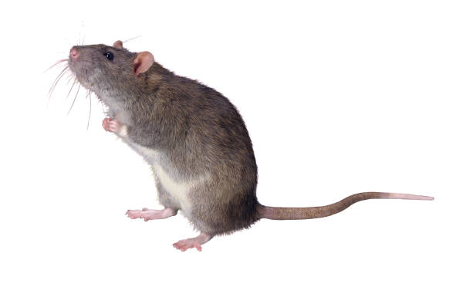
Potential energy only depends on the height difference, not anything else such as steepness, length of the hill etc.

