Slide 2
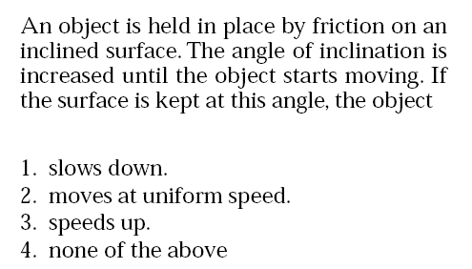

Slide 3
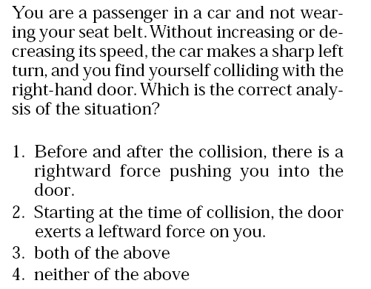

Slide 4
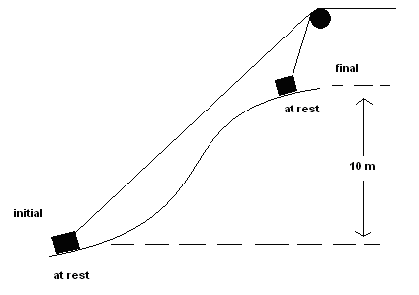
A box is dragged up a frictionless surface by a rope as shown.
The box has a mass of 2 kg.
What was the value of the total work done on the block?
(1)196 J
(2) Zero
(3) Greater than 196 J
(4) -196 J
(5) There is not enough information to answer the question.
Answer:2 Total work done equals change in kinetic energy

Slide 5
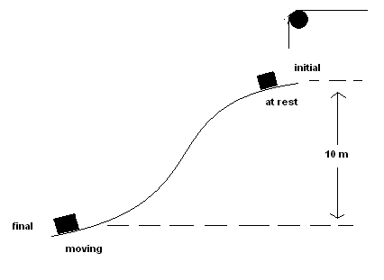
Suppose the rope holding the 2 kg block is cut and the box slides down the slope back to the original position. (No new forces are introduced!)
What is the value of the total work done on the block?
196 J
Zero
Greater than 196 J
-196 J
There is not enough information to answer the question.
Answer: 1 Gravity force does positive work equal to mg(yf-yi)

Slide 6
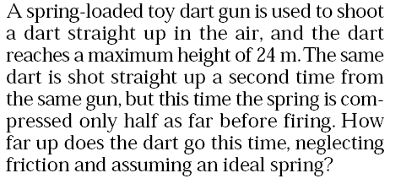
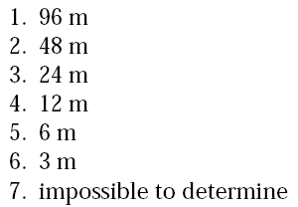
Answer: 5
The spring potential energy is reduced by a factor of 4 and this gets turned into gravitational potential energy.

Slide 7
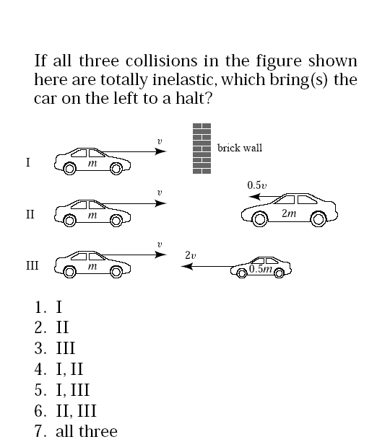
Answer: 7
I: KE is not conserved.
II and III: conservation of momentum

Slide 8
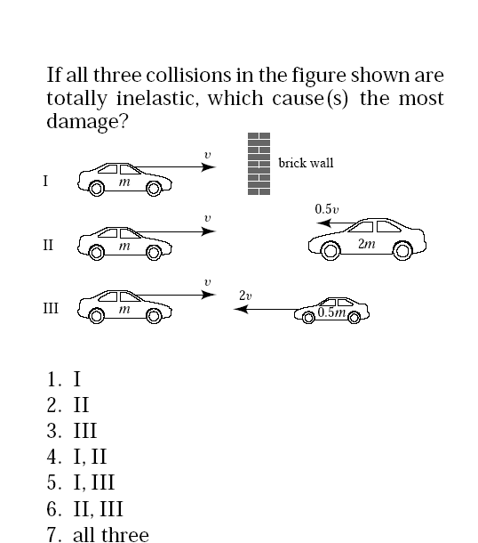
Answer: 3 Energy loss in the collision goes into deforming the cars and so that is what causes the damage.

