Slide 1
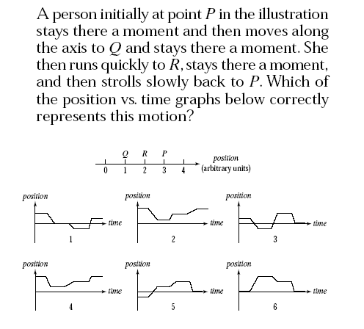
Please use:
A for 1
B for 2
C for 3
D for 4
E for 5
No Vote
for 6
Answer: 2 - B

Slide 2
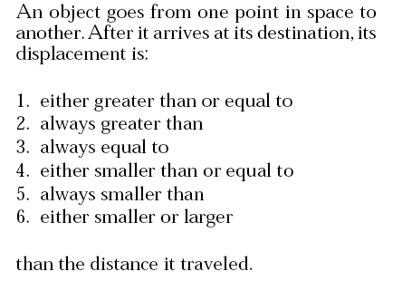
Please use:
A for 1
B for 2
C for 3
D for 4
E for 5
No Vote
for 6
Answer: 4 - D

Slide 3
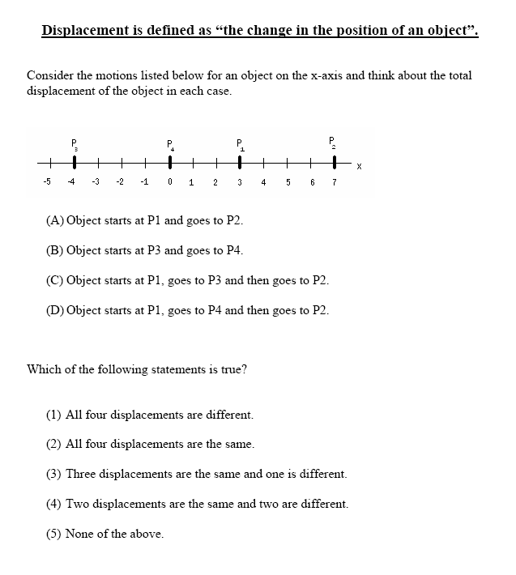
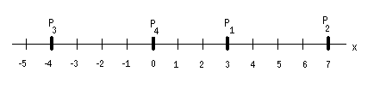
Answer: (2) Here all the displacement vectors are the same (4 units to the right!)

Slide 4
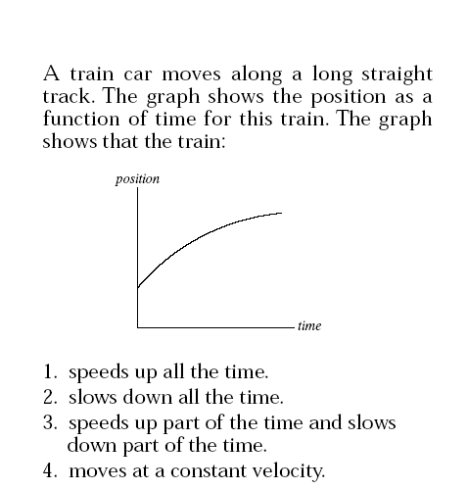
Please use:
A for 1
B for 2
C for 3
D for 4
Answer: 2 - B

Slide 5
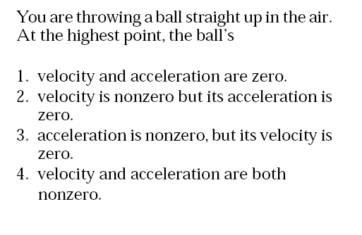
Please use:
A for 1
B for 2
C for 3
D for 4
Answer: 3 - C: For an object in free fall the object’s acceleration
is always 9.8 m/s² downward.

Slide 6
Consider the following four situations:
Please use:
A for 1
B for 2
C for 3
D for 4
E for 5
you make a U-turn at constant speed
you are driving forward, stop, and go in reverse
you make a right turn at constant speed
you make a right turn and brake while turning
For which of these situations do you experience a nonzero
average acceleration?
d
b and d
b
a, b and d
all of them
Answer: E- In all cases there is a nonzero change in the vector velocity from start to finish and so there is a nonzero average acceleration.

