Slide 1
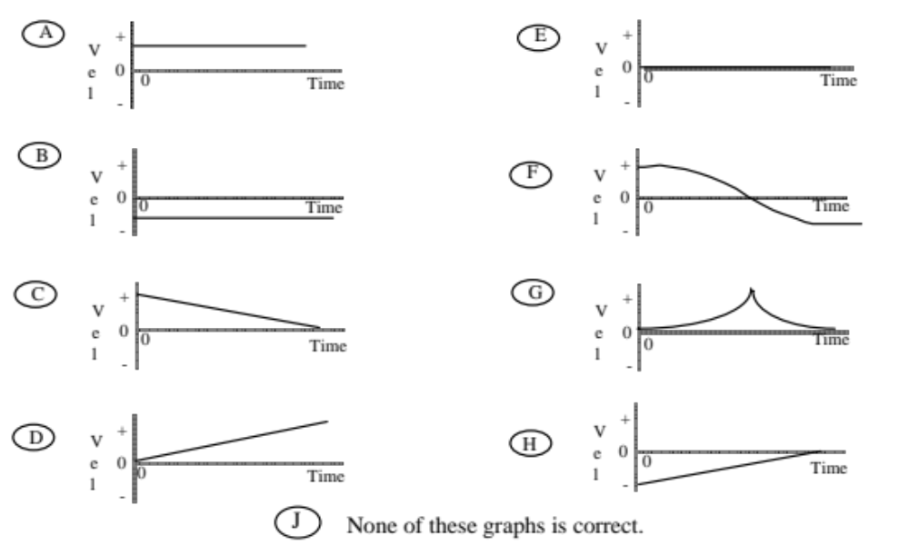
A car can move to the right or left along a horizontal line. If the positive direction is to the right, using the following graphs answer the questions asked.
Which velocity graph shows the car moving toward the right at a steady velocity?
Answer: 1 - A

Slide 2
Which velocity graph shows the car reversing direction?
Answer: F

Slide 3
Which velocity graph shows the car moving toward the left at a steady velocity?
Answer: B

Slide 4
Which velocity graph shows the car increasing its speed at a steady rate?
Answer: D

Slide 5
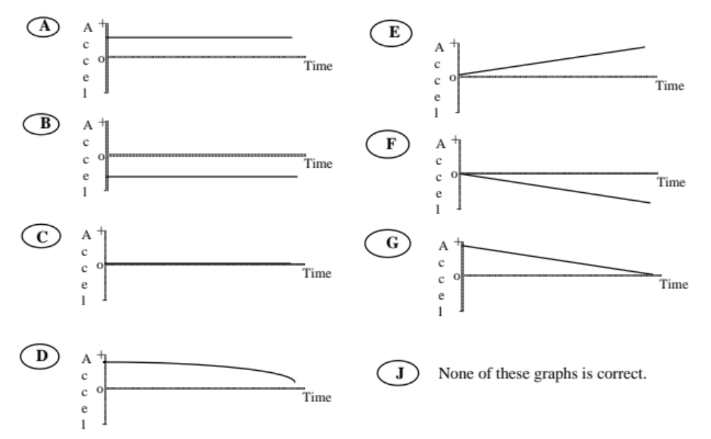
A car can move to the right or left along a horizontal line. If the positive direction is to the right, using the following graphs answer the questions asked.
Which acceleration graph shows the car moving toward the right, speeding up at a steady rate?
Answer: A

Slide 6
Which acceleration graph shows the car moving toward the right, slowing down at a steady rate?
Answer: B

Slide 7
Which acceleration graph shows the car moving toward the left at a constant velocity?
Answer: C

Slide 8
Which acceleration graph shows the car moving toward the left, speeding up at a steady rate?
Answer: B

Slide 9
Which acceleration graph shows the car moving toward the right at a constant velocity?
Answer: C

