Slide 1
If you drop an object in the absence of air
resistance, it accelerates downward at 9.8
m/s². If instead you throw it downward, its
downward acceleration after release is
A- less than 9.8 m/s2.
B- 9.8 m/s2.
C- more than 9.8 m/s2.
D- none of the above
Answer: B

Slide 2
A marathon runner runs at a steady 15
km/hr. When the runner is 7.5 km from the
finish, a bird begins flying from the runner to
the finish at 30 km/hr. When the bird reaches
the finish line, it turns around and flies
back to the runner, and then turns around
again, repeating the back-and-forth trips
until the runner reaches the finish line. How
many kilometers does the bird travel?
A- 10 km C- 20 km
B- 15 km D- 30 km
Answer: B- 15 km

Slide 3
A person standing at the edge of a cliff
throws one ball straight up and another ball
straight down at the same initial speed. Neglecting
air resistance, the ball to hit the
ground below the cliff with the greater speed
is the one initially thrown
A- upward.
B- downward.
C- neither—they both hit at the same speed.
Answer: C

Slide 4
Consider the situation depicted here. An arrow
is accurately aimed at an apple hanging on a tree. The
apple is well within the arrow’s range, but the
instant the arrow is shot with an initial speed v_{o}(nonzero), the apple breaks free from the branch of the tree. What happens? The arrow
A- hits the apple regardless of the value of v_{o}.
B- hits the apple only if v_{o} is large enough.
C- misses the apple by passing right above it.
D- misses the apple by passing right below it.
Answer: A- Their accelerations are identical and they both “fall” the same distance

Slide 5
Consider the situation depicted here. A child is sitting in a cart and the cart is moving at a constant velocity. If the child throws an apple straight upward, what would happen?
A- the apple goes up and falls behind the cart.
B- the apple goes up and falls in front of the cart.
C- the apple goes up and falls right into the hands of the child, and so he just keeps playing with it.
D- It depends how fast the apple is thrown.
Answer: C- Their initial horizontal velocities are the same, thus the apple will travel
the same distance as the cart and the child ,and when it falls back it will fall into the
hands of the child. This is regardless of the initial upward speed of the apple.

Slide 6
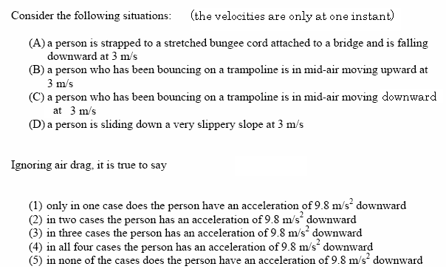
Answer: (2) In cases B and C there is nothing touching the person
and so the person is in “free-fall”. Only in such a case
is the acceleration of the person equal to 9.8 m/s² downward.

