Slide 1
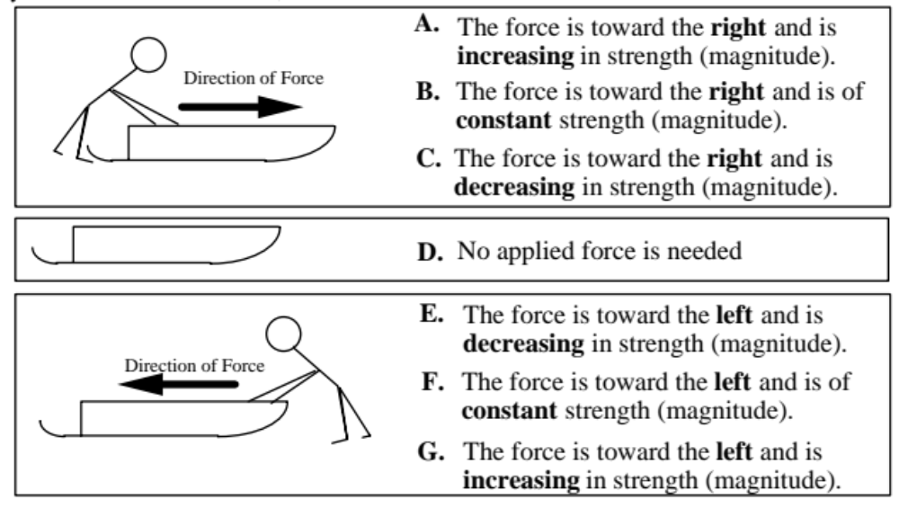
A sled on ice moves in the ways described in questions below. We ignore friction. A person wearing proper shoes standing on the ice can apply a force to the sled and push it along the ice. Choose the one force which would keep the sled moving as described in each statement below. If none is correct, answer J.

Slide 2
1- Which force would keep the sled moving toward the right and speeding up at a steady rate (constant acceleration)?
Answer: B

Slide 3
2- Which force would keep the sled moving toward the right at a steady (constant) velocity?
Answer: D

Slide 4
3- The sled is moving toward the right. Which force would slow it down at a steady rate (constant acceleration)?
Answer: F

Slide 5
4- Which force would keep the sled moving toward the left and speeding up at a steady rate (constant acceleration)?
Answer: F

Slide 6
5- The sled was started from rest and pushed until it reached a steady (constant) velocity toward the right. Which force would keep the sled moving at this velocity?
Answer: D

Slide 7
6- The sled is slowing down at a steady rate and has an acceleration to the right. Which force would account for this motion?
Answer: B

Slide 8
7- The sled is moving toward the left. Which force would slow it down at a steady rate (constant acceleration)?
Answer: B

Slide 9
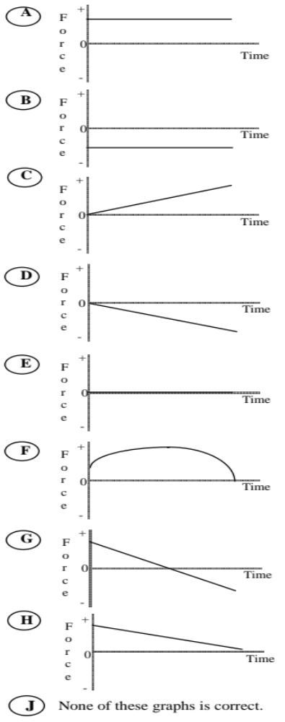
A toy car can move to the right or left along a horizontal line. Assume no friction. A force is applied to the car. Choose the one force graph for each statement below which would allow the described motion of the car to continue. If none is correct, answer J.

Slide 10
1- The car moves toward the right (away from the origin) with a steady (constant) velocity.
Answer: E

Slide 11
2- The car is at rest.
Answer: E

Slide 12
3- The car moves toward the right and is speeding up at a steady rate (constant acceleration).
Answer: A

Slide 13
4- The car moves toward the left (toward the origin) with a steady (constant) velocity.
Answer: E

Slide 14
5- The car moves toward the right and is slowing down at a steady rate (constant acceleration).
Answer: B

Slide 15
6- The car moves toward the left and is speeding up at a steady rate (constant acceleration).
Answer: B

Slide 16
7- The car moves toward the right, speeds up and then slows down.
Answer: G

Slide 17
8- The car was pushed toward the right and then released. Which graph describes the force after the car is released?
Answer: E

