Slide 1
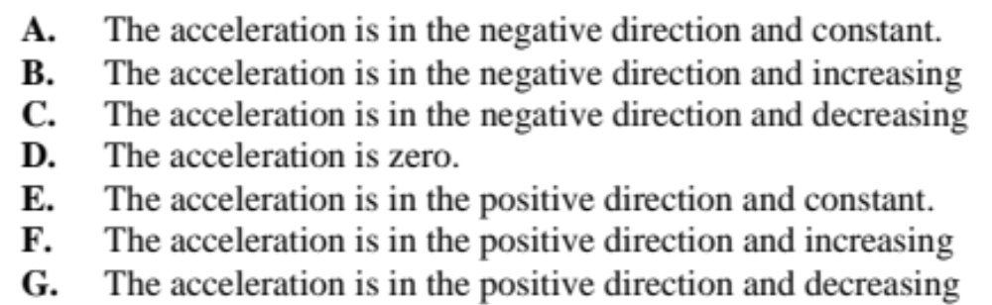
A coin is tossed straight up into the air. After it is released it moves upward, reaches its highest point and falls back down again. Use one of the following choices to indicate the acceleration of the coin during each of the stages of the coin’s motion described below. Take up to be the positive direction. If none is correct, answer J. Assume no air resistance or wind.

Slide 2
1- The coin is moving upward after it is released.
Answer: A

Slide 3
2- The coin is at its highest point.
Answer: A

Slide 4
3- The coin is moving downward.
Answer: A

Slide 6
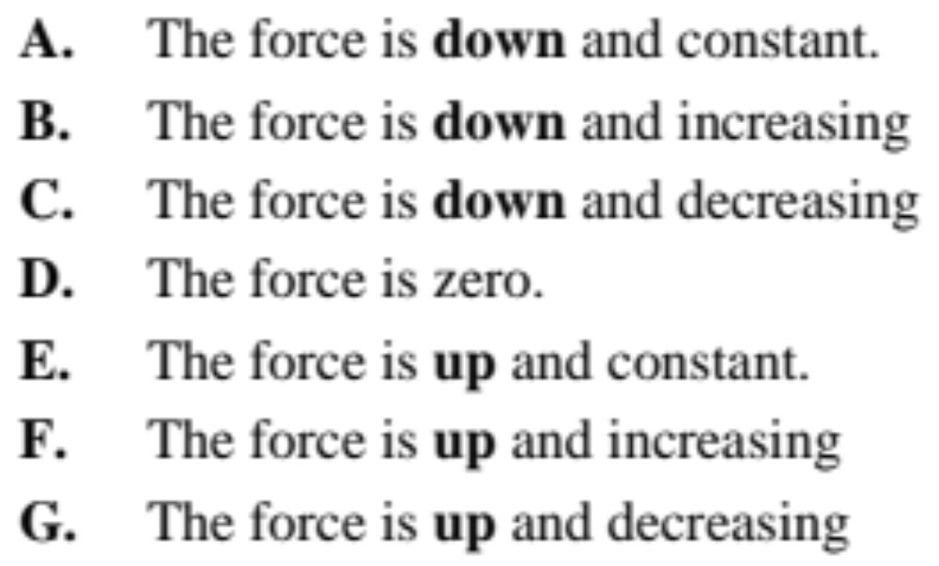
A coin is tossed straight up into the air. After it is released it moves upward, reaches its highest point and falls back down again. Use one of the following choices to indicate the force acting on the coin for each of the cases described below. If none is correct, answer J. . Assume no air resistance or wind.

Slide 7
1- The coin is moving upward after it is released.
Answer: A

Slide 8
2- The coin is at its highest point.
Answer: A

Slide 9
3- The coin is moving downward.
Answer: A

