Slide 1
A crate is sliding down an inclined surface with friction at constant velocity. What is the net work done on the crate as it descends the incline?
A Zero
B Nonzero
C Not enough info is given, hence cannot be determined
Answer: A Recall the Work-Energy Theorem W_{net} = ∆KE

Slide 2
Suppose you lift a box of mass m from ground to a height of h with constant velocity. The net work done on the mass is
A Zero
B Non-zero
C Don’t know
Answer: A Recall the Work-Energy Theorem W_{net} = ∆KE

Slide 3
Suppose you lift a box of mass m from ground to a height of h with constant velocity. Which one of the following is correct?
A You did not do any work on the mass because there is no change in the kinetic energy of the mass
B You did a nonzero positive work on the mass but because the gravity did a nonzero negative work on it, they cancelled out
C There is a net work done on the mass because of you doing a nonzero work on it.
D None of the above.
Answer: B Recall the Work-Energy Theorem W_{net} = ∆KE

Slide 4
Which one of the following is correct?
A Friction is a conservative force
B Potential energy can only exist in association with a non- conservative force
C Potential energy can only exist in association with a conservative force
D None of the above.
Answer: C

Slide 5
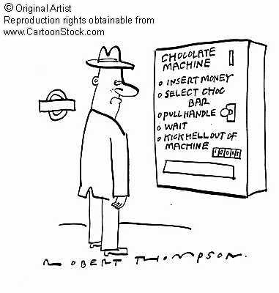
Conservative Forces:
Potential Energy
Non-conservative Forces:
No potential energy

