Slide 2
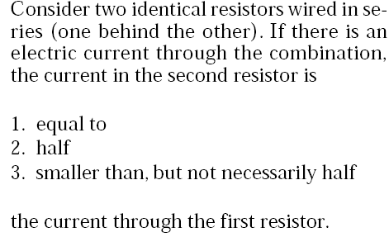
Please use:
A for 1
B for 2
C for 3
D for 4
E for 5
No Vote
for 6
Answer: 1

Slide 3
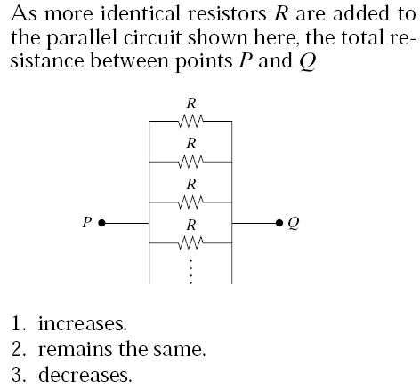
Please use:
A for 1
B for 2
C for 3
D for 4
E for 5
No Vote
for 6
Answer: 3

Slide 4
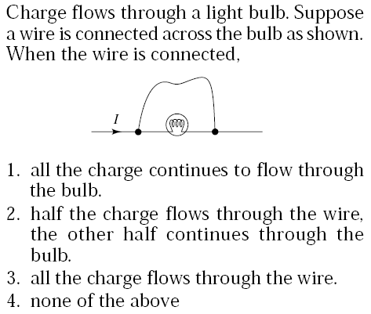
Answer: 3

Slide 5
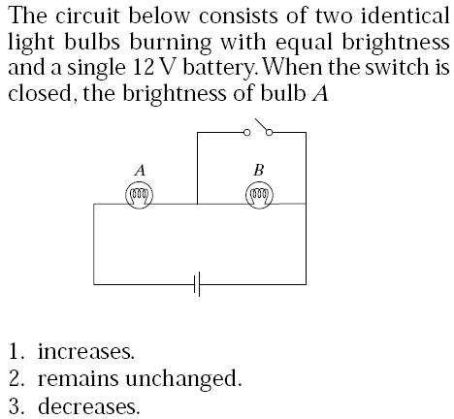
Answer: 1

Slide 6
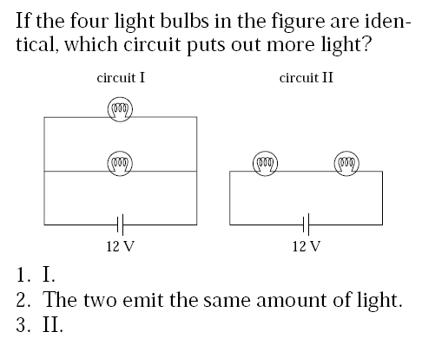
Answer: I

Slide 7
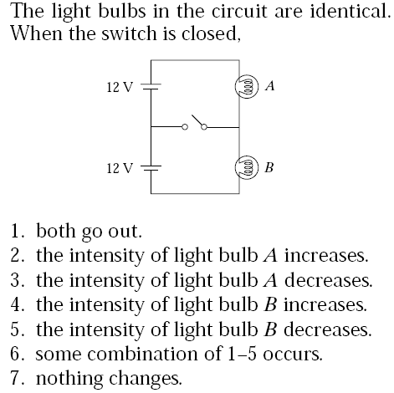
Answer: 7

Slide 8
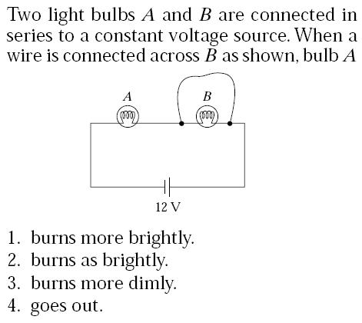
Answer: 1

Slide 9
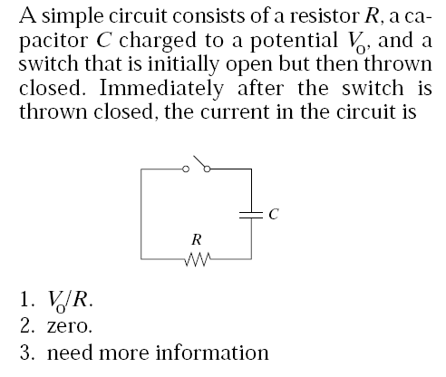
Answer: 1

Slide 10
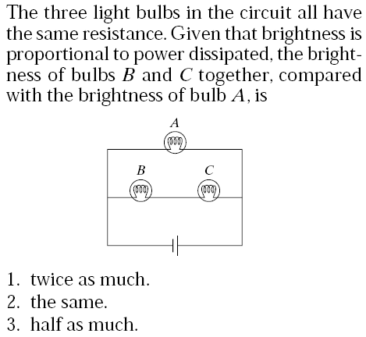
Answer: 3

Slide 11
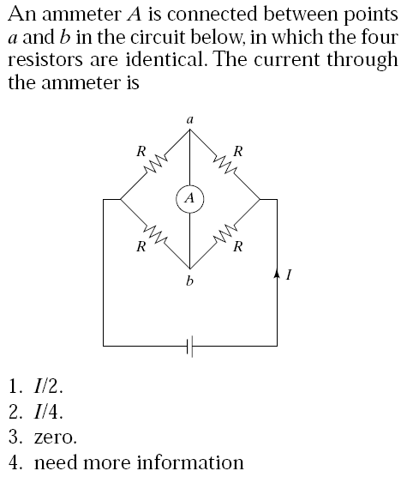
Answer: 3

Slide 12
Kirchhoff’s circuit rules:
1- Junction Rule
2- Loop Rule

