Slide 1
http://phet.colorado.edu/simulations/sims.php?sim=Balloons_and_Static_Electricity
Ion Propulsion:
http://www.youtube.com/watch?v=HcEc7dnRppw
http://www.youtube.com/watch?v=grU8g9jnS4w

Slide 2
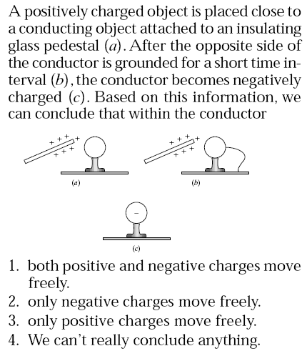
Please use:
A for 1
B for 2
C for 3
D for 4
E for 5
No Vote
for 6
Answer: 4

Slide 3
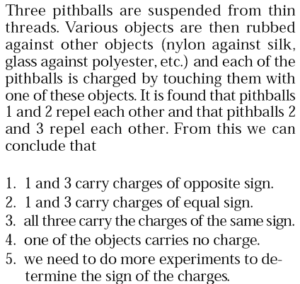
Please use:
A for 1
B for 2
C for 3
D for 4
E for 5
No Vote
for 6
Answer: 3

Slide 4
A
B
+
+
??
+
+
Before
+
+
+
+
+
+
+
+
+
After
+
+
+
When a sphere A of unknown charge content is brought near a positively charged sphere B, they attract each other.
Which one of the following is a correct conclusion?
1- A is positively charged
2- A is neutral
3- A is negatively charged
4- Both 2 and 3 are legitimate possibilities.
Answer: 4

Slide 5
We have three pithballs with unknown charge contents that are suspended from thin threads. It is found that pithballs 1 and 2 attract each other and that pithballs 2 and 3 repel each other. From this we can conclude that
1 and 3 carry charges of opposite sign.
1 and 3 carry charges of equal sign.
all three carry the charges of the same sign.
one of the objects carries no charge.
we need to do more experiments to determine the sign of the charges.
Answer: 5, a neutral object will also be attracted to (but cannot be repelled by)
any charged object

Slide 6
Three pithballs are suspended from thin threads. Various objects are then rubbed against other objects (nylon against silk, glass against polyester, etc.) and each of the pithballs is charged by touching them with one of these objects. It is found that pithballs 1 and 2 attract each other and that pithballs 2 and 3 repel each other. From this we can conclude that
1 and 3 carry charges of opposite sign.
1 and 3 carry charges of equal sign.
all three carry the charges of the same sign.
one of the objects carries no charge.
we need to do more experiments to determine the sign of the charges.
Answer: 1

Slide 7
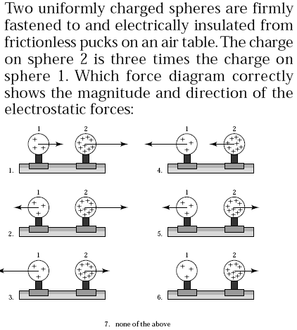
Answer: 5, Like charges repel + Newton’s third law.

Slide 8
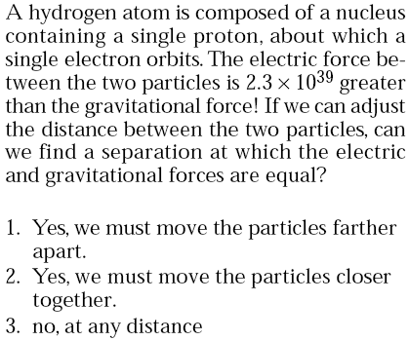
Answer: 3, both forces are diluted as the inverse square of distance!

Slide 9
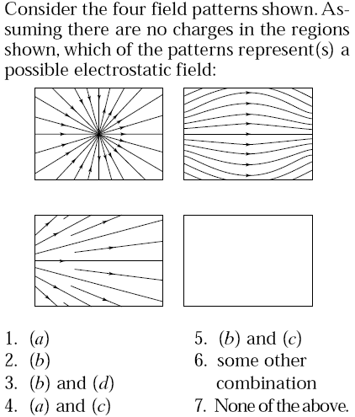
a
b
c
d
Answer: 2

Slide 10
Which one of the following is a correct statement?
(A) Electric field is the same as electrostatic force.
(B) Electric field cannot exist at a point at which there is no charge.
(C) Electric field is zero inside a metal that is not connected to a power supply or battery.
(D) Coulomb’s law gives us the electric field.
Answer: C

Slide 11
Which one of the following is a false statement?
Neutral particles will feel a net electrostatic force on themselves when placed in a non-uniform electric field.
Electric field lines originate at positive charges and terminate at negative charges.
(C) Electric field is created by any charged particle.
(D) Any charged particle which finds itself inside an electric field will feel a force on it.
(E) Neutral particles will feel a net electrostatic force on themselves when placed in a uniform electric field.

Slide 12
Which one of the following is a false statement?
(A) Electric field lines originate at positive charges and terminate at negative charges.
(B) Electric field is created by any charged particle.
(C) Any charged particle which finds itself inside an electric field will feel a force on it.
(D) Neutral particles will feel a net electrostatic force on themselves when placed in a uniform electric field.
(E) Neutral particles will feel a net electrostatic force on themselves when placed in a non-uniform electric field.
Answer: D

Slide 13
At which point below will a negatively charged particle feel the largest force in the north direction?
B
D
North
A
C
E
Answer: E

Slide 14
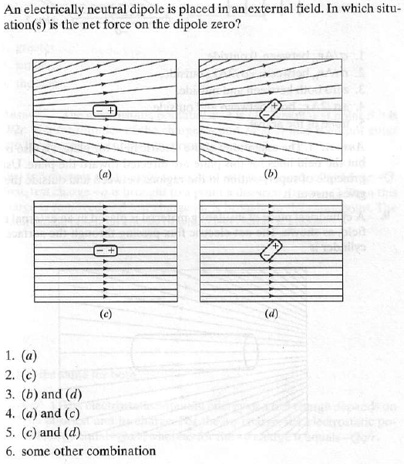
Answer: 5

