Slide 2
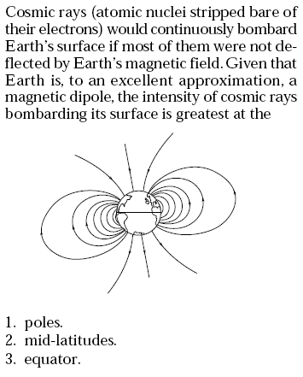
Please use:
A for 1
B for 2
C for 3
D for 4
E for 5
No Vote
for 6
Answer: 1 (Northern lights (aurora) occur because of this)

Slide 3
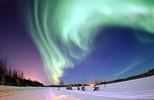
http://en.wikipedia.org/wiki/Aurora_%28astronomy%29

Slide 4
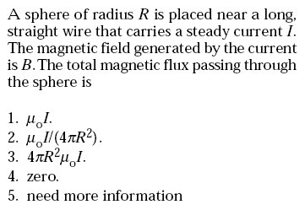
Please use:
A for 1
B for 2
C for 3
D for 4
E for 5
No Vote
for 6
Answer: 4

Slide 5
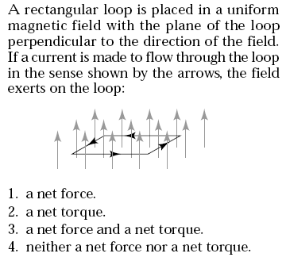
Answer: 4

Slide 6
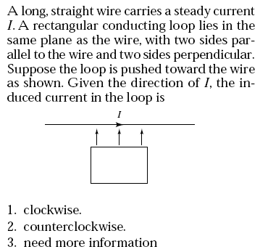
Answer: 2

