Slide 1


Introductory statistics
Chapter 1 SAMPLING AND DATA
PowerPoint Image Slideshow

Slide 2

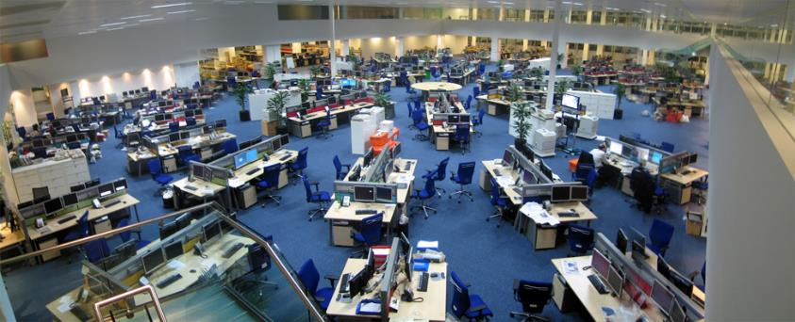
Figure 1.1
We encounter statistics in our daily lives more often than we probably realize and from many different sources, like the news. (credit: David Sim)

Slide 3
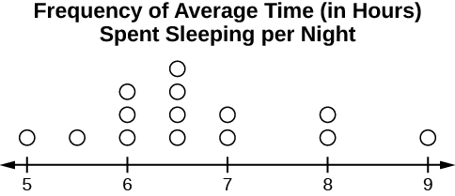
Figure 1.2

Slide 4
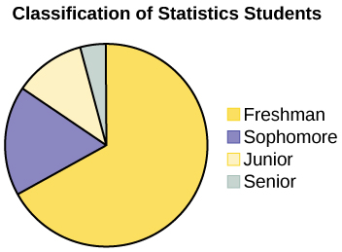
Figure 1.3

Slide 5
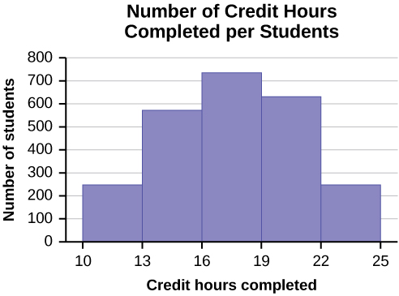
Figure 1.4

Slide 6
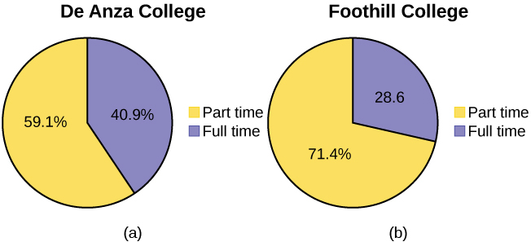
Figure 1.5

Slide 7
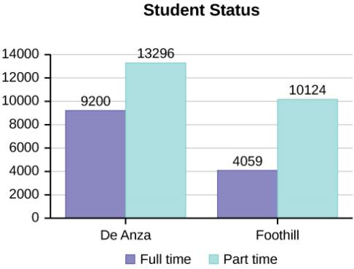
Figure 1.6

Slide 8
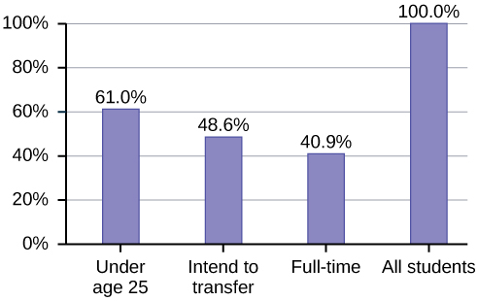
Figure 1.7

Slide 9
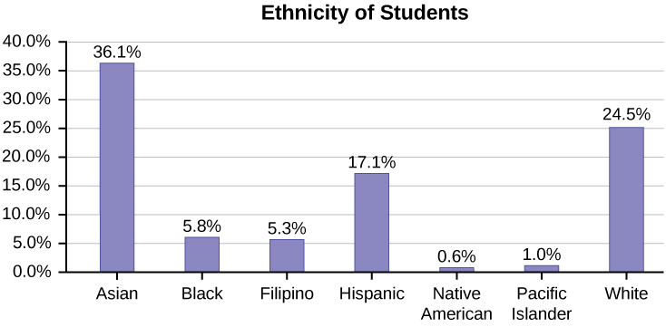
Figure 1.8

Slide 10
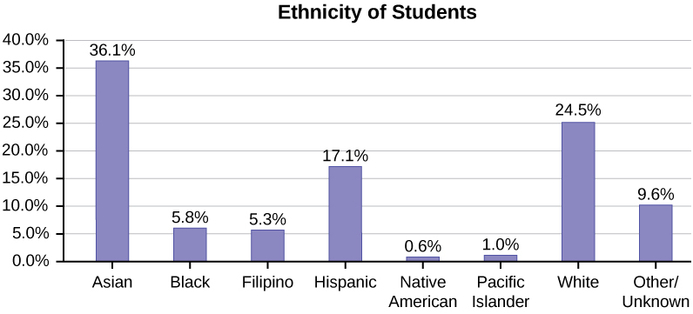
Figure 1.9
Bar graph with Other/Unknown Category

Slide 11
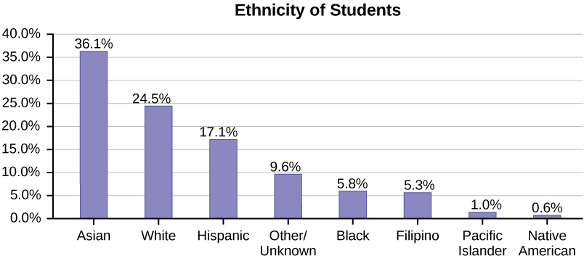
Figure 1.10
Pareto Chart With Bars Sorted by Size

Slide 12
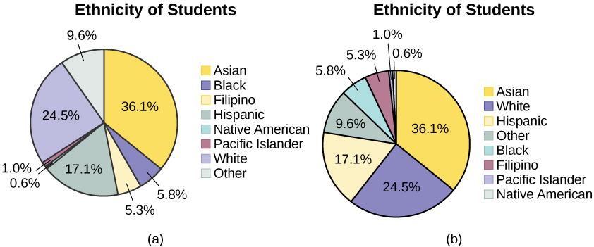
Figure 1.11

Slide 13
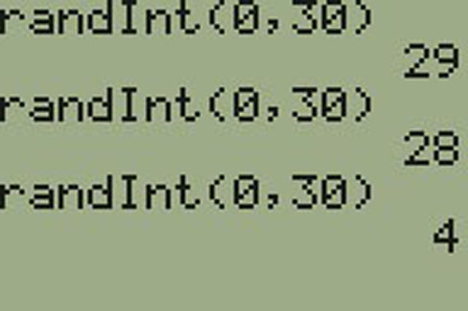
Figure 1.12

Slide 14
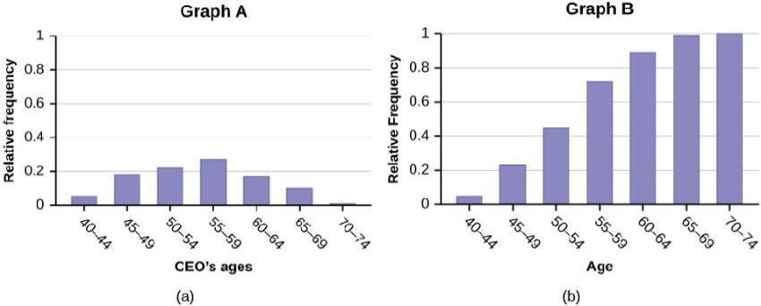
Figure 1.13

Slide 15
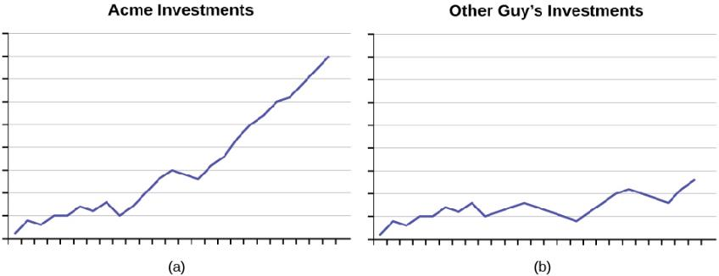
Figure 1.14
As the graphs show, Acme consistently outperforms the Other Guys!

Slide 16
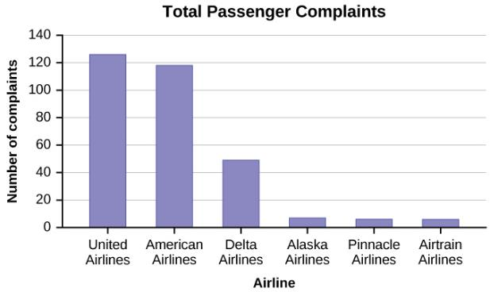
Figure 1.15

Slide 17
This OpenStax ancillary resource is © Rice University under a CC-BY 4.0 International license; it may be reproduced or modified but must be attributed to OpenStax, Rice University and any changes must be noted.

