Slide 1


INTRODUCTORY STATISTICS
Chapter 2 DESCRIPTIVE STATISTICS
PowerPoint Image Slideshow

Slide 2

Figure 2.1
When you have large amounts of data, you will need to organize it in a way that makes sense. These ballots from an election are rolled together with similar ballots to keep them organized. (credit: William Greeson)

Slide 3
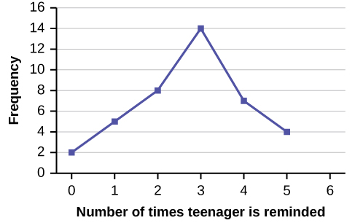
Figure 2.2

Slide 4
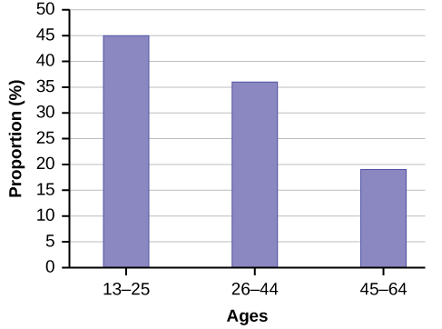
Figure 2.3

Slide 5
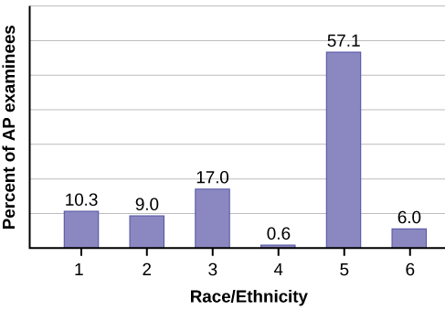
Figure 2.4

Slide 6
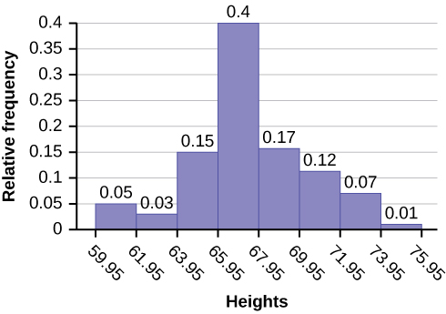
Figure 2.5

Slide 7
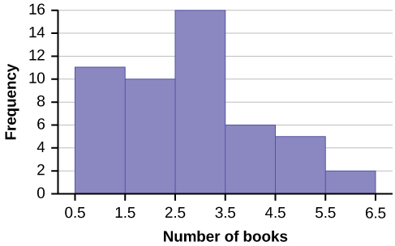
Figure 2.6

Slide 8
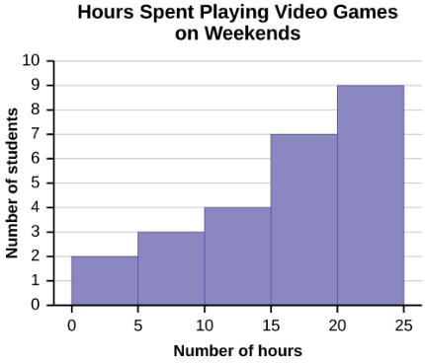
Figure 2.7

Slide 9
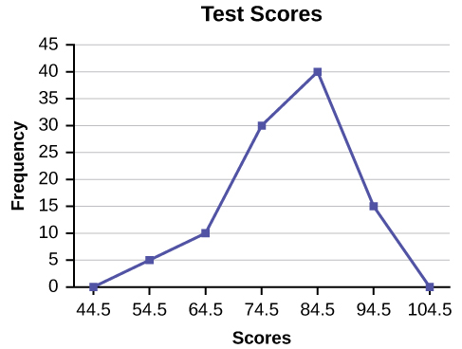
Figure 2.8

Slide 10
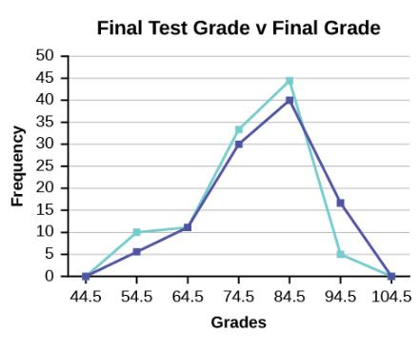
Figure 2.9

Slide 11
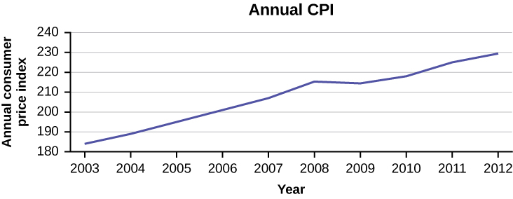
Figure 2.10

Slide 12
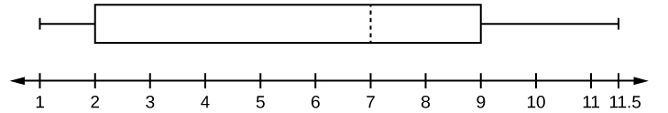
Figure 2.11

Slide 13
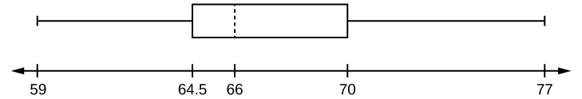
Figure 2.12

Slide 14
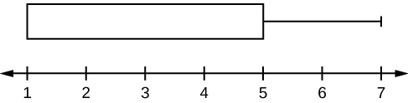
Figure 2.13

Slide 15
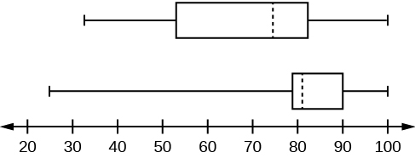
Figure 2.14

Slide 16
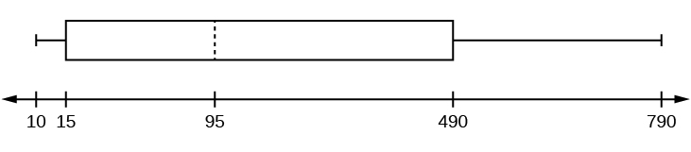
Figure 2.15

Slide 17
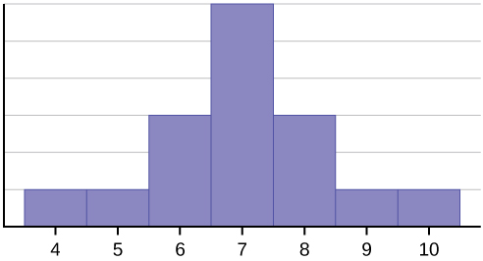
Figure 2.16

Slide 18
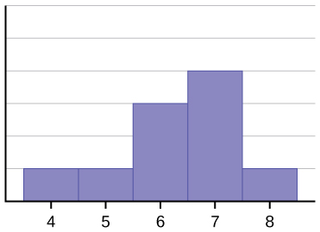
Figure 2.17

Slide 19
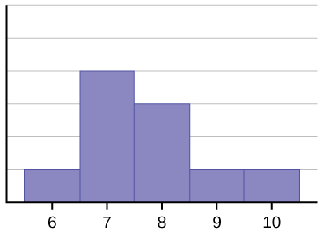
Figure 2.18

Slide 20
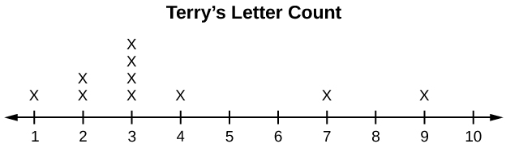
Figure 2.19
Terry’s distribution has a right (positive) skew.

Slide 21
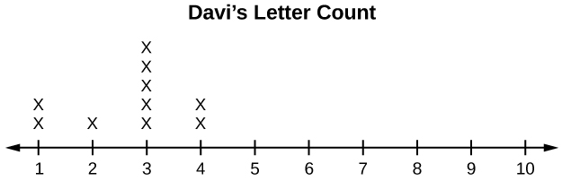
Figure 2.20
Davis’ distribution has a left (negative) skew

Slide 22
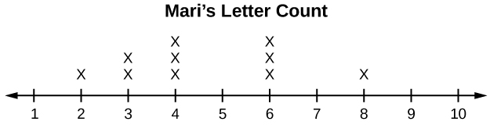
Figure 2.21
Maris’ distribution is symmetrically shaped.

Slide 23
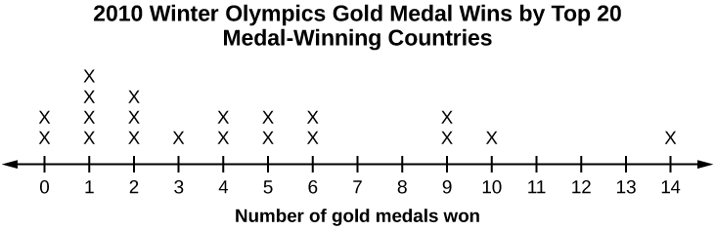
Figure 2.22

Slide 24
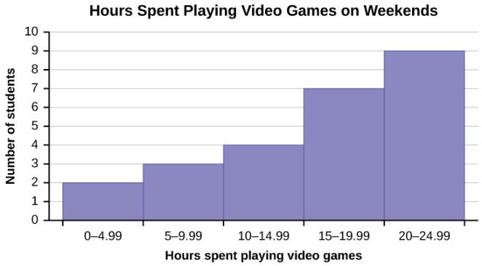
Figure 2.23

Slide 25
Figure 2.24

Slide 26
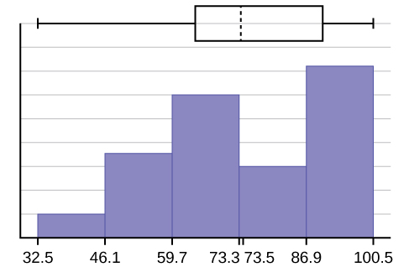
Figure 2.25

Slide 27
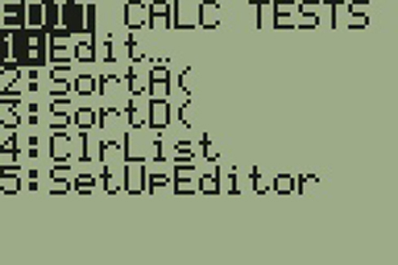
Figure 2.26

Slide 28
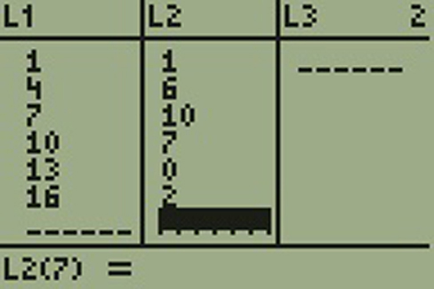
Figure 2.27

Slide 29

Figure 2.28

Slide 30
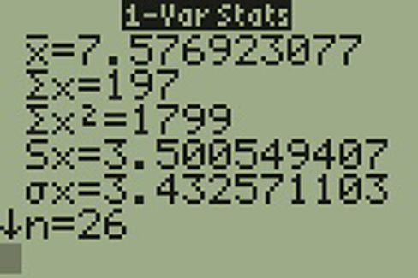
Figure 2.29

Slide 31
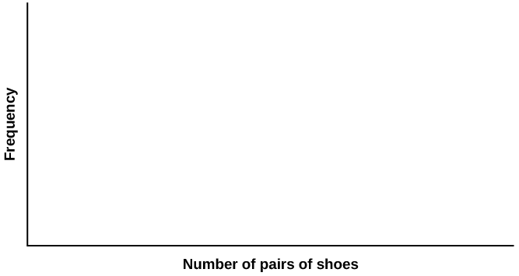
Figure 2.30

Slide 32

Figure 2.31

Slide 33
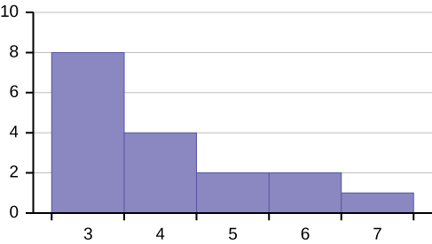
Figure 2.32

Slide 34
Figure 2.33

Slide 35
Figure 2.34

Slide 36
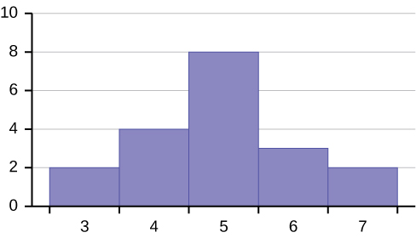
Figure 2.35

Slide 37
Figure 2.36

Slide 38
Figure 2.37

Slide 39
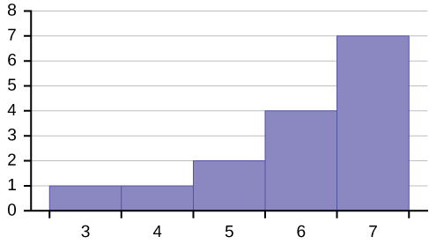
Figure 2.38

Slide 40
Figure 2.39

Slide 41
Figure 2.40

Slide 42
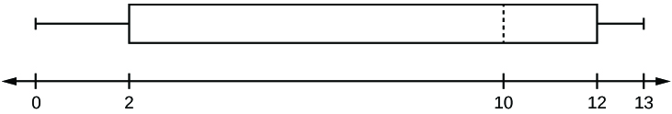
Figure 2.41

Slide 43
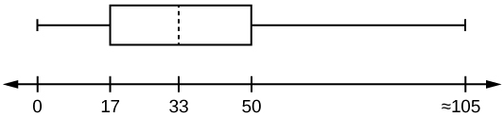
Figure 2.42

Slide 44
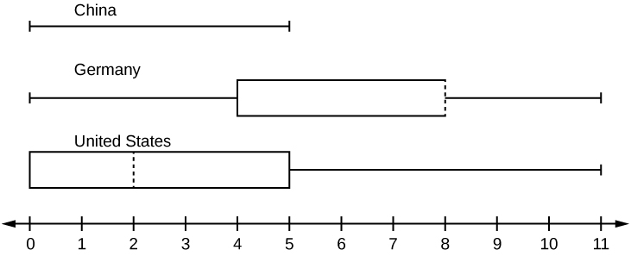
Figure 2.43

Slide 45
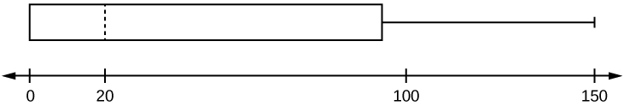
Figure 2.44

Slide 46
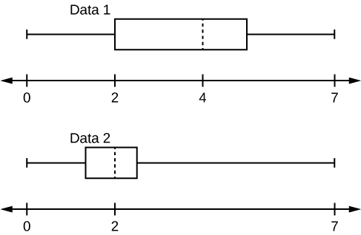
Figure 2.45

Slide 47
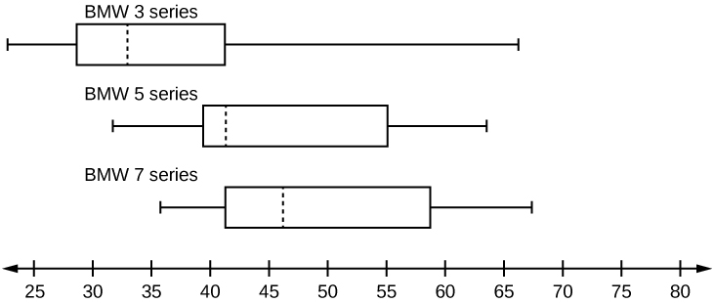
Figure 2.46

Slide 48
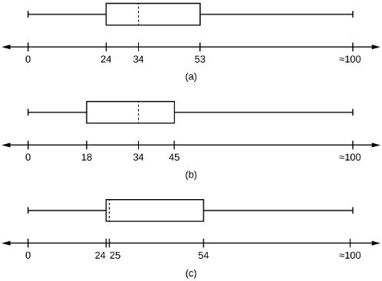
Figure 2.47

Slide 49
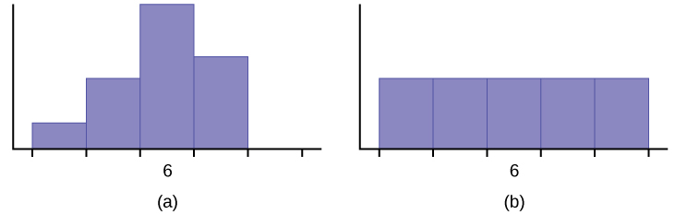
Figure 2.48

Slide 50
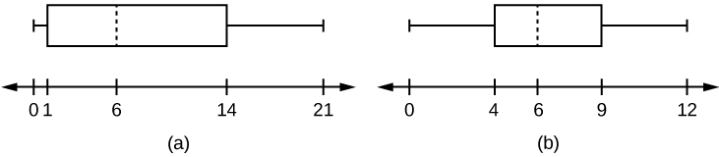
Figure 2.49

Slide 51
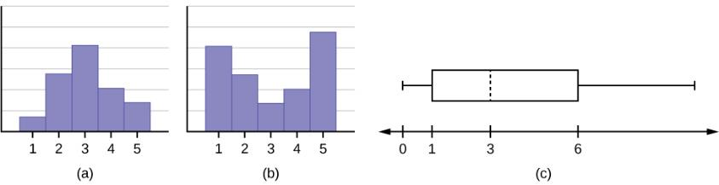
Figure 2.50

Slide 52
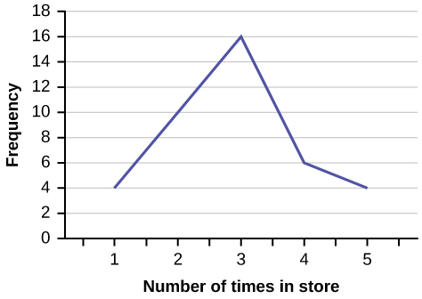
Figure 2.51

Slide 53
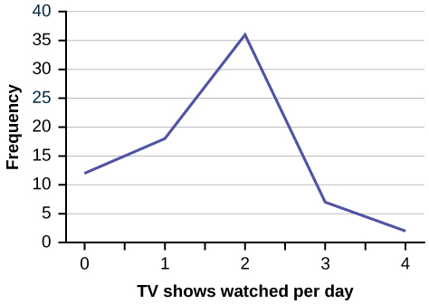
Figure 2.52

Slide 54
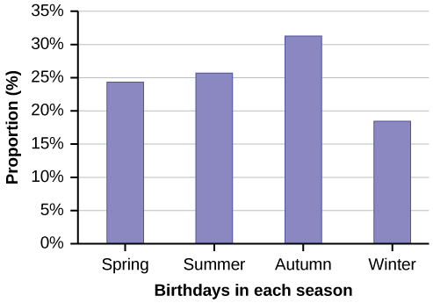
Figure 2.53

Slide 55
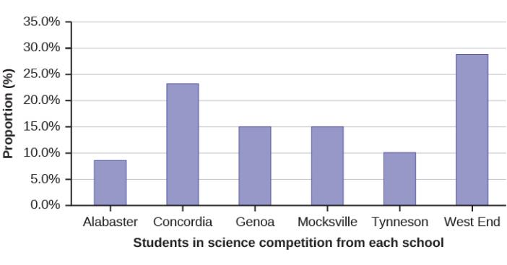
Figure 2.54

Slide 56
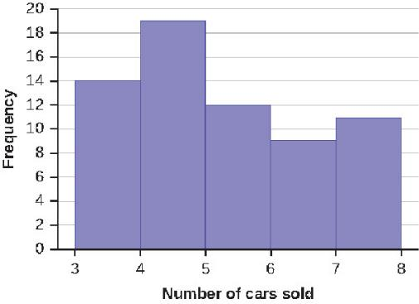
Figure 2.55

Slide 57
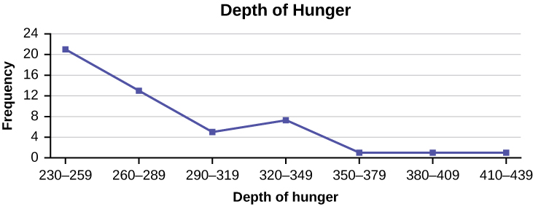
Figure 2.56

Slide 58
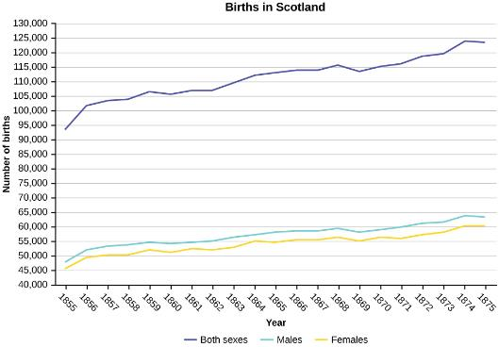
Figure 2.57

Slide 59
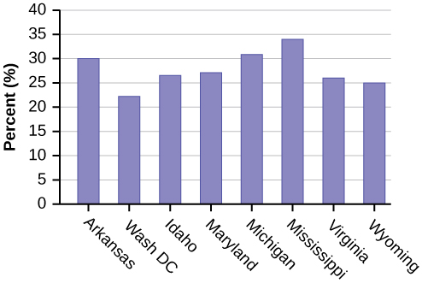
Figure 2.58

Slide 60
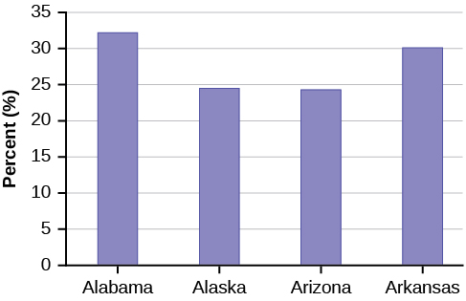
Figure 5.59

Slide 61
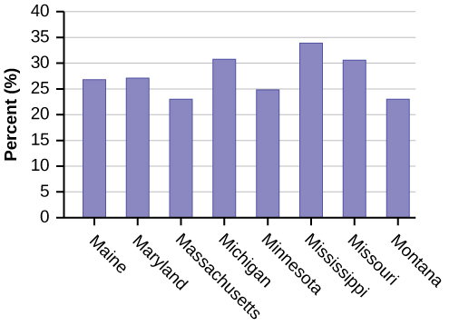
Figure 2.60

Slide 62

Figure 2.61

Slide 63

Figure 2.62

Slide 64
This OpenStax ancillary resource is © Rice University under a CC-BY 4.0 International license; it may be reproduced or modified but must be attributed to OpenStax, Rice University and any changes must be noted.

