Slide 1
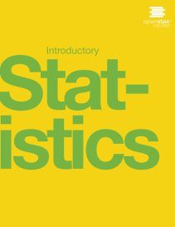

INTRODUCTORY STATISTICS
Chapter 3 PROBABILITY TOPICS
PowerPoint Image Slideshow

Slide 2
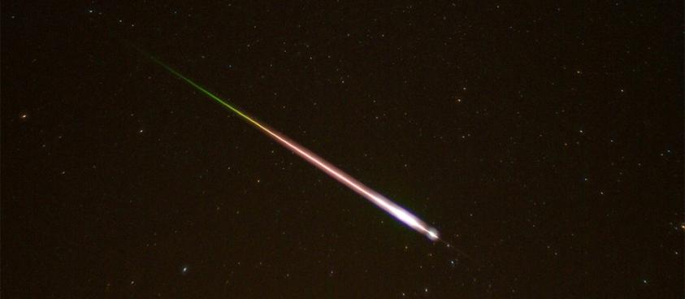
Figure 3.1
Meteor showers are rare, but the probability of them occurring can be calculated. (credit: Navicore/flickr)

Slide 3
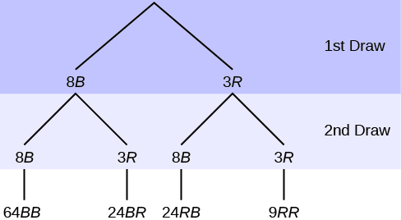
Figure 3.2
Total = 64 + 24 + 24 + 9 = 121

Slide 4
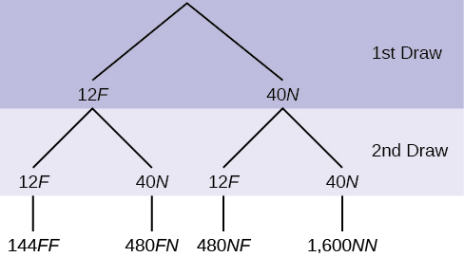
Figure 3.3

Slide 5
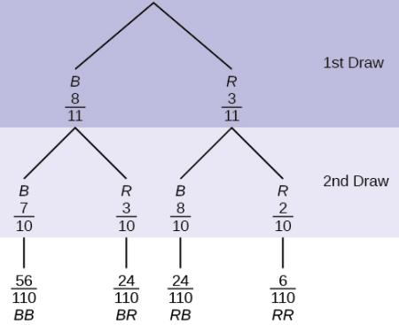
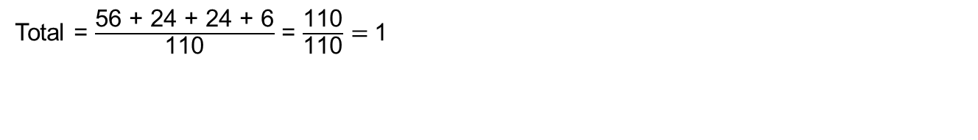
Figure 3.4
Total = $\frac{\text{56} \text{+} \text{24} \text{+} \text{24} \text{+} \text{6}}{\text{110}}$ = $\frac{\text{110}}{\text{110}}=$1

Slide 6
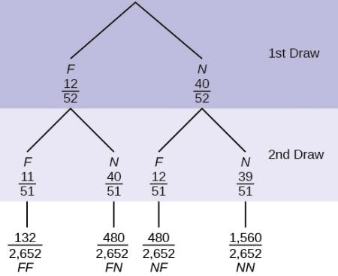
Figure 3.5

Slide 7
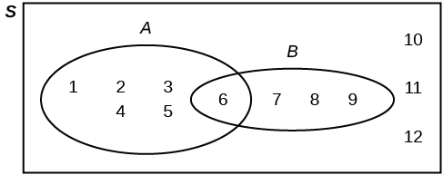
Figure 3.6

Slide 8
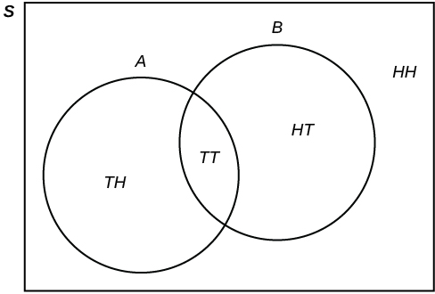
Figure 3.7

Slide 9
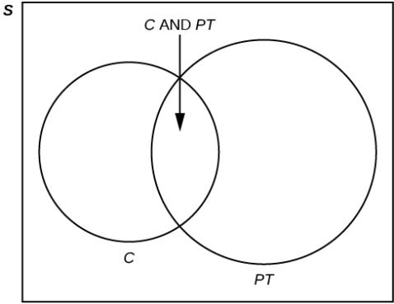
Figure 3.8

Slide 10
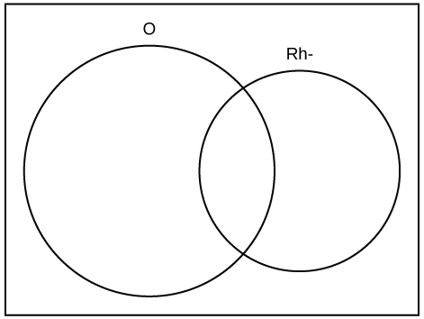
Figure 3.9

Slide 11
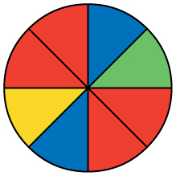
Figure 3.10

Slide 12
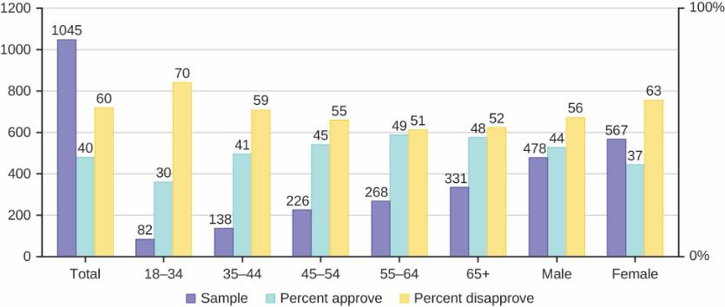
Figure 3.11

Slide 13
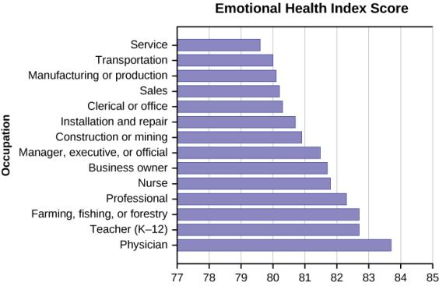
Figure 3.12

Slide 14
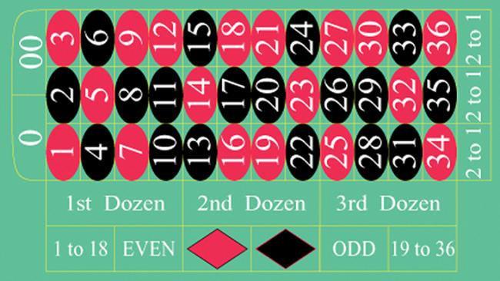
Figure 3.13
(credit: film8ker/wikibooks)

Slide 15
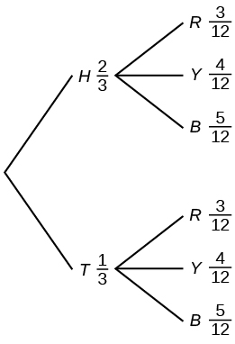
Figure 3.14

Slide 16
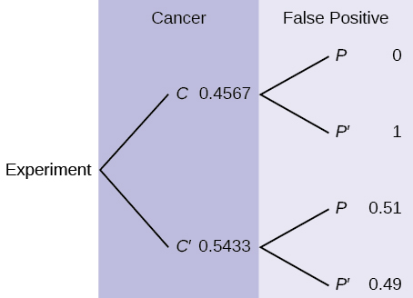
Figure 3.15

Slide 17
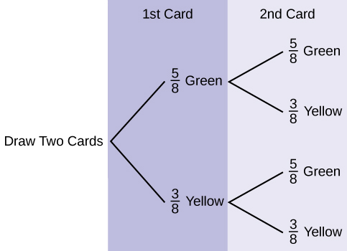
Figure 3.16

Slide 18
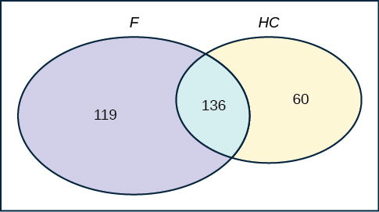
Figure 3.17

Slide 19
This OpenStax ancillary resource is © Rice University under a CC-BY 4.0 International license; it may be reproduced or modified but must be attributed to OpenStax, Rice University and any changes must be noted.

