Slide 1
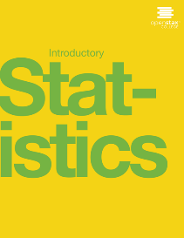

Introductory statistics
Chapter 4 DISCRETE RANDOM VARIABLES
PowerPoint Image Slideshow

Slide 2
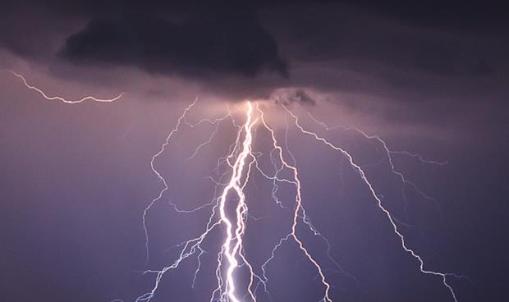
Figure 4.1
You can use probability and discrete random variables to calculate the likelihood of lightening striking the ground five times during a half-hour thunderstorm.
(Credit: Leszek Leszczynski)

Slide 3
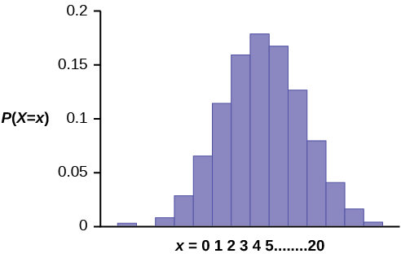
Figure 4.2

Slide 4
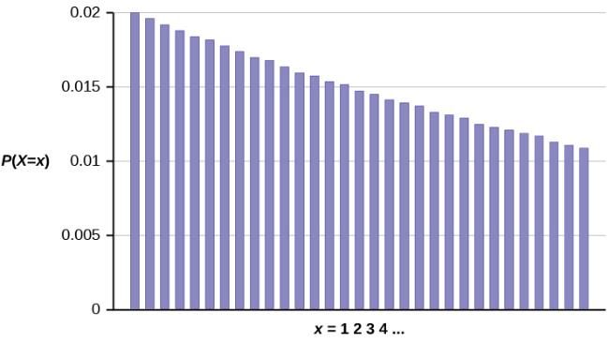
Figure 4.3

Slide 5
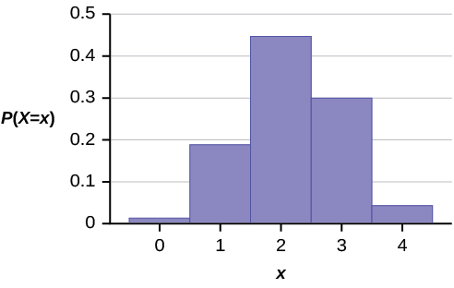
Figure 4.4

Slide 6
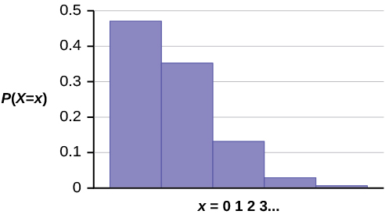
Figure 4.5

Slide 7
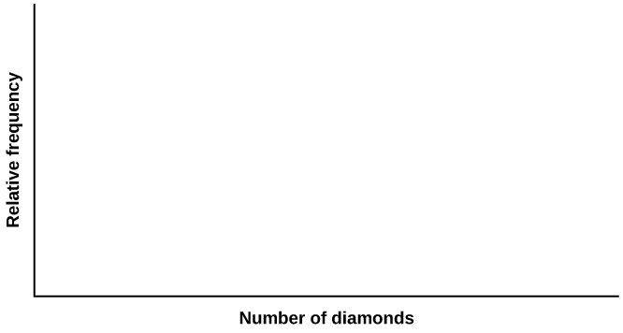
Figure 4.6

Slide 8
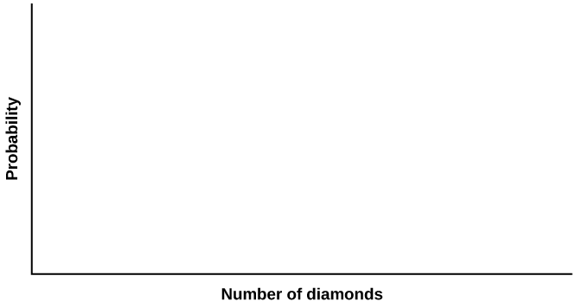
Figure 4.7

Slide 9
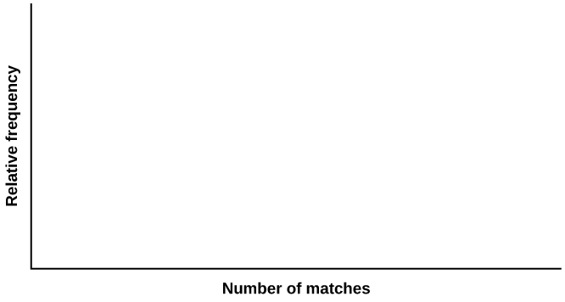
Figure 4.8

Slide 10
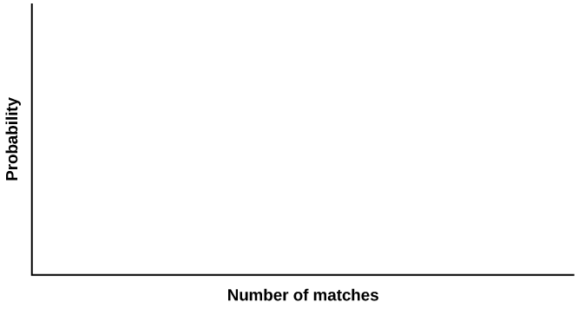
Figure 4.9

Slide 11
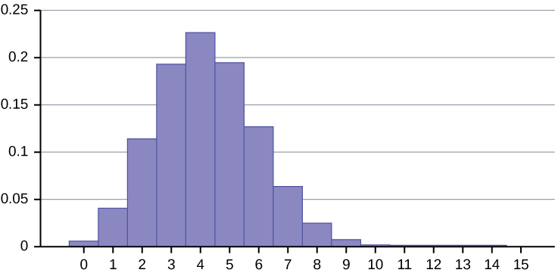
Figure 4.10

Slide 12
This OpenStax ancillary resource is © Rice University under a CC-BY 4.0 International license; it may be reproduced or modified but must be attributed to OpenStax, Rice University and any changes must be noted.

