Slide 1
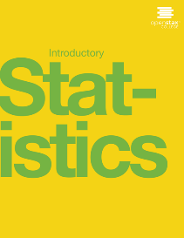

Introductory statistics
Chapter 6 THE NORMAL DISTRIBUTION
PowerPoint Image Slideshow

Slide 2
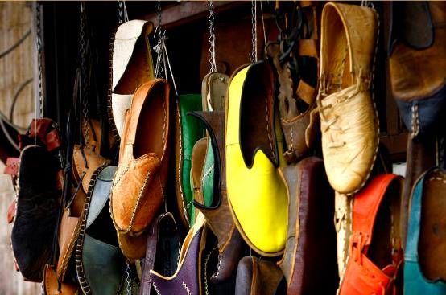
Figure 6.1
If you ask enough people about their shoe size, you will find that your graphed data is shaped like a bell curve and can be described as normally distributed.
(credit: Ömer Ünlü)

Slide 3
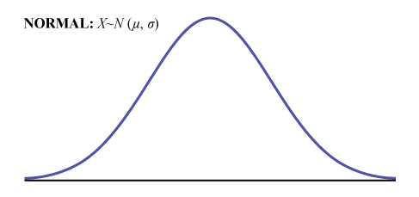
Figure 6.2

Slide 4
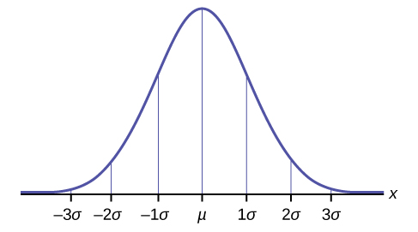
Figure 6.3

Slide 5
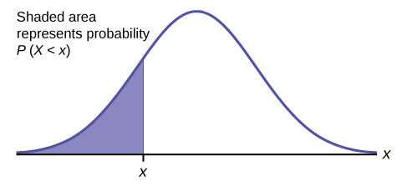
Figure 6.4

Slide 6
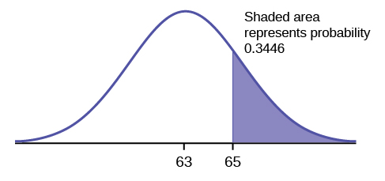
Figure 6.5

Slide 7
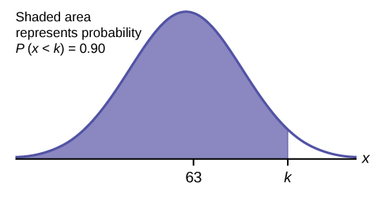
Figure 6.6

Slide 8
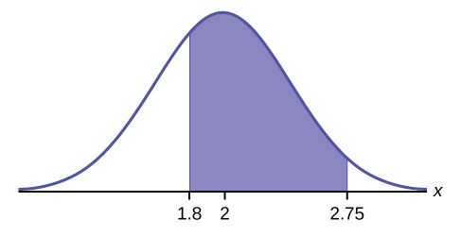
Figure 6.7

Slide 9
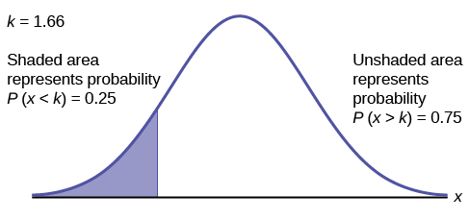
Figure 6.8

Slide 10
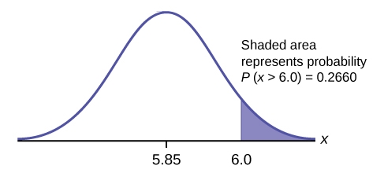
Figure 6.9

Slide 11
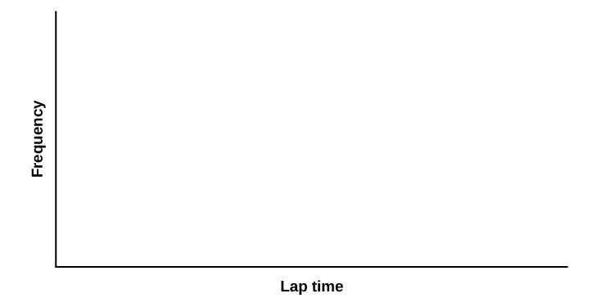
Figure 6.10

Slide 12
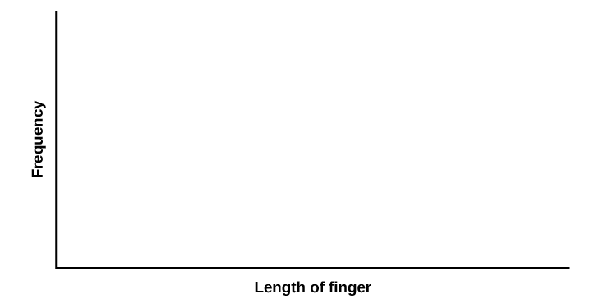
Figure 6.11

Slide 13
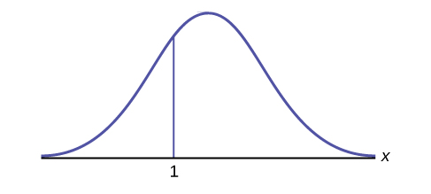
Figure 6.12

Slide 14
Figure 6.13

Slide 15
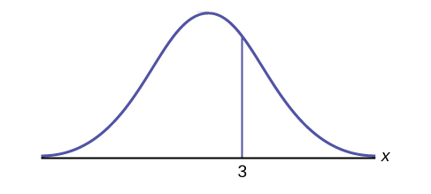
Figure 6.14

Slide 16
Figure 6.15

Slide 17
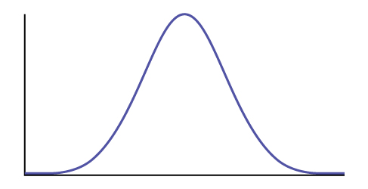
Figure 6.16

Slide 18
Figure 6.17

Slide 19
Figure 6.18

Slide 20
This OpenStax ancillary resource is © Rice University under a CC-BY 4.0 International license; it may be reproduced or modified but must be attributed to OpenStax, Rice University and any changes must be noted.

