Slide 1
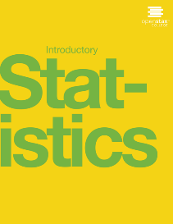

Introductory statistics
Chapter 7 THE CENTRAL LIMIT THEOREM
PowerPoint Image Slideshow

Slide 2

Figure 7.1
If you want to figure out the distribution of the change people carry in their pockets, using the central limit theorem and assuming your sample is large enough, you will find that the distribution is normal and bell-shaped. (credit: John Lodder)

Slide 3
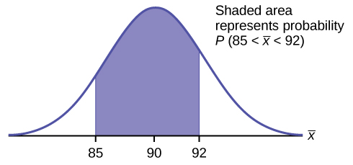
Figure 7.2

Slide 4
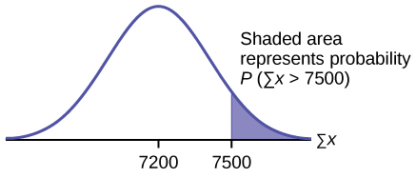
Figure 7.3

Slide 5
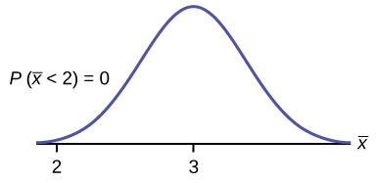
Figure 7.4

Slide 6
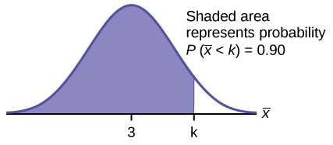
Figure 7.5

Slide 7
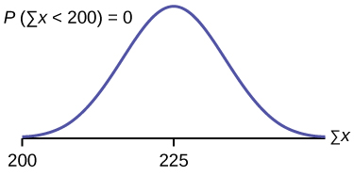
Figure 7.6

Slide 8
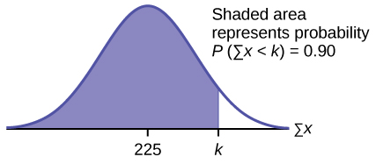
Figure 7.7

Slide 9
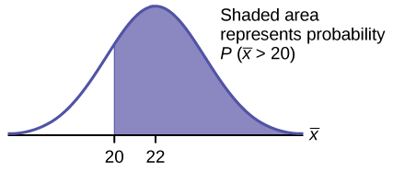
Figure 7.8

Slide 10
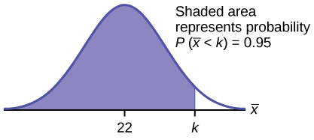
Figure 7.9

Slide 11
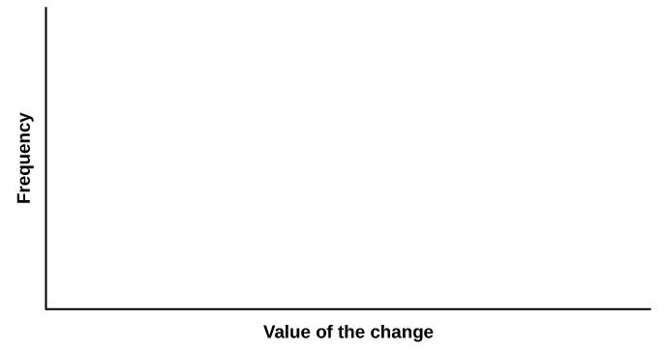
Figure 7.10

Slide 12
Figure 7.11

Slide 13
Figure 7.12

Slide 14
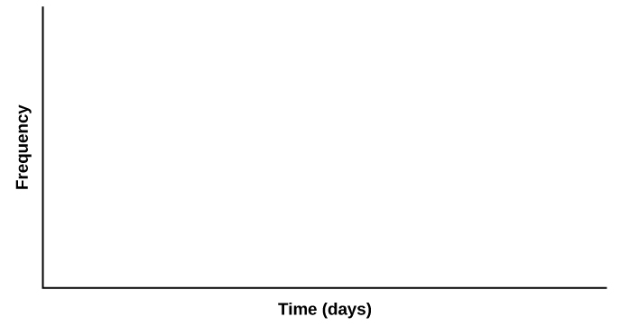
Figure 7.13

Slide 15

Figure 7.14

Slide 16

Figure 7.15

Slide 17
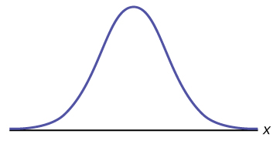
Figure 7.16

Slide 18
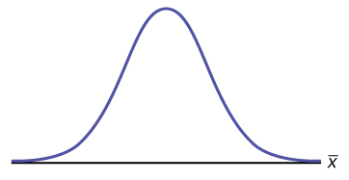
Figure 7.17

Slide 19

Figure 7.18

Slide 20
This OpenStax ancillary resource is © Rice University under a CC-BY 4.0 International license; it may be reproduced or modified but must be attributed to OpenStax, Rice University and any changes must be noted.

