Slide 1
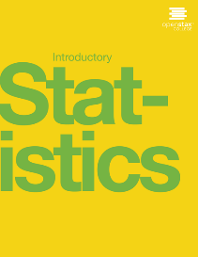

INTRODUCTORY Statistics
Chapter 8 CONFIDENCE INTERVALS
PowerPoint Image Slideshow

Slide 2
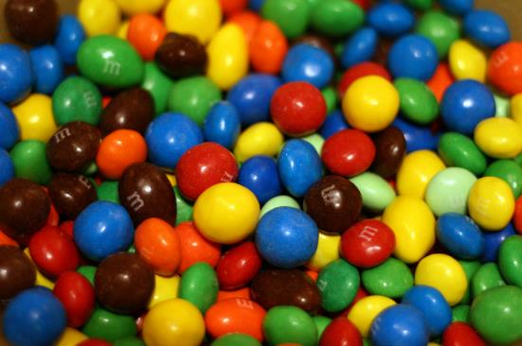
Figure 8.1
Have you ever wondered what the average number of M&Ms in a bag at the grocery store is? You can use confidence intervals to answer this question.
(credit: comedy_nose/flickr)

Slide 3
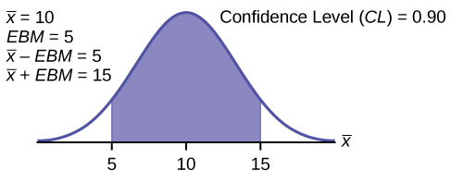
Figure 8.2

Slide 4
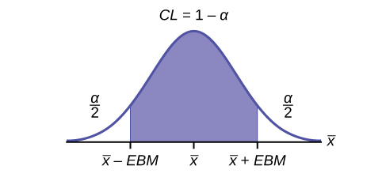
Figure 8.3

Slide 5
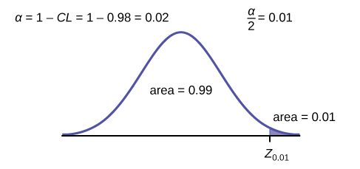
Figure 8.4

Slide 6
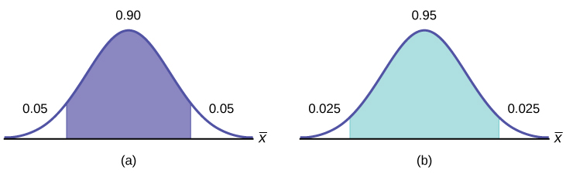
Figure 8.5

Slide 7
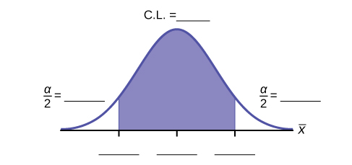
Figure 8.6

Slide 8
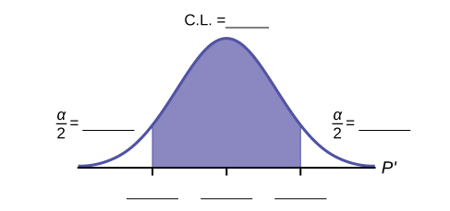
Figure 8.7

Slide 9
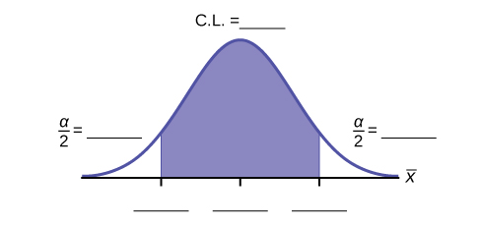
Figure 8.8

Slide 10
Figure 8.9

Slide 11
Figure 8.10

Slide 12
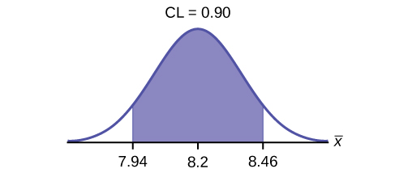
Figure 8.11

Slide 13
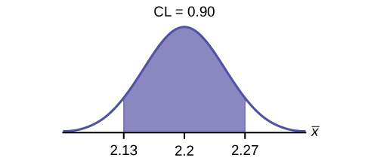
Figure 8.12

Slide 14
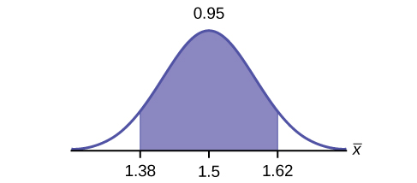
Figure 8.13

Slide 15
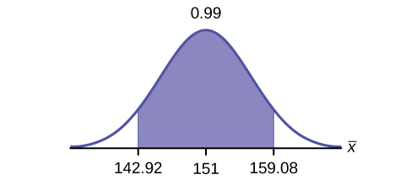
Figure 8.14

Slide 16
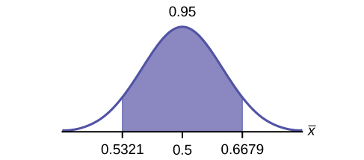
Figure 8.15

Slide 17
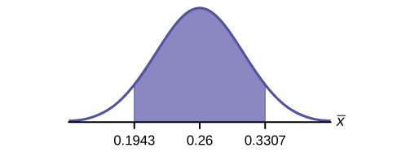
Figure 8.16

Slide 18
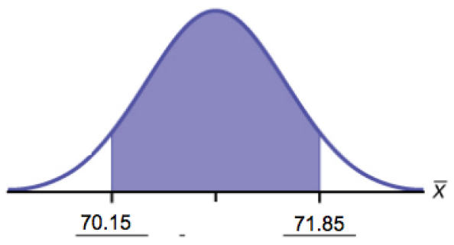
Figure 8.17

Slide 19
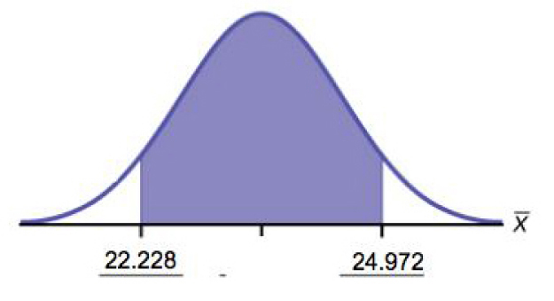
Figure 8.18

Slide 20
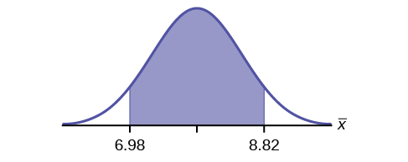
Figure 8.19

Slide 21
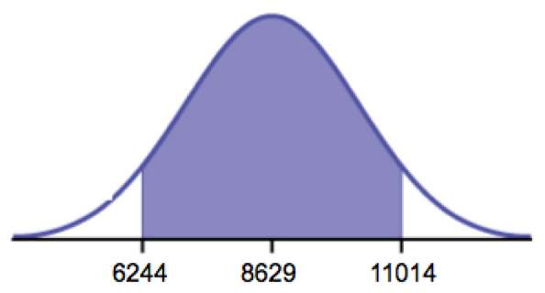
Figure 8.20

Slide 22
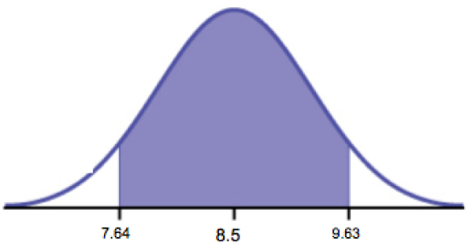
Figure 8.21

Slide 23
This OpenStax ancillary resource is © Rice University under a CC-BY 4.0 International license; it may be reproduced or modified but must be attributed to OpenStax, Rice University and any changes must be noted.

