Slide 1
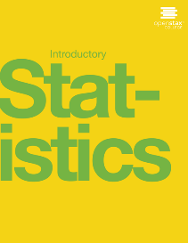

INTRODUCTORY Statistics
Chapter 9 HYPOTHESIS TESTING WITH ONE SAMPLE:
SINGLE MEAN AND SINGLE PROPORTION
PowerPoint Image Slideshow

Slide 2
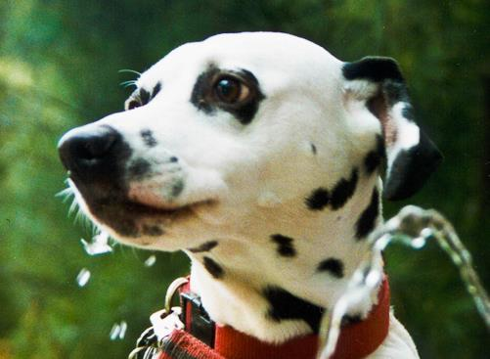
Figure 9.1
You can use a hypothesis test to decide if a dog breeder’s claim that every Dalmatian has 35 spots is statistically sound. (Credit: Robert Neff)

Slide 3
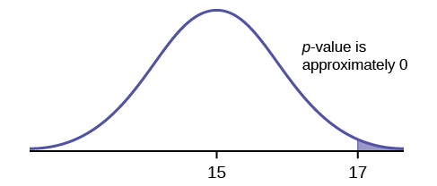
Figure 9.2

Slide 4
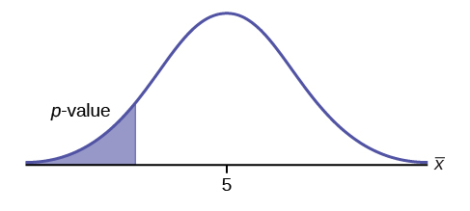
Figure 9.3

Slide 5
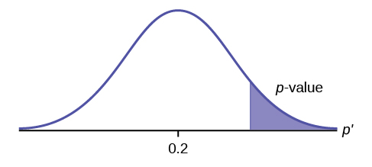
Figure 9.4

Slide 6
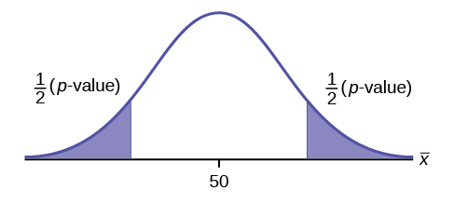
Figure 9.5

Slide 7
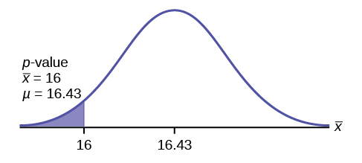
Figure 9.6

Slide 8
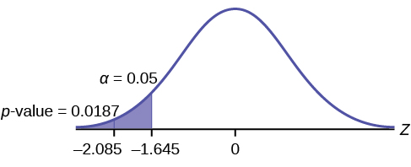
Figure 9.7

Slide 9
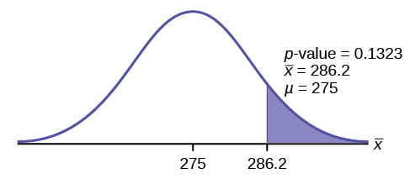
Figure 9.8

Slide 10
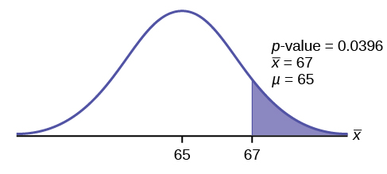
Figure 9.9

Slide 11
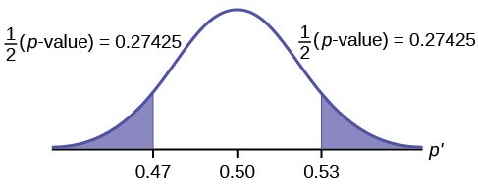
Figure 9.10

Slide 12
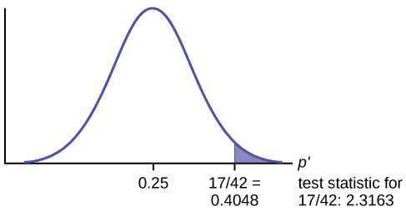
Figure 9.11

Slide 13
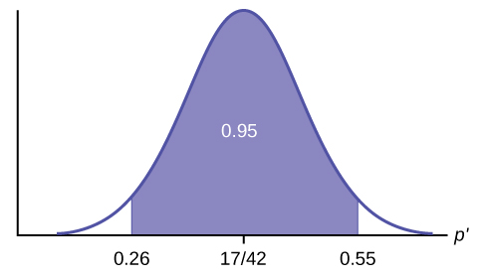
Figure 9.12

Slide 14
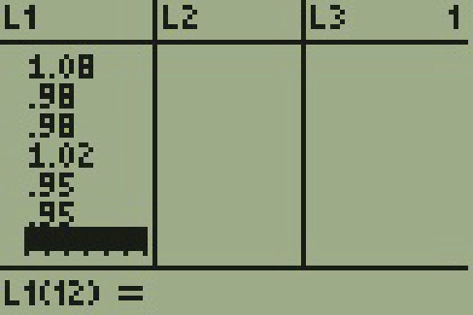
Figure 9.13

Slide 15
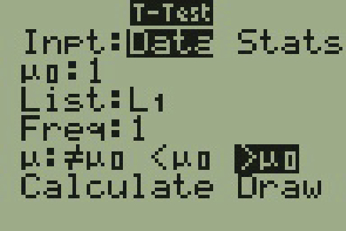
Figure 9.14

Slide 16
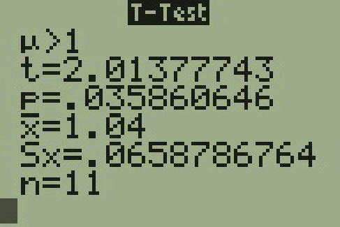
Figure 9.15

Slide 17
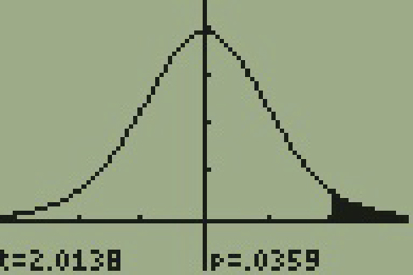
Figure 9.16

Slide 18
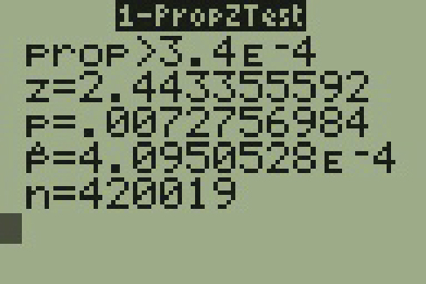
Figure 9.17

Slide 19
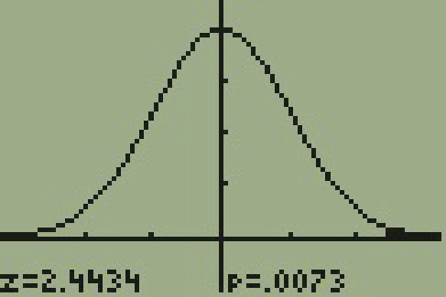
Figure 9.18

Slide 20
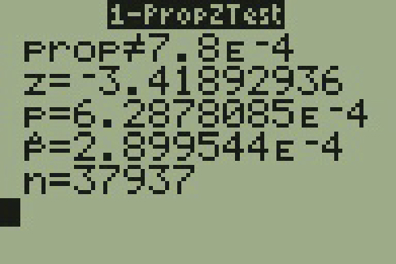
Figure 9.19

Slide 21
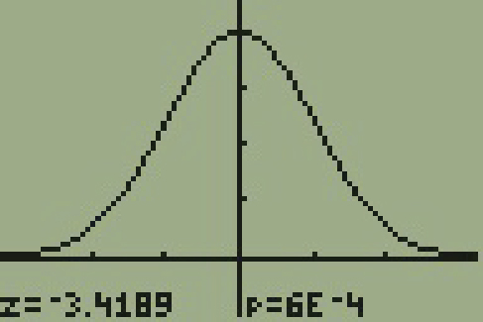
Figure 9.20

Slide 22

Figure 9.21

Slide 23
Figure 9.22

Slide 24
Figure 9.23

Slide 25
Figure 9.24

Slide 26
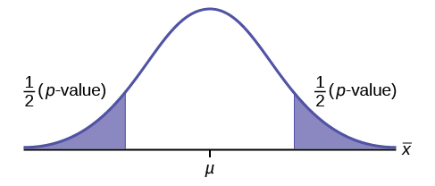
Figure 9.25

Slide 27
This OpenStax ancillary resource is © Rice University under a CC-BY 4.0 International license; it may be reproduced or modified but must be attributed to OpenStax, Rice University and any changes must be noted.

