Slide 1
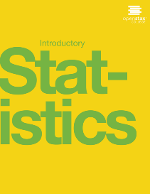

Introductory statistics
Chapter 10 HYPOTHESIS TESTING WITH TWO SAMPLES:
TWO MEANS, PAIRED DATA, TWO PROPORTIONS
PowerPoint Image Slideshow

Slide 2
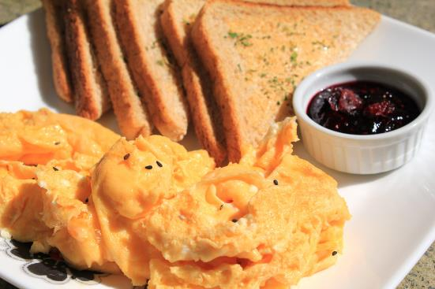
Figure 10.1
If you want to test a claim that involves two groups (the types of breakfasts eaten east and west of the Mississippi River) you can use a slightly different technique when conducting a hypothesis test. (credit: Chloe Lim)

Slide 3
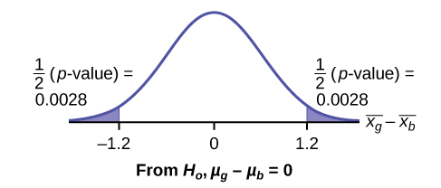
Figure 10.2

Slide 4
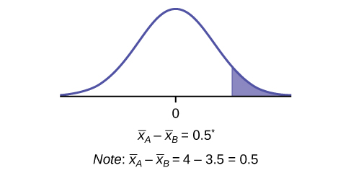
Figure 10.3

Slide 5
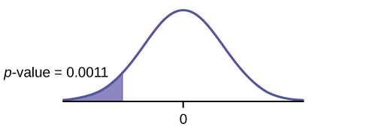
Figure 10.4

Slide 6
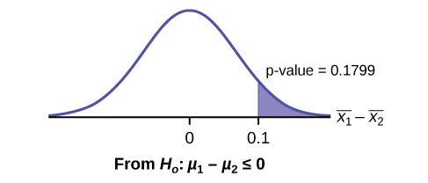
Figure 10.5

Slide 7
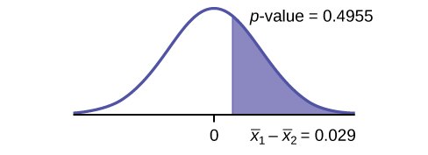
Figure 10.6

Slide 8
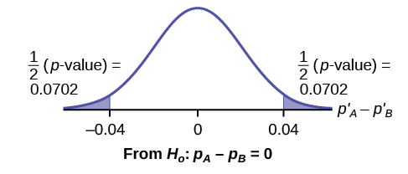
Figure 10.7

Slide 9
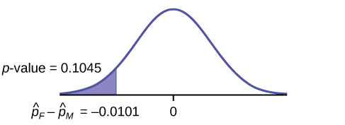
Figure 10.8

Slide 10
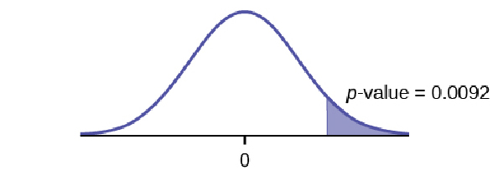
Figure 10.9

Slide 11
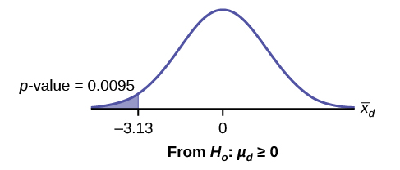
Figure 10.10

Slide 12
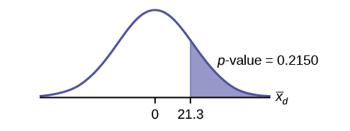
Figure 10.11

Slide 13
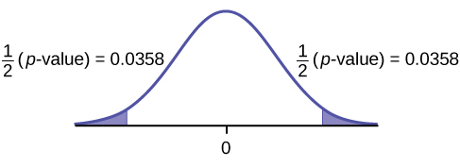
Figure 10.12

Slide 14
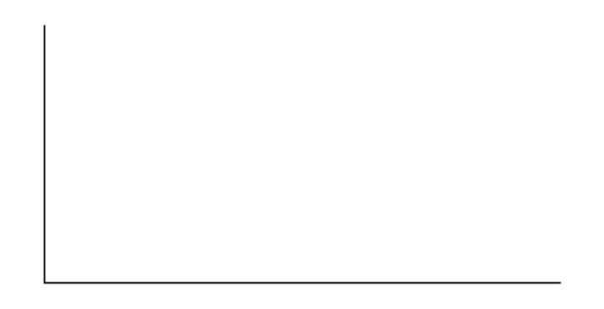
Figure 10.13

Slide 15
Figure 10.14

Slide 16
Figure 10.15

Slide 17
Figure 10.16

Slide 18
Figure 10.17

Slide 19
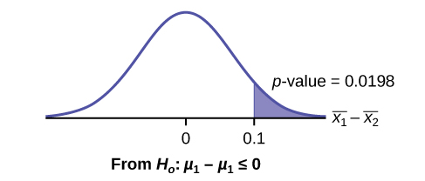
Figure 10.18

Slide 20
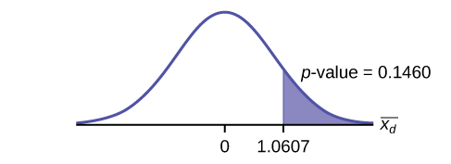
Figure 10.19

Slide 21
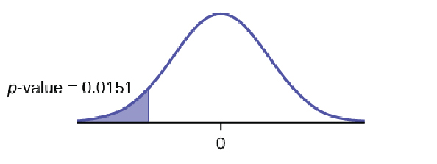
Figure 10.20

Slide 22
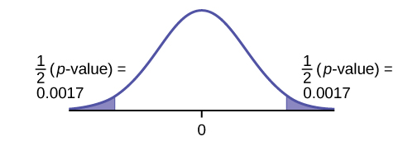
Figure 10.21

Slide 23
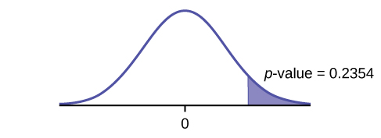
Figure 10.22

Slide 24
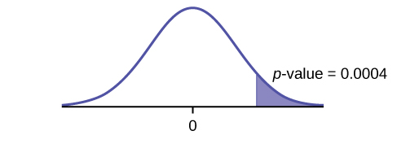
Figure 10.23

Slide 25
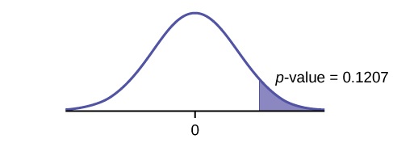
Figure 10.24

Slide 26
This OpenStax ancillary resource is © Rice University under a CC-BY 4.0 International license; it may be reproduced or modified but must be attributed to OpenStax, Rice University and any changes must be noted.

