Slide 1
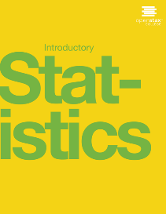

Introductory statistics
Chapter 11 THE CHI-SQUARE DISTRIBUTION
PowerPoint Image Slideshow

Slide 2
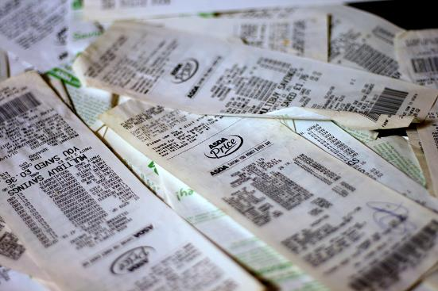
Figure 11.1
The chi-square distribution can be used to find relationships between two things, like grocery prices at different stores. (credit: Pete/flickr)

Slide 3
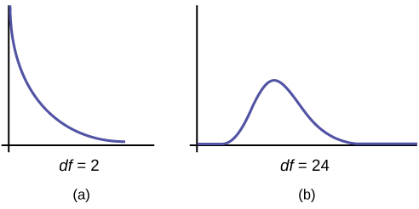
Figure 11.2

Slide 4
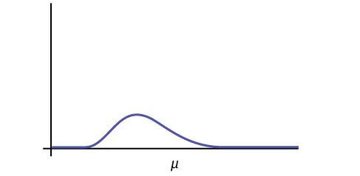
Figure 11.3

Slide 5
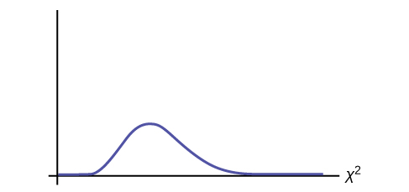
Figure 11.4

Slide 6
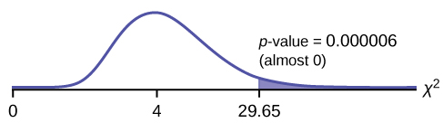
Figure 11.5

Slide 7
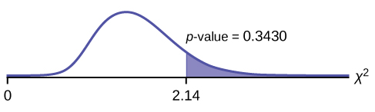
Figure 11.6

Slide 8
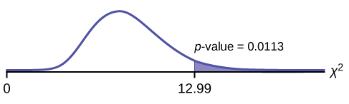
Figure 11.7

Slide 9
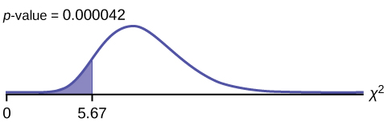
Figure 11.8

Slide 10
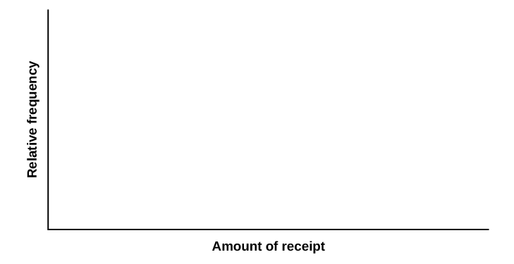
Figure 11.9

Slide 11
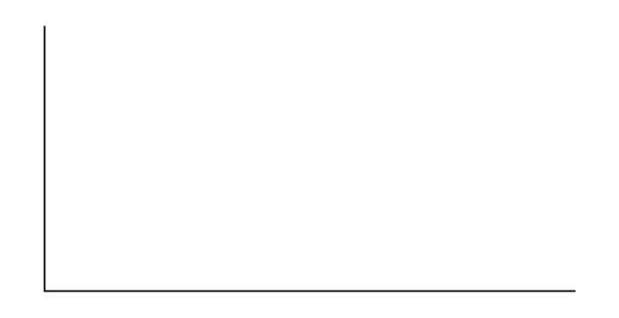
Figure 11.10

Slide 12
Figure 11.11

Slide 13
Figure 11.12

Slide 14
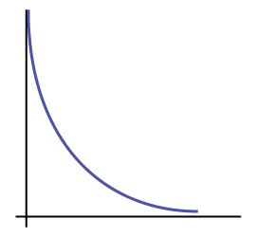
Figure 11.13

Slide 15
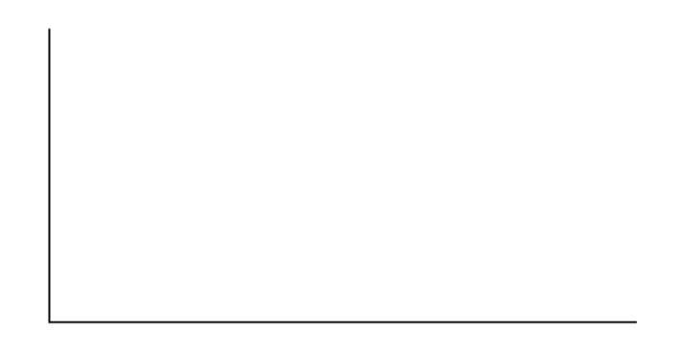
Figure 11.14

Slide 16
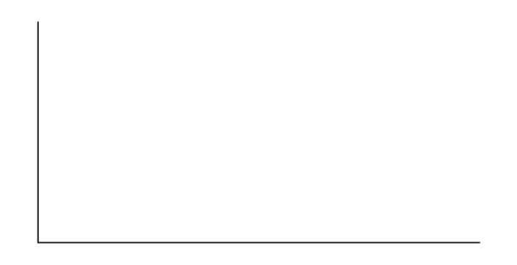
Figure 11.15

Slide 17
This OpenStax ancillary resource is © Rice University under a CC-BY 4.0 International license; it may be reproduced or modified but must be attributed to OpenStax, Rice University and any changes must be noted.

