Slide 1
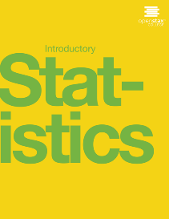

Introductory statistics
Chapter 12 LINEAR REGRESSION AND CORRELATION
PowerPoint Image Slideshow

Slide 2

Figure 12.1
Linear regression and correlation can help you determine if an auto mechanic’s salary is related to his work experience. (credit: Joshua Rothhaas)

Slide 3
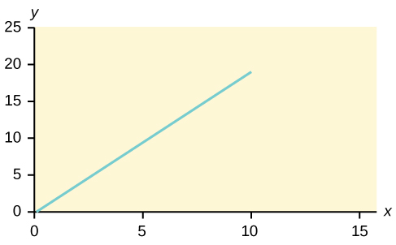
Figure 12.2

Slide 4
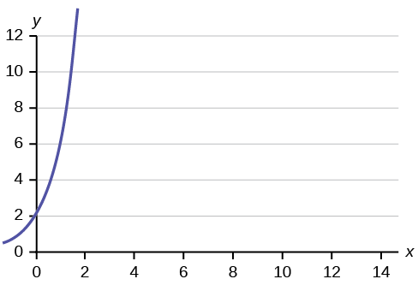
Figure 12.3

Slide 5
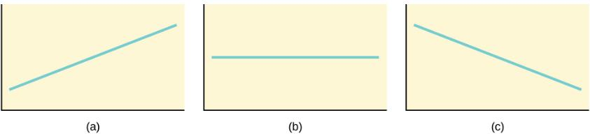
Figure 12.4
Three possible graphs of y = a + bx.
If b > 0, the line slopes upward to the right.
If b = 0, the line is horizontal.
If b < 0, the line slopes downward to the right.

Slide 6
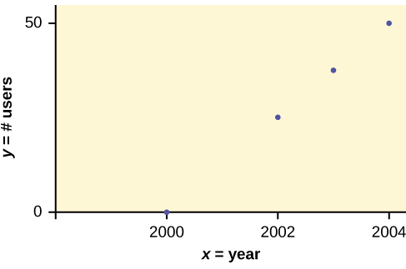
Figure 12.5
Scatter plot showing the number of m-commerce users (in millions) by year.

Slide 7
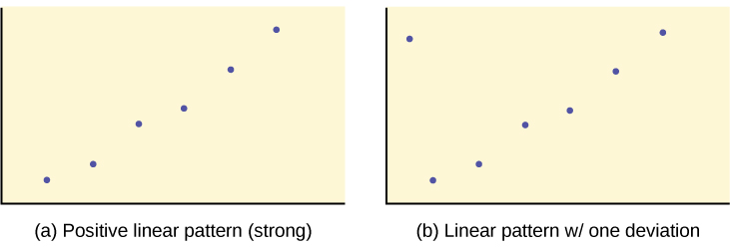
Figure 12.6

Slide 8
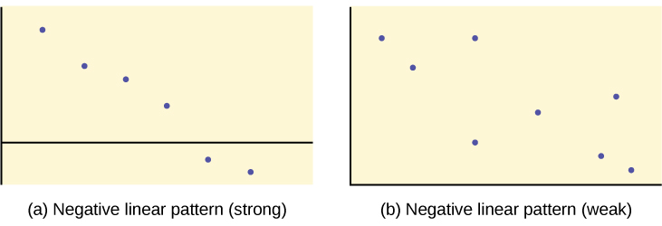
Figure 12.7

Slide 9
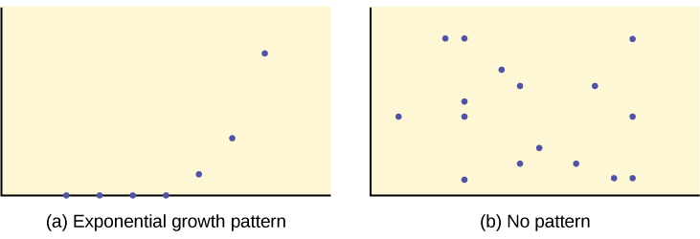
Figure 12.8

Slide 10
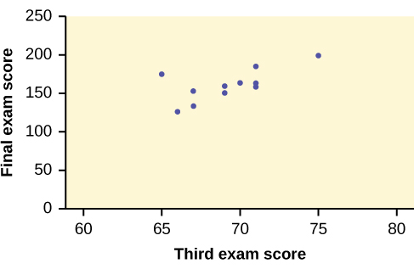
Figure 12.9
Scatter plot showing the scores on the final exam based on scores from the third exam.

Slide 11
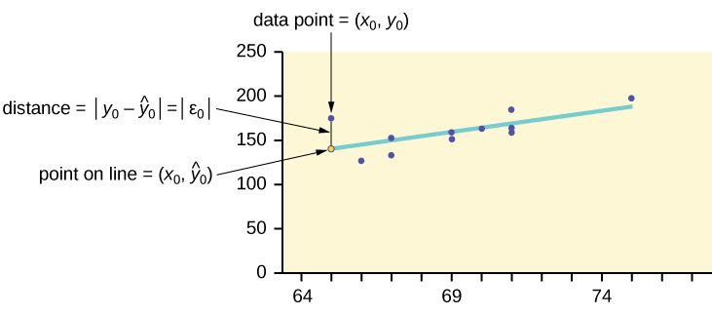
Figure 12.10

Slide 12
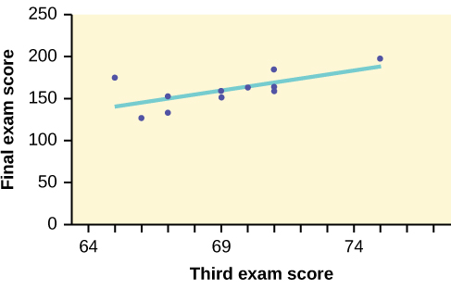
Figure 12.11

Slide 13
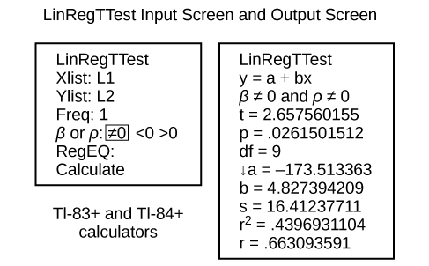
Figure 12.12

Slide 14
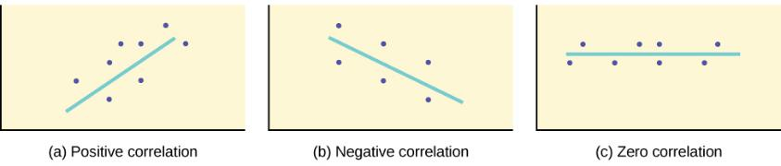
Figure 12.13
A scatter plot showing data with a positive correlation. 0 < r < 1
A scatter plot showing data with a negative correlation. –1 < r < 0
A scatter plot showing data with zero correlation. r = 0

Slide 15
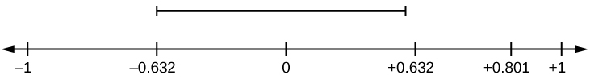
Figure 12.14
r is not significant between -0.632 and +0.632. r = 0.801 > +0.632. Therefore, r is significant.

Slide 16
Figure 12.15
r = –0.624-0.532. Therefore, r is significant.

Slide 17
Figure 12.16
-0.811 < r = 0.776 < 0.811. Therefore, r is not significant.

Slide 18
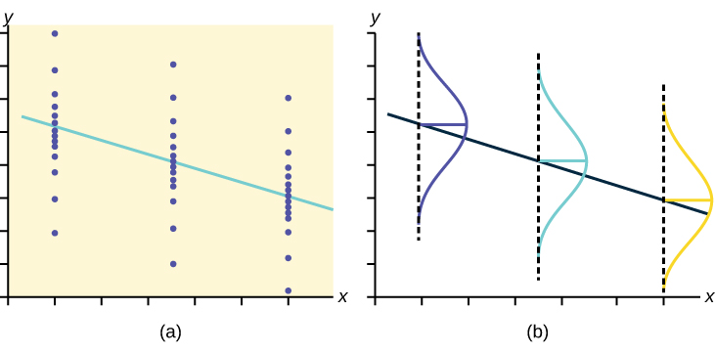
Figure 12.17
The y values for each x value are normally distributed about the line with the same standard deviation. For each x value, the mean of the y values lies on the regression line. More y values lie near the line than are scattered further away from the line.

Slide 19
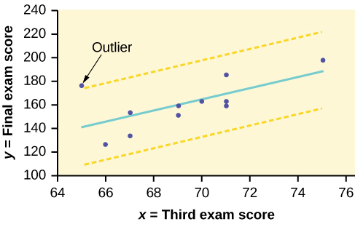
Figure 12.18

Slide 20
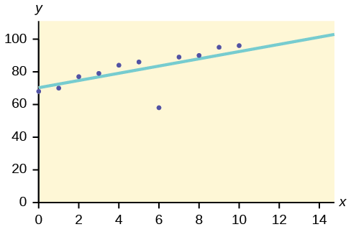
Figure 12.19

Slide 21
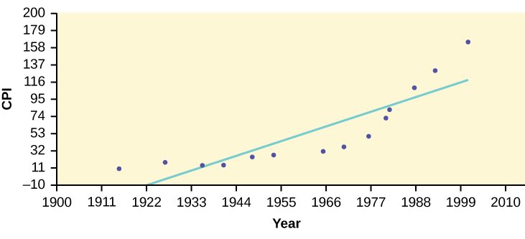
Figure 12.20

Slide 22
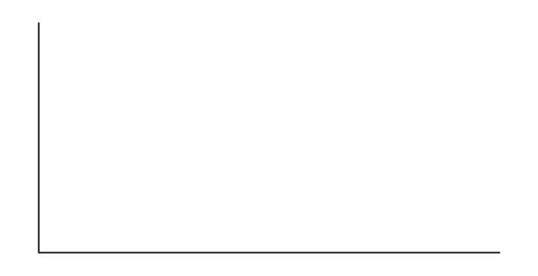
Figure 12.21

Slide 23
Figure 12.22

Slide 24
Figure 12.23

Slide 25
Figure 12.24

Slide 26
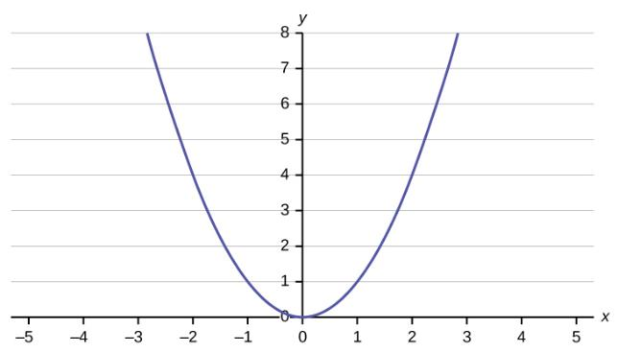
Figure 12.25

Slide 27
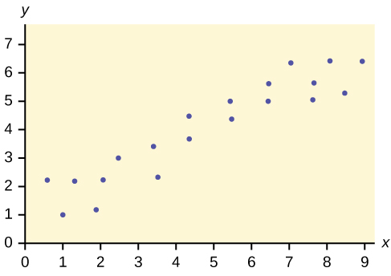
Figure 12.26

Slide 28
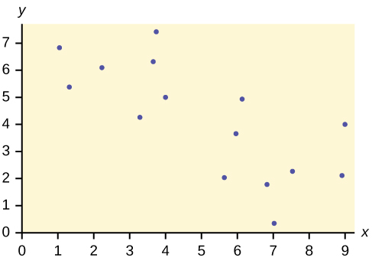
Figure 12.27

Slide 29
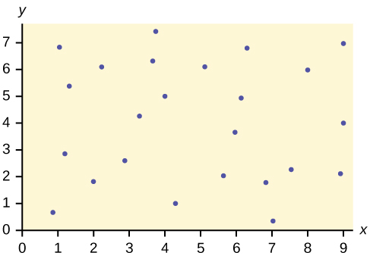
Figure 12.28

Slide 30
Figure 12.29

Slide 31
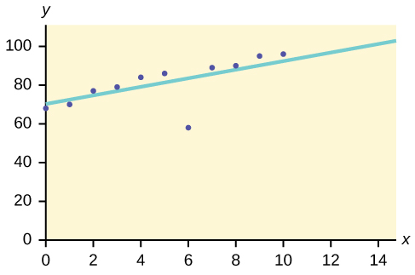
Figure 12.30

Slide 32
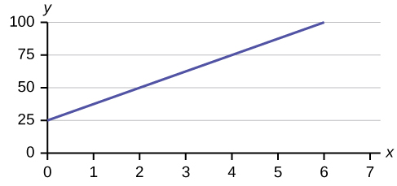
Figure 12.31

Slide 33
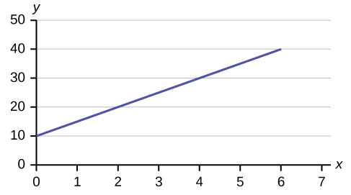
Figure 12.32

Slide 34
This OpenStax ancillary resource is © Rice University under a CC-BY 4.0 International license; it may be reproduced or modified but must be attributed to OpenStax, Rice University and any changes must be noted.

