Slide 1
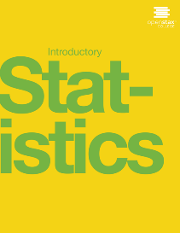

INTRODUCTORY Statistics
Chapter 13 F DISTRIBUTION AND ONE-WAY ANOVA
PowerPoint Image Slideshow

Slide 2
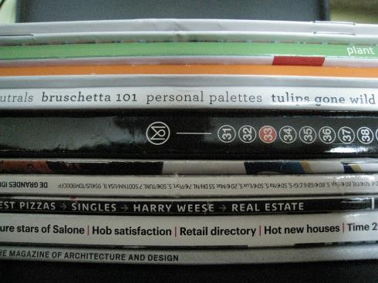
Figure 13.1
One-way ANOVA is used to measure information from several groups.

Slide 3
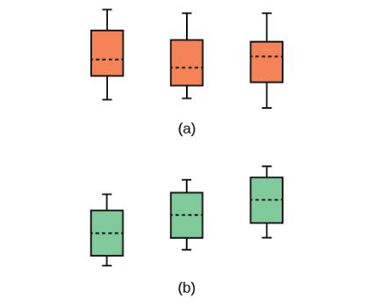
Figure 13.2
(a) H₀ is true. All means are the same; the differences are due to random variation.
(b) H₀ is not true. All means are not the same; the differences are too large to be due to random variation.

Slide 4
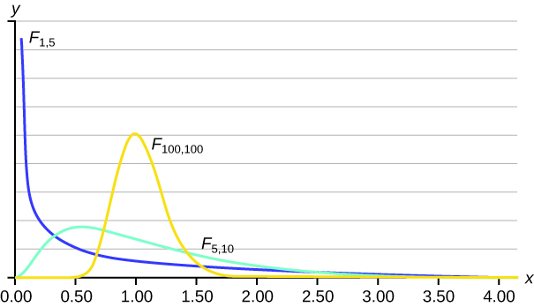
Figure 13.3

Slide 5
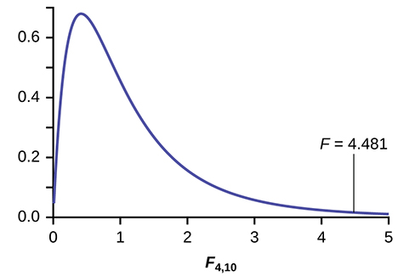
Figure 13.4

Slide 6
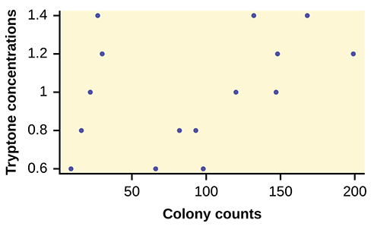
Figure 13.5

Slide 7
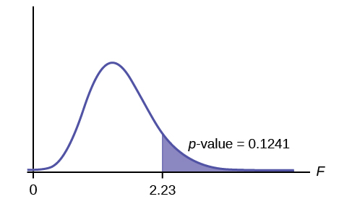
Figure 13.6

Slide 8
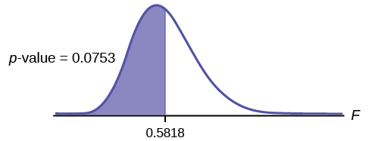
Figure 13.7

Slide 9
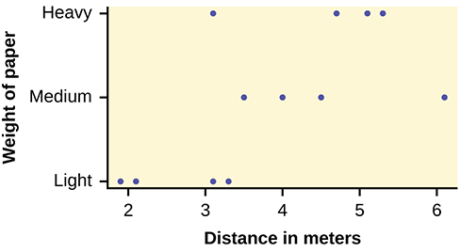
Figure 13.8

Slide 10
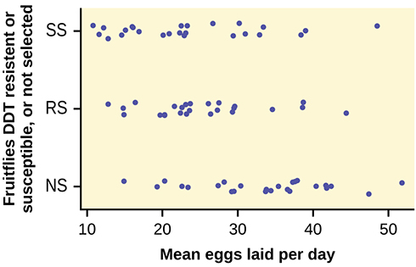
Figure 13.9

Slide 11
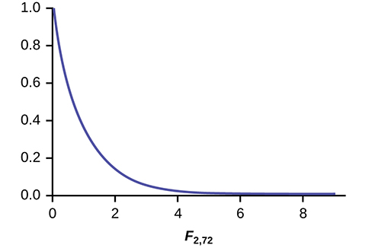
Figure 13.10

Slide 12
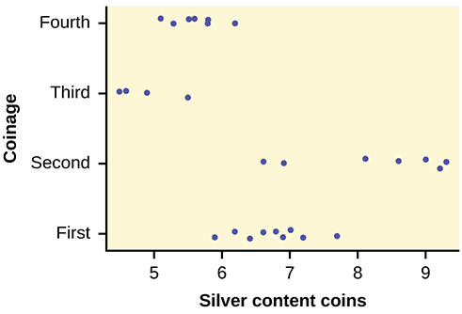
Figure 13.11

Slide 13
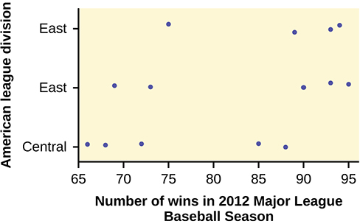
Figure 13.12

Slide 14
This OpenStax ancillary resource is © Rice University under a CC-BY 4.0 International license; it may be reproduced or modified but must be attributed to OpenStax, Rice University and any changes must be noted.

