Slide 1
Review of surface propagation studies in Moore's Bay, and other calculations
Jordan Hanson
CCAPP
February 24th, 2017

Slide 2
Outline
Explanation of an experiment conducted in Moore's Bay, 2011-12
  Motivation
  Setup
  Results
Theoretical calculations (Fermat's principle)
Reading: “Radio surf in polar ice: A new method of ultrahigh energy neutrino detection.” J. Ralston, Phys. Rev. D 71 011503 (2005)

Slide 3
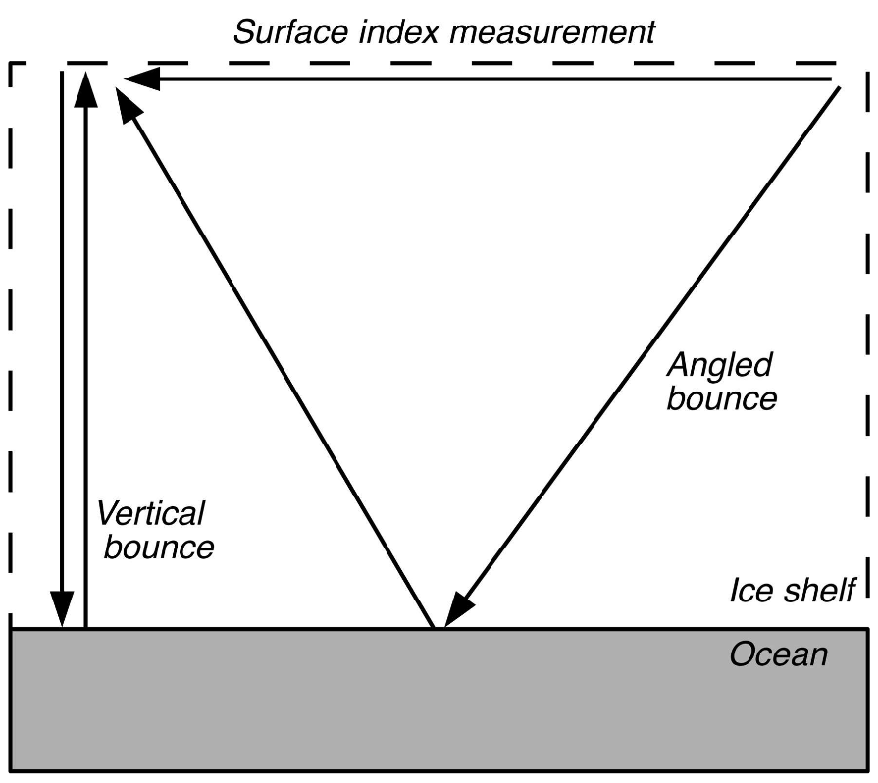
Moore's Bay Surface Propagation Experiment

Slide 4
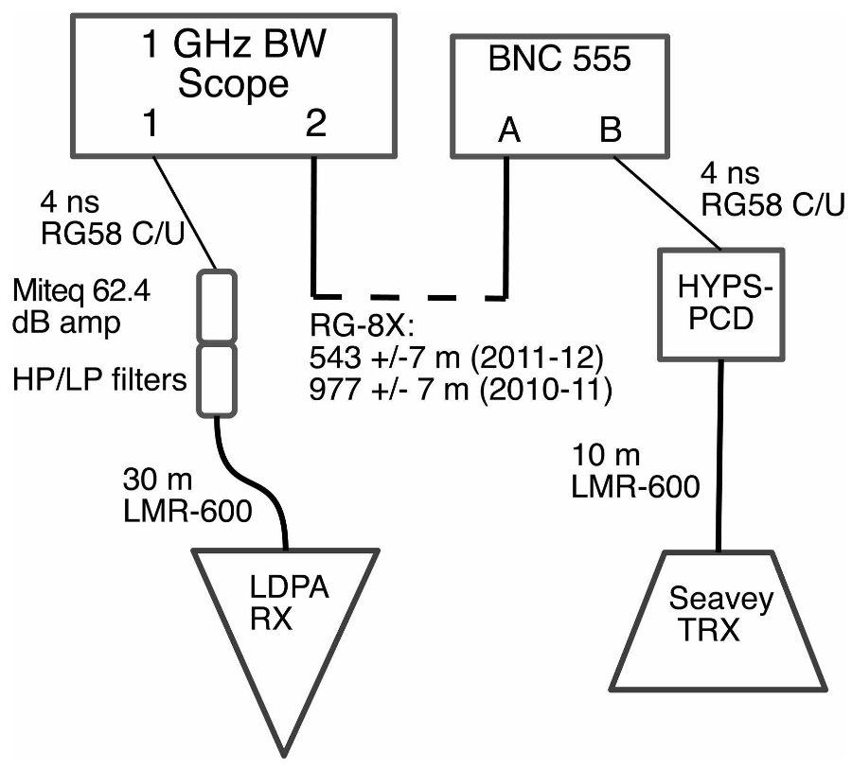
Moore's Bay Surface Propagation Experiment

Slide 5
Moore's Bay Surface Propagation Experiment
Results: Δ = 360+/-10 ns, Δtsys = 1964 ns n = 1.29+/-0.02
(No one source of error dominates).
Component | Delay (ns)
RG-58 | 4.0
10 m LMR-600 | 38
20 m LMR-600 | 76
RG-8X | 2134
PCD | 10

Slide 6
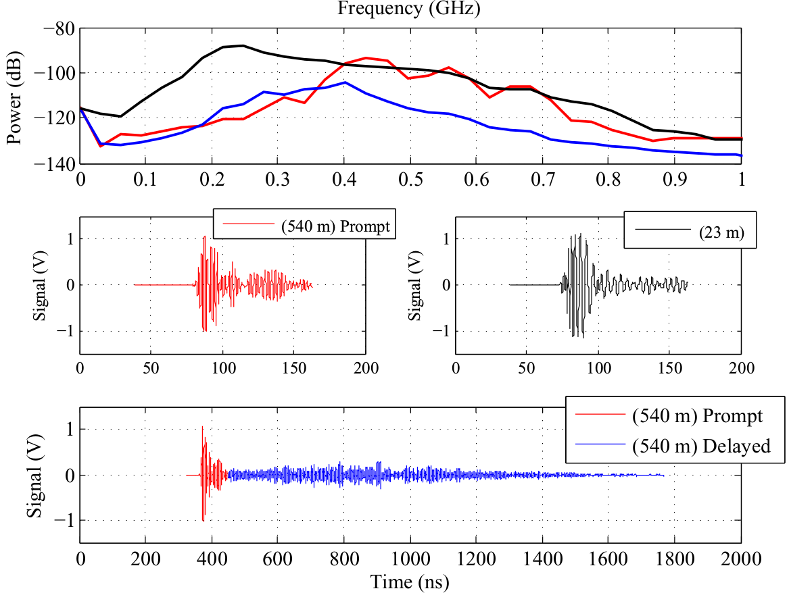
Data Acquired

Slide 7
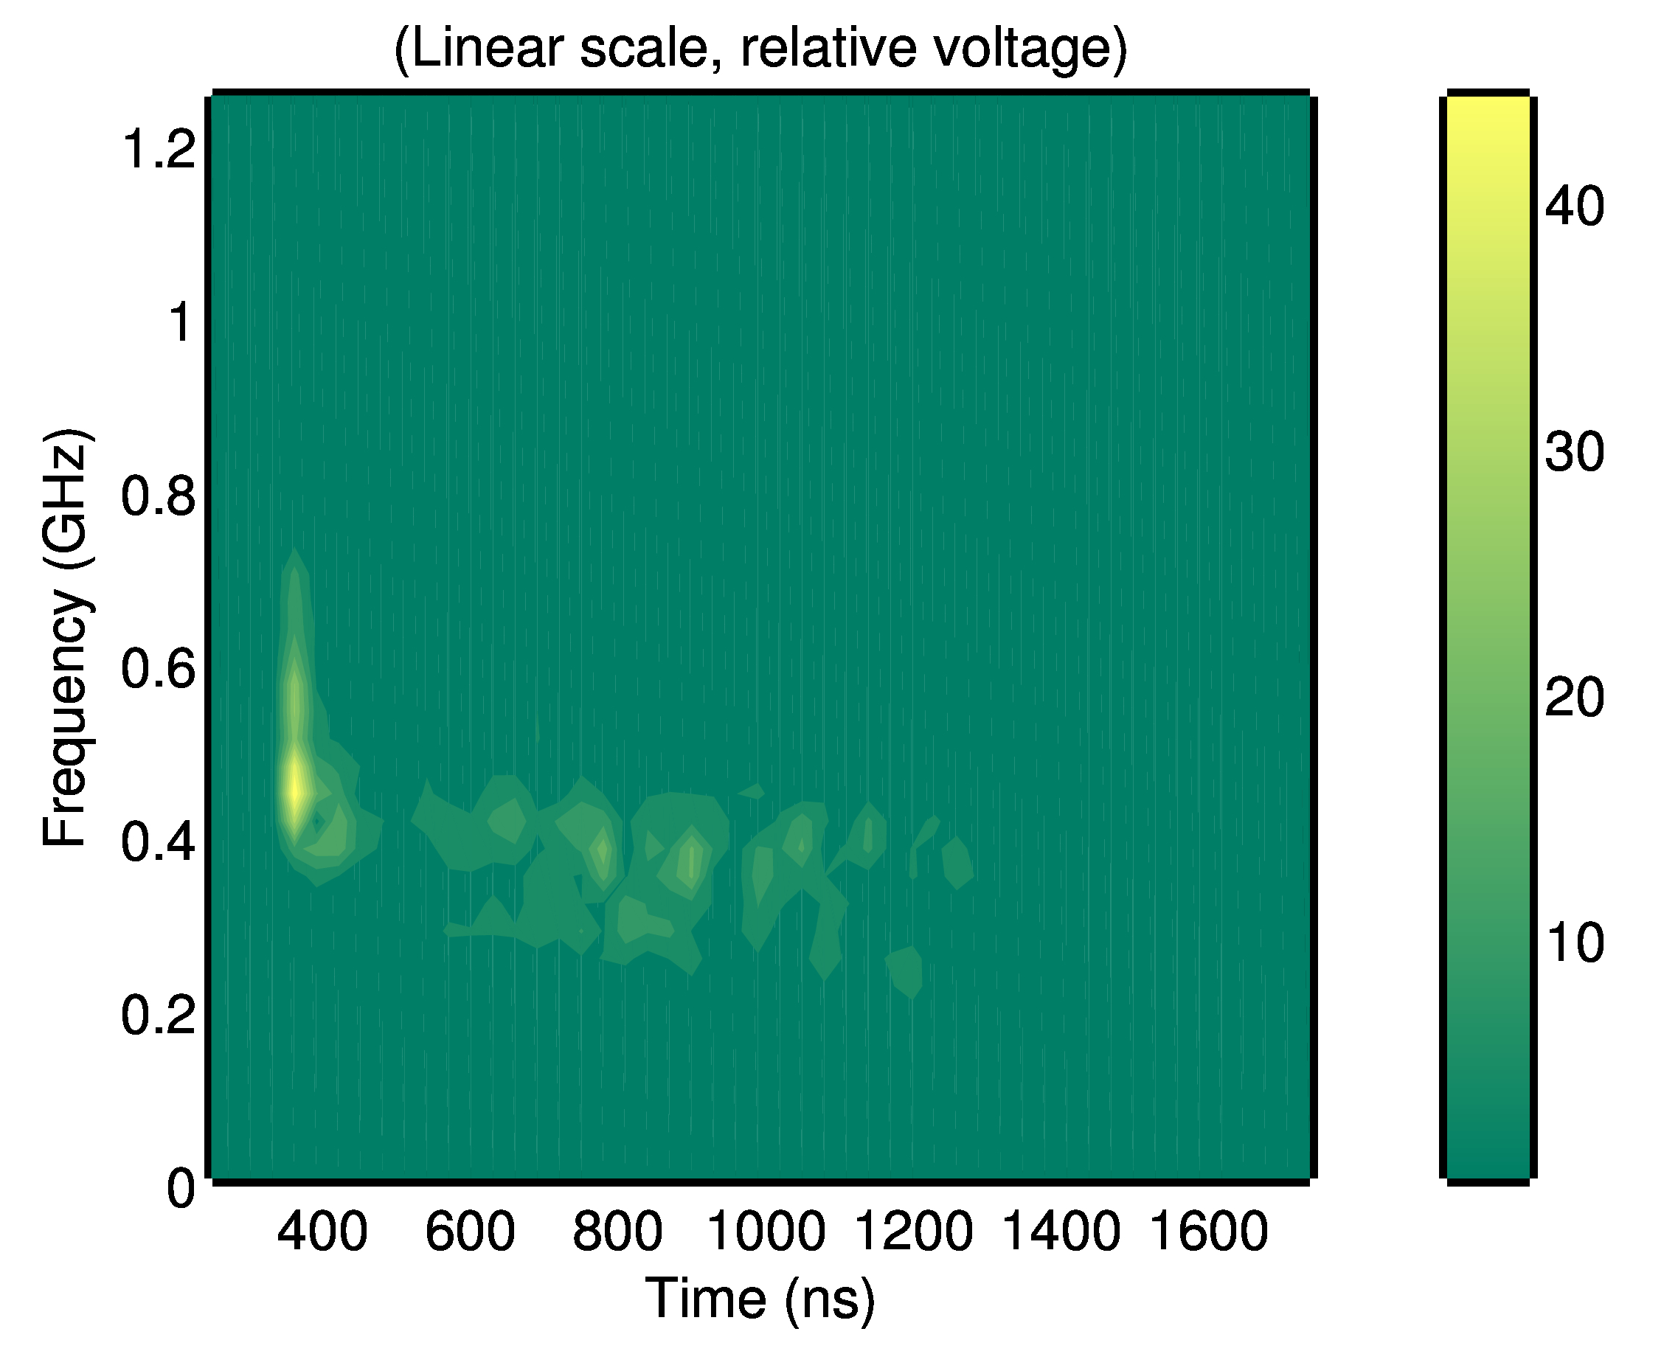
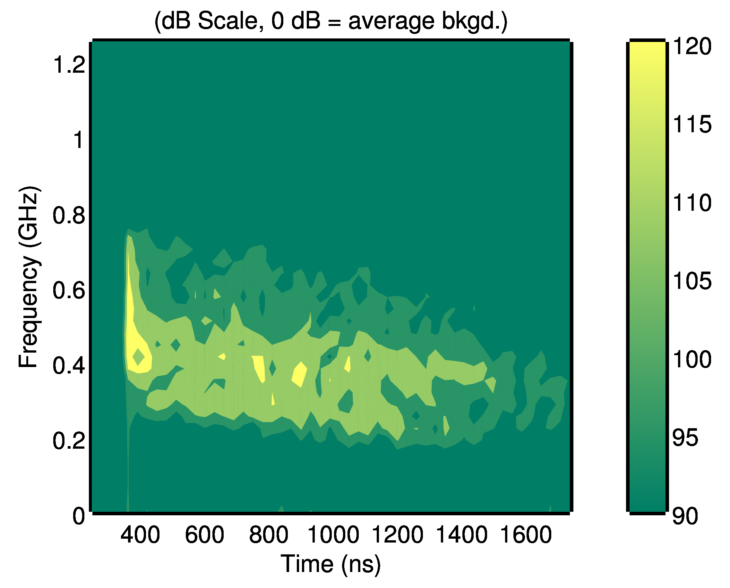
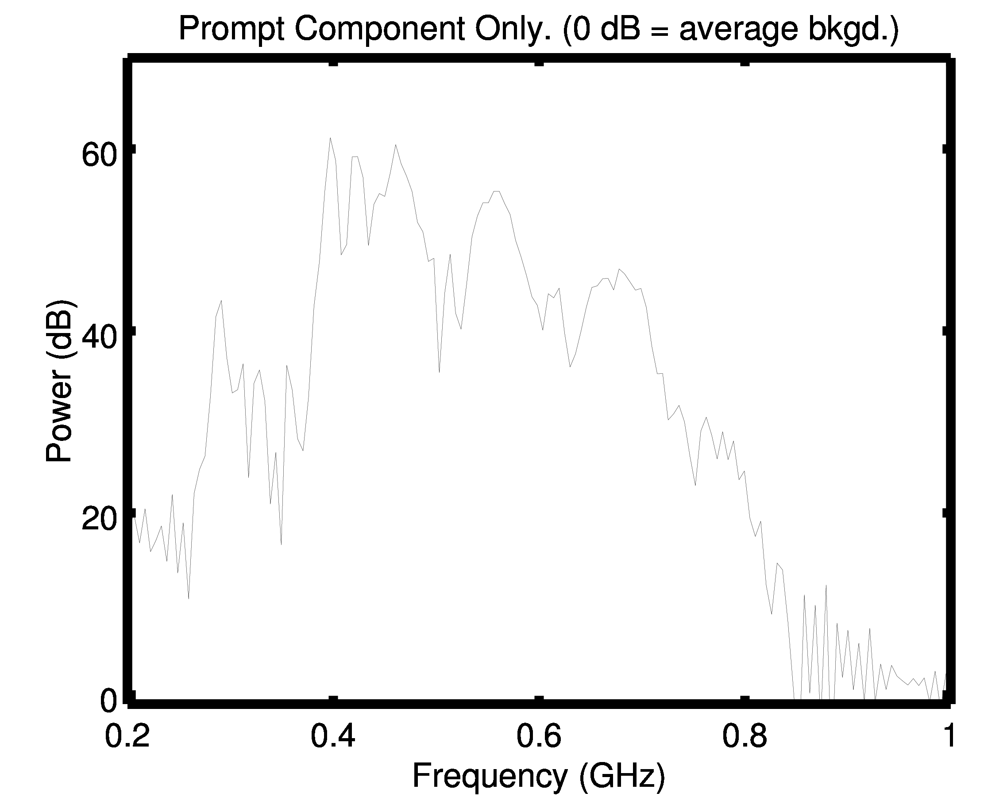
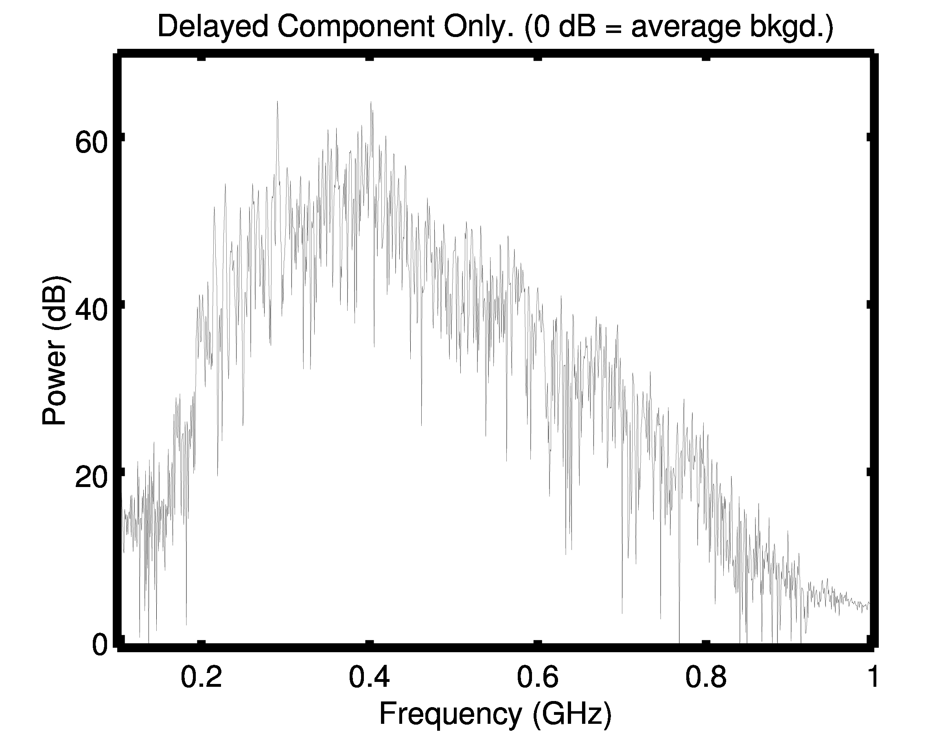

Slide 8
Theoretical Calculations (see report on Dropbox)
Fermat's Principle
Straight rays
Surface
y
-z
Deep Ice

Slide 9
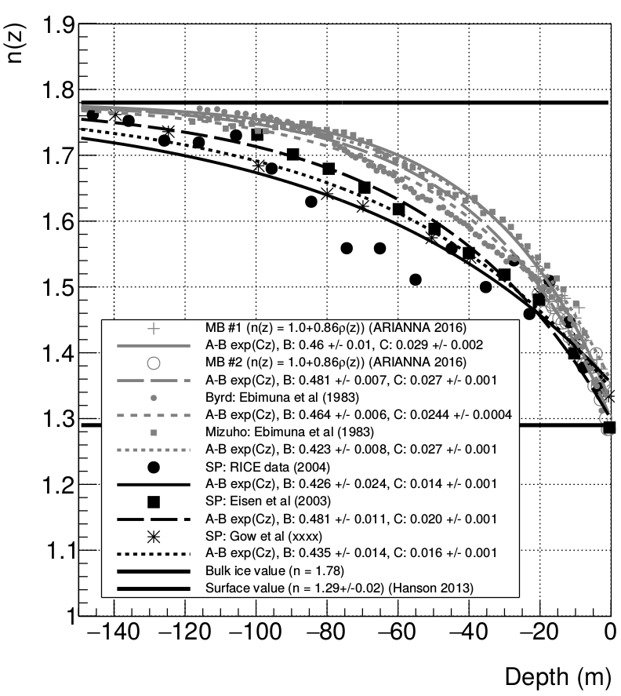
Theoretical Calculations (see report on Dropbox)
Measured index profiles in Antarctica

Slide 10
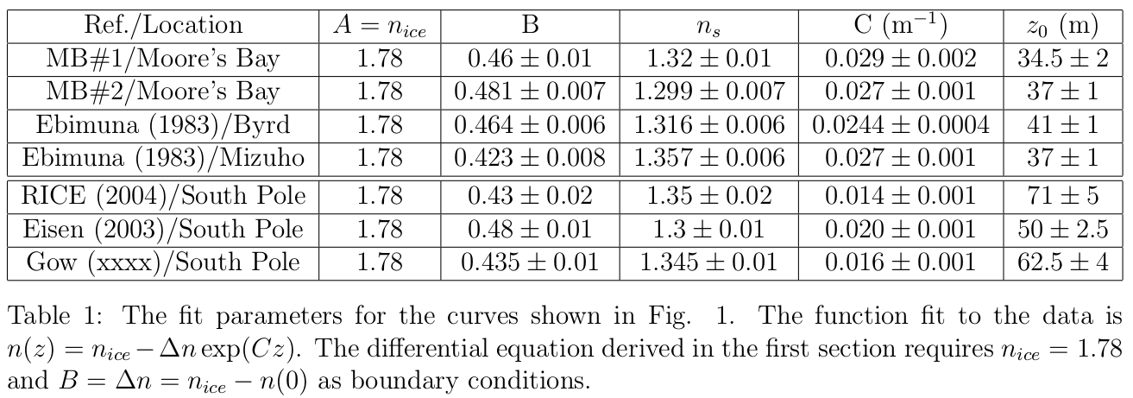
Theoretical Calculations (see report on Dropbox)

Slide 11
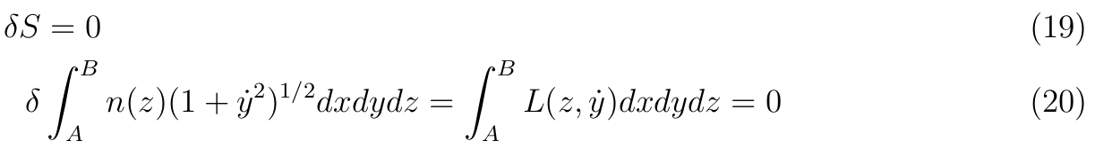
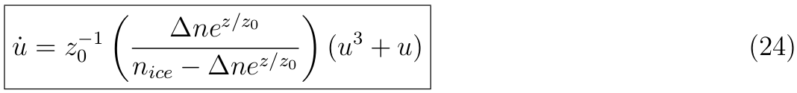
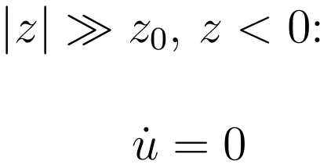
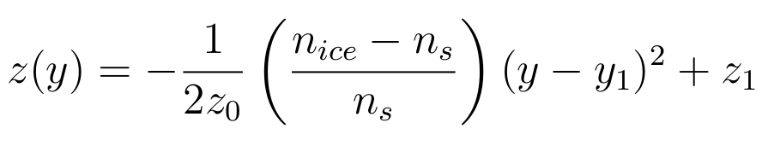
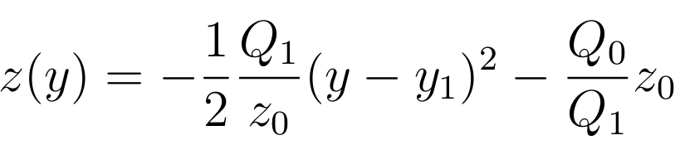
Theoretical Calculations (see report on Dropbox)
Definitions:
1) Derivatives are with respect to z
2) u = dy/dz
3) z0 is the same from n(z)
Limiting Cases: a) Deep ice: straight lines b) Surface, ~horizontal: quadratic c) Shallow: quadratic

Slide 12
Wait for it...If z_0 is the quadratic curvature, and that number is measured to be larger for Moore's Bay, paths should be bent MORE in Moore's Bay.
They are not, apparently. Or, at least some portion of the wave is not.
So although my analytic model of ray-tracing is fast, simple, and based on Fermat's principle, it's not entirely correct.

Slide 13
Conclusions
Explanation of an experiment conducted in Moore's Bay, 2011-12
  Motivation – Looking for surface propagation
  Setup – 540 meter baseline
  Results – Prompt and Delayed Components propagated along surface
Theoretical calculations: Fermat's principle tells us that if there is a solution between two points, the fastest path between them for firn is roughly quadratic.
Reading: “Radio surf in polar ice: A new method of ultrahigh energy neutrino detection.” J. Ralston, Phys. Rev. D 71 011503 (2005)

