Slide 1


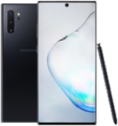











android
WAS
/api/
https://k02b2051.p.ssafy.io
front
/
Made by 은비까비들

