Slide 1
What is learning?
Learning takes place as a result of interaction between an agent and the world, the idea behind learning is that
  Percepts received by an agent should be used not only for acting, but also for improving the agent’s ability to behave optimally in the future to achieve the goal.

Slide 2
Learning types
Learning types
  Supervised learning:
    a situation in which sample (input, output) pairs of the function to be learned can be perceived or are given
    You can think it as if there is a kind teacher
  Reinforcement learning:
    in the case of the agent acts on its environment, it receives some evaluation of its action (reinforcement), but is not told of which action is the correct one to achieve its goal

Slide 3
Reinforcement learning
Task
  Learn how to behave successfully to achieve a goal while interacting with an external environment
  Learn via experiences!
Examples
  Game playing: player knows whether it win or lose, but not know how to move at each step
  Control: a traffic system can measure the delay of cars, but not know how to decrease it.

Slide 4
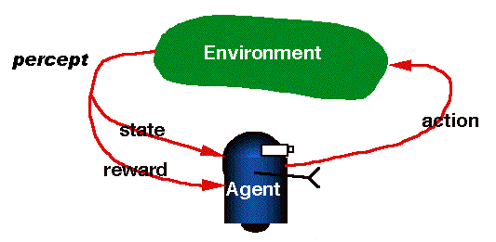
RL is learning from interaction

Slide 5
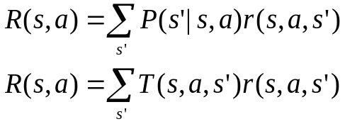
Review of MDP model
MDP model <S,T,A,R>
S– set of states
A– set of actions
T(s,a,s’) = P(s’|s,a)– the probability of transition from s to s’ given action a
R(s,a)– the expected reward for taking action a in state s
Agent
State
Action
Reward
Environment
a₀
a1
a2
s₀
s₁
s2
s3
r₀
r1
r2

Slide 6
Model based v.s.Model free approaches
But, we don’t know anything about the environment model—the transition function T(s,a,s’)
Here comes two approaches
  Model based approach RL:
  learn the model, and use it to derive the optimal policy.
    e.g Adaptive dynamic learning(ADP) approach
  Model free approach RL:
  derive the optimal policy without learning the model.
    e.g LMS and Temporal difference approach
Which one is better?

Slide 7
Passive learning v.s. Active learning
Passive learning
  The agent imply watches the world going by and tries to learn the utilities of being in various states
Active learning
  The agent not simply watches, but also acts

Slide 8
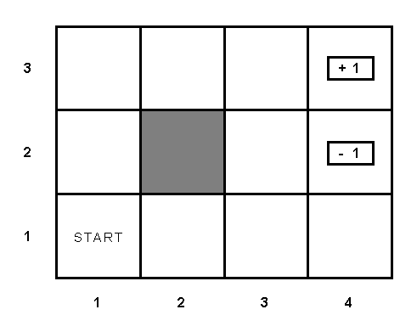
Example environment

Slide 9
Passive learning scenario
The agent see the the sequences of state transitions and associate rewards
  The environment generates state transitions and the agent perceive them
    e.g (1,1) →(1,2) →(1,3) →(2,3) →(3,3) →(4,3)[+1]
      (1,1)→(1,2) →(1,3) →(1,2) →(1,3) →(1,2) →(1,1) →(2,1) →(3,1) →(4,1) →(4,2)[-1]
Key idea: updating the utility value using the given training sequences.

Slide 10
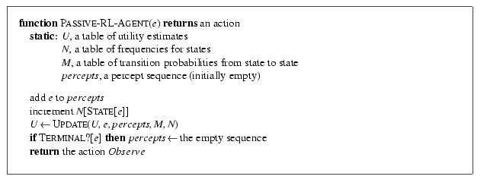
Passive leaning scenario

Slide 11

Temporal difference method in passive learning
TD(0) key idea:
  adjust the estimated utility value of the current state based on its immediately reward and the estimated value of the next state.
The updating rule
  is the learning rate parameter
  Only when is a function that decreases as the number of times a state has been visited increased, then can U(s)converge to the correct value.

Slide 12
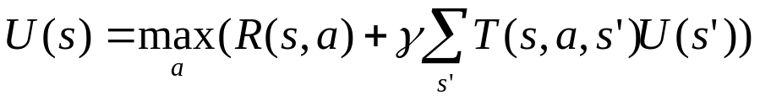
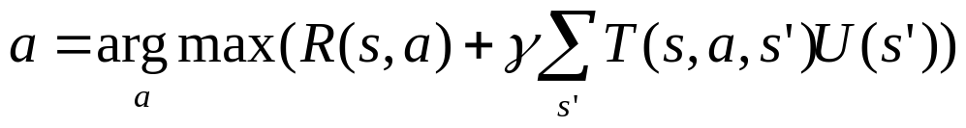
Active learning
An active agent must consider
  what actions to take?
  what their outcomes maybe(both on learning and receiving the rewards in the long run)?
Update utility equation
Rule to chose action

Slide 13
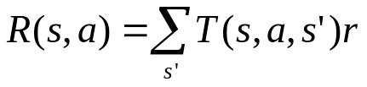
How to learn model?
Use the transition tuple <s, a, s’, r> to learn T(s,a,s’) and R(s,a). That’s supervised learning!
  Since the agent can get every transition (s, a, s’,r) directly, so take (s,a)/s’ as an input/output example of the transition probability function T.
  Different techniques in the supervised learning(see further reading for detail)
  Use r and T(s,a,s’) to learn R(s,a)

Slide 14
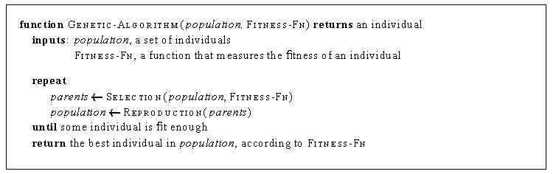
Genetic algorithm and Evolutionary programming
Start with a set of individuals
Apply selection and reproduction operators to “evolve” an individual that is successful (measured by a fitness function)

Slide 15
Genetic algorithm and Evolutionary programming
Imagine the individuals as agent functions
Fitness function as performance measure or reward function
No attempt made to learn the relationship the rewards and actions taken by an agent
Simply searches directly in the individual space to find one that maximizes the fitness functions

Slide 16
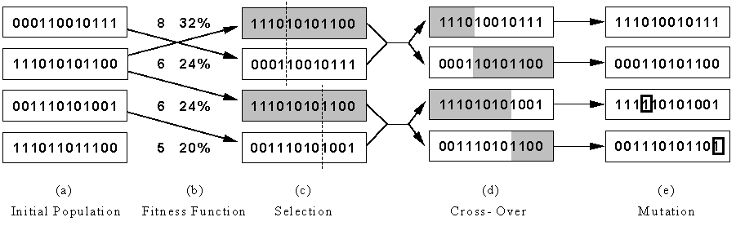
Genetic algorithm and Evolutionary programming
Represent an individual as a binary string(each bit of the string is called a gene)
Selection works like this: if individual X scores twice as high as Y on the fitness function, then X is twice likely to be selected for reproduction than Y is
Reproduction is accomplished by cross-over and mutation

Slide 17
Thank you!

Slide 18
REFERENCES
OPENAI Blogs
UC Berkeley Syllabus
Self Driving car example for model free learning
Medium blogs

