Slide 1













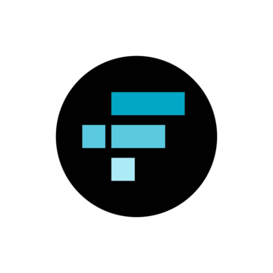


EXCHANGES
DECENTRALISED vs CENTRALISED
[xTx]

Slide 2
Decentralised Exchanges
[xTx]

Slide 3



Privacy (No KYC Required)
[xTx]
DEXs don’t require users to complete Know Your Customer (KYC) verification.
Appeals strongly to privacy-conscious users and communities valuing digital anonymity.
This protects user identity and reduces data leaks or surveillance risk.

Slide 4



Autonomy & Self-Custody
[xTx]
Users maintain full control over their funds—no third party holds your private keys.
Aligns with Bitcoin’s philosophy of decentralization and user sovereignty.
Reduces counterparty risk (e.g., the risk of exchange hacks or withdrawals being frozen).

Slide 5



Lower Entry Barriers
[xTx]
Anyone can participate—no account setup or approvals needed.
Anyone can review the code and suggest improvements.
Facilitates inclusion in regions with restricted financial access or banking systems.

Slide 6



Global Access (Borderless)
[xTx]
Operates globally without geographic restrictions or banking dependencies.
Especially valuable in politically or economically unstable regions.
Open 24/7 with no centralised downtime.

Slide 7
Centralised Exchanges
[xTx]

Slide 8



Regulatory Compliance
[xTx]
Regulated entities that often offer fiat-to-btc options (e.g., via bank transfers or credit cards).
Comply with local and international laws (KYC/AML).
Easier for governments and institutions to interact with.

Slide 9



Speed
[xTx]
High liquidity and fast order execution.
Lower latency compared to most DEXs—especially during high-volume trading.
Better suited for large transactions.

Slide 10



UX Friendly *
[xTx]
Intuitive interfaces, mobile apps, and customer support.
Helpful for beginners transitioning from traditional finance to bitcoin.
Often provide dashboards, charts, alerts, and portfolio management tools.

Slide 11

Access to Shitcoins
[xTx]
Play stupid games, win stupid prizes

