Slide 1


Multi-Signature
[xTx]
What is?
Benefits
Trade offs
Case of use
Best Practices
Q&A

Slide 2
What is
[xTx]
Multi-signature requires several keys to authorize a Bitcoin transaction instead of a single key.
Note: If you use Hodl Hold or Lend, you are utilizing a multisig setup.

Slide 3
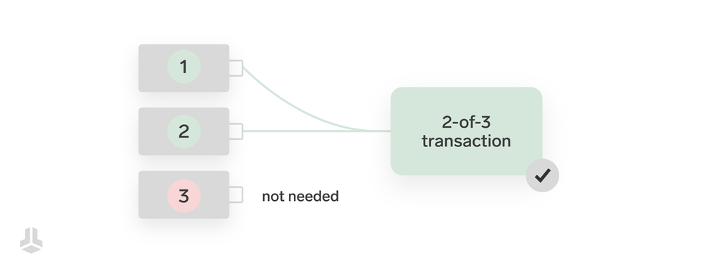

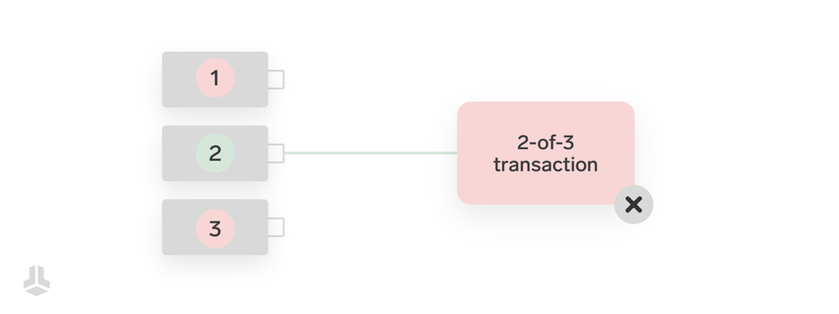
[xTx]

Slide 4

[xTx]

Slide 5
Benefits
[xTx]
Enhanced Security
Shared Control
Transparency & Accountability
Safer Long-Term Storage
Business and Legal Applications
Customizable Access Models

Slide 6
Trade offs
[xTx]
Complexity: The descriptor is a important piece
Single Point of Miscommunication
Key Management Risks
Tooling and Wallet Compatibility
Higher Transaction Costs

Slide 7
Risks
[xTx]
Maintain multiple backups
Store each key’s XPUB
You cannot switch from single-sig to multi-sig or viceversa.

Slide 8
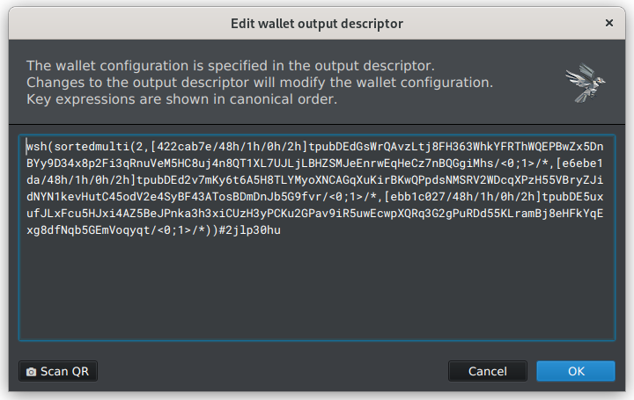
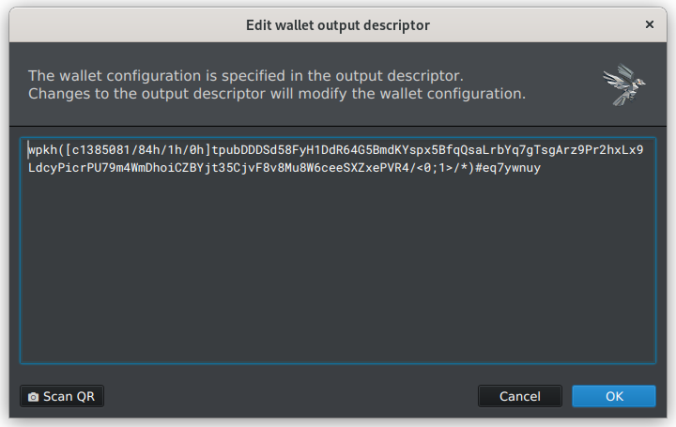
[xTx]

Slide 9
Case of use
[xTx]
Personal Security
Businesses and Organizations
Collaborative custody
Family Wealth Management
Escrow Services
Decentralized Autonomous Organizations (DAOs)

Slide 10
Best Practices
[xTx]
Test a Mock Setup on Testnet
Decide on Spending Rules
Configure the Multisig Wallet
Generate and Distribute Private Keys Securely
Test the Wallet
Delete and Re-import the Wallet
Repeat Until It's Muscle Memory

Slide 11
Coordinator Software Desktop
[xTx]
Electrum (They are missing some standards)
Specter (PGP key is expired since last November)
Sparrow (It’s the current standard)
Nunchuck (Desktop version not as good mobile)
Bitcoin Safe (UX an UI not the best, but FOSS)

Slide 12
Coordinator Software Mobile
[xTx]
Blue (IOS and Android)
Nunchuck (IOS and Android)
Bitcoin Keeper (IOS and Android)

Slide 13
Q&A
[xTx]

Slide 14
[xTx]

