Slide 1

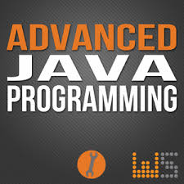
AP101: Advanced Computer Programming
S.M.M.Ahmadpanah
Babak Alipour
Parham Alvani
Hani Hojjat Ansari
Amirkabir University of Technology (Tehran Polytechnic)
Chapters 8, 9 & 10
March 11, 2015
April 7, 2015

Slide 2
Controlling Access to Members
The access modifiers public, protected and private control access to a class’s variables and methods.
The primary purpose of public methods is to present to the class’s clients a view of the services the class provides.
Clients need not be concerned with how the class accomplishes its public tasks.
A class’s private variables and private methods (i.e., its implementation details) are not accessible to its clients.

Slide 3
this Reference
A non-static method of an object implicitly uses keyword this to refer to the object’s instance variables and other methods. Keyword this can also be used explicitly.
If a local variable has the same name as a class’s field, the local variable shadows the field. (Netbeans IDE hint: “Local variable hides a field” ) You can use the this reference in a method to refer to the shadowed field explicitly.

Slide 4
Enumerations
All enum types are reference types. An enum type is declared with an enum declaration, which is a comma-separated list of enum constants.
The declaration may optionally include other components of traditional classes, such as constructors, fields and methods.
enum constants are implicitly final, because they declare constants that should not be modified.
enum constants are implicitly static.
Any attempt to create an object of an enum type with operator new results in a compilation error.

Slide 5
Enumerations
public enum PEnum {
/* declare constants of enum type */
A(10), B(20), C(30);
private int value;
/* enum constructor */
private PEnum(int value){
this.value = value;
}
/* Accessor for field value */
public int getValue(){
return value;
}
}

Slide 6
Enumerations
enum constants can be used anywhere constants can be used, such as in the case labels of switch statements and to control enhanced for statements.
Each enum constant in an enum declaration is optionally followed by arguments which are passed to the enum constructor.
For every enum, the compiler generates a static method called values that returns an array of the enum’s constants in the order in which they were declared.
EnumSet static method range receives the first and last enum constants in a range and returns an EnumSet that contains all the constants between these two constants, inclusive.

Slide 7
Enumerations
public class Main {
public static void main(String args[]){
System.out.println(PEnum.A.getValue());
System.out.println(PEnum.A.name());
System.out.println(PEnum.B.getValue());
/* print all values in enum PNum */
for (PEnum element : PEnum.values())
System.out.println(element.getValue());
for (PEnum element : EnumSet.range(PEnum.A, PEnum.B))
System.out.println(element.getValue());
}
}

Slide 8
Inheritance
reduces program-development time.
The direct superclass of a subclass (specified by the keyword extends in the first line of a class declaration) is the superclass from which the subclass inherits. An indirect superclass of a subclass is two or more levels up the class hierarchy from that subclass.
In single inheritance , a class is derived from one direct superclass. In multiple inheritance, a class is derived from more than one direct superclass. Java does not support multiple inheritance.

Slide 9
Inheritance
A subclass is more specific than its superclass and represents a smaller group of objects.
Every object of a subclass is also an object of that class’s superclass. However, a superclass object is not an object of its class’s subclasses.
An is-a relationship represents inheritance. In an is-a relationship, an object of a subclass also can be treated as an object of its superclass.
A has-a relationship represents composition. In a has-a relationship, a class object contains references to objects of other classes.

Slide 10
Inheritance
Single-inheritance relationships form treelike hierarchical structures—a superclass exists in a hierarchical relationship with its subclasses.

Slide 11
Inheritance

Slide 12
Inheritance

Slide 13
protected Members
A superclass’s public members are accessible wherever the program has a reference to an object of that superclass or one of its subclasses.
A superclass’s private members can be accessed directly only within the superclass’s declaration.
A superclass’s protected members have an intermediate level of protection between public and private access. They can be accessed by members of the superclass, by members of its subclasses and by members of other classes in the same package.
A superclass’s private members are hidden in its subclasses and can be accessed only through the public or protected methods inherited from the superclass.
An overridden superclass method can be accessed from a subclass if the superclass method name is preceded by super and a dot (.) separator.

Slide 14
Relationship between Superclasses and Subclasses
A subclass cannot access the private members of its superclass, but it can access the non-private members.
A subclass can invoke a constructor of its superclass by using the keyword super, followed by a set of parentheses containing the superclass constructor arguments. This must appear as the first statement in the subclass constructor’s body.
A superclass method can be overridden in a subclass to declare an appropriate implementation for the subclass.
The annotation @Override indicates that a method should override a superclass method. When the compiler encounters a method declared with @Override, it compares the method’s signature with the superclass’s method signatures. If there isn’t an exact match, the compiler issues an error message.

Slide 15
ToString method
toString()
All objects in Java have a toString() method that returns a String representation of the object. Method toString() is called implicitly when an object appears in code where a String is needed.
e.g. System.out.println(obj);
Override toString() of your own classes to provide specific information

Slide 16
ToString method (Contd.)
Method toString takes no arguments and returns a String. The Object class’s toString method is normally overridden by a subclass.
When an object is output using the %s format specifier, the object’s toString method is called implicitly to obtain its String representation.

Slide 17
Constructors in Subclasses
The first task of a subclass constructor is to call its direct superclass’s constructor to ensure that the instance variables inherited from the superclass are initialized.
Java ensure that even if a constructor does not assign a value to an instance variable is still initialized to its default value (e.g 0 for primitive numeric types, false for booleans, null for references).

Slide 18
Object Class
All classes in Java inherit directly or indirectly from the Object class (package java.lang), so its 11 methods (some are overloaded) are inherited by all other classes.

Slide 19
Object Class
protected Object | clone()Creates and returns a copy of this object.
boolean | equals(Object obj)Indicates whether some other object is "equal to" this one.
protected void | finalize()Called by the garbage collector on an object when garbage collection determines that there are no more references to the object.
Class<?> | getClass()Returns the runtime class of this Object.
int | hashCode()Returns a hash code value for the object.
void | notify()Wakes up a single thread that is waiting on this object's monitor.
void | notifyAll()Wakes up all threads that are waiting on this object's monitor.
String | toString()Returns a string representation of the object.
void | wait()Causes the current thread to wait until another thread invokes the notify() method or the notifyAll() method for this object.
void | wait(long timeout)Causes the current thread to wait until either another thread invokes the notify() method or the notifyAll() method for this object, or a specified amount of time has elapsed.
void | wait(long timeout, int nanos)Causes the current thread to wait until another thread invokes the notify() method or the notifyAll() method for this object, or some other thread interrupts the current thread, or a certain amount of real time has elapsed.

Slide 20

Nowruz ☺

Slide 21
Polymorphism
Polymorphism enables us to write programs that process objects that share the same superclass as if they’re all objects of the superclass; this can simplify programming.
With polymorphism, we can design and implement systems that are easily extensible. The only parts of a program that must be altered to accommodate new classes are those that require direct knowledge of the new classes that you add to the hierarchy.
Facilitates adding new classes to a system with minimal modifications to the system’s code
Polymorphism is particularly effective for implementing layered software systems.

Slide 22
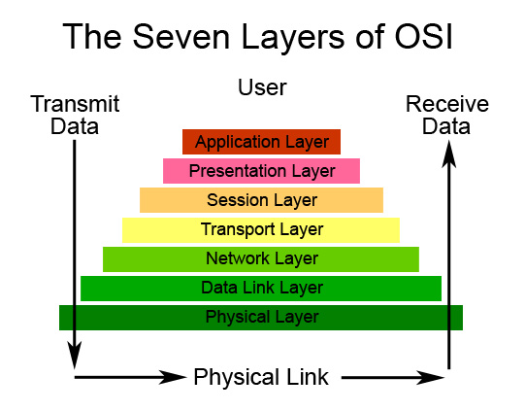
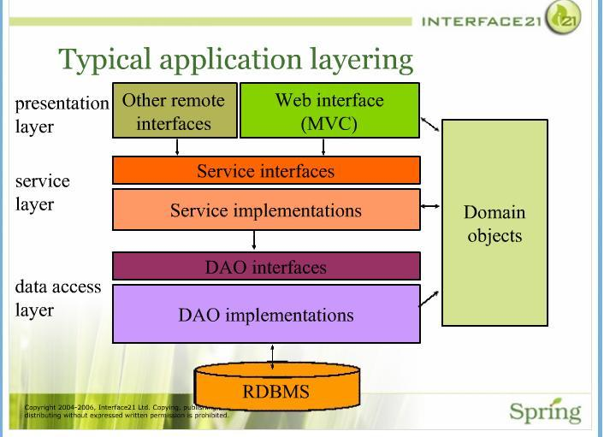
Abstraction & Polymorphism in Real Life

Slide 23
Abstract Classes and Methods
The primary purpose of an abstract class is to provide an appropriate superclass from which other classes can inherit and thus share a common design.
Abstract classes cannot be used to instantiate objects, because they’re incomplete.
Classes that can be used to instantiate objects are called concrete classes. They provide implementations of every method they declare (some of the implementations can be inherited).
Programmers often write client code that uses only abstract superclasses to reduce client code’s dependencies on specific subclass types.
Abstract classes sometimes constitute several levels of a hierarchy.

Slide 24
Abstract Classes and Methods
An abstract class normally contains one or more abstract methods.
Abstract methods do not provide implementations.
A class that contains any abstract methods must be declared as an abstract class . Each concrete subclass must provide implementations of each of the superclass’s abstract methods.
Constructors and static methods cannot be declared abstract.

Slide 25
Abstraction Vs Polymorphism
Abstract superclass variables can hold references to objects of any concrete class derived from the superclass. Programs typically use such variables to manipulate subclass objects polymorphically.

Slide 26
Abstract Classes and Methods

Slide 27
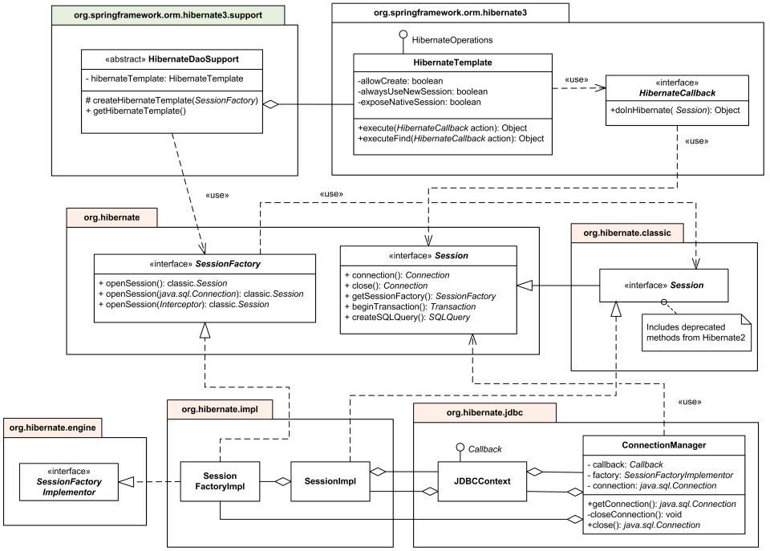
Real World

Slide 28
Abstract Classes and Methods
A hierarchy designer can demand that each concrete subclass provide an appropriate method implementation by including an abstract method in a superclass.
A superclass variable can be used to invoke only methods declared in the superclass.
Operator instanceof determines if an object has the is-a relationship with a specific type.
Every object in Java knows its own class and can access it through Object method getClass , which returns an object of type Class (package java.lang).
The is-a relationship applies only between the subclass and its superclasses, not vice versa.

Slide 29
final Methods and Classes
A method that’s declared final in a superclass cannot be overridden in a subclass.
Methods declared private are implicitly final, because you can’t override them in a subclass.
Methods that are declared static are implicitly final.
A final method’s declaration can never change, so all subclasses use the same implementation, and calls to final methods are resolved at compile time—this is known as static binding.
Since the compiler knows that final methods cannot be overridden, it can optimize programs by removing calls to final methods and replacing them with the expanded code of their declarations at each method-call location—a technique known as inlining the code.
A class that’s declared final cannot be a superclass.
All methods in a final class are implicitly final.

Slide 30
Why make class final ? Based on stackoverflow answer
Joshua Bloch's excellent book "Effective Java", called "Design and document for inheritance or else prohibit it".
The interaction of inherited classes with their parents can be surprising and unpredictable if the ancestor wasn't designed to be inherited from.
Classes should therefore come in two kinds :
Classes designed to be extended, and with enough documentation to describe how it should be done
Classes marked final

Slide 31
Summary of the Allowed Assignments Between Superclass and Subclass Variables
Assigning a superclass reference to a superclass variable is straightforward
Assigning a subclass reference to a subclass variable is straightforward
Assigning a subclass reference to a superclass variable is safe because of the is-a relationship
Referring to subclass-only members through superclass variables is a compilation error
Assigning a superclass reference to a subclass variable is a compilation error
Downcasting can get around this error

Slide 32

Interfaces ☺
An interface specifies what operations are allowed but not how they’re performed.

Slide 33
Abstraction Vs Interface Based on stackoverflow answer
There are different views on the subject of using an interface versus abstract class.
An interface, though, should express the behavior of an object (what it can do) and the abstract class should define what it is.
Basically "I can" versus "I am" from the object's perspective.

Slide 34
Creating and Using Interfaces
A Java interface describes a set of methods that can be called on an object.
An interface declaration begins with the keyword interface.
All interface members must be public, and interfaces may not specify any implementation details , such as concrete method declarations and instance variables.
All methods declared in an interface are implicitly public abstract methods and all fields are implicitly public, static and final.

Slide 35
Creating and Using Interfaces
To use an interface, a concrete class must specify that it implements the interface and must declare each interface method with the signature specified in the interface declaration. A class that does not implement all the interface’s methods must be declared abstract.

Slide 36
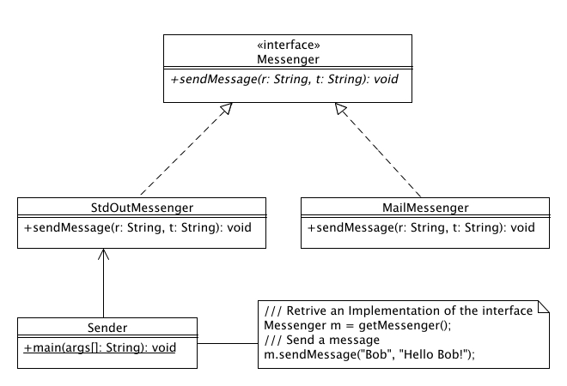
Creating and Using Interfaces
Implementing an interface is like signing a contract with the compiler that states, “I will declare all the methods specified by the interface or I will declare my class abstract.”

Slide 37
Creating and Using Interfaces
An interface is typically used when disparate (i.e., unrelated) classes need to share common methods and constants. This allows objects of unrelated classes to be processed polymorphically—objects of classes that implement the same interface can respond to the same method calls.
You can create an interface that describes the desired functionality, then implement the interface in any classes that require that functionality.
An interface is often used in place of an abstract class when there’s no default implementation to inherit—that is, no instance variables and no default method implementations.
Like public abstract classes, interfaces are typically public types, so they’re normally declared in files by themselves with the same name as the interface and the .java file-name extension.

Slide 38
Creating and Using Interfaces
Java does not allow subclasses to inherit from more than one superclass, but it does allow a class to inherit from a superclass and implement more than one interface.
All objects of a class that implement multiple interfaces have the is-a relationship with each implemented interface type.
An interface can declare constants. The constants are implicitly public, static and final.

Slide 39
Common Interfaces of the Java API
The Java API’s interfaces enable you to use your own classes within the frameworks provided by Java, such as comparing objects of your own types and creating tasks that can execute concurrently with other tasks in the same program.

Slide 40
Common Interfaces of the Java API
Comparable
This interface imposes a total ordering on the objects of each class that implements it. This ordering is referred to as the class's natural ordering, and the class's compareTo method is referred to as its natural comparison method.
(x, y) such that x.compareTo(y)
Serializable
Serializability of a class is enabled by the class implementing the java.io.Serializable interface. Classes that do not implement this interface will not have any of their state serialized or deserialized. All subtypes of a serializable class are themselves serializable. The serialization interface has no methods or fields and serves only to identify the semantics of being serializable.

Slide 41
Common Interfaces of the Java API
Runnable
The Runnable interface should be implemented by any class whose instances are intended to be executed by a thread. The class must define a method of no arguments called run.
GUI Event Listeners ?!?
See them in the next session !

Slide 42

Questions?

