Slide 1


AP101: Advanced Computer Programming
Babak Alipour
(8931023)
Pantea Habibi
(9131010)
Parham Alvani
(9231058)
Amirkabir University of Technology (Tehran Polytechnic)
AWT & Swing
April, 2015

Slide 2
The Abstract Windowing Toolkit
Since Java was first released, its user interface facilities have been a significant weakness
The Abstract Windowing Toolkit (AWT) was part of the JDK form the beginning, but it really was not sufficient to support a complex user interface
JDK 1.1 fixed a number of problems, and most notably, it introduced a new event model. It did not make any major additions to the basic components

Slide 3
Java Foundation Classes
In April 1997, JavaSoft announced the Java Foundation Classes (JFC).
a major part of the JFC is a new set of user interface components called Swing.
AWT
Swing
Accessibility
Java
2D
Drag
And
Drop

Slide 4
Swing
The Swing classes are used to build GUIs
Swing does not stand for anything
Swing is built on top of the 1.1/1.2 AWT libraries
Swing makes 3 major improvements on the AWT
does not rely on the platform’s native components (is it good ?)
it supports “Pluggable Look-and-Feel” or PLAF ??
it is based on the Model-View-Controller (MVC) ??
JFC
AWT
JDK 1.2
Swing

Slide 5
Components
A GUI consists of different graphic Component objects which are combined into a hierarchy using Container objects.
Component
An abstract class for GUI components such as menus, buttons, labels, lists, etc.
Container
An abstract class that extends Component. Containers can hold multiple components.

Slide 6
Weighing Components
Sun (Oracle !) makes a distinction between lightweight and heavyweight components
Lightweight components are not dependent on native peers to render themselves. They are coded in Java.
Heavyweight components are rendered by the host operating system. They are resources managed by the underlying window manager.

Slide 7
Heavyweight Components
Heavyweight components were unwieldy for two reasons
Equivalent components on different platforms do not necessarily act alike.
The look and feel of each component was tied to the host operating system
Almost all Swing components are lightweight except
JApplet, JFrame, JDialog, and JWindow

Slide 8
Additional Swing Features
Swing also provides
A wide variety of components (tables, trees, sliders, progress bars, internal frame, …)
Swing components can have tooltips placed over them.
Arbitrary keyboard events can be bound to components.
Additional debugging support.
Support for parsing and displaying HTML based information.

Slide 9
Applets versus Applications
Using Swing it is possible to create two different types of GUI programs
Standalone applications
Programs that are started from the command line
Code resides on the machine on which they are run
Applets
Programs run inside a web browser
Code is downloaded from a web server
JVM is contained inside the web browser
For security purposes Applets are normally prevented from doing certain things (for example opening files)
JNLP (Java Lunch Network Protocol)
It is NEW ! RESEARCH about it ….
For now we will write standalone applications

Slide 10
Three Types of GUI Classes
Containers
JFrame, JPanel, JApplet
Components
JButton, JTextField, JComboBox, JList, etc.
Helpers
Graphics, Color, Font, Dimension, etc.

Slide 11
JFrames
A JFrame is a Window with all of the adornments added.
JFrame inherits from Frame, Window, Container, Component, and Object
A JFrame provides the basic building block for screen-oriented applications.
JFrame win = new JFrame( “title” );

Slide 12
Creating a JFrame
import javax.swing.*;
public class SwingFrame {
public static void main(String args[]) {
JFrame win = new JFrame( "My First GUI Program" );
win.setVisible(true);
}
} // SwingFrame

Slide 13
JFrame
Sizing a Frame
You can specify the size
Height and width given in pixels
The size of a pixel will vary based on the resolution of the device on which the frame is rendered
Usually one uses an instance of the Dimension class.
The method pack() will set the size of the frame automatically, based on the size of the components contained in the content pane
Note that pack does not look at the title bar
Sometimes pack() does not work as you might expect; try it and see.

Slide 14
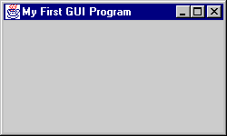
Creating a JFrame
import javax.swing.*;
import java.awt.*;
public class SwingFrame {
static Dimension windowSize = new Dimension( 250, 150 );
public static void main( String args[] ) {
JFrame win = new JFrame( "My First GUI Program" );
win.setDefaultCloseOperation( JFrame.EXIT_ON_CLOSE );
win.setSize( windowSize );
win.setVisible(true);
}
} // SwingFrame

Slide 15
JFrame
Layered pane
JFrames have several panes:
Components are placed in the Content Pane
Glass pane
Menu bar
Content pane

Slide 16
Swing Components
JComponent
JComboBox,
Jlabel
Jlist
JMenuBar
Jpanel
JPopupMenu
JScrollBar
JScrollPane
Jtable
Jtree

Slide 17
Swing Components (Cont.)
JInternalFrame
JOptionPane
JProgressBar
JRootPane
Jseparator
Jslider
JSplitPane
JTabbedPane
JToolBar
JToolTip
Jviewport
JColorChooser
JTextComponent, …

Slide 18
JLabels
JLabels are components that you can fill with text.
When creating a label you can specify the initial value and the alignment you wish to use within the label.
You can use getText() and setText() to get and change the value of the label.
lbl = new JLabel( ”text", JLabel.RIGHT );

Slide 19

Hello World
import javax.swing.*;
public class SwingFrame {
public static void main( String args[] ) {
JFrame win = new JFrame( "My First GUI Program" );
JLabel label = new JLabel( "Hello World" );
win.getContentPane().add( label );
win.setVisible(true);
}
} // SwingFrame

Slide 20
JButtons
JButton extends Component , displays a string, and delivers an ActionEvent for each mouse click.
Normally buttons are displayed with a border
In addition to text, JButtons can also display icons
button = new JButton( ”text“ );

Slide 21

JButtons
import javax.swing.*;
public class SwingFrame {
public static void main( String args[] ) {
JFrame win = new JFrame( "My First GUI Program" );
JButton button = new JButton( "Click Me!!" );
win.getContentPane().add( button );
win.setVisible(true);
}
} // SwingFrame

Slide 22
Layout Manager
Layout Manager
An interface that defines methods for positioning and sizing objects within a container. Java defines several default implementations of LayoutManager.
Geometrical placement in a Container is controlled by a LayoutManager object

Slide 23
Components, Containers, and Layout Managers
Containers may contain components (which means containers can contain containers!!).
All containers come equipped with a layout manager which positions and shapes (lays out) the container's components.
Much of the action in Swing occurs between components, containers, and their layout managers.

Slide 24
Layout Managers
Layouts allow you to format components on the screen in a platform-independent way
The standard JDK provides many classes that implement the LayoutManager interface, including:
FlowLayout
GridLayout
BorderLayout
BoxLayout
CardLayout
OverlayLayout
GridBagLayout

Slide 25
Changing the Layout
To change the layout used in a container you first need to create the layout.
Then you invoke the setLayout() method on the container to use the new layout.
The layout manager should be established before any components are added to the container
JPanel p = new JPanel() ;
p.setLayout( new FlowLayout() )

Slide 26
FlowLayout
FlowLayout is the default layout for the JPanel class.
When you add components to the screen, they flow left to right (centered) based on the order added and the width of the screen.
Very similar to word wrap and full justification on a word processor.
If the screen is resized, the components' flow will change based on the new width and height

Slide 27
Flow Layout
import javax.swing.*;
import java.awt.*;
public class ShowFlowLayout {
public static void main( String args[] ) {
JFrame win = new JFrame( "My First GUI Program" );
win.setDefaultCloseOperation( JFrame.EXIT_ON_CLOSE );
win.getContentPane().setLayout( new FlowLayout() );
for ( int i = 0; i < 10; i++ ) {
win.getContentPane().add( new JButton( String.valueOf( i ) ) );
}
win.setVisible(true);
}
} // ShowFlowLayout

Slide 28

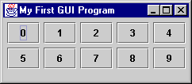
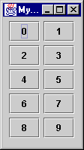
FlowLayout

Slide 29
GridLayout
Arranges components in rows and columns
If the number of rows is specified
columns = number of components / rows
If the number of columns is specified
Rows = number of components / columns
The number of columns is ignored unless the number of rows is zero.
The order in which you add components matters
Component 1 → (0,0), Component 2 → (0,1), …...
Components are resized to fit the row-column area

Slide 30
Grid Layout
import javax.swing.*;
import java.awt.*;
public class ShowGridLayout {
public static void main( String args[] ) {
JFrame win = new JFrame( "My First GUI Program" );
win.setDefaultCloseOperation( JFrame.EXIT_ON_CLOSE );
win.getContentPane().setLayout( new GridLayout( 2, 0 ) );
for ( int i = 0; i < 10; i++ ){
win.getContentPane().add( new JButton( String.valueOf( i ) ) );
}
win.setVisible(true);
}
} // ShowGridLayout

Slide 31

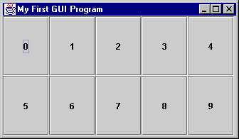
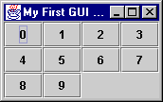
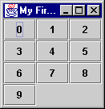
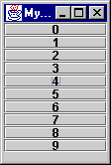
GridLayout
gridLayout( 2, 4 )
gridLayout( 0, 4 )
gridLayout( 4, 4 )
gridLayout( 10, 10 )

Slide 32
BoxLayout
BoxLayout provides an easy way to lay out components horizontally or vertically.
Components are added in order.
BoxLayout attempts to arrange components at their
preferred widths (for horizontal layout) or
preferred heights (for vertical layout).
Static methods in Box class are available for “glue” and “struts.”

Slide 33
BoxLayout
import javax.swing.*;
import java.awt.*;
public class ShowBoxLayout {
public static void main( String args[] ) {
JFrame win = new JFrame( "My First GUI Program" );
win.setDefaultCloseOperation( JFrame.EXIT_ON_CLOSE );
win.getContentPane().setLayout( new BoxLayout( win.getContentPane(), BoxLayout.X_AXIS ) );
for ( int i = 0; i < 10; i++ ){
win.getContentPane().add( new JButton( String.valueOf( i ) ) );
win.getContentPane().add( Box.createHorizontalGlue() );
}
win.pack();
win.setVisible(true);
}
} // ShowBoxLayout

Slide 34

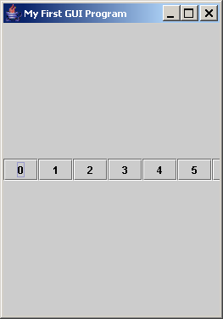
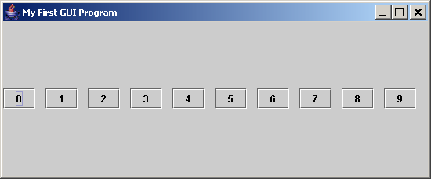
BoxLayout
Note that components retain their preferred size.

Slide 35
BorderLayout
BorderLayout provides 5 areas to hold components. These are named after the four different borders of the screen, North, South, East, West, and Center.
When a Component is added to the layout, you must specify which area to place it in. The order in which components are added is not important.
The center area will always be resized to be as large as possible

Slide 36
BorderLayout
import javax.swing.*;
import java.awt.*;
public class ShowBorderLayout {
public static void main( String args[] ) {
JFrame win = new JFrame( "My First GUI Program" );
win.setDefaultCloseOperation( JFrame.EXIT_ON_CLOSE );
Container content = win.getContentPane();
content.setLayout( new BorderLayout() );
content.add( BorderLayout.NORTH, new JButton( "North" ));
content.add( BorderLayout.SOUTH, new JButton( "South" ));
content.add( BorderLayout.EAST, new JButton( "East" ));
content.add( BorderLayout.WEST, new JButton( "West" ));
content.add( BorderLayout.CENTER, new JButton( "Center" ));
win.setVisible(true);
}
} // ShowBorderLayout

Slide 37
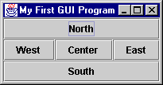
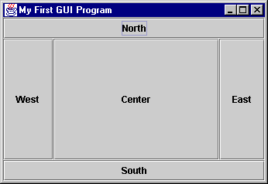
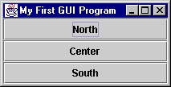
BorderLayout

Slide 38
SpringLayout
SpringLayout allows you to attach "springs" to components.
Components are laid out relative to other components.
Each component added to the container can have an attached SpringLayout.Constraints.

Slide 39
SpringLayout
import java.awt.Component;
import java.awt.Container;
import javax.swing.JFrame;
import javax.swing.JLabel;
import javax.swing.JTextField;
import javax.swing.SpringLayout;
public class SpringSample {
public static void main(String args[]) {
JFrame frame = new JFrame("SpringLayout");
frame.setDefaultCloseOperation(JFrame.EXIT_ON_CLOSE);
Container contentPane = frame.getContentPane();
SpringLayout layout = new SpringLayout();
contentPane.setLayout(layout);
Component left = new JLabel("Left");
Component right = new JTextField(15);
contentPane.add(left);
contentPane.add(right);
layout.putConstraint(SpringLayout.WEST, left, 10, SpringLayout.WEST, contentPane);
layout.putConstraint(SpringLayout.NORTH, left, 25, SpringLayout.NORTH, contentPane);
layout.putConstraint(SpringLayout.NORTH, right, 25, SpringLayout.NORTH, contentPane);
layout.putConstraint(SpringLayout.WEST, right, 20, SpringLayout.EAST, left);
frame.setSize(300, 100);
frame.setVisible(true);
}
}

Slide 40
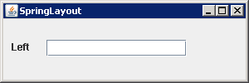
SpringLayout

Slide 41
Containers
A JFrame is not the only type of container that you can use in Swing
The subclasses of Container are:
JPanel
JWindow
JApplet
Window is subclassed as follows:
JDialog
JFrame

Slide 42

Questions?

