Slide 1


AP101: Advanced Computer Programming
Multithreading
18 May, 2015

Slide 2
Introduction
Performing operations concurrently (in parallel)
We can walk, talk, breathe, see, hear, smell... all at the same time
Computers can do this as well - download a file, print a file, receive email, run the clock, more or less in parallel….
How are these tasks typically accomplished?
Operating systems support processes
What’s the difference between a process and a thread?
Processes have their own memory space, threads share memory
Hence processes are “heavyweight” while threads are “lightweight”
Most programming languages do not allow concurrency
Usually limited to operating system "primitives" available to systems programmers
Java supports concurrency as part of language and libraries
What other languages support

Slide 3
Thread
Thread: single sequential flow of control within a program
Single-threaded program can handle one task at any time.
Multitasking allows single processor to run several concurrent threads.
Most modern operating systems support multitasking.

Slide 4
Advantages of Multithreading
Reactive systems – constantly monitoring
More responsive to user input – GUI application can interrupt a time-consuming task
Server can handle multiple clients simultaneously
Can take advantage of parallel processing

Slide 5
Threads Concept
Multiple threads on multiple CPUs
Multiple threads sharing a single CPU

Slide 6
Kernel Threads
Supported by the Kernel
Examples
Windows XP/2000
Solaris
Linux
Tru64 UNIX
Mac OS X

Slide 7
User Threads
Thread management done by user-level threads library
Three primary thread libraries:
POSIX threads (Pthreads)
Win32 threads
Java threads

Slide 8
Threads in Java
Creating threads in Java:
Extend java.lang.Thread class
OR
Implement java.lang.Runnable interface

Slide 9
Threads in Java
Creating threads in Java:
Extend java.lang.Thread class
run() method must be overridden (similar to main method of sequential program)
run() is called when execution of the thread begins
A thread terminates when run() returns
start() method invokes run()
Calling run() does not create a new thread

Slide 10
Threads in Java
Creating threads in Java:
Implement java.lang.Runnable interface
If already inheriting another class (i.e., JApplet)
Single method: public void run()
Thread class implements Runnable.

Slide 11
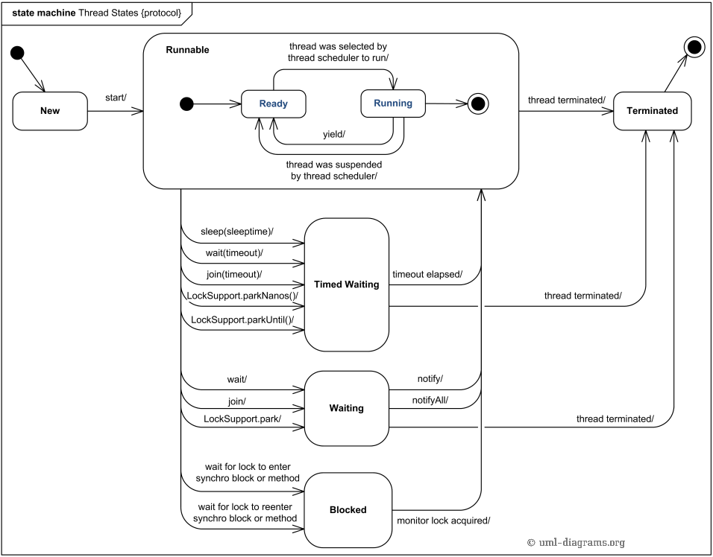
Thread States

Slide 12
Thread termination
A thread becomes Not Runnable when one of these events occurs:
Its sleep method is invoked.
The thread calls the wait method to wait for a specific condition to be satisifed.
The thread is blocking on I/O.

Slide 13
Example: Using the Runnable Interface to Create and Launch Threads
Objective: Create and run three threads:
The first thread prints the letter a 100 times.
The second thread prints the letter b 100 times.
The third thread prints the integers 1 through 100.

Slide 14
Example: Using the Runnable Interface to Create and Launch Threads
public class First implements Runnable {
for (i = 0; i < 100; i++)
System.out.println("a");
}
public class Second implements Runnable {
for (i = 0; i < 100; i++)
System.out.println(“b");
}
public class Third implements Runnable {
for (i = 0; i < 100; i++)
System.out.println(i);
}

Slide 15
Example: Using the Runnable Interface to Create and Launch Threads
public static void main(String args[]) {
Runnable r1 = new First();
Thread t1 = new Thread(r1);
t1.start();
Thread t2 = new Thread(new Second());
t2.start();
(new Thread(new Third())).start()
}

Slide 16
The Static yield() Method
You can use the yield() method to temporarily release time for other threads.
public void run() {
for (int i = 1; i <= lastNum; i++) {
System.out.print(" " + i);
Thread.yield();
}
}
Every time a number is printed, the print100 thread is yielded. So, the numbers are printed after the characters.

Slide 17
The Static sleep(milliseconds) Method
The sleep(long mills) method puts the thread to sleep for the specified time in milliseconds.
public void run() {
for (int i = 1; i <= lastNum; i++) {
System.out.print(" " + i);
try {
if (i >= 50)
Thread.sleep(1);
} catch (InterruptedException ex) {
}
}
}
Every time a number (>= 50) is printed, the print100 thread is put to sleep for 1 millisecond.

Slide 18
The join() Method
You can use the join() method to force one thread to wait for another thread to finish.
public void run() {
Thread printA = new Thread("printA");
printA.start();
try {
for (int i = 1; i <= lastNum; i++) {
System.out.print(" " + i);
if (i == 50) printA.join();
}
} catch (
InterruptedException ex) { }
}
}

Slide 19
The join() Method (Cont.)
The numbers after 50 are printed after thread printA is finished.

Slide 20
Thread methods
isAlive()
method used to find out the state of a thread.
returns true: thread is in the Ready, Blocked, or Running state
returns false: thread is new and has not started or if it is finished.
interrupt()
if a thread is currently in the Ready or Running state, its interrupted flag is set
if a thread is currently blocked, it is awakened and enters the Ready state, and an java.io.InterruptedException is thrown.
isInterrupt()
The method tests whether the thread is interrupted.

Slide 21
The deprecated stop(), suspend(), and resume() Methods
The Thread class also contains the stop(), suspend(), and resume() methods. As of Java 2, these methods are deprecated (or outdated) because they are known to be inherently unsafe.
You should assign null to a Thread variable to indicate that it is stopped rather than use the stop() method.

Slide 22
Thread Priority
Each thread is assigned a default priority of Thread.NORM_PRIORITY (constant of 5). You can reset the priority using setPriority(int priority).
Some constants for priorities include Thread.MIN_PRIORITY Thread.MAX_PRIORITY Thread.NORM_PRIORITY
By default, a thread has the priority level of the thread that created it.

Slide 23
Thread Scheduling
An operating system’s thread scheduler determines which thread runs next.
Most operating systems use timeslicing for threads of equal priority.
Preemptive scheduling: when a thread of higher priority enters the running state, it preempts the current thread.
Starvation: Higher-priority threads can postpone (possible forever) the execution of lower-priority threads.

Slide 24
Thread Pools
Starting a new thread for each task could limit throughput and cause poor performance.
A thread pool is ideal to manage the number of tasks executing concurrently.
Executor interface for executing Runnable objects in a thread pool
ExecutorService is a subinterface of Executor.

Slide 25
Creating Executors
To create an Executor object, use the static methods in the Executors class.

Slide 26
Thread Synchronization
A shared resource may be corrupted if it is accessed simultaneously by multiple threads.
Example: two unsynchronized threads accessing the same bank account may cause conflict.

Slide 27
Race Condition
What, then, caused the error in the example? Here is a possible scenario:
Effect: Task 1 did nothing (in Step 4 Task 2 overrides the result)
Problem: Task 1 and Task 2 are accessing a common resource in a way that causes conflict.
Known as a race condition in multithreaded programs.
A thread-safe class does not cause a race condition in the presence of multiple threads.
The Account class is not thread-safe.

Slide 28
Synchronized
Problem: race conditions
Solution: give exclusive access to one thread at a time to code that manipulates a shared object.
Synchronization keeps other threads waiting until the object is available.
The synchronized keyword synchronizes the method so that only one thread can access the method at a time.
The critical region in the previous example is the entire deposit method.
One way to correct the problem in the previous example : make Account thread-safe by adding the synchronized keyword in deposit:
public synchronized void deposit(double amount)

Slide 29
Synchronizing Statements
Invoking a synchronized instance method of an object acquires a lock on the object.
Invoking a synchronized static method of a class acquires a lock on the class.
A synchronized block can be used to acquire a lock on any object, not just this object, when executing a block of code.
synchronized (expr) {
statements;
}
expr must evaluate to an object reference.
If the object is already locked by another thread, the thread is blocked until the lock is released.
When a lock is obtained on the object, the statements in the synchronized block are executed, and then the lock is released.

Slide 30
Synchronizing Statements vs. Methods
Any synchronized instance method can be converted into a synchronized statement. Suppose that the following is a synchronized instance method:
public synchronized void xMethod() {
// method body
}
This method is equivalent to
public void xMethod() {
synchronized (this) {
// method body
}
}

Slide 31
Deadlock
Sometimes two or more threads need to acquire the locks on several shared objects.
This could cause deadlock, in which each thread has the lock on one of the objects and is waiting for the lock on the other object.
In the figure below, the two threads wait for each other to release the in order to get a lock, and neither can continue to run.

Slide 32
Deadlock (Cont.)

Slide 33
wait(), notify(), and notifyAll()
Use the wait(), notify(), and notifyAll() methods to facilitate communication among threads.
The wait(), notify(), and notifyAll() methods must be called in a synchronized method or a synchronized block on the calling object of these methods. Otherwise, an IllegalMonitorStateException would occur.
The wait() method lets the thread wait until some condition occurs. When it occurs, you can use the notify() or notifyAll() methods to notify the waiting threads to resume normal execution. The notifyAll() method wakes up all waiting threads, while notify() picks up only one thread from a waiting queue.

Slide 34
Blocking Queues
A blocking queue causes a thread to block when you try to add an element to a full queue or to remove an element from an empty queue.

Slide 35
Synchronized Collections
The classes in the Java Collections Framework are not thread-safe.
Their contents may be corrupted if they are accessed and updated concurrently by multiple threads.
You can protect the data in a collection by locking the collection or using synchronized collections.
The Collections class provides six static methods for creating synchronization wrappers.

Slide 36
Synchronized Collections (Cont.)

Slide 37
Vector, Stack, and Hashtable
Invoking synchronizedCollection(Collection c) returns a new Collection object, in which all the methods that access and update the original collection c are synchronized. These methods are implemented using the synchronized keyword. For example, the add method is implemented like this:
public boolean add(E o) {
synchronized (this) {
return c.add(o);
}
}
The synchronized collections can be safely accessed and modified by multiple threads concurrently.
The methods in java.util.Vector, java.util.Stack, and Hashtable are already synchronized. These are old classes introduced in JDK 1.0. In JDK 1.5.
you should use java.util.ArrayList to replace Vector,
java.util.LinkedList to replace Stack, and java.util.Map to replace Hashtable.
If synchronization is needed, use a synchronization wrapper.

Slide 38
Fail-Fast
The synchronization wrapper classes are thread-safe, but the iterator is fail-fast. This means that if you are using an iterator to traverse a collection while the underlying collection is being modified by another thread, then the iterator will immediately fail by throwing java.util.ConcurrentModificationException, which is a subclass of RuntimeException.
To avoid this error, you need to create a synchronized collection object and acquire a lock on the object when traversing it. For example, suppose you want to traverse a set, you have to write the code like this:
Set hashSet = Collections.synchronizedSet(new HashSet());
synchronized (hashSet) {
Iterator iterator = hashSet.iterator();
while (iterator.hasNext()) {
System.out.println(iterator.next());
}
}
Failure to do so may result in nondeterministic behavior, such as ConcurrentModificationException.

Slide 39
GUI Event Dispatcher Thread
GUI event handling and painting code executes in a single thread, called the event dispatcher thread. This ensures that each event handler finishes executing before the next one executes and the painting isn’t interrupted by events.

Slide 40
invokeLater and invokeAndWait
In certain situations, you need to run the code in the event dispatcher thread to avoid possible deadlock.
You can use the static methods, invokeLater and invokeAndWait, in the javax.swing.SwingUtilities class to run the code in the event dispatcher thread.
You must put this code in the run method of a Runnable object and specify the Runnable object as the argument to invokeLater and invokeAndWait.
The invokeLater method returns immediately, without waiting for the event dispatcher thread to execute the code.
The invokeAndWait method is just like invokeLater, except that invokeAndWait doesn't return until the event-dispatching thread has executed the specified code.

