Slide 1

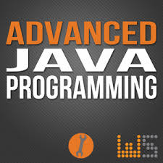
AP101: Advanced Computer Programming
Babak Alipour
Kiana Mostaghasi
Pantea Habibi
Parham Alvani
Amirkabir University of Technology (Tehran Polytechnic)
Chapter 11 : Exception handling
May, 2015

Slide 2
What are exceptions
An exception is an event that occurs during the execution of a program that disrupts the normal flow of instructions.
The Java programming language uses exceptions to handle errors and other exceptional events.

Slide 3
Types of Programming Errors
Compile Errors
Logical Errors
Resource Errors
Exceptions
Runtime Errors
Syntax Errors
Compiler Version Errors

Slide 4
Object
Exception
Throwable
Error
Error and its subclasses represent abnormal situations that happen in the JVM.
Most Errors happen infrequently and should not be caught by applications—it’s usually not possible for applications to recover from Errors

Slide 5
The Causes of Exceptions
JVM Exceptions:
Exclusively or logically thrown by JVM
NullPointerException
ArrayIndexOutOfBoundsException
ClassCastException
Programmatic Exceptions
Thrown by the application or the API programmers
IllegalArgumentException
IllegalStateException

Slide 6
try {
// block of code to monitor for errors } catch(ExceptionType1 e1) {
// exception handler for EcxeptionType1
} catch(ExceptionType2 e2) {
// exception handler for ExceptionType2
} finally {
// follows the try block
}
Java exception handling is managed by using 5 keywords:
Try
Catch
Throw
Throws
finally

Slide 7
try
The first step in constructing an exception handler is to enclose the code that might throw an exception within a try block.
A try block looks like the following:
try {
code
} catch and finally blocks . . .
If an exception occurs within the try block, that exception is handled by an exception handler associated with it.
To associate an exception handler with a try block, you must put a catch block after it.

Slide 8
catch
You associate exception handlers with a try block by providing one or more catch blocks directly after the try block.
No code can be between the end of the try block and the beginning of the first catch block.
try {
} catch (ExceptionType name) {
} catch (ExceptionType name) {
}
Each catch block is an exception handler and handles the type of exception indicated by its argument. ExceptionType must be the name of a class that inherits from the Throwable class.
The handler can refer to the exception with name.

Slide 9
catch (cont’d)
The catch block contains code that is executed if and when the exception handler is invoked.
The runtime system invokes the exception handler when the handler is the first one in the call stack whose ExceptionType matches the type of the exception thrown.
The system considers it a match if the thrown object can legally be assigned to the exception handler's argument.

Slide 10
throw
Before you can catch an exception, some code somewhere must throw one.
Any code can throw an exception: your code, code from a package written by someone else such as the packages that come with the Java platform, or the Java runtime environment.
Regardless of what throws the exception, it's always thrown with the throw statement. All methods use the throw statement to throw an exception.
The throw statement requires a single argument: a throwable object.
Throwable objects are instances of any subclass of the Throwable class.
Here's an example of a throw statement: throw someThrowableObject;

Slide 11
throws
throws is a Java keyword. It is used in a method definition to declare the Exceptions to be thrown by the method.
Syntax:
public myMethod() throws MyException1, MyException2 {
...
}
You only need to declare an exception in throws when the exception is a checked exception [meaning it is from the other side of the Exception class hierarchy from RuntimeException.]
Common checked exceptions are IOException and SQLException. Checked exceptions must be listed in the throws part of the method signature if you don't handle them yourself.
Anything subclassing RuntimeException and like NullPointerException is an unchecked exception and doesn't have to be caught or thrown or anything.

Slide 12
Throw or Throws
class MyDefinedException extends Exception {
public MyDefinedException(String str) {
super(str);
}
}
public class myClass {
public static void showMyName(String str) throws MyDefinedException {
if (str.equals("What is your name ?"))
throw new MyDefinedException("My name is Parham Alvani");
}
public static void main(String args[]) {
try {
showMyName("What is your name ?");
} catch(MyDefinedException exp) {
exp.printStackTrace();
}
}
}

Slide 13
finally
The finally block always executes when the try block exits. This ensures that the finally block is executed even if an unexpected exception occurs.
finally is useful for more than just exception handling. It allows the programmer to avoid having cleanup code accidentally bypassed by a return, continue, or break. Putting cleanup code in a finally block is always a good practice, even when no exceptions are anticipated.
Note: If the JVM exits while the try or catch code is being executed, then the finally block may not execute. Likewise, if the thread executing the try or catch code is interrupted or killed, the finally block may not execute even though the application as a whole continues.
Important: The finally block is a key tool for preventing resource leaks. When closing a file or otherwise recovering resources, place the code in a finally block to ensure that resource is always recovered.

Slide 14
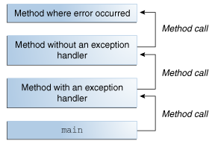
Call Stack
After a method throws an exception, the runtime system attempts to find something to handle it.
There is a list of methods that had been called to get to the method where the error occurred. The list of methods is known as the call stack

Slide 15
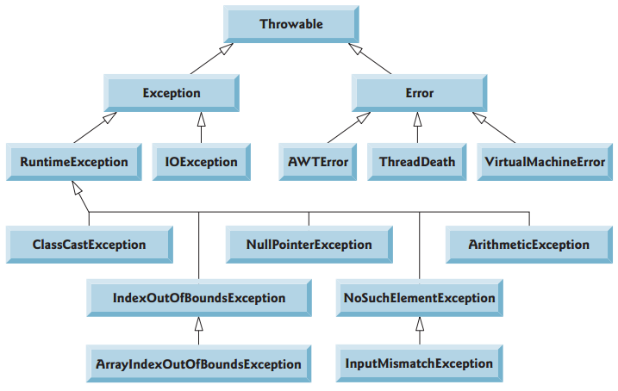
Java Exception Hierarchy
All Java exception classes inherit directly or indirectly from class Exception, forming an inheritance hierarchy. You can extend this hierarchy with your own exception classes.
A small portion of the inheritance hierarchy for class Throwable (a subclass of Object ), which is the superclass of class Exception.

Slide 16

Questions?

