Slide 1


AP101: Advanced Computer Programming
Networking
25 May, 2015

Slide 2
Network. Host. Internet
A network is a hardware and software data communication system that provides interconnection of computers and other devices.
A node (host) is an addressable device (computer) attached to a computer network.
An internet is a set of networks connected with routers.
The Internet is the largest internet that includes commercial, military, university and other networks with different physical links and various protocols including IP (Internet Protocol)

Slide 3
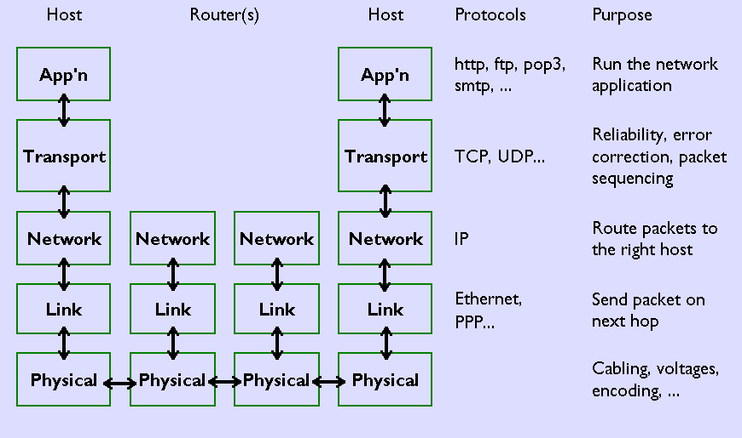
TCP/IP Protocol Stack

Slide 4
Transport Protocols: TCP
TCP (Transmission Control Protocol) is a reliable connection-oriented stream-based transport protocol.
Phases of TCP communication:
Establish a connection (open a TCP session)
Transfer data over the connection
Release the connection

Slide 5
Transport Protocols: UDP
UDP, the User Datagram Protocol
For pure message passing (datagram send/receive).
Neither guarantees delivery nor requires a connection.
Connectionless:
UDP datagrams are sent between two hosts with no previous setup.
The datagrams contain the destination address, may take different routes.
Lightweight and efficient. Low overhead compare to TCP
Phases of UDP communication:
Sending: create a UDP socket; create a datagram with the message and specified destination (IP address & port); send the datagram over the UDP socket.
Receiving: receive a datagram from the UDP socket; get data and source from the datagram

Slide 6
Addressing a Node on the Internet. IP Address
An Internet address (IP address) of a node on the Internet is a four-byte (32-bit) unsigned integer number (IPv4).
Dot decimal notation: four unsigned integers, each ranging from 0 to 255, separated by periods.
127.0.0.1 - the local loopback interface, localhost

Slide 7
Host Names
A hostname is a unique name of a computer on the Internet. It consists of a local name and a domain name.

Slide 8
Sockets
Socket is an end-point of a virtual network connection between processes – much like a full-duplex channel
A socket address: IP address and a port number
A socket type: distinguished by the transport protocol used for communication over the socket
• TCP socket - stream-based, connection-oriented
• UDP socket - datagram-based, connectionless

Slide 9
Sockets
There are four fundamental operations a socket performs. These are:
Connect to a remote machine
Send data
Receive data
Close the connection
A socket may not be connected to more than one host at a time.
A socket may not reconnect after it's closed.

Slide 10
Socket Options
Several methods set various socket options. Most of the time the defaults are fine.
public void setTcpNoDelay(boolean on) throws SocketException
public boolean getTcpNoDelay() throws SocketException
public void setSoLinger(boolean on, int val) throws SocketException
public int getSoLinger() throws SocketException
public void setSoTimeout(int timeout) throws SocketException
public int getSoTimeout() throws SocketException

Slide 11
SO_LINGER
When enabled, a close() or shutdown() will not return until all queued messages for the socket have been successfully sent or the linger timeout has been reached. Otherwise, the call returns immediately and the closing is done in the background. When the socket is closed as part of exit(), it always lingers in the background.

Slide 12
TCP_NODELAY
TCP_NODELAY is an option to enable quick sending of TCP packets, regardless of their size. This is very useful option when speed matters

Slide 13
Ports
Port is an entry point to a process that resides on a host.
65,535 logical ports with integer numbers 1 - 65,535
Ports with numbers 1-1023 are reserved for well-known services.

Slide 14
Sending and Receiving Data
Data is sent and received with output and input streams.
There are methods to get an input stream for a socket and an output stream for the socket.
public InputStream getInputStream() throws IOException
public OutputStream getOutputStream() throws IOException
There's also a method to close a socket:
public synchronized void close() throws IOException

Slide 15
Constructing a Socket
Connection is accomplished through the constructors.
public Socket(String host, int port) throws UnknownHostException, IOException
public Socket(InetAddress address, int port) throws IOException
public Socket(String host, int port, InetAddress localAddr, int localPort) throws IOException
public Socket(InetAddress address, int port, InetAddress localAddr, int localPort) throws IOException

