Slide 1

Internet of Things
IoT Communication Technologies
Mehdi Rasti
Amirkabir University of Technology
spring 2020

Slide 2
Contents
IoT Protocol Stack
Physical and Link Layers Protocols
Communication Technologies
Communication Models
Communication Technologies Criteria
IP as the IoT Network Layer
Transport Layer
Application Layer Protocols
Mostly adopted from IoT Fundamentals: Networking Technologies, Protocols, and Use Cases for the Internet of Thing, Cisco press, 2017

Slide 3
Contents
IoT Protocol Stack
Physical and Link Layers Protocols
Communication Technologies
Communication Models
Communication Technologies Criteria
IP as the IoT Network Layer
Transport Layer
Application Layer Protocols

Slide 4
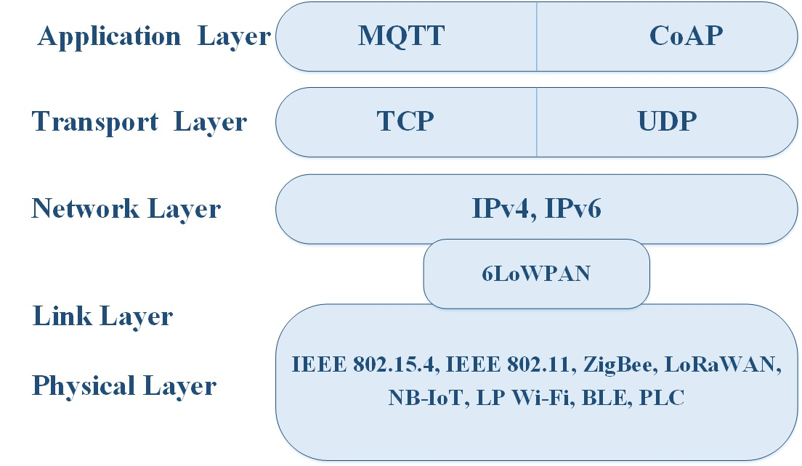
IoT Protocol Stack

Slide 5
Contents
IoT Protocol Stack
Physical and Link Layers Protocols
Communication Technologies
Communication Models
Communication Technologies Criteria
IP as the IoT Network Layer
Transport Layer
Application Layer Protocols

Slide 6
IoT Protocol Stack- Physical and Link Layers Protocols
Physical and Link Layers Protocols
IEEE 802.15.4
IEEE 802.11
ZigBee
LoRaWAN
NB-IoT
low-power Wi-Fi
Bluetooth Low Energy (BLE)
power line communications (PLC)
* Internet of Things Architectures, Protocols and Standards, Wiley press, 2019
* IoT Fundamentals: Networking Technologies, Protocols, and Use Cases for the Internet of Thing, Cisco press, 2017

Slide 7
Physical and Link Layers Protocols- IEEE 802.15.4
IEEE 802.15.4 is a wireless access technology for low-cost and low-data-rate devices powered or run on batteries.
IEEE 802.15.4 is commonly found in the following types of deployments:
Home and building automation
Automotive networks
Industrial wireless sensor networks
Interactive toys and remote controls
* IoT Fundamentals: Networking Technologies, Protocols, and Use Cases for the Internet of Thing, Cisco press, 2017
Notes:
IEEE 802.15.4
IEEE 802.15.4 is a wireless access technology for low-cost and low-data-rate devices that are powered or run on batteries. In addition to being low cost and offering a reasonable battery life, this access technology enables easy installation using a compact protocol stack while remaining both simple and flexible. Several network communication stacks, including deterministic ones, and profiles leverage this technology to address a wide range of IoT use cases
in both the consumer and business markets.
IEEE 802.15.4 is commonly found in the following types of deployments:
Home and building automation
Automotive networks
Industrial wireless sensor networks
Interactive toys and remote controls
Criticisms of IEEE 802.15.4 often focus on its MAC reliability, unbounded latency, and susceptibility to interference and multipath fading. The negatives around reliability and latency often have to do with the Collision Sense Multiple Access/Collision Avoidance (CSMA/CA) algorithm. CSMA/CA is an access method in which a device “listens” to make sure no other devices are transmitting before starting its own transmission. If another device is transmitting, a wait time (which is usually random) occurs before “listening” occurs again. Interference and multipath fading occur with IEEE 802.15.4 because it lacks a frequency-hopping technique. Later variants of 802.15.4 from the IEEE start to address these issues. (See the section “IEEE 802.15.4e and 802.15.4g,” later in this chapter, for more information.)

Slide 8
Physical and Link Layers Protocols- IEEE 802.15.4
IEEE 802.15.4 Drawbacks:
MAC reliability,
unbounded latency, and
susceptibility to interference and multipath fading
Protocol Stacks Utilizing IEEE 802.15.4
ZigBee
ZigBee IP
6LoWPAN
* IoT Fundamentals: Networking Technologies, Protocols, and Use Cases for the Internet of Thing, Cisco press, 2017
Notes:
IEEE 802.15.4
IEEE 802.15.4 is a wireless access technology for low-cost and low-data-rate devices that are powered or run on batteries. In addition to being low cost and offering a reasonable battery life, this access technology enables easy installation using a compact protocol stack while remaining both simple and flexible. Several network communication stacks, including deterministic ones, and profiles leverage this technology to address a wide range of IoT use cases
in both the consumer and business markets.
IEEE 802.15.4 is commonly found in the following types of deployments:
Home and building automation
Automotive networks
Industrial wireless sensor networks
Interactive toys and remote controls
Criticisms of IEEE 802.15.4 often focus on its MAC reliability, unbounded latency, and susceptibility to interference and multipath fading. The negatives around reliability and latency often have to do with the Collision Sense Multiple Access/Collision Avoidance (CSMA/CA) algorithm. CSMA/CA is an access method in which a device “listens” to make sure no other devices are transmitting before starting its own transmission. If another device is transmitting, a wait time (which is usually random) occurs before “listening” occurs again. Interference and multipath fading occur with IEEE 802.15.4 because it lacks a frequency-hopping technique. Later variants of 802.15.4 from the IEEE start to address these issues. (See the section “IEEE 802.15.4e and 802.15.4g,” later in this chapter, for more information.)

Slide 9
Physical and Link Layers Protocols- IEEE 802.15.4
IEEE 802.15.4- Physical layer
The 802.15.4 standard supports an extensive number of PHY options that range from 2.4 GHz to sub-GHz frequencies in ISM bands.
The original physical layer transmission options were as follows:
2.4 GHz, 16 channels, with a data rate of 250 kbps
915 MHz, 10 channels, with a data rate of 40 kbps
868 MHz, 1 channel, with a data rate of 20 kbps
only the 2.4 GHz band operates worldwide.
The 915 MHz band operates mainly in North and South America, and the 868 MHz frequencies are used in Europe, the Middle East, and Africa.
* IoT Fundamentals: Networking Technologies, Protocols, and Use Cases for the Internet of Thing, Cisco press, 2017
Notes:
The 802.15.4 standard supports an extensive number of PHY options that range from 2.4 GHz to sub-GHz frequencies in ISM bands.
The original IEEE 802.15.4-2003 standard specified only three PHY options based on direct sequence spread spectrum (DSSS) modulation. DSSS is a modulation technique in which a signal is intentionally spread in the frequency domain, resulting in greater bandwidth.
The original physical layer transmission options were as follows:
2.4 GHz, 16 channels, with a data rate of 250 kbps
915 MHz, 10 channels, with a data rate of 40 kbps
868 MHz, 1 channel, with a data rate of 20 kbps
You should note that only the 2.4 GHz band operates worldwide. The 915 MHz band operates mainly in North and South America, and the 868 MHz frequencies are used in Europe, the Middle East, and Africa.

Slide 10
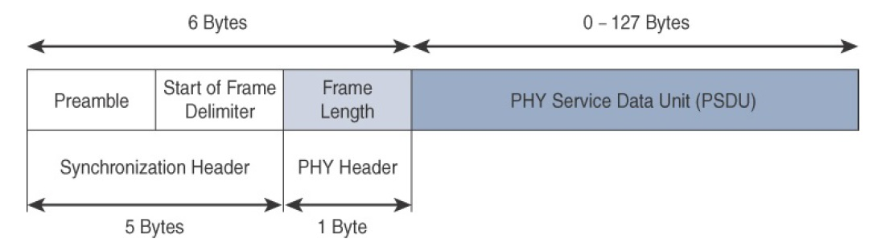
Physical and Link Layers Protocols- IEEE 802.15.4
IEEE 802.15.4
IEEE 802.15.4 PHY layer frame format
* IoT Fundamentals: Networking Technologies, Protocols, and Use Cases for the Internet of Thing, Cisco press, 2017
Notes:
The synchronization header for this frame is composed of the Preamble and the Start of Frame Delimiter fields. The Preamble field is a 32-bit 4-byte (for parallel construction) pattern that identifies the start of the frame and is used to synchronize the data transmission. The Start of Frame Delimiter field informs the receiver that frame contents start immediately after this byte.
The PHY Header portion of the PHY frame is simply a frame length value. It lets the receiver know how much total data to expect in the PHY service data unit (PSDU) portion of the 802.4.15 PHY. The PSDU is the data field or payload.

Slide 11
Physical and Link Layers Protocols- IEEE 802.15.4
IEEE 802.15.4- MAC layer
manages access to the PHY channel by defining how devices in the same area will share the frequencies
the scheduling and routing of data frames are also coordinated.
The 802.15.4 MAC layer performs the following tasks:
Network beaconing for devices acting as coordinators
PAN association and disassociation by a device
Device security
Reliable link communications between two peer MAC entities
* IoT Fundamentals: Networking Technologies, Protocols, and Use Cases for the Internet of Thing, Cisco press, 2017
Notes:
The IEEE 802.15.4 MAC layer manages access to the PHY channel by defining how devices in the same area will share the frequencies allocated. At this layer, the scheduling and routing of data frames are also coordinated. The 802.15.4 MAC layer performs the following tasks:
Network beaconing for devices acting as coordinators (New devices use beacons to join an 802.15.4 network)
PAN association and disassociation by a device
Device security
Reliable link communications between two peer MAC entities
The MAC layer achieves these tasks by using various predefined frame types. In fact, four types of MAC frames are specified in 802.15.4:
Data frame: Handles all transfers of data
Beacon frame: Used in the transmission of beacons from a PAN coordinator
Acknowledgement frame: Confirms the successful reception of a frame
MAC command frame: Responsible for control communication between devices

Slide 12
Physical and Link Layers Protocols- IEEE 802.15.4
IEEE 802.15.4- MAC layer
The MAC layer achieves these tasks by using various predefined frame types:
Data frame
Beacon frame
Acknowledgement frame
MAC command frame
* IoT Fundamentals: Networking Technologies, Protocols, and Use Cases for the Internet of Thing, Cisco press, 2017
Notes:
The IEEE 802.15.4 MAC layer manages access to the PHY channel by defining how devices in the same area will share the frequencies allocated. At this layer, the scheduling and routing of data frames are also coordinated. The 802.15.4 MAC layer performs the following tasks:
Network beaconing for devices acting as coordinators (New devices use beacons to join an 802.15.4 network)
PAN association and disassociation by a device
Device security
Reliable link communications between two peer MAC entities
The MAC layer achieves these tasks by using various predefined frame types. In fact, four types of MAC frames are specified in 802.15.4:
Data frame: Handles all transfers of data
Beacon frame: Used in the transmission of beacons from a PAN coordinator
Acknowledgement frame: Confirms the successful reception of a frame
MAC command frame: Responsible for control communication between devices

Slide 13
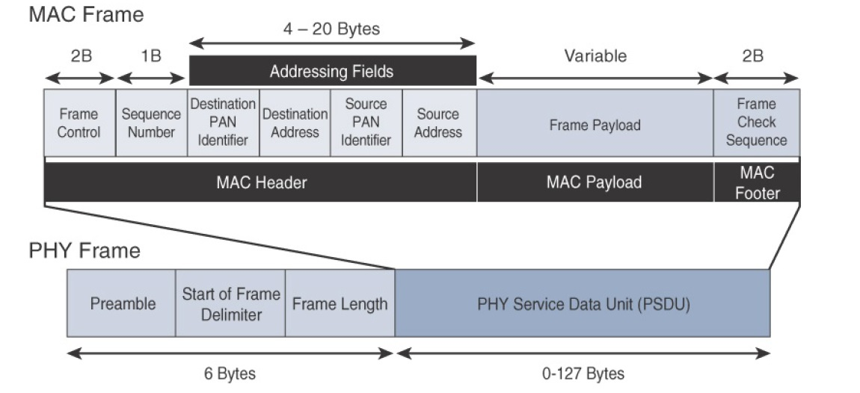
Physical and Link Layers Protocols- IEEE 802.15.4
IEEE 802.15.4
IEEE 802.15.4 MAC layer frame format
* IoT Fundamentals: Networking Technologies, Protocols, and Use Cases for the Internet of Thing, Cisco press, 2017
Notes:
The MAC Header field is composed of the Frame Control, Sequence Number and the Addressing fields. The Frame Control field defines attributes such as frame type, addressing modes, and other control flags. The Sequence Number field indicates the sequence identifier for the frame. The Addressing field specifies the Source and Destination PAN Identifier fields as well as the Source and Destination Address fields.
The MAC Payload field varies by individual frame type. For example, beacon frames have specific fields and payloads related to beacons, while MAC command frames have different fields present. The MAC Footer field is nothing more than a frame check sequence (FCS). An FCS is a calculation based on the data in the frame that is used by the receiving side to confirm the integrity of the data in the frame.
IEEE 802.15.4 requires all devices to support a unique 64-bit extended MAC address, based on EUI-64. However, because the maximum payload is 127 bytes, 802.15.4 also defines how a 16-bit “short address” is assigned to devices. This short address is local to the PAN and substantially reduces the frame overhead compared to a 64-bit extended MAC address. However, you should be aware that the use of this short address might be limited to specific upper-layer protocol stacks.

Slide 14
Physical and Link Layers Protocols- IEEE 802.15.4
IEEE 802.15.4
Topology
Star
Peer-to-Peer
Mesh
* IoT Fundamentals: Networking Technologies, Protocols, and Use Cases for the Internet of Thing, Cisco press, 2017
Notes:
IEEE 802.15.4–based networks can be built as star, peer-to-peer, or mesh topologies. Mesh networks tie together many nodes. This allows nodes that would be out of range if trying to communicate directly to leverage intermediary nodes to transfer communications. Please note that every 802.15.4 PAN should be set up with a unique ID. All the nodes in the same 802.15.4 network should use the same PAN ID.

Slide 15
Physical and Link Layers Protocols- IEEE 802.15.4e/g
IEEE 802.15.4e
IEEE 802.15.4e as an amendment of 802.15.4-2011 expands the MAC layer features including reliability, unbounded latency, and multipath fading.
IEEE 802.15.4e also made improvements to better cope with certain application domains, such as factory and process.
* IoT Fundamentals: Networking Technologies, Protocols, and Use Cases for the Internet of Thing, Cisco press, 2017
Notes:
The IEEE 802.15.4e amendment of 802.15.4-2011 expands the MAC layer feature set to remedy the disadvantages associated with 802.15.4, including MAC reliability, unbounded latency, and multipath fading. In addition to making general enhancements to the MAC layer, IEEE 802.15.4e also made improvements to better cope with certain application domains, such as factory and process automation and smart grid.
Smart grid is associated with the modernization of the power grid and utilities infrastructure by connecting intelligent devices and communications. IEEE 802.15.4e-2012 enhanced the IEEE 802.15.4 MAC layer capabilities in the areas of frame format, security, determinism mechanism, and frequency hopping.
IEEE 802.15.4g-2012 is also an amendment to the IEEE 802.15.4-2011 standard, and just like 802.15.4e-2012, it has been fully integrated into the core IEEE 802.15.4-2015 specification. The focus of this specification is the smart grid or, more specifically, smart utility network communication.
802.15.4g seeks to optimize large outdoor wireless mesh networks for field area networks (FANs). New PHY definitions are introduced, as well as some MAC modifications needed to support their implementation.
This technology applies to IoT use cases such as the following:
Distribution automation and industrial supervisory control and data acquisition (SCADA) environments for remote monitoring and control
Public lighting
Environmental wireless sensors in smart cities
Electrical vehicle charging stations
Smart parking meters
Micro grids
Renewable energy

Slide 16
Physical and Link Layers Protocols- IEEE 802.15.4e/g
The focus of IEEE 802.15.4g-2012 as an amendment to the IEEE 802.15.4-2011 is the smart grid or, more specifically, smart utility network communication.
This technology applies to IoT use cases such as the following:
Distribution automation and industrial supervisory control and data acquisition (SCADA) environments for remote monitoring and control
Public lighting
Environmental wireless sensors in smart cities
Electrical vehicle charging stations
Smart parking meters
Micro grids
Renewable energy
* IoT Fundamentals: Networking Technologies, Protocols, and Use Cases for the Internet of Thing, Cisco press, 2017
Notes:
The IEEE 802.15.4e amendment of 802.15.4-2011 expands the MAC layer feature set to remedy the disadvantages associated with 802.15.4, including MAC reliability, unbounded latency, and multipath fading. In addition to making general enhancements to the MAC layer, IEEE 802.15.4e also made improvements to better cope with certain application domains, such as factory and process automation and smart grid.
Smart grid is associated with the modernization of the power grid and utilities infrastructure by connecting intelligent devices and communications. IEEE 802.15.4e-2012 enhanced the IEEE 802.15.4 MAC layer capabilities in the areas of frame format, security, determinism mechanism, and frequency hopping.
IEEE 802.15.4g-2012 is also an amendment to the IEEE 802.15.4-2011 standard, and just like 802.15.4e-2012, it has been fully integrated into the core IEEE 802.15.4-2015 specification. The focus of this specification is the smart grid or, more specifically, smart utility network communication.
802.15.4g seeks to optimize large outdoor wireless mesh networks for field area networks (FANs). New PHY definitions are introduced, as well as some MAC modifications needed to support their implementation.
This technology applies to IoT use cases such as the following:
Distribution automation and industrial supervisory control and data acquisition (SCADA) environments for remote monitoring and control
Public lighting
Environmental wireless sensors in smart cities
Electrical vehicle charging stations
Smart parking meters
Micro grids
Renewable energy

Slide 17
Physical and Link Layers Protocols- IEEE 802.15.4e/g
IEEE 802.15.4e and 802.15.4g- Physical layer
In IEEE 802.15.4g-2012, the original IEEE 802.15.4 maximum payload size of 127 bytes was increased to 2047 bytes.
Fragmentation is no longer necessary at Layer 2 when IPv6 packets are transmitted over IEEE 802.15.4g MAC frames.
The error protection was improved in IEEE 802.15.4g by evolving the CRC from 16 to 32 bits.
* IoT Fundamentals: Networking Technologies, Protocols, and Use Cases for the Internet of Thing, Cisco press, 2017
Notes:
In IEEE 802.15.4g-2012, the original IEEE 802.15.4 maximum PSDU or payload size of 127 bytes was increased for the SUN (smart utility network) PHY to 2047 bytes. This provides a better match for the greater packet sizes found in many upper-layer protocols. For example, the default IPv6 MTU setting is 1280 bytes.
Fragmentation is no longer necessary at Layer 2 when IPv6 packets are transmitted over IEEE 802.15.4g MAC frames. Also, the error protection was
improved in IEEE 802.15.4g by evolving the CRC from 16 to 32 bits.
The SUN PHY, as described in IEEE 802.15.4g-2012, supports multiple data rates in bands ranging from 169 MHz to 2.4 GHz. These bands are covered in the unlicensed ISM frequency spectrum specified by various countries and regions. Within these bands, data must be modulated onto the frequency using at least one of the following PHY mechanisms to be IEEE 802.15.4g compliant:
Multi-Rate and Multi-Regional Frequency Shift Keying (MRFSK): Offers good transmit power efficiency due to the constant envelope of the transmit signal
Multi-Rate and Multi-Regional Orthogonal Frequency Division Multiplexing (MR-OFDM): Provides higher data rates but may be too complex for low-cost and low-power devices
Multi-Rate and Multi-Regional Offset Quadrature Phase-Shift Keying (MR-O-QPSK): Shares the same characteristics of the IEEE 802.15.4-2006 O-QPSK PHY, making multi-mode systems more cost effective and easier to design
Enhanced data rates and a greater number of channels for channel hopping are available, depending on the frequency bands and modulation. For example, for the 902–928 MHz ISM band that is used in the United States, MR-FSK provides 50, 150, or 200 kbps. MR-OFDM at this same frequency allows up to 800 kbps. Other frequencies provide their own settings.
Therefore, products and solutions must refer to the proper IEEE 802.15.4 specification, frequency band, modulation, and data rate when providing details about their PHY implementation. This is important because the availability of chipsets supporting new PHY mechanisms, such as MROFDM, may limit the implementation of enhanced data rates. You should look to the Wi-SUN Alliance to mitigate these problems and provide some consistency in terms of implementation, interoperability, and certifications.
For example, the Wi-SUN PHY working group publishes a Regional Frequency Bands specification describing the details for various regions and countries.

Slide 18
Physical and Link Layers Protocols- IEEE 802.15.4e/g
IEEE 802.15.4e and 802.15.4g- MAC layer
IEEE 802.15.4g/e MAC Frame Format
The main difference between 802.15.4 and 802.15.4g frame format is the payload size, with 802.15.4g supporting up to 2047 bytes and 802.15.4 supporting only 127 bytes.
The other difference is the presence of the Auxiliary Security Header and Information Elements (IE) field.
The Auxiliary Security header provides for the encryption of the data frame.
the IE field contains one or more information elements that allow for additional information to be exchanged at the MAC layer.
* IoT Fundamentals: Networking Technologies, Protocols, and Use Cases for the Internet of Thing, Cisco press, 2017

Slide 19
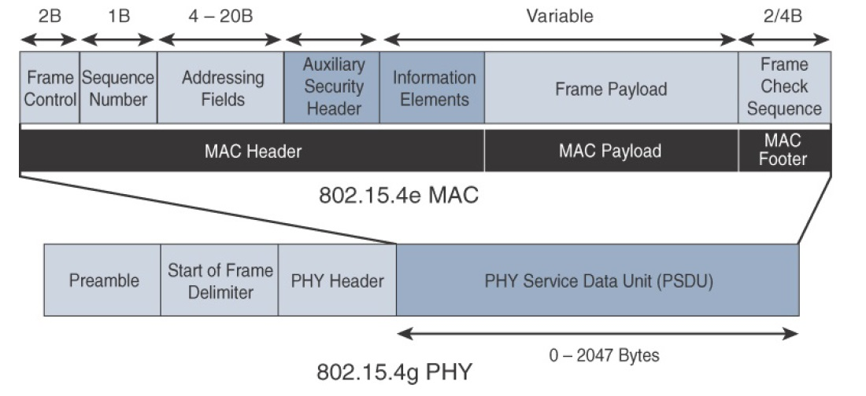
Physical and Link Layers Protocols- IEEE 802.15.4e/g
IEEE 802.15.4e and 802.15.4g- MAC layer
IEEE 802.15.4g/e MAC Frame Format
* IoT Fundamentals: Networking Technologies, Protocols, and Use Cases for the Internet of Thing, Cisco press, 2017

Slide 20
Physical and Link Layers Protocols- IEEE 802.15.4e/g
IEEE 802.15.4e and 802.15.4g
Topology
Mesh
* IoT Fundamentals: Networking Technologies, Protocols, and Use Cases for the Internet of Thing, Cisco press, 2017
Notes:
Deployments of IEEE 802.15.4g-2012 are mostly based on a mesh topology. This is because a mesh topology is typically the best choice for use cases in the industrial and smart cities areas where 802.15.4g-2012 is applied. A mesh topology allows deployments to be done in urban or rural areas, expanding the distance between nodes that can relay the traffic of other nodes.
Considering the use cases addressed by this technology, powered nodes have been the primary targets of implementations. Support for battery-powered nodes with a long lifecycle requires optimized Layer 2 forwarding or Layer 3 routing protocol implementations. This provides an extra level of complexity but is necessary in order to cope with sleeping battery-powered nodes.

Slide 21
Physical and Link Layers Protocols- IEEE 802.11ah
In unconstrained networks, IEEE 802.11 is a key IoT wireless access technology, either for connecting or for deploying Wi-Fi backhaul infrastructures, such as outdoor Wi-Fi mesh in smart cities, oil and mining, or other environments.
Three main use cases are identified for IEEE 802.11ah:
Sensors and meters covering a smart grid
Backhaul aggregation of industrial sensors and meter data
Extended range Wi-Fi
* IoT Fundamentals: Networking Technologies, Protocols, and Use Cases for the Internet of Thing, Cisco press, 2017
Notes:
In unconstrained networks, IEEE 802.11 Wi-Fi is certainly the most successfully deployed wireless technology. This standard is a key IoT wireless access technology, either for connecting endpoints such as fog computing nodes, high-data-rate sensors, and audio or video analytics devices or for deploying Wi-Fi backhaul infrastructures, such as outdoor Wi-Fi mesh in smart cities, oil and mining, or other environments. However, Wi-Fi lacks sub-GHz support for better signal penetration, low power for battery-powered nodes, and the ability to support a large number of devices. For these reasons, the IEEE 802.11 working group launched a task group named IEEE 802.11ah
to specify a sub-GHz version of Wi-Fi. Three main use cases are identified for IEEE 802.11ah:
Sensors and meters covering a smart grid: Meter to pole, environmental/agricultural monitoring, industrial process sensors, indoor healthcare system and fitness sensors, home and building automation sensors
Backhaul aggregation of industrial sensors and meter data: Potentially connecting IEEE 802.15.4g subnetworks
Extended range Wi-Fi: For outdoor extended-range hotspot or cellular traffic offloading when distances already covered by IEEE 802.11a/b/g/n/ac are not good enough

Slide 22
Physical and Link Layers Protocols- IEEE 802.11ah
IEEE 802.11ah- Physical layer
IEEE 802.11ah essentially provides an additional 802.11 physical layer operating in unlicensed sub-GHz bands.
Based on OFDM modulation, IEEE 802.11ah uses channels of 2, 4, 8, or 16 MHz (and also 1 MHz for low-bandwidth transmission). This results in low speed data.
802.11ah does provide an extended range for its lower speed data.
* IoT Fundamentals: Networking Technologies, Protocols, and Use Cases for the Internet of Thing, Cisco press, 2017
Notes:
Physical Layer
IEEE 802.11ah essentially provides an additional 802.11 physical layer operating in unlicensed sub-GHz bands. For example, various countries and regions use the following bands for IEEE 802.11ah: 868–868.6 MHz for EMEAR, 902–928 MHz and associated subsets for North America and Asia-Pacific regions, and 314–316 MHz, 430–434 MHz, 470–510 MHz, and 779–787 MHz for China.
Based on OFDM modulation, IEEE 802.11ah uses channels of 2, 4, 8, or 16 MHz (and also 1 MHz for low-bandwidth transmission). This is one-tenth of the IEEE 802.11ac channels, resulting in one-tenth of the corresponding data rates of IEEE 802.11ac. The IEEE 802.11ac standard is a high-speed wireless LAN protocol at the 5 GHz band that is capable of speeds up to 1 Gbps.
While 802.11ah does not approach this transmission speed (as it uses one tenth of 802.11ac channel width, it reaches one-tenth of 802.11ac speed), it does provide an extended range for its lower speed data. For example, at a data rate of 100 kbps, the outdoor transmission range for IEEE 802.11ah is expected to be 0.62 mile.

Slide 23
Physical and Link Layers Protocols- IEEE 802.11ah
IEEE 802.11ah- MAC layer
The 802.11ah MAC layer is focused on
power consumption and mechanisms to allow low-power Wi-Fi stations to wake up less often and operate more efficiently.
providing low power consumption and the ability to support a larger number of endpoints.
This sort of MAC layer is ideal for IoT devices that often produce short, low-bit-rate transmissions.
* IoT Fundamentals: Networking Technologies, Protocols, and Use Cases for the Internet of Thing, Cisco press, 2017
Notes:
MAC Layer
The IEEE 802.11ah MAC layer is optimized to support the new sub-GHz Wi-Fi PHY while providing low power consumption and the ability to support a larger number of endpoints. Enhancements and features specified by IEEE 802.11ah for the MAC layer include the following:
Number of devices: Has been scaled up to 8192 per access point.
MAC header: Has been shortened to allow more efficient communication.
Null data packet (NDP) support: Is extended to cover several control and management frames. Relevant information is concentrated in the PHY header and the additional overhead associated with decoding the MAC header and data payload is avoided. This change makes the control frame exchanges efficient and less power-consuming for the receiving stations.
Grouping and sectorization: Enables an AP to use sector antennas and also group stations (distributing a group ID). In combination with RAW and TWT, this mechanism reduces contention in large cells with many clients by restricting which group, in which sector, can contend during which time window.
Restricted access window (RAW): Is a control algorithm that avoids simultaneous transmissions when many devices are present and provides fair access to the wireless network. By providing more efficient access to the medium, additional power savings for battery powered devices can be achieved, and collisions are reduced.
Target wake time (TWT): Reduces energy consumption by permitting an access point to define times when a device can access the network. This allows devices to enter a low-power state until their TWT time arrives. It also reduces the probability of collisions in large cells with many clients.
Speed frame exchange: Enables an AP and endpoint to exchange frames during a reserved transmit opportunity (TXOP). This reduces contention on the medium, minimizes the number of frame exchanges to improve channel efficiency, and extends battery life by keeping awake times short.
You can see from this feature list that the 802.11ah MAC layer is focused on power consumption and mechanisms to allow low-power Wi-Fi stations to wake up less often and operate more efficiently. This sort of MAC layer is ideal for IoT devices that often produce short, low-bit-rate transmissions.

Slide 24
Physical and Link Layers Protocols- IEEE 802.11ah
IEEE 802.11ah- MAC layer
Enhancements and features specified by IEEE 802.11ah for the MAC layer include the following:
Number of devices
MAC header
Null data packet (NDP) support
Grouping and sectorization
Restricted access window (RAW)
Target wake time (TWT)
Speed frame exchange
* IoT Fundamentals: Networking Technologies, Protocols, and Use Cases for the Internet of Thing, Cisco press, 2017
Notes:
MAC Layer
The IEEE 802.11ah MAC layer is optimized to support the new sub-GHz Wi-Fi PHY while providing low power consumption and the ability to support a larger number of endpoints. Enhancements and features specified by IEEE 802.11ah for the MAC layer include the following:
Number of devices: Has been scaled up to 8192 per access point.
MAC header: Has been shortened to allow more efficient communication.
Null data packet (NDP) support: Is extended to cover several control and management frames. Relevant information is concentrated in the PHY header and the additional overhead associated with decoding the MAC header and data payload is avoided. This change makes the control frame exchanges efficient and less power-consuming for the receiving stations.
Grouping and sectorization: Enables an AP to use sector antennas and also group stations (distributing a group ID). In combination with RAW and TWT, this mechanism reduces contention in large cells with many clients by restricting which group, in which sector, can contend during which time window.
Restricted access window (RAW): Is a control algorithm that avoids simultaneous transmissions when many devices are present and provides fair access to the wireless network. By providing more efficient access to the medium, additional power savings for battery powered devices can be achieved, and collisions are reduced.
Target wake time (TWT): Reduces energy consumption by permitting an access point to define times when a device can access the network. This allows devices to enter a low-power state until their TWT time arrives. It also reduces the probability of collisions in large cells with many clients.
Speed frame exchange: Enables an AP and endpoint to exchange frames during a reserved transmit opportunity (TXOP). This reduces contention on the medium, minimizes the number of frame exchanges to improve channel efficiency, and extends battery life by keeping awake times short.
You can see from this feature list that the 802.11ah MAC layer is focused on power consumption and mechanisms to allow low-power Wi-Fi stations to wake up less often and operate more efficiently. This sort of MAC layer is ideal for IoT devices that often produce short, low-bit-rate transmissions.

Slide 25
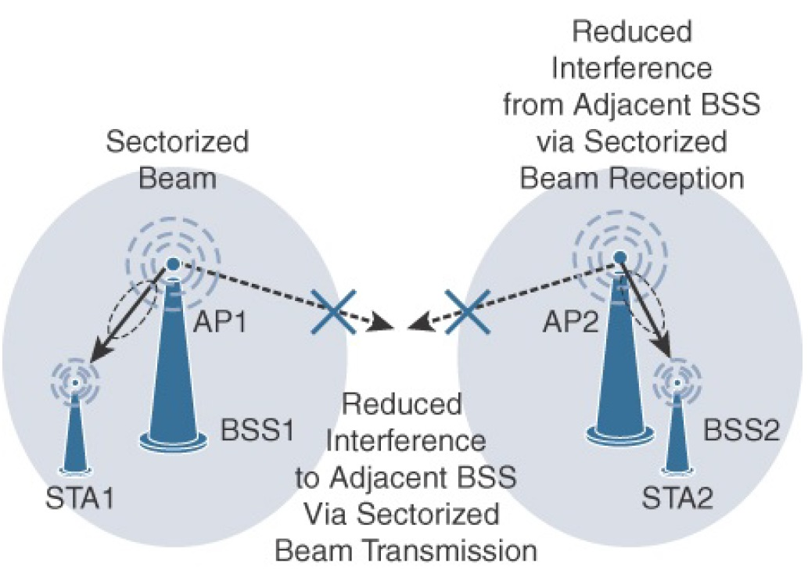
Physical and Link Layers Protocols- IEEE 802.11ah
IEEE 802.11ah
Topology
Star
* IoT Fundamentals: Networking Technologies, Protocols, and Use Cases for the Internet of Thing, Cisco press, 2017
Notes:
While IEEE 802.11ah is deployed as a star topology, it includes a simple hops relay operation to extend its range. This relay option is not capped, but the IEEE 802.11ah task group worked on the assumption of two hops. It allows one 802.11ah device to act as an intermediary and relay data to another. In some ways, this is similar to a mesh, and it is important to note that the clients and not the access point handle the relay function.
This relay operation can be combined with a higher transmission rate or modulation and coding scheme (MCS). This means that a higher transmit rate is used by relay devices talking directly to the access point. The transmit rate reduces as you move further from the access point via relay clients. This ensures an efficient system that limits transmission speeds at the edge of the relays so that communications close to the AP are not negatively affected.
Sectorization is a technique that involves partitioning the coverage area into several sectors to get reduced contention within a certain sector. This technique is useful for limiting collisions in cells that have many clients. This technique is also often necessary when the coverage area of 802.11ah access points is large, and interference from neighboring access points is problematic. Sectorization uses an antenna array and beam-forming techniques to partition the cell-coverage area.

Slide 26
Physical and Link Layers Protocols- ZigBee
ZigBee
ZigBee is aimed at smart objects and sensors that have low bandwidth and low power needs.
Functions for a device
Metering
Temperature
Lighting control
* IoT Fundamentals: Networking Technologies, Protocols, and Use Cases for the Internet of Thing, Cisco press, 2017
Notes:
ZigBee solutions are aimed at smart objects and sensors that have low bandwidth and low power needs. Furthermore, products that are ZigBee compliant and certified by the ZigBee Alliance should interoperate even though different vendors may manufacture them.
The Zigbee specification has undergone several revisions. In the 2006 revision, sets of commands and message types were introduced, and increased in number in the 2007 (called Zigbee pro) iteration, to achieve different functions for a device, such as metering, temperature, or lighting control.
These sets of commands and message types are called clusters. Ultimately, these clusters from different functional domains or libraries form the building blocks of Zigbee application profiles. Vendors implementing pre-defined Zigbee application profiles like Home Automation or Smart Energy can ensure interoperability between their products.
The main areas where ZigBee is the most well-known include automation for commercial, retail, and home applications and smart energy. In the industrial and commercial automation space, ZigBee-based devices can handle various functions, from measuring temperature and humidity to tracking assets. For home automation, ZigBee can control lighting, thermostats, and security functions. ZigBee Smart Energy brings together a variety of interoperable products, such as smart meters, that can monitor and control the use and delivery of utilities, such as electricity and water. These ZigBee products are controlled by the utility provider and can help coordinate usage between homes and businesses and the utility provider itself to provide more efficient operations.

Slide 27
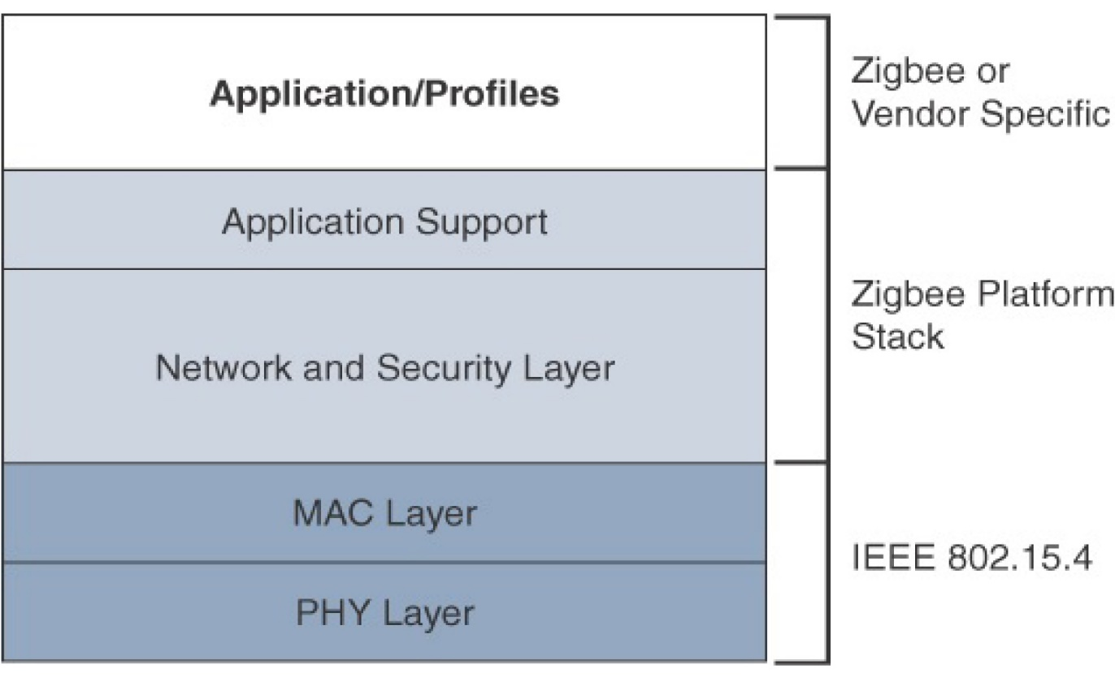
Physical and Link Layers Protocols- ZigBee
ZigBee- Protocol stack
* IoT Fundamentals: Networking Technologies, Protocols, and Use Cases for the Internet of Thing, Cisco press, 2017
Notes:
The ZigBee network and security layer provides mechanisms for network startup, configuration, routing, and securing communications. This includes calculating routing paths in what is often a changing topology, discovering neighbors, and managing the routing tables as devices join for the first time.
The network layer is also responsible for forming the appropriate topology, which is often a mesh but could be a star or tree as well. From a security perspective, ZigBee utilizes 802.15.4 for security at the MAC layer, using the Advanced Encryption Standard (AES) with a 128-bit key and also provides security at the network and application layers.
The application support layer in this figure interfaces the lower portion of the stack dealing with the networking of ZigBee devices with the higher-layer applications. ZigBee predefines many application profiles for certain industries, and vendors can optionally create their own custom ones at this layer. As mentioned previously, Home Automation and Smart Energy are two examples of popular application profiles.
ZigBee is one of the most well-known protocols built on an IEEE 802.15.4 foundation. On top of the 802.15.4 PHY and MAC layers, ZigBee specifies its own network and security layer and application profiles. While this structure has provided a fair degree of interoperability for vendors with membership in the ZigBee Alliance, it has not provided interoperability with other IoT solutions. However, this has started to change with the release of ZigBee IP, which is discussed next.

Slide 28
Physical and Link Layers Protocols- LoRaWAN
LoRaWAN
LoRaWAN is an example of an unlicensed-band Low-Power Wide-Area (LPWA) technology.
LPWA particularly well adapted for long-range and battery-powered endpoints.
* IoT Fundamentals: Networking Technologies, Protocols, and Use Cases for the Internet of Thing, Cisco press, 2017

Slide 29
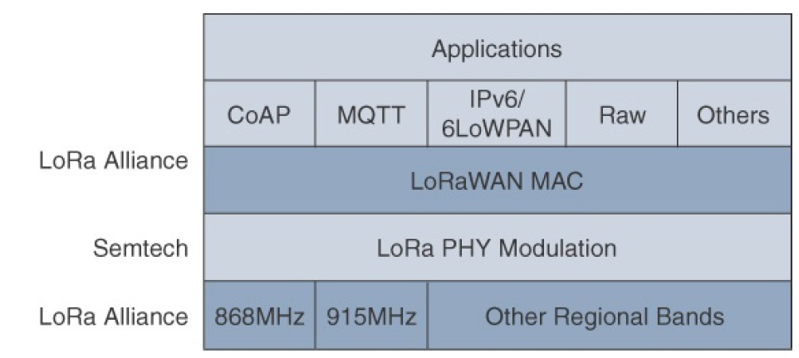
Physical and Link Layers Protocols- LoRaWAN
LoRaWAN Layers
* IoT Fundamentals: Networking Technologies, Protocols, and Use Cases for the Internet of Thing, Cisco press, 2017
Notes:
Initially, LoRa was a physical layer, or Layer 1, modulation that was developed by a French company named Cycleo. Later, Cycleo was acquired by Semtech.
Optimized for long-range, two-way communications and low power consumption, the technology evolved from Layer 1 to a broader scope through the creation of the LoRa Alliance.
Semtech LoRa as a Layer 1 PHY modulation technology is available through multiple chipset vendors. To differentiate from the physical layer modulation known as LoRa, the LoRa Alliance uses the term LoRaWAN to refer to its architecture and its specifications that describe end-to-end LoRaWAN communications and protocols.
In this figure, notice that Semtech is responsible for the PHY layer, while the LoRa Alliance handles the MAC layer and regional frequency bands.
Overall, the LoRa Alliance owns and manages the roadmap and technical development of the LoRaWAN architecture and protocol. This alliance also handles the LoRaWAN endpoint certification program and technology promotion through its certification and marketing committees.

Slide 30
Physical and Link Layers Protocols- LoRaWAN
LoRaWAN- Physical layer
Semtech LoRa modulation is based on chirp spread spectrum modulation, which trades a lower data rate for receiver sensitivity to significantly increase the communication distance.
It allows demodulation below the noise floor, offers robustness to noise and interference, and manages a single channel occupation by different spreading factors.
An important feature of LoRa is its ability to handle various data rates via the spreading factor.
Devices with a low spreading factor (SF) achieve less distance in their communications but transmit at faster speeds, resulting in less airtime.
A higher SF provides slower transmission rates but achieves a higher reliability at longer distances.
* IoT Fundamentals: Networking Technologies, Protocols, and Use Cases for the Internet of Thing, Cisco press, 2017
Notes:
Physical Layer
Semtech LoRa modulation is based on chirp spread spectrum modulation, which trades a lower data rate for receiver sensitivity to significantly increase the communication distance. In addition, it allows demodulation below the noise floor, offers robustness to noise and interference, and manages a single channel occupation by different spreading factors. This enables LoRa devices to receive on multiple channels in parallel.
The data rate in LoRaWAN varies depending on the frequency bands and adaptive data rate (ADR). ADR is an algorithm that manages the data rate and radio signal for each endpoint. The ADR algorithm ensures that packets are delivered at the best data rate possible and that network performance is both optimal and scalable. Endpoints close to the gateways with good signal values transmit with the highest data rate, which enables a shorter transmission time over the wireless network, and the lowest transmit power. Meanwhile, endpoints at the edge of the link budget communicate at the lowest data rate and highest transmit power.
An important feature of LoRa is its ability to handle various data rates via the spreading factor. Devices with a low spreading factor (SF) achieve less distance in their communications but transmit at faster speeds, resulting in less airtime. A higher SF provides slower transmission rates but achieves a higher reliability at longer distances.

Slide 31
Physical and Link Layers Protocols- LoRaWAN
LoRaWAN- LoRa gateway
A LoRa gateway is deployed as the center hub of a star network architecture.
It uses multiple transceivers and channels and can demodulate multiple channels at once or even demodulate multiple signals on the same channel simultaneously.
LoRa gateways serve as a transparent bridge relaying data between endpoints, and the endpoints use a single-hop wireless connection to communicate with one or many gateways.
* IoT Fundamentals: Networking Technologies, Protocols, and Use Cases for the Internet of Thing, Cisco press, 2017
Notes:
Physical Layer
Understanding LoRa gateways is critical to understanding a LoRaWAN system. A LoRa gateway is deployed as the center hub of a star network architecture. It uses multiple transceivers and channels and can demodulate multiple channels at once or even demodulate multiple signals on the same channel simultaneously. LoRa gateways serve as a transparent bridge relaying data between endpoints, and the endpoints use a single-hop wireless connection to communicate with one or many gateways.

Slide 32
Physical and Link Layers Protocols- LoRaWAN
LoRaWAN- MAC layer
This layer takes advantage of the LoRa physical layer and classifies LoRaWAN endpoints to optimize their battery life and ensure downstream communications to the LoRaWAN endpoints.
The classes of LoRaWAN devices:
Class A: This class is the default implementation. Optimized for battery-powered nodes, it allows bidirectional communications.
Class B: A Class B node or endpoint should get additional receive windows compared to Class A, but gateways must be synchronized through a beaconing process.
Class C: This class is particularly adapted for powered nodes.
* IoT Fundamentals: Networking Technologies, Protocols, and Use Cases for the Internet of Thing, Cisco press, 2017
Notes:
MAC layer
This layer takes advantage of the LoRa physical layer and classifies LoRaWAN endpoints to optimize their battery life and ensure downstream communications to the LoRaWAN endpoints. The LoRaWAN specification documents three classes of LoRaWAN devices:
Class A: This class is the default implementation. Optimized for battery-powered nodes, it allows bidirectional communications, where a given node is able to receive downstream traffic after transmitting. Two receive windows are available after each transmission.
Class B: This class was designated “experimental” in LoRaWAN 1.0.1 until it can be better defined. A Class B node or endpoint should get additional receive windows compared to Class A, but gateways must be synchronized through a beaconing process.
Class C: This class is particularly adapted for powered nodes. This classification enables a node to be continuously listening by keeping its receive window open when not transmitting.

Slide 33
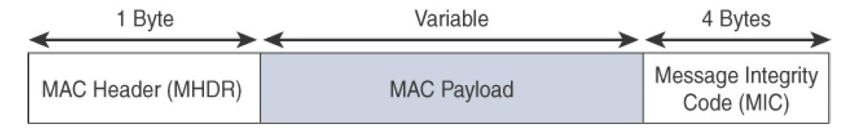
Physical and Link Layers Protocols- LoRaWAN
LoRaWAN- MAC layer
LoRaWAN messages, have a
PHY payload composed of a 1-byte MAC header,
a variable-byte MAC payload, and
a MIC that is 4 bytes in length.
The MAC payload size depends on the frequency band and the data rate, ranging from 59 to 230 bytes for the 863–870 MHz band and 19 to 250 bytes for the 902–928 MHz band.
* IoT Fundamentals: Networking Technologies, Protocols, and Use Cases for the Internet of Thing, Cisco press, 2017
Notes:
MAC layer
LoRaWAN messages, either uplink or downlink, have a PHY payload composed of a 1-byte MAC header, a variable-byte MAC payload, and a MIC that is 4 bytes in length. The MAC payload size depends on the frequency band and the data rate, ranging from 59 to 230 bytes for the 863–870 MHz band and 19 to 250 bytes for the 902–928 MHz band.
LoRaWAN endpoints are uniquely addressable through a variety of methods, including the following:
An endpoint can have a global end device ID or DevEUI represented as an IEEE EUI-64 address.
An endpoint can have a global application ID or AppEUI represented as an IEEE EUI-64 address that uniquely identifies the application provider, such as the owner, of the end device.
In a LoRaWAN network, endpoints are also known by their end device address, known as a DevAddr, a 32-bit address. The 7 most significant bits are the network identifier (NwkID), which identifies the LoRaWAN network. The 25 least significant bits are used as the network address (NwkAddr) to identify the endpoint in the network.

Slide 34
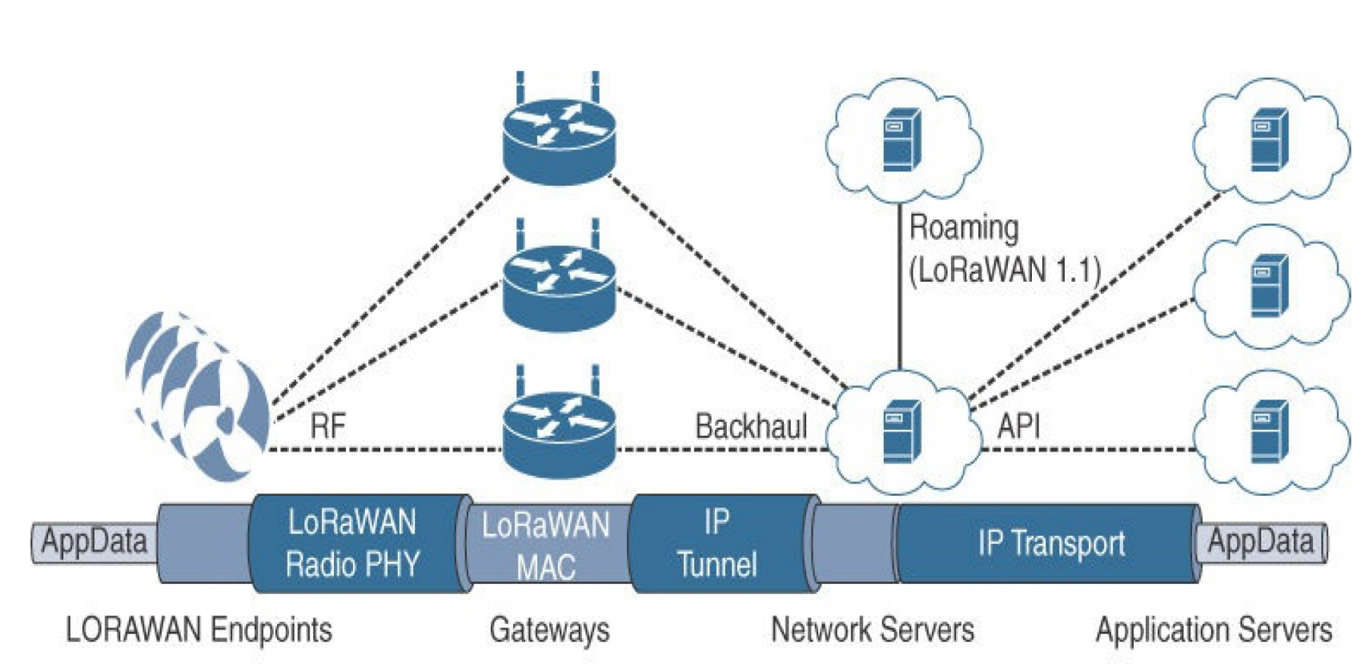
Physical and Link Layers Protocols- LoRaWAN
LoRaWAN
Topology
Star of stars
* IoT Fundamentals: Networking Technologies, Protocols, and Use Cases for the Internet of Thing, Cisco press, 2017
Notes:
LoRaWAN topology is often described as a “star of stars” topology. As shown in this figure, the infrastructure consists of endpoints exchanging packets through gateways acting as bridges, with a central LoRaWAN network server. Gateways connect to the backend network using standard IP connections, and endpoints communicate directly with one or more gateways.
LoRaWAN endpoints transport their selected application data over the LoRaWAN MAC layer on top of one of the supported PHY layer frequency bands. The application data is contained in upper protocol layers.
These upper layers are not the responsibility of the LoRa Alliance, but best practices may be developed and recommended. These upper layers could just be raw data on top of the LoRaWAN MAC layer, or the data could be stacked in multiple protocols. For example, you could have upper-layer protocols, such as ZigBee Control Layer (ZCL), Constrained Application Protocol (CoAP), or Message Queuing Telemetry Transport (MQTT), with or without an IPv6/6LoWPAN layer.
LoRaWAN gateways act as bridges that relay between endpoints and the network servers. Multiple gateways can receive and transport the same packets. When duplicate packets are received, deduplication is a function of the network server.

Slide 35
Physical and Link Layers Protocols- NB-IoT
NB-IoT
NB-IoT addresses
the requirements of a massive number of low throughput devices,
low device power consumption,
improved indoor coverage, and
optimized network architecture.
* IoT Fundamentals: Networking Technologies, Protocols, and Use Cases for the Internet of Thing, Cisco press, 2017
Notes:
NB-IoT
Existing cellular technologies, such as GPRS, Edge, 3G, and 4G/LTE, are not particularly well adapted to battery-powered devices and small objects specifically developed for the Internet of Things. While industry players have been developing unlicensed-band LPWA technologies, 3GPP and associated vendors have been working on evolving cellular technologies to better address IoT requirements. The effort started with the definition of new LTE device categories. The aim was to both align with specific IoT requirements, such as low throughput and low power consumption, and decrease the complexity and cost of the LTE devices. This resulted in the definition of the LTE-M work item.
Because the new LTE-M device category was not sufficiently close to LPWA capabilities, in 2015 3GPP approved a proposal to standardize a new narrowband radio access technology called Narrowband IoT (NB-IoT). NB-IoT specifically addresses the requirements of a massive number of low throughput devices, low device power consumption, improved indoor coverage, and optimized network architecture.
Consolidation occurred with the agreement to specify a single NB-IoT version based on orthogonal frequency-division multiple access (OFDMA) in the downlink and a couple options for the uplink. OFDMA is a modulation scheme in which individual users are assigned subsets of subcarrier frequencies. This enables multiple users to transmit low-speed data simultaneously. For more information on the uplink options, refer to the 3GPP specification TR 36.802.

Slide 36
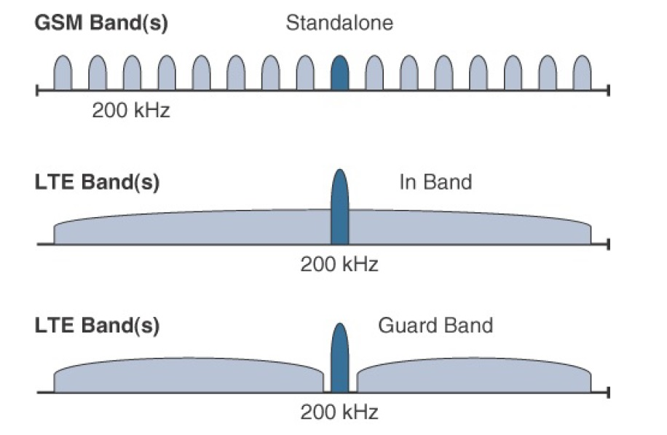
Physical and Link Layers Protocols- NB-IoT
NB-IoT
* IoT Fundamentals: Networking Technologies, Protocols, and Use Cases for the Internet of Thing, Cisco press, 2017
Notes:
Three modes of operation are applicable to NB-IoT:
Standalone: A GSM carrier is used as an NB-IoT carrier, enabling reuse of 900 MHz or 1800 MHz.
In-band: Part of an LTE carrier frequency band is allocated for use as an NB-IoT frequency. The service provider typically makes this allocation, and IoT devices are configured accordingly. You should be aware that if these devices must be deployed across different countries or regions using a different service provider, problems may occur unless there is some coordination between the service providers, and the NB-IoT frequency band allocations are the same.
Guard band: An NB-IoT carrier is between the LTE or WCDMA bands. This requires coexistence between LTE and NB-IoT bands.
Mobile service providers consider NB-IoT the target technology as it allows them to leverage their licensed spectrum to support LPWA use cases. For instance, NB-IoT is defined for a 200-kHz-wide channel in both uplink and downlink, allowing mobile service providers to optimize their spectrum, with a number of deployment options for GSM, WCDMA, and LTE spectrum.
In an LTE network, resource blocks are defined with an effective bandwidth of 180 kHz, while on NB-IoT, tone or subcarriers replace the LTE resource blocks. The uplink channel can be 15 kHz or 3.75 kHz or multi-tone (n*15 kHz, n up to 12). At Layer 1, the maximum transport block size (TBS) for downlink is 680 bits, while uplink is 1000 bits. At Layer 2, the maximum acket Data Convergence Protocol (PDCP) service data unit (SDU) size is 1600 bytes.
NB-IoT operates in half-duplex frequency-division duplexing (FDD) mode with a maximum data rate uplink of 60 kbps and downlink of 30 kbps.

Slide 37
Physical and Link Layers Protocols- NB-IoT
NB-IoT
Topology
NB-IoT is defined with a link budget of 164 dB; compare this with the GPRS link budget of 144 dB, used by many machine-to-machine services.
The additional 20 dB link budget increase should guarantee better signal penetration in buildings and basements while achieving battery life requirements.
* IoT Fundamentals: Networking Technologies, Protocols, and Use Cases for the Internet of Thing, Cisco press, 2017
Notes:
NB-IoT is defined with a link budget of 164 dB; compare this with the GPRS link budget of 144 dB, used by many machine-to-machine services. The additional 20 dB link budget increase should guarantee better signal penetration in buildings and basements while achieving battery life requirements.

Slide 38
Physical and Link Layers Protocols- LP-WiFi
The LP-WiFi also known as WiFi HaLow consumes lower power than a traditional WiFi device and also has a longer range.
The range of WiFi HaLow is nearly twice that of traditional WiFi.
Like other WiFi devices, devices supporting WiFi HaLow also support IP connectivity, which is important for IoT applications.
* Internet of Things: Architectures, Protocols, and Applications, Hindawi, 2017
Notes:
The WiFi alliance has recently developed “WiFi HaLow,” which is based on the IEEE 802.11ah standard. It consumes lower power than a traditional WiFi device and also has a longer range. This is why this protocol is suitable for Internet of Things applications. The range of WiFi HaLow is nearly twice that of traditional WiFi.
Like other WiFi devices, devices supporting WiFi HaLow also support IP connectivity, which is important for IoT applications. Let us look at the specifications of the IEEE 802.11ah standard. This standard was developed to deal with wireless sensor network scenarios, where devices are energy constrained and require relatively long range communication. IEEE 802.11ah operates in the sub-gigahertz band (900MHz). Because of the relatively lower frequency, the range is longer since higher frequency waves suffer from higher attenuation. We can extend the range (currently 1 km) by lowering the frequency further; however, the data rate will also be lower and thus the tradeoff is not justified. IEEE 802.11ah is also designed to support large star shaped networks, where a lot of stations are connected to a single access point.

Slide 39
Physical and Link Layers Protocols- BLE
Bluetooth Low Energy (BLE)/ Bluetooth Smart
BLE has a relatively shorter range and consumes lower energy as compared to competing protocols.
The BLE protocol stack is similar to the stack used in classic Bluetooth technology.
It has two parts:
controller
The physical and link layer are implemented in the controller
The controller is typically a SOC (System on Chip) with a radio. The functionalities of upper layers are included in the host.
host
* Internet of Things: Architectures, Protocols, and Applications, Hindawi, 2017
Notes:
Bluetooth Low Energy, also known as “Bluetooth Smart,” was developed by the Bluetooth Special Interest Group. It has a relatively shorter range and consumes lower energy as compared to competing protocols.
The BLE protocol stack is similar to the stack used in classic Bluetooth technology. It has two parts: controller and host. The physical and link layer are implemented in the controller.
The controller is typically a SOC (System on Chip) with a radio. The functionalities of upper layers are included in the host. BLE is not compatible with classic Bluetooth. Let us look at the differences between classic Bluetooth and BLE.
The main difference is that BLE does not support data streaming. Instead, it supports quick transfer of small packets of data (packet size is small) with a data rate of 1Mbps.
There are two types of devices in BLE: master and slave.
Themaster acts as a central device that can connect to various slaves. Let us consider an IoT scenario where a phone or PC serve as themaster and mobile devices such as a thermostat, fitness tracker, smart watch, or any monitoring device act as slaves. In such cases, slaves must be very power efficient.
Therefore, to save energy, slaves are by default in sleep mode and wake up periodically to receive packets from the master.
In classic Bluetooth, the connection is on all the time even if no data transfer is going on. Additionally, it supports 79 data channels (1MHz channel bandwidth) and a data rate of 1 million symbols/s, whereas, BLE supports 40 channels with 2MHz channel bandwidth (double of classic Bluetooth) and 1 million symbols/s data rate. BLE supports low duty cycle requirements as its packet size is small and the time taken to transmit the smallest packet is as small as 80 𝜇s. The BLE protocol stack supports IP based communication also.

Slide 40
Physical and Link Layers Protocols- BLE
Bluetooth Low Energy (BLE)/ Bluetooth Smart
BLE does not support data streaming. Instead, it supports quick transfer of small packets of data (packet size is small) with a data rate of 1Mbps.
There are two types of devices in BLE:
master
The master acts as a central device that can connect to various slaves.
Therefore, to save energy, slaves are by default in sleep mode and wake up periodically to receive packets from the master.
slave
* Internet of Things: Architectures, Protocols, and Applications, Hindawi, 2017
Notes:
Bluetooth Low Energy, also known as “Bluetooth Smart,” was developed by the Bluetooth Special Interest Group. It has a relatively shorter range and consumes lower energy as compared to competing protocols.
The BLE protocol stack is similar to the stack used in classic Bluetooth technology. It has two parts: controller and host. The physical and link layer are implemented in the controller.
The controller is typically a SOC (System on Chip) with a radio. The functionalities of upper layers are included in the host. BLE is not compatible with classic Bluetooth. Let us look at the differences between classic Bluetooth and BLE.
The main difference is that BLE does not support data streaming. Instead, it supports quick transfer of small packets of data (packet size is small) with a data rate of 1Mbps.
There are two types of devices in BLE: master and slave.
Themaster acts as a central device that can connect to various slaves. Let us consider an IoT scenario where a phone or PC serve as themaster and mobile devices such as a thermostat, fitness tracker, smart watch, or any monitoring device act as slaves. In such cases, slaves must be very power efficient.
Therefore, to save energy, slaves are by default in sleep mode and wake up periodically to receive packets from the master.
In classic Bluetooth, the connection is on all the time even if no data transfer is going on. Additionally, it supports 79 data channels (1MHz channel bandwidth) and a data rate of 1 million symbols/s, whereas, BLE supports 40 channels with 2MHz channel bandwidth (double of classic Bluetooth) and 1 million symbols/s data rate. BLE supports low duty cycle requirements as its packet size is small and the time taken to transmit the smallest packet is as small as 80 𝜇s. The BLE protocol stack supports IP based communication also.

Slide 41
Physical and Link Layers Protocols- BLE
Bluetooth Low Energy (BLE)/ Bluetooth Smart
The differences between BLE and classic Bluetooth:
In classic Bluetooth, the connection is on all the time even if no data transfer is going on.
The classic Bluetooth supports 79 data channels (1MHz channel bandwidth) and a data rate of 1 million symbols/s
BLE supports 40 channels with 2MHz channel bandwidth (double of classic Bluetooth) and 1 million symbols/s data rate.
BLE supports low duty cycle requirements as its packet size is small and the time taken to transmit the smallest packet is as small as 80 𝜇s.
The BLE protocol stack supports IP based communication also.
* Internet of Things: Architectures, Protocols, and Applications, Hindawi, 2017
Notes:
Bluetooth Low Energy, also known as “Bluetooth Smart,” was developed by the Bluetooth Special Interest Group. It has a relatively shorter range and consumes lower energy as compared to competing protocols.
The BLE protocol stack is similar to the stack used in classic Bluetooth technology. It has two parts: controller and host. The physical and link layer are implemented in the controller.
The controller is typically a SOC (System on Chip) with a radio. The functionalities of upper layers are included in the host. BLE is not compatible with classic Bluetooth. Let us look at the differences between classic Bluetooth and BLE.
The main difference is that BLE does not support data streaming. Instead, it supports quick transfer of small packets of data (packet size is small) with a data rate of 1Mbps.
There are two types of devices in BLE: master and slave.
Themaster acts as a central device that can connect to various slaves. Let us consider an IoT scenario where a phone or PC serve as themaster and mobile devices such as a thermostat, fitness tracker, smart watch, or any monitoring device act as slaves. In such cases, slaves must be very power efficient.
Therefore, to save energy, slaves are by default in sleep mode and wake up periodically to receive packets from the master.
In classic Bluetooth, the connection is on all the time even if no data transfer is going on. Additionally, it supports 79 data channels (1MHz channel bandwidth) and a data rate of 1 million symbols/s, whereas, BLE supports 40 channels with 2MHz channel bandwidth (double of classic Bluetooth) and 1 million symbols/s data rate. BLE supports low duty cycle requirements as its packet size is small and the time taken to transmit the smallest packet is as small as 80 𝜇s. The BLE protocol stack supports IP based communication also.

Slide 42
Physical and Link Layers Protocols- PLC
PLC is the use of electrical wires to provide data transmission capabilities
PLC networks provide a number of advantages that make them both a useful complement and a strong competitor to wireless networking solutions.
low deployment cost when an electrical wired infrastructure is already in place.
PLC networks allow communication through obstacles that commonly degrade wireless signals, while delivering high data rates.
PLC also provides a low-cost alternative to complement existing technologies when aiming for ubiquitous coverage.
PLC provides the possibility of re-using the existing wired electrical network to provide communication capabilities
* State-of-the-art in Power Line Communications: from the Applications to the Medium, IEEE Journal on Selected Areas in Communications, 2016
Notes:
The use of electrical wires to provide data transmission capabilities, known as Power Line Communication (PLC), has recently experienced increased deployment. Chip manufacturers of PLC devices for in-home and for smart grid applications report that they are shipping millions of such devices each year and expect the number to continue to grow in the future.
PLC networks provide a number of advantages that make them both a useful complement and a strong competitor to wireless networking solutions. The main appeal of PLC networks is their low deployment cost when an electrical wired infrastructure is already in place. In addition, PLC networks allow communication through obstacles that commonly degrade wireless signals, while delivering high data rates.
Moreover, PLC also provides a low-cost alternative to complement existing technologies when aiming for ubiquitous coverage. For instance, as a backhaul for wireless sensor networks or small cells.
Since one of the main advantages of using PLC networks is the possibility of re-using the existing wired electrical network to provide communication capabilities, the smart grid remains one of the most appealing applications of PLC and consequently the research carried out in this area is vast.

Slide 43
Physical and Link Layers Protocols- PLC
A classification of PLC systems is according to frequency bands:
ultra-narrowband (UNB) operating between about 125–3000 Hz,
narrowband (NB) operating between about 3–500 kHz , and
broadband (BB) operating between about 1.8–100 MHz
* State-of-the-art in Power Line Communications: from the Applications to the Medium, IEEE Journal on Selected Areas in Communications, 2016
Notes:
The frequency range used for today’s PLC solutions starts as low as 125 Hz and reaches as high as 100 MHz. A useful classification of PLC systems is according to frequency bands.
ultra-narrowband (UNB) operating between about 125–3000 Hz,
narrowband (NB) operating between about 3–500 kHz , and
broadband (BB) operating between about 1.8–100 MHz

Slide 44
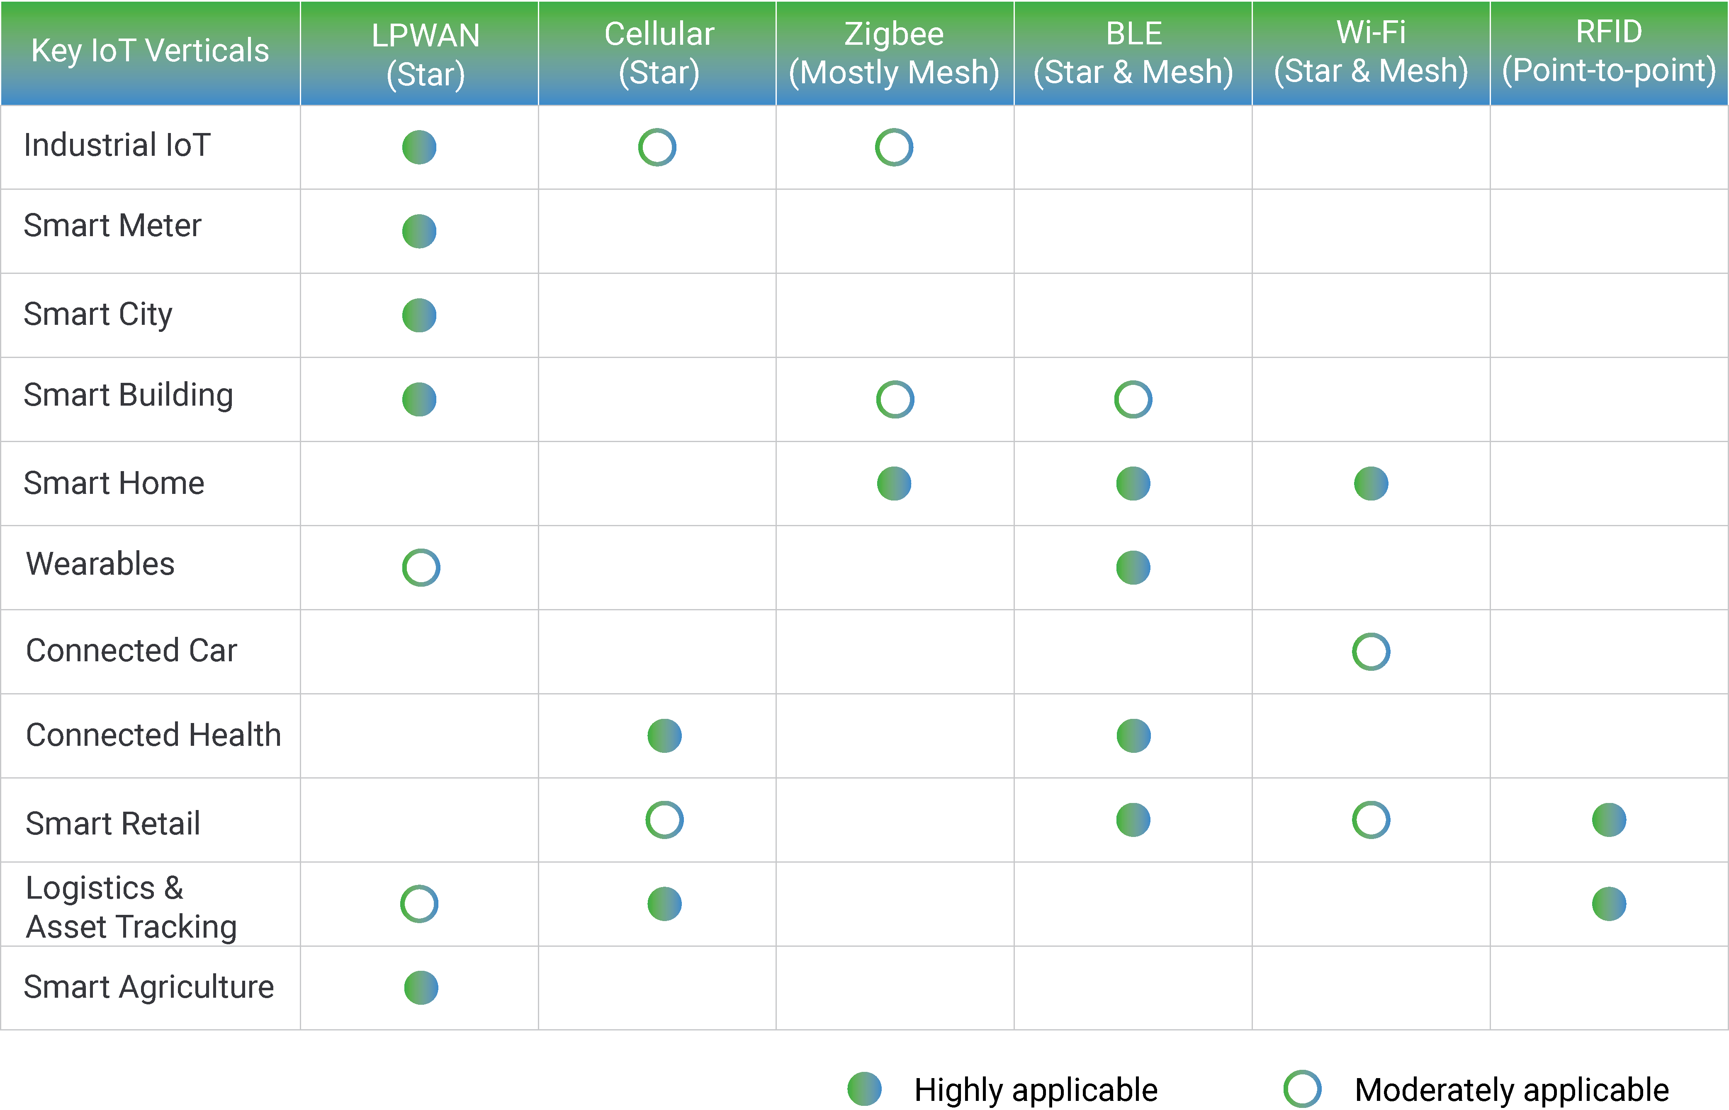
Physical and Link Layers Protocols- use cases
* https://behrtech.com/blog/6-leading-types-of-iot-wireless-tech-and-their-best-use-cases/
Notes:
The frequency range used for today’s PLC solutions starts as low as 125 Hz and reaches as high as 100 MHz. A useful classification of PLC systems is according to frequency bands.
ultra-narrowband (UNB) operating between about 125–3000 Hz,
narrowband (NB) operating between about 3–500 kHz , and
broadband (BB) operating between about 1.8–100 MHz

Slide 45
Contents
IoT Protocol Stack
Physical and Link Layers Protocols
Communication Technologies
Communication Models
Communication Technologies Criteria
IP as the IoT Network Layer
Transport Layer
Application Layer Protocols

Slide 46
Communication Models
Device-To-Device Communications
Device-To-Cloud Communications
Device-to-Gateway Communications
Back-End Data-Sharing Model
* The Internet Of Things: An Overview, Internet Society, 2015

Slide 47
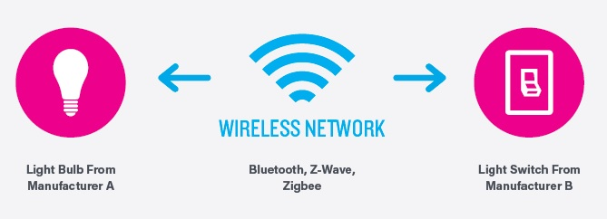
Communication Models
Device-To-Device Communications
* The Internet Of Things: An Overview, Internet Society, 2015
Notes:
The device-to-device communication model represents two or more devices that directly connect and communicate between one another, rather than through an intermediary application server. These devices communicate over many types of networks, including IP networks or the Internet. Often, however these devices use protocols like Bluetooth, Z-Wave, or ZigBee to establish direct device-to-device communications.
These device-to-device networks allow devices that adhere to a particular communication protocol to communicate and exchange messages to achieve their function. This communication model is commonly used in applications like home automation systems, which typically use small data packets of information to communicate between devices with relatively low data rate requirements. Residential IoT devices like light bulbs, light switches, thermostats, and door locks normally end small amounts of information to each other (e.g. a door lock status message or turn on light command) in a home automation scenario.
This device-to-device communication approach illustrates many of the interoperability challenges. These devices often have a direct relationship, they usually have built-in security and trust [mechanisms], but they also use device-specific data models that require redundant development efforts [by device manufacturers. This means that the device manufacturers need to invest in development efforts to implement device-specific data formats rather than open approaches that enable use of standard data formats.
From the user’s point of view, this often means that underlying device-to-device communication protocols are not compatible, forcing the user to select a family of devices that employ a common protocol. For example, the family of devices using the Z-Wave protocol is not natively compatible with the ZigBee family of devices. While these incompatibilities limit user choice to devices within a particular protocol family, the user benefits from knowing that products within a particular family tend to communicate well.

Slide 48
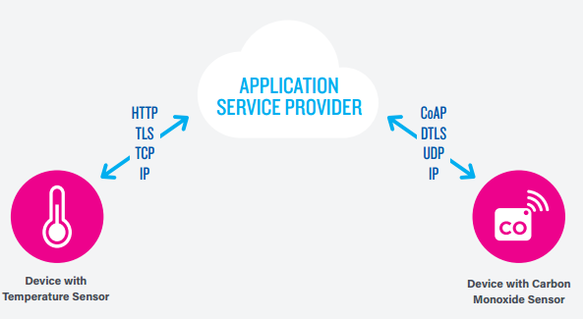
Communication Models
Device-To-Cloud Communications
* The Internet Of Things: An Overview, Internet Society, 2015
Notes:
In a device-to-cloud communication model, the IoT device connects directly to an Internet cloud service like an application service provider to exchange data and control message traffic. This approach frequently takes advantage of existing communications mechanisms like traditional wired Ethernet or Wi-Fi connections to establish a connection between the device and the IP network, which ultimately connects to the cloud service.
This communication model is employed by some popular consumer IoT devices like the Nest Labs Learning Thermostat and the Samsung SmartTV. In the case of the Nest Learning Thermostat, the device transmits data to a cloud database where the data can be used to analyze home energy consumption. Further, this cloud connection enables the user to obtain remote access to their thermostat via a smartphone or Web interface, and it also supports software updates to the thermostat. Similarly with the Samsung SmartTV technology, the television uses an Internet connection to transmit user viewing information to Samsung for analysis and to enable the interactive voice recognition features of the TV. In these cases, the device-to-cloud model adds value to the end user by extending the capabilities of the device beyond its native features.
However, interoperability challenges can arise when attempting to integrate devices made by different manufacturers. Frequently, the device and cloud service are from the same vendor. If proprietary data protocols are used between the device and the cloud service, the device owner or user may be tied to a specific cloud service, limiting or preventing the use of alternative service providers. This is commonly referred to as “vendor lock-in’’, a term that encompasses other facets of the relationship with the provider such as ownership of and access to the data. At the same time, users can generally have confidence that devices designed for the specific platform can be integrated.

Slide 49
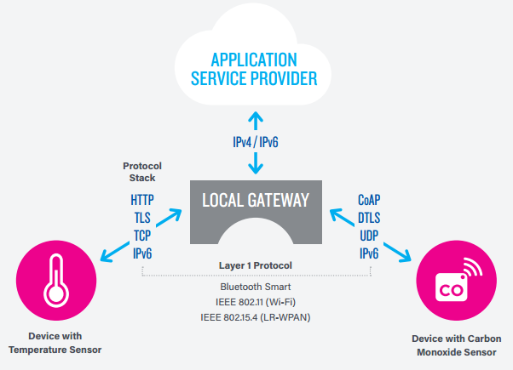
Communication Models
Device-to-Gateway Communications
* The Internet Of Things: An Overview, Internet Society, 2015
Notes:
In the device-to-gateway model, or more typically, the device-to-application-layer gateway (ALG) model, the IoT device connects through an ALG service as a conduit to reach a cloud service. In simpler terms, this means that there is application software operating on a local gateway device, which acts as an intermediary between the device and the cloud service and provides security and other functionality such as data or protocol translation.
Several forms of this model are found in consumer devices. In many cases, the local gateway device is a smartphone running an app to communicate with a device and relay data to a cloud service. This is often the model employed with popular consumer items like personal fitness trackers. These devices do not have the native ability to connect directly to a cloud service, so they frequently rely on smartphone app software to serve as an intermediary gateway to connect the fitness device to the cloud.
The other form of this device-to-gateway model is the emergence of “hub” devices in home automation applications. These are devices that serve as a local gateway between individual IoT devices and a cloud service, but they can also bridge the interoperability gap between devices themselves. For example, the SmartThings hub is a stand-alone gateway device that has Z-Wave and Zigbee transceivers installed to communicate with both families of devices. It then connects to the SmartThings cloud service, allowing the user to gain access to the devices using a smartphone app and an Internet connection.
From a broader technical perspective, the benefit of the device-to-gateway approach are as follows:
This [communication model] is used in situations where the smart objects require interoperability with non-IP [Internet protocol] devices. Sometimes this approach is taken for integrating IPv6-only devices, which means a gateway is necessary for legacy IPv4-only devices and services. In other words, this communications model is frequently used to integrate new smart devices into a legacy system with devices that are not natively interoperable with them. A downside of this approach is that the necessary development of the application-layer gateway software and system adds complexity and cost to the overall system.
It is expected that in the future, more generic gateways will be deployed to lower cost and infrastructure complexity for end consumers, enterprises, and industrial environments. Such generic gateways are more likely to exist if IoT device designs make use of generic Internet protocols and not require application-layer gateways that translate one application-layer protocol to another one. The use of application-layer gateways will, in general, lead to a more fragile deployment, as has been observed in the past.
The evolution of systems using the device-to-gateway communication model and its larger role in addressing interoperability challenges among IoT devices is still unfolding.

Slide 50
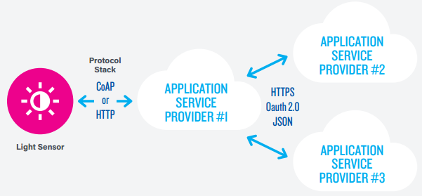
Communication Models
Back-End Data-Sharing Communication
* The Internet Of Things: An Overview, Internet Society, 2015
Notes:
The back-end data-sharing model refers to a communication architecture that enables users to export and analyze smart object data from a cloud service in combination with data from other sources. This architecture supports “the [user’s] desire for granting access to the uploaded sensor data to third parties”. This approach is an extension of the single device-to-cloud communication model, which can lead to data silos where “IoT devices upload data only to a single application service provider’’. A back-end sharing architecture allows the data collected from single IoT device data streams to be aggregated and analyzed.
For example, a corporate user in charge of an office complex would be interested in consolidating and analyzing the energy consumption and utilities data produced by all the IoT sensors and Internet-enabled utility systems on the premises. Often in the single device-to-cloud model, the data each IoT sensor or system produces sits in a stand-alone data silo. An effective back-end data sharing architecture would allow the company to easily access and analyze the data in the cloud produced by the whole spectrum of devices in the building. Also, this kind of architecture facilitates data portability needs. Effective back-end data-sharing architectures allow users to move their data when they switch between IoT services, breaking down traditional data silo barriers.
The back-end data-sharing model suggests a federated cloud services approach or cloud applications programmer interfaces (APIs) are needed to achieve interoperability of smart device data hosted in the cloud. This architecture model is an approach to achieve interoperability among these back-end systems. Standard protocols can help but are not sufficient to eliminate data silos because common information models are needed between the vendors. In other words, this communication model is only as effective as the underlying IoT system designs. Back-end data sharing architectures cannot fully overcome closed system designs.

Slide 51
Contents
IoT Protocol Stack
Physical and Link Layers Protocols
Communication Technologies
Communication Models
Communication Technologies Criteria
IP as the IoT Network Layer
Transport Layer
Application Layer Protocols

Slide 52
Communication Technologies Criteria
Range
Frequency Bands
Power Consumption
Topology
Constrained Devices
Constrained-Node Networks
* IoT Fundamentals: Networking Technologies, Protocols, and Use Cases for the Internet of Thing, Cisco press, 2017

Slide 53
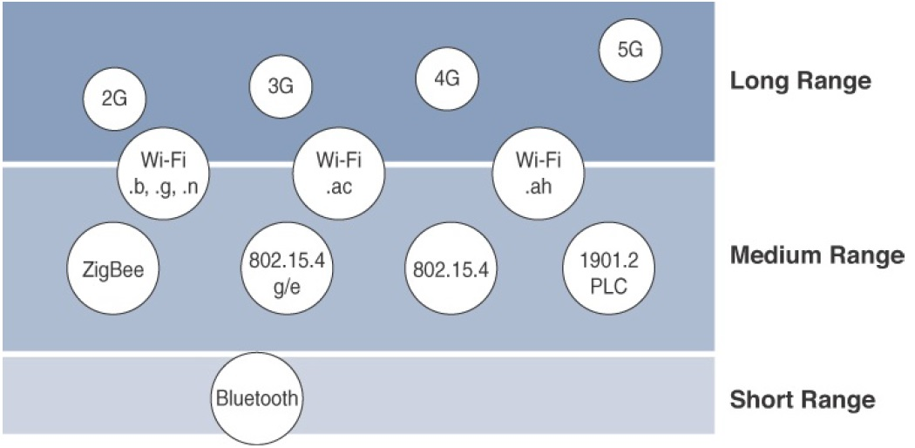
Communication Technologies Criteria
Range
Frequency Bands
Power Consumption
Topology
Constrained Devices
Constrained-Node Networks
* IoT Fundamentals: Networking Technologies, Protocols, and Use Cases for the Internet of Thing, Cisco press, 2017

Slide 54
Communication Technologies Criteria
Range
Short range:
tens of meters of maximum distance between two device
Examples: IEEE 802.15.1 Bluetooth and IEEE 802.15.7 Visible Light Communications (VLC).
Medium range:
is the main category of IoT access technologies
in the range of tens to hundreds of meters
Examples: IEEE 802.11 Wi-Fi, IEEE 802.15.4, and 802.15.4g WPAN. Wired technologies such as IEEE 802.3 Ethernet and IEEE 1901.2 Narrowband PLC
Long range:
distances greater than 1 mile between two devices require long-range technologies.
Examples: cellular (2G, 3G, 4G) and some applications of outdoor IEEE 802.11 Wi-Fi and Low-Power Wide-Area (LPWA) technologies.
* IoT Fundamentals: Networking Technologies, Protocols, and Use Cases for the Internet of Thing, Cisco press, 2017
Notes:
Short range: The classical wired example is a serial cable. Wireless short-range technologies are often considered as an alternative to a serial cable, supporting tens of meters of maximum distance between two devices. Examples of short-range wireless technologies are IEEE 802.15.1 Bluetooth and IEEE 802.15.7 Visible Light Communications (VLC). These short-range communication methods are found in only a minority of IoT installations. In some cases, they are not mature enough for production deployment.
Medium range: This range is the main category of IoT access technologies. In the range of tens to hundreds of meters, many specifications and implementations are available. The maximum distance is generally less than 1 mile between two devices, although RF technologies do not have real maximum distances defined, as long as the radio signal is transmitted and received in the scope of the applicable specification. Examples of medium-range wireless technologies include IEEE 802.11 Wi-Fi, IEEE 802.15.4, and 802.15.4g WPAN. Wired technologies such as IEEE 802.3 Ethernet and IEEE 1901.2 Narrowband Power Line Communications (PLC) may also be classified as medium range, depending on their physical media characteristics.
Long range: Distances greater than 1 mile between two devices require long-range technologies. Wireless examples are cellular (2G, 3G, 4G)
and some applications of outdoor IEEE 802.11 Wi-Fi and Low-Power Wide-Area (LPWA) technologies. LPWA communications have the ability to communicate over a large area without consuming much power. These technologies are therefore ideal for battery-powered IoT sensors.

Slide 55
Communication Technologies Criteria
Frequency Bands
Licensed: Licensed spectrum is generally applicable to IoT long-range access technologies and allocated to communications infrastructures deployed by services providers, public services (for example, first responders, military), broadcasters, and utilities.
Examples: cellular, WiMAX, and Narrowband IoT (NB-IoT) technologies.
Unlicensed: The ITU has also defined unlicensed spectrum for the industrial, scientific, and medical (ISM) portions of the radio bands. These frequencies are used in many communications technologies for short-range devices (SRDs).
Examples: 2.4 GHz band as used by IEEE 802.11b/g/n Wi-Fi, IEEE 802.15.1 Bluetooth, and IEEE 802.15.4 WPAN.
* IoT Fundamentals: Networking Technologies, Protocols, and Use Cases for the Internet of Thing, Cisco press, 2017
Notes:
Focusing on IoT access technologies, the frequency bands leveraged by wireless communications are split between licensed and unlicensed bands.
Licensed spectrum is generally applicable to IoT long-range access technologies and allocated to communications infrastructures deployed by services providers, public services (for example, first responders, military), broadcasters, and utilities.
An important consideration for IoT access infrastructures that wish to utilize licensed spectrum is that users must subscribe to services when connecting
their IoT devices. This adds more complexity to a deployment involving large numbers of sensors and other IoT devices, but in exchange for the
subscription fee, the network operator can guarantee the exclusivity of the frequency usage over the target area and can therefore sell a better guarantee
of service.
Improvements have been made in handling the complexity that is inherent when deploying large numbers of devices in the licensed spectrum. Thanks to
the development of IoT platforms, such as the Cisco Jasper Control Center, automating the provisioning, deployment, and management of large numbers
of devices has become much easier. Examples of licensed spectrum commonly used for IoT access are cellular, WiMAX, and Narrowband IoT
(NB-IoT) technologies.
The ITU has also defined unlicensed spectrum for the industrial, scientific, and medical (ISM) portions of the radio bands. These frequencies are used in
many communications technologies for short-range devices (SRDs).
Unlicensed means that no guarantees or protections are offered in the ISM bands for device communications. For IoT access, these are the most wellknown
ISM bands:
2.4 GHz band as used by IEEE 802.11b/g/n Wi-Fi
IEEE 802.15.1 Bluetooth
IEEE 802.15.4 WPAN
An unlicensed band, such as those in the ISM range of frequencies, is not unregulated. National and regional regulations exist for each of the allocated
frequency bands (much as with the licensed bands). These regulations mandate device compliance on parameters such as transmit power, duty cycle
and dwell time, channel bandwidth, and channel hopping.
Unlicensed spectrum is usually simpler to deploy than licensed because it does not require a service provider. However, it can suffer from more interference because other devices may be competing for the same frequency in a specific area. This becomes a key element in decisions for IoT deployments. Should an IoT infrastructure utilize unlicensed spectrum available for private networks or licensed frequencies that are dependent on a service provider? Various LPWA technologies are taking on a greater importance when it comes to answering this question. In addition to meeting low power requirements, LPWA communications are able to cover long distances that in the past required the licensed bands offered by service providers for cellular devices.
Some communications within the ISM bands operate in the sub-GHz range.
Sub-GHz bands are used by protocols such as IEEE 802.15.4, 802.15.4g, and 802.11ah, and LPWA technologies such as LoRa and Sigfox.
The frequency of transmission directly impacts how a signal propagates and its practical maximum range. Either for indoor or outdoor deployments, the sub-GHz frequency bands allow greater distances between devices. These bands have a better ability than the 2.4 GHz ISM band to penetrate building infrastructures or go around obstacles, while keeping the transmit power within regulation.
The disadvantage of sub-GHz frequency bands is their lower rate of data delivery compared to higher frequencies. However, most IoT sensors do not need to send data at high rates. Therefore, the lower transmission speeds of sub-GHz technologies are usually not a concern for IoT sensor deployments.
For example, in most European countries, the 169 MHz band is often considered best suited for wireless water and gas metering applications. This is due to its good deep building basement signal penetration. In addition, the low data rate of this frequency matches the low volume of data that needs to be transmitted.
Several sub-GHz ranges have been defined in the ISM band. The most wellknown ranges are centered on 169 MHz, 433 MHz, 868 MHz, and 915 MHz.
However, most IoT access technologies tend to focus on the two sub-GHz frequency regions around 868 MHz and 915 MHz. These main bands are commonly found throughout the world and are applicable to nearly all countries.

Slide 56
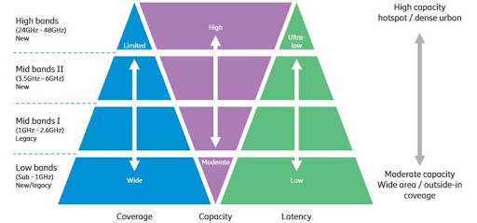
Communication Technologies Criteria
Frequency Bands
*

Slide 57
Communication Technologies Criteria
Power Consumption
Powered nodes: have a direct connection to a power source, and communications are usually not limited by power consumption criteria.
Battery-powered nodes: bring much more flexibility to IoT devices. These nodes are often classified by the required lifetimes of their batteries. Their batteries can be changed or the devices replaced when a street gets resurfaced. For devices under regular maintenance, a battery life of 2 to 3 years is an option.
IoT wireless access technologies must address the needs of low power consumption and connectivity for battery-powered nodes. This has led to the evolution of a new wireless environment known as Low-Power Wide-Area (LPWA).
* IoT Fundamentals: Networking Technologies, Protocols, and Use Cases for the Internet of Thing, Cisco press, 2017
Notes:
While the definition of IoT device is very broad, there is a clear delineation between powered nodes and battery-powered nodes.
A powered node has a direct connection to a power source, and communications are usually not limited by power consumption criteria. However, ease of deployment of
powered nodes is limited by the availability of a power source, which makes mobility more complex.
Battery-powered nodes bring much more flexibility to IoT devices. These nodes are often classified by the required lifetimes of their batteries. Does a
node need 10 to 15 years of battery life, such as on water or gas meters? Or is a 5- to 7-year battery life sufficient for devices such as smart parking sensors? Their batteries can be changed or the devices replaced when a street gets resurfaced. For devices under regular maintenance, a battery life of 2 to 3 years is an option.
IoT wireless access technologies must address the needs of low power consumption and connectivity for battery-powered nodes. This has led to the evolution of a new wireless environment known as Low-Power Wide-Area (LPWA). Obviously, it is possible to run just about any wireless technology on batteries. However, in reality, no operational deployment will be acceptable if hundreds of batteries must be changed every month.
Wired IoT access technologies consisting of powered nodes are not exempt from power optimization. In the case of deployment of smart meters over PLC, the radio interface on meters can’t consume 5 to 10 watts of power, or this will add up to a 20-million-meter deployment consuming 100 to 200 megawatts of energy for communications.

Slide 58
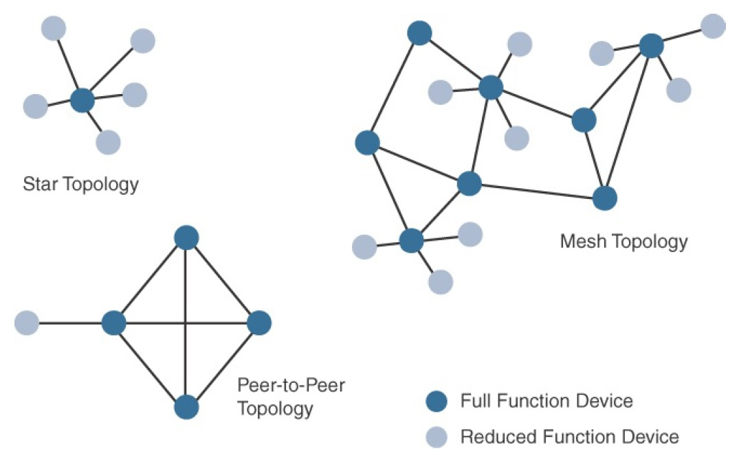
Communication Technologies Criteria
Topology
Star
Mesh
Peer-to-Peer
Full-function device (FFD) or an intermediate node: is simply a node that interconnects other nodes.
Reduced-function device (RFD) or a leaf node: a node that doesn’t interconnect or relay the traffic of other .
* IoT Fundamentals: Networking Technologies, Protocols, and Use Cases for the Internet of Thing, Cisco press, 2017
Notes:
Topology
Among the access technologies available for connecting IoT devices, three main topology schemes are dominant: star, mesh, and peer-to-peer.
For long range and short-range technologies, a star topology is prevalent, as seen with cellular, LPWA, and Bluetooth networks. Star topologies utilize a single central base station or controller to allow communications with endpoints.
For medium-range technologies, a star, peer-to-peer, or mesh topology is common, as shown in Figure 4-2. Peer-to-peer topologies allow any device to communicate with any other device as long as they are in range of each other. Obviously, peer-to-peer topologies rely on multiple full-function devices.
Peer-to-peer topologies enable more complex formations, such as a mesh networking topology.
For example, indoor Wi-Fi deployments are mostly a set of nodes forming a star topology around their access points (APs). Meanwhile, outdoor Wi-Fi may consist of a mesh topology for the backbone of APs, with nodes connecting to the APs in a star topology. Similarly, IEEE 802.15.4 and 802.15.4g and even wired IEEE 1901.2a PLC are generally deployed as a mesh topology. A mesh topology helps cope with low transmit power, searching to reach a greater overall distance, and coverage by having intermediate nodes relaying traffic for other nodes.
Mesh topology requires the implementation of a Layer 2 forwarding protocol known as mesh-under or a Layer 3 forwarding protocol referred to as mesh over on each intermediate node. (See Chapter 5, “IP as the IoT Network Layer,” for more information.) As discussed previously in Chapter 2, “IoT Network Architecture and Design,” an intermediate node or full-function device (FFD) is simply a node that interconnects other nodes. A node that doesn’t interconnect or relay the traffic of other nodes is known as a leaf node, or reduced-function device (RFD).
While well adapted to powered nodes, mesh topology requires a properly optimized implementation for battery-powered nodes. Battery-powered nodes are often placed in a “sleep mode” to preserve battery life when not transmitting. In the case of mesh topology, either the battery-powered nodes act as leaf nodes or as a “last resource path” to relay traffic when used as intermediate nodes. Otherwise, battery lifetime is greatly shortened.
For battery-powered nodes, the topology type and the role of the node in the topology (for example, being an intermediate or leaf node) are significant factors for a successful implementation.

Slide 59
Communication Technologies Criteria
Topology
For long range and short-range technologies, a star topology is prevalent, as seen with cellular, LPWA, and Bluetooth networks.
Star topologies utilize a single central base station or controller to allow communications with endpoints.
For medium-range technologies, a star, peer-to-peer, or mesh topology is common, as shown in Figure 4-2. Peer-to-peer topologies allow any device to communicate with any other device as long as they are in range of each other.
* IoT Fundamentals: Networking Technologies, Protocols, and Use Cases for the Internet of Thing, Cisco press, 2017
Notes:
Topology
Among the access technologies available for connecting IoT devices, three main topology schemes are dominant: star, mesh, and peer-to-peer.
For long range and short-range technologies, a star topology is prevalent, as seen with cellular, LPWA, and Bluetooth networks. Star topologies utilize a single central base station or controller to allow communications with endpoints.
For medium-range technologies, a star, peer-to-peer, or mesh topology is common, as shown in Figure 4-2. Peer-to-peer topologies allow any device to communicate with any other device as long as they are in range of each other. Obviously, peer-to-peer topologies rely on multiple full-function devices.
Peer-to-peer topologies enable more complex formations, such as a mesh networking topology.
For example, indoor Wi-Fi deployments are mostly a set of nodes forming a star topology around their access points (APs). Meanwhile, outdoor Wi-Fi may consist of a mesh topology for the backbone of APs, with nodes connecting to the APs in a star topology. Similarly, IEEE 802.15.4 and 802.15.4g and even wired IEEE 1901.2a PLC are generally deployed as a mesh topology. A mesh topology helps cope with low transmit power, searching to reach a greater overall distance, and coverage by having intermediate nodes relaying traffic for other nodes.
Mesh topology requires the implementation of a Layer 2 forwarding protocol known as mesh-under or a Layer 3 forwarding protocol referred to as mesh over on each intermediate node. (See Chapter 5, “IP as the IoT Network Layer,” for more information.) As discussed previously in Chapter 2, “IoT Network Architecture and Design,” an intermediate node or full-function device (FFD) is simply a node that interconnects other nodes. A node that doesn’t interconnect or relay the traffic of other nodes is known as a leaf node, or reduced-function device (RFD).
While well adapted to powered nodes, mesh topology requires a properly optimized implementation for battery-powered nodes. Battery-powered nodes are often placed in a “sleep mode” to preserve battery life when not transmitting. In the case of mesh topology, either the battery-powered nodes act as leaf nodes or as a “last resource path” to relay traffic when used as intermediate nodes. Otherwise, battery lifetime is greatly shortened.
For battery-powered nodes, the topology type and the role of the node in the topology (for example, being an intermediate or leaf node) are significant factors for a successful implementation.

Slide 60
Communication Technologies Criteria
Constrained Devices
Constrained nodes have limited resources that impact their networking feature set and capabilities.
Classes of Constrained Nodes, as Defined by RFC 7228:
Class 0: are typically battery-powered nodes such as push button nodes that sends 1 byte of information when changing its status
Memory << 10 KB
Processing capability and storage << 100 KB
Class 1: are capable enough to use a protocol stack specifically designed for constrained nodes
Memory ~ 10 KB
Processing capability and storage ~ 100 KB
Class 2:
Memory > 50 KB
Processing capability and storage > 250 KB
* IoT Fundamentals: Networking Technologies, Protocols, and Use Cases for the Internet of Thing, Cisco press, 2017
Notes:
Class 0 devices are very constrained sensor-like motes. They are so severely constrained in memory and processing capabilities that most likely they will not have the resources required to communicate directly with the Internet in a secure manner (rare heroic, narrowly targeted implementation efforts notwithstanding). Class 0 devices will participate in Internet communications with the help of larger devices acting as proxies, gateways, or servers. Class 0 devices generally cannot be secured or managed comprehensively in the traditional sense. They will most likely be preconfigured (and will be reconfigured rarely, if at all) with a very small data set. For management purposes, they could answer keep alive signals and send on/ off or basic health indications.
Class 1 devices are quite constrained in code space and processing capabilities, such that they cannot easily talk to other Internet nodes employing a full protocol stack such as using HTTP, Transport Layer Security (TLS), and related security protocols and XML-based data representations. However, they are capable enough to use a protocol stack specifically designed for constrained nodes (such as the Constrained Application Protocol (CoAP) over UDP [COAP]) and participate in meaningful conversations without the help of a gateway node. In particular, they can provide support for the security functions required on a large network. Therefore, they can be integrated as fully developed peers into an IP network, but they need to be parsimonious with state memory, code space, and often power expenditure for protocol and application usage.
Class 2 devices are less constrained and fundamentally capable of supporting most of the same protocol stacks as used on notebooks or servers. However, even these devices can benefit from lightweight and energy-efficient protocols and from consuming less bandwidth. Furthermore, using fewer resources for networking leaves more resources available to applications. Thus, using the protocol stacks defined for more constrained devices on Class 2 devices might reduce development costs and increase the interoperability.

Slide 61
Communication Technologies Criteria
Constrained-Node Networks
Constrained-Node Networks are often referred to as low-power and lossy networks (LLNs).
Low-power refers to the fact that nodes must cope with the requirements from powered and battery-powered constrained nodes.
Lossy networks indicates that network performance may suffer from interference and variability due to harsh radio environments.
some IoT access technologies are more suited to specifically connect constrained nodes such as IEEE 802.15.4, 802.15.4g RF, IEEE 1901.2a, PLC, LPWA, and IEEE 802.11ah access technologies.
* IoT Fundamentals: Networking Technologies, Protocols, and Use Cases for the Internet of Thing, Cisco press, 2017

Slide 62
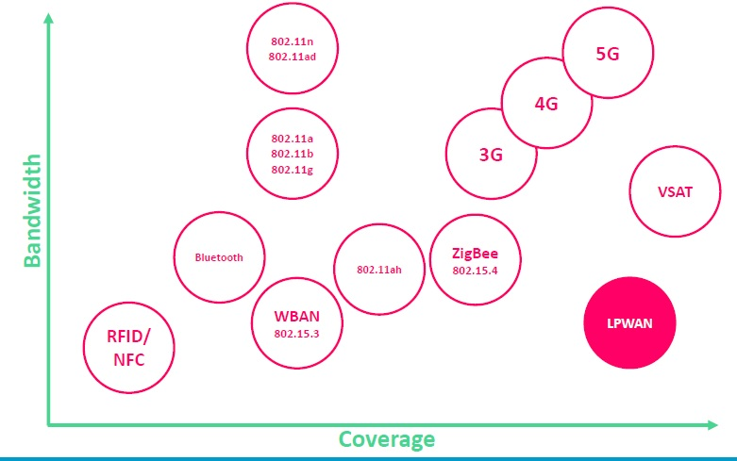
Communication Technologies Comparison
Range vs Bandwidth
* Introduction to the Internet of Thing, Telecommunication Department, Monenco Iran
Notes:
Focusing on IoT access technologies, the frequency bands leveraged by wireless communications are split between licensed and unlicensed bands.
Licensed spectrum is generally applicable to IoT long-range access technologies and allocated to communications infrastructures deployed by services providers, public services (for example, first responders, military), broadcasters, and utilities.
An important consideration for IoT access infrastructures that wish to utilize licensed spectrum is that users must subscribe to services when connecting
their IoT devices. This adds more complexity to a deployment involving large numbers of sensors and other IoT devices, but in exchange for the
subscription fee, the network operator can guarantee the exclusivity of the frequency usage over the target area and can therefore sell a better guarantee
of service.
Improvements have been made in handling the complexity that is inherent when deploying large numbers of devices in the licensed spectrum. Thanks to
the development of IoT platforms, such as the Cisco Jasper Control Center, automating the provisioning, deployment, and management of large numbers
of devices has become much easier. Examples of licensed spectrum commonly used for IoT access are cellular, WiMAX, and Narrowband IoT
(NB-IoT) technologies.
The ITU has also defined unlicensed spectrum for the industrial, scientific, and medical (ISM) portions of the radio bands. These frequencies are used in
many communications technologies for short-range devices (SRDs).
Unlicensed means that no guarantees or protections are offered in the ISM bands for device communications. For IoT access, these are the most wellknown
ISM bands:
2.4 GHz band as used by IEEE 802.11b/g/n Wi-Fi
IEEE 802.15.1 Bluetooth
IEEE 802.15.4 WPAN
An unlicensed band, such as those in the ISM range of frequencies, is not unregulated. National and regional regulations exist for each of the allocated
frequency bands (much as with the licensed bands). These regulations mandate device compliance on parameters such as transmit power, duty cycle
and dwell time, channel bandwidth, and channel hopping.
Unlicensed spectrum is usually simpler to deploy than licensed because it does not require a service provider. However, it can suffer from more interference because other devices may be competing for the same frequency in a specific area. This becomes a key element in decisions for IoT deployments. Should an IoT infrastructure utilize unlicensed spectrum available for private networks or licensed frequencies that are dependent on a service provider? Various LPWA technologies are taking on a greater importance when it comes to answering this question. In addition to meeting low power requirements, LPWA communications are able to cover long distances that in the past required the licensed bands offered by service providers for cellular devices.
Some communications within the ISM bands operate in the sub-GHz range.
Sub-GHz bands are used by protocols such as IEEE 802.15.4, 802.15.4g, and 802.11ah, and LPWA technologies such as LoRa and Sigfox.
The frequency of transmission directly impacts how a signal propagates and its practical maximum range. Either for indoor or outdoor deployments, the sub-GHz frequency bands allow greater distances between devices. These bands have a better ability than the 2.4 GHz ISM band to penetrate building infrastructures or go around obstacles, while keeping the transmit power within regulation.
The disadvantage of sub-GHz frequency bands is their lower rate of data delivery compared to higher frequencies. However, most IoT sensors do not need to send data at high rates. Therefore, the lower transmission speeds of sub-GHz technologies are usually not a concern for IoT sensor deployments.
For example, in most European countries, the 169 MHz band is often considered best suited for wireless water and gas metering applications. This is due to its good deep building basement signal penetration. In addition, the low data rate of this frequency matches the low volume of data that needs to be transmitted.
Several sub-GHz ranges have been defined in the ISM band. The most wellknown ranges are centered on 169 MHz, 433 MHz, 868 MHz, and 915 MHz.
However, most IoT access technologies tend to focus on the two sub-GHz frequency regions around 868 MHz and 915 MHz. These main bands are commonly found throughout the world and are applicable to nearly all countries.

Slide 63
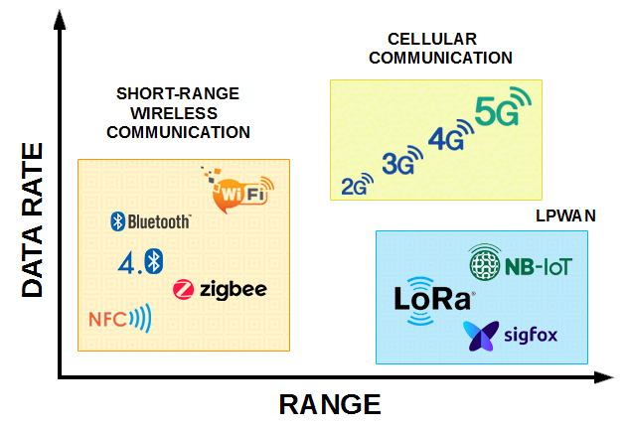
Communication Technologies Comparison
Range vs Data Rate
*
Notes:
Focusing on IoT access technologies, the frequency bands leveraged by wireless communications are split between licensed and unlicensed bands.
Licensed spectrum is generally applicable to IoT long-range access technologies and allocated to communications infrastructures deployed by services providers, public services (for example, first responders, military), broadcasters, and utilities.
An important consideration for IoT access infrastructures that wish to utilize licensed spectrum is that users must subscribe to services when connecting
their IoT devices. This adds more complexity to a deployment involving large numbers of sensors and other IoT devices, but in exchange for the
subscription fee, the network operator can guarantee the exclusivity of the frequency usage over the target area and can therefore sell a better guarantee
of service.
Improvements have been made in handling the complexity that is inherent when deploying large numbers of devices in the licensed spectrum. Thanks to
the development of IoT platforms, such as the Cisco Jasper Control Center, automating the provisioning, deployment, and management of large numbers
of devices has become much easier. Examples of licensed spectrum commonly used for IoT access are cellular, WiMAX, and Narrowband IoT
(NB-IoT) technologies.
The ITU has also defined unlicensed spectrum for the industrial, scientific, and medical (ISM) portions of the radio bands. These frequencies are used in
many communications technologies for short-range devices (SRDs).
Unlicensed means that no guarantees or protections are offered in the ISM bands for device communications. For IoT access, these are the most wellknown
ISM bands:
2.4 GHz band as used by IEEE 802.11b/g/n Wi-Fi
IEEE 802.15.1 Bluetooth
IEEE 802.15.4 WPAN
An unlicensed band, such as those in the ISM range of frequencies, is not unregulated. National and regional regulations exist for each of the allocated
frequency bands (much as with the licensed bands). These regulations mandate device compliance on parameters such as transmit power, duty cycle
and dwell time, channel bandwidth, and channel hopping.
Unlicensed spectrum is usually simpler to deploy than licensed because it does not require a service provider. However, it can suffer from more interference because other devices may be competing for the same frequency in a specific area. This becomes a key element in decisions for IoT deployments. Should an IoT infrastructure utilize unlicensed spectrum available for private networks or licensed frequencies that are dependent on a service provider? Various LPWA technologies are taking on a greater importance when it comes to answering this question. In addition to meeting low power requirements, LPWA communications are able to cover long distances that in the past required the licensed bands offered by service providers for cellular devices.
Some communications within the ISM bands operate in the sub-GHz range.
Sub-GHz bands are used by protocols such as IEEE 802.15.4, 802.15.4g, and 802.11ah, and LPWA technologies such as LoRa and Sigfox.
The frequency of transmission directly impacts how a signal propagates and its practical maximum range. Either for indoor or outdoor deployments, the sub-GHz frequency bands allow greater distances between devices. These bands have a better ability than the 2.4 GHz ISM band to penetrate building infrastructures or go around obstacles, while keeping the transmit power within regulation.
The disadvantage of sub-GHz frequency bands is their lower rate of data delivery compared to higher frequencies. However, most IoT sensors do not need to send data at high rates. Therefore, the lower transmission speeds of sub-GHz technologies are usually not a concern for IoT sensor deployments.
For example, in most European countries, the 169 MHz band is often considered best suited for wireless water and gas metering applications. This is due to its good deep building basement signal penetration. In addition, the low data rate of this frequency matches the low volume of data that needs to be transmitted.
Several sub-GHz ranges have been defined in the ISM band. The most wellknown ranges are centered on 169 MHz, 433 MHz, 868 MHz, and 915 MHz.
However, most IoT access technologies tend to focus on the two sub-GHz frequency regions around 868 MHz and 915 MHz. These main bands are commonly found throughout the world and are applicable to nearly all countries.

Slide 64
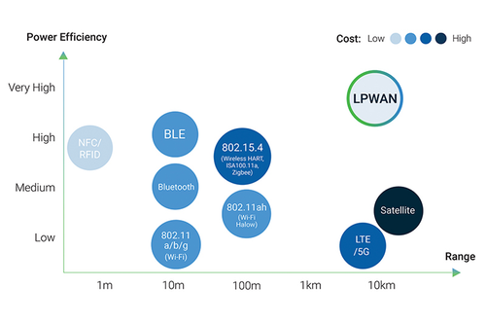
Communication Technologies Comparison
Range vs Power Efficiency
*
Notes:
Focusing on IoT access technologies, the frequency bands leveraged by wireless communications are split between licensed and unlicensed bands.
Licensed spectrum is generally applicable to IoT long-range access technologies and allocated to communications infrastructures deployed by services providers, public services (for example, first responders, military), broadcasters, and utilities.
An important consideration for IoT access infrastructures that wish to utilize licensed spectrum is that users must subscribe to services when connecting
their IoT devices. This adds more complexity to a deployment involving large numbers of sensors and other IoT devices, but in exchange for the
subscription fee, the network operator can guarantee the exclusivity of the frequency usage over the target area and can therefore sell a better guarantee
of service.
Improvements have been made in handling the complexity that is inherent when deploying large numbers of devices in the licensed spectrum. Thanks to
the development of IoT platforms, such as the Cisco Jasper Control Center, automating the provisioning, deployment, and management of large numbers
of devices has become much easier. Examples of licensed spectrum commonly used for IoT access are cellular, WiMAX, and Narrowband IoT
(NB-IoT) technologies.
The ITU has also defined unlicensed spectrum for the industrial, scientific, and medical (ISM) portions of the radio bands. These frequencies are used in
many communications technologies for short-range devices (SRDs).
Unlicensed means that no guarantees or protections are offered in the ISM bands for device communications. For IoT access, these are the most wellknown
ISM bands:
2.4 GHz band as used by IEEE 802.11b/g/n Wi-Fi
IEEE 802.15.1 Bluetooth
IEEE 802.15.4 WPAN
An unlicensed band, such as those in the ISM range of frequencies, is not unregulated. National and regional regulations exist for each of the allocated
frequency bands (much as with the licensed bands). These regulations mandate device compliance on parameters such as transmit power, duty cycle
and dwell time, channel bandwidth, and channel hopping.
Unlicensed spectrum is usually simpler to deploy than licensed because it does not require a service provider. However, it can suffer from more interference because other devices may be competing for the same frequency in a specific area. This becomes a key element in decisions for IoT deployments. Should an IoT infrastructure utilize unlicensed spectrum available for private networks or licensed frequencies that are dependent on a service provider? Various LPWA technologies are taking on a greater importance when it comes to answering this question. In addition to meeting low power requirements, LPWA communications are able to cover long distances that in the past required the licensed bands offered by service providers for cellular devices.
Some communications within the ISM bands operate in the sub-GHz range.
Sub-GHz bands are used by protocols such as IEEE 802.15.4, 802.15.4g, and 802.11ah, and LPWA technologies such as LoRa and Sigfox.
The frequency of transmission directly impacts how a signal propagates and its practical maximum range. Either for indoor or outdoor deployments, the sub-GHz frequency bands allow greater distances between devices. These bands have a better ability than the 2.4 GHz ISM band to penetrate building infrastructures or go around obstacles, while keeping the transmit power within regulation.
The disadvantage of sub-GHz frequency bands is their lower rate of data delivery compared to higher frequencies. However, most IoT sensors do not need to send data at high rates. Therefore, the lower transmission speeds of sub-GHz technologies are usually not a concern for IoT sensor deployments.
For example, in most European countries, the 169 MHz band is often considered best suited for wireless water and gas metering applications. This is due to its good deep building basement signal penetration. In addition, the low data rate of this frequency matches the low volume of data that needs to be transmitted.
Several sub-GHz ranges have been defined in the ISM band. The most wellknown ranges are centered on 169 MHz, 433 MHz, 868 MHz, and 915 MHz.
However, most IoT access technologies tend to focus on the two sub-GHz frequency regions around 868 MHz and 915 MHz. These main bands are commonly found throughout the world and are applicable to nearly all countries.

Slide 65
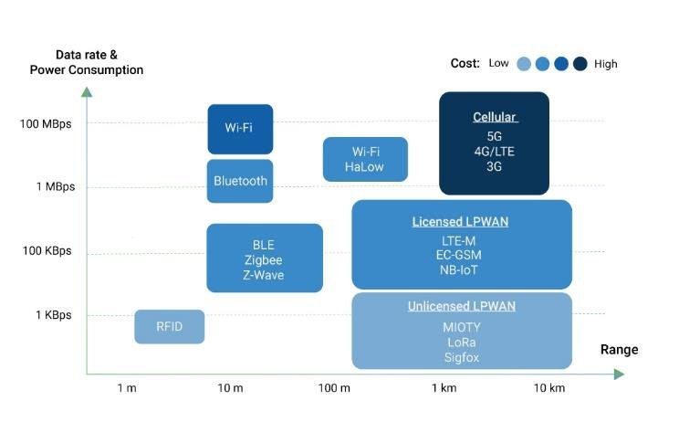
Communication Technologies Comparison
Range vs Data Rate and Power consumption
* https://behrtech.com/blog/6-leading-types-of-iot-wireless-tech-and-their-best-use-cases/
Notes:
Focusing on IoT access technologies, the frequency bands leveraged by wireless communications are split between licensed and unlicensed bands.
Licensed spectrum is generally applicable to IoT long-range access technologies and allocated to communications infrastructures deployed by services providers, public services (for example, first responders, military), broadcasters, and utilities.
An important consideration for IoT access infrastructures that wish to utilize licensed spectrum is that users must subscribe to services when connecting
their IoT devices. This adds more complexity to a deployment involving large numbers of sensors and other IoT devices, but in exchange for the
subscription fee, the network operator can guarantee the exclusivity of the frequency usage over the target area and can therefore sell a better guarantee
of service.
Improvements have been made in handling the complexity that is inherent when deploying large numbers of devices in the licensed spectrum. Thanks to
the development of IoT platforms, such as the Cisco Jasper Control Center, automating the provisioning, deployment, and management of large numbers
of devices has become much easier. Examples of licensed spectrum commonly used for IoT access are cellular, WiMAX, and Narrowband IoT
(NB-IoT) technologies.
The ITU has also defined unlicensed spectrum for the industrial, scientific, and medical (ISM) portions of the radio bands. These frequencies are used in
many communications technologies for short-range devices (SRDs).
Unlicensed means that no guarantees or protections are offered in the ISM bands for device communications. For IoT access, these are the most wellknown
ISM bands:
2.4 GHz band as used by IEEE 802.11b/g/n Wi-Fi
IEEE 802.15.1 Bluetooth
IEEE 802.15.4 WPAN
An unlicensed band, such as those in the ISM range of frequencies, is not unregulated. National and regional regulations exist for each of the allocated
frequency bands (much as with the licensed bands). These regulations mandate device compliance on parameters such as transmit power, duty cycle
and dwell time, channel bandwidth, and channel hopping.
Unlicensed spectrum is usually simpler to deploy than licensed because it does not require a service provider. However, it can suffer from more interference because other devices may be competing for the same frequency in a specific area. This becomes a key element in decisions for IoT deployments. Should an IoT infrastructure utilize unlicensed spectrum available for private networks or licensed frequencies that are dependent on a service provider? Various LPWA technologies are taking on a greater importance when it comes to answering this question. In addition to meeting low power requirements, LPWA communications are able to cover long distances that in the past required the licensed bands offered by service providers for cellular devices.
Some communications within the ISM bands operate in the sub-GHz range.
Sub-GHz bands are used by protocols such as IEEE 802.15.4, 802.15.4g, and 802.11ah, and LPWA technologies such as LoRa and Sigfox.
The frequency of transmission directly impacts how a signal propagates and its practical maximum range. Either for indoor or outdoor deployments, the sub-GHz frequency bands allow greater distances between devices. These bands have a better ability than the 2.4 GHz ISM band to penetrate building infrastructures or go around obstacles, while keeping the transmit power within regulation.
The disadvantage of sub-GHz frequency bands is their lower rate of data delivery compared to higher frequencies. However, most IoT sensors do not need to send data at high rates. Therefore, the lower transmission speeds of sub-GHz technologies are usually not a concern for IoT sensor deployments.
For example, in most European countries, the 169 MHz band is often considered best suited for wireless water and gas metering applications. This is due to its good deep building basement signal penetration. In addition, the low data rate of this frequency matches the low volume of data that needs to be transmitted.
Several sub-GHz ranges have been defined in the ISM band. The most wellknown ranges are centered on 169 MHz, 433 MHz, 868 MHz, and 915 MHz.
However, most IoT access technologies tend to focus on the two sub-GHz frequency regions around 868 MHz and 915 MHz. These main bands are commonly found throughout the world and are applicable to nearly all countries.

Slide 66
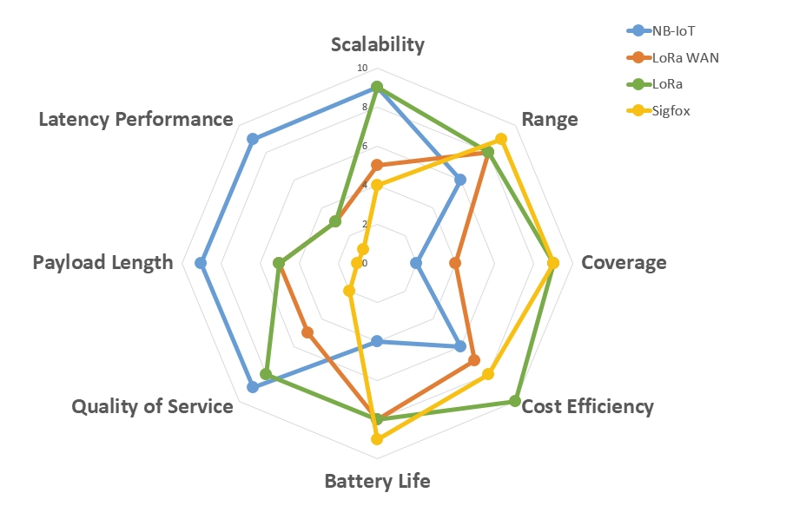
Communication Technologies Comparison
Comparison of SigFox, LoRa, LoRaWAN, and NB-IoT in terms of different criteria
* https://www.betasolutions.co.nz/Blog/25/20-Things-to-Consider-When-Planning-an-IoT-Solution-_-Part-2

Slide 67
Contents
IoT Protocol Stack
Physical and Link Layers Protocols
Communication Models
Communication Technologies Criteria
Communication Technologies
IP as the IoT Network Layer
Transport Layer
Application Layer Protocols

Slide 68
IoT Protocol Stack- IP as the IoT Network Layer
The key advantages of the IP suite for the Internet of Things:
Open and standards-based
Versatile
Ubiquitous
Scalable
Manageable and highly secure
Stable and resilient
Consumers’ market adoption
The innovation factor
* IoT Fundamentals: Networking Technologies, Protocols, and Use Cases for the Internet of Thing, Cisco press, 2017
Notes:
The key advantages of the IP suite for the Internet of Things:
Open and standards-based: Operational technologies have often been delivered as turnkey features by vendors who may have optimized the communications through closed and proprietary networking solutions. The Internet of Things creates a new paradigm in which devices, applications, and users can leverage a large set of devices and functionalities while guaranteeing interchangeability and interoperability, security, and management. This calls for implementation, validation, and deployment of open, standards-based solutions. While many standards development organizations (SDOs) are working on Internet of Things definitions, frameworks, applications, and technologies, none are questioning the role of the Internet Engineering Task Force (IETF) as the foundation for specifying and optimizing the network and transport layers. The IETF is an open standards body that focuses on the development of the Internet Protocol suite and related Internet technologies and protocols.
Versatile: A large spectrum of access technologies is available to offer connectivity of “things” in the last mile. Additional protocols and technologies are also used to transport IoT data through backhaul links and in the data center. Even if physical and data link layers such as Ethernet, Wi-Fi, and cellular are widely adopted, the history of data communications demonstrates that no given wired or wireless technology fits all deployment criteria. Furthermore, communication technologies evolve at a pace faster than the expected 10- to 20-year lifetime of OT solutions. So, the layered IP architecture is well equipped to cope with any type of physical and data link layers. This makes IP ideal as a long-term investment because various protocols at these layers can be used in a deployment now and over time, without requiring changes to the whole solution architecture and data flow.
Ubiquitous: All recent operating system releases, from general purpose computers and servers to lightweight embedded systems (TinyOS, Contiki, and so on), have an integrated dual (IPv4 and IPv6) IP stack that gets enhanced over time. In addition, IoT application protocols in many industrial OT solutions have been updated in recent years to run over IP. While these updates have mostly consisted of IPv4 to this point, recent standardization efforts in several areas are adding IPv6. In fact, IP is the most pervasive protocol when you look at what is supported across the various IoT solutions and industry verticals.
Scalable: As the common protocol of the Internet, IP has been massively deployed and tested for robust scalability. Millions of private and public IP infrastructure nodes have been operational for years, offering strong foundations for those not familiar with IP network management. Of course, adding huge numbers of “things” to private and public infrastructures may require optimizations and design rules specific to the new devices. However, you should realize that this is not very different from the recent evolution of voice and video endpoints integrated over IP. IP has proven before that scalability is one of its strengths.
Manageable and highly secure: Communications infrastructure requires appropriate management and security capabilities for proper operations. One of the benefits that comes from 30 years of operational IP networks is the well-understood network management and security protocols, mechanisms, and toolsets that are widely available. Adopting IP network management also brings an operational business application to OT. Well-known network and security management tools are easily leveraged with an IP network layer. However, you should be aware that despite the secure nature of IP, real challenges exist in this area. Specifically, the industry is challenged in securing constrained nodes, handling legacy OT protocols, and scaling operations.
Stable and resilient: IP has been around for 30 years, and it is clear that IP is a workable solution. IP has a large and well-established knowledge base and, more importantly, it has been used for years in critical infrastructures, such as financial and defense networks. In addition, IP has been deployed for critical services, such as voice and video, which have already transitioned from closed environments to open IP standards. Finally, its stability and resiliency benefit from the large ecosystem of IT professionals who can help design, deploy, and operate IP-based solutions.
Consumers’ market adoption: When developing IoT solutions and products targeting the consumer market, vendors know that consumers’ access to applications and devices will occur predominantly over broadband and mobile wireless infrastructure. The main consumer devices range from smart phones to tablets and PCs. The common protocol that links IoT in the consumer space to these devices is IP.
The innovation factor: The past two decades have largely established the adoption of IP as a factor for increased innovation. IP is the underlying protocol for applications ranging from file transfer and email to the World Wide Web, e-commerce, social networking, mobility, and more. Even the recent computing evolution from PC to mobile and mainframes to cloud services are perfect demonstrations of the innovative ground enabled by IP. Innovations in IoT can also leverage an IP underpinning.

Slide 69
IoT Protocol Stack- IP as the IoT Network Layer
The need for optimization of IP for IoT
Constrained Nodes
Constrained Networks
* IoT Fundamentals: Networking Technologies, Protocols, and Use Cases for the Internet of Thing, Cisco press, 2017
Notes:
The Internet of Things will largely be built on the Internet Protocol suite. However, challenges still exist for IP in IoT solutions. In addition to coping with the integration of non-IP devices, you may need to deal with the limits at the device and network levels that IoT often imposes. Therefore, optimizations are needed at various layers of the IP stack to handle the restrictions that are present in IoT networks. Both the nodes and the network itself can often be constrained in IoT solutions. Also, IP is transitioning from version 4 to version 6, which can add further confinements in the IoT space.

Slide 70
IoT Protocol Stack- IP as the IoT Network Layer
The need for optimization of IP for IoT
Constrained Nodes
Devices that are very constrained in resources, may communicate infrequently to transmit a few bytes, and may have limited security and management capabilities
Devices with enough power and capacities to implement a stripped down IP stack or non-IP stack
Devices that are similar to generic PCs in terms of computing and power resources but have constrained networking capacities, such as bandwidth
Constrained Networks
* IoT Fundamentals: Networking Technologies, Protocols, and Use Cases for the Internet of Thing, Cisco press, 2017
Notes:
Constrained Nodes
Another limit is that this network protocol stack on an IoT node may be required to communicate through an unreliable path. Even if a full IP stack is available on the node, this causes problems such as limited or unpredictable throughput and low convergence when a topology change occurs. Finally, power consumption is a key characteristic of constrained nodes.
Many IoT devices are battery powered, with lifetime battery requirements varying from a few months to 10+ years. This drives the selection of networking technologies since high-speed ones, such as Ethernet, Wi-Fi, and cellular, are not (yet) capable of multi-year battery life. Current capabilities practically allow less than a year for these technologies on battery-powered nodes. Of course, power consumption is much less of a concern on nodes that do not require batteries as an energy source.
You should also be aware that power consumption requirements on battery powered nodes impact communication intervals. To help extend battery life, you could enable a “low-power” mode instead of one that is “always on.” Another option is “always off,” which means communications are enabled only when needed to send data.
While it has been largely demonstrated that production IP stacks perform well in constrained nodes, classification of these nodes helps when evaluating the IP adoption versus adaptation model selection. IoT constrained nodes can be classified as follows:
Devices that are very constrained in resources, may communicate infrequently to transmit a few bytes, and may have limited security and management capabilities: This drives the need for the IP adaptation model, where nodes communicate through gateways and proxies.
Devices with enough power and capacities to implement a stripped down IP stack or non-IP stack: In this case, you may implement either an optimized IP stack and directly communicate with application servers (adoption model) or go for an IP or non-IP stack and communicate through gateways and proxies (adaptation model).
Devices that are similar to generic PCs in terms of computing and power resources but have constrained networking capacities, such as bandwidth: These nodes usually implement a full IP stack (adoption model), but network design and application behaviors must cope with the bandwidth constraints.

Slide 71
IoT Protocol Stack- IP as the IoT Network Layer
The need for optimization of IP for IoT
Constrained Nodes
Constrained Networks
low-power links
low-bandwidth links (wireless and wired).
operate between a few kbps and a few hundred kbps
may utilize a star, mesh, or combined network topologies
* IoT Fundamentals: Networking Technologies, Protocols, and Use Cases for the Internet of Thing, Cisco press, 2017
Notes:
Constrained Networks
In the early years of the Internet, network bandwidth capacity was restrained due to technical limitations. Connections often depended on low-speed modems for transferring data. However, these low-speed connections demonstrated that IP could run over low-bandwidth networks.
Fast forward to today, and the evolution of networking has seen the emergence of high-speed infrastructures. However, high-speed connections are not usable by some IoT devices in the last mile. The reasons include the implementation of technologies with low bandwidth, limited distance and bandwidth due to regulated transmit power, and lack of or limited network services. When link layer characteristics that we take for granted are not present, the network is constrained. A constrained network can have high latency and a high potential for packet loss.
Constrained networks have unique characteristics and requirements. In contrast with typical IP networks, where highly stable and fast links are available, constrained networks are limited by low-power, low-bandwidth links (wireless and wired). They operate between a few kbps and a few hundred kbps and may utilize a star, mesh, or combined network topologies, ensuring proper operations.
With a constrained network, in addition to limited bandwidth, it is not unusual for the packet delivery rate (PDR) to oscillate between low and high percentages. Large bursts of unpredictable errors and even loss of connectivity at times may occur. These behaviors can be observed on both wireless and narrowband power-line communication links, where packet delivery variation may fluctuate greatly during the course of a day. Unstable link layer environments create other challenges in terms of latency and control plane reactivity. One of the golden rules in a constrained network is to “underreact to failure.” Due to the low bandwidth, a constrained network that overreacts can lead to a network collapse—which makes the existing problem worse. Control plane traffic must also be kept at a minimum; otherwise, it consumes the bandwidth that is needed by the data traffic. Finally, you have to consider the power consumption in battery-powered nodes. Any failure or verbose control plane protocol may reduce the lifetime of the batteries.

Slide 72
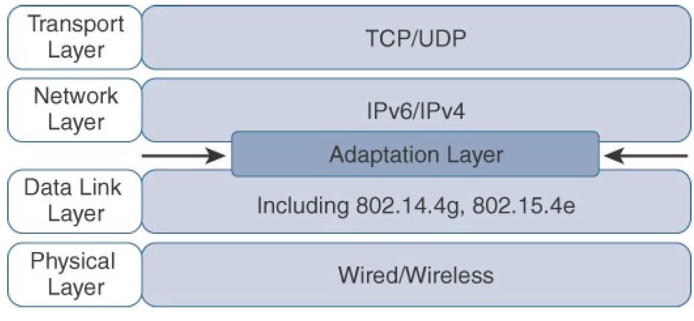
IoT Protocol Stack- IP as the IoT Network Layer
The need for optimization of IP for IoT
* IoT Fundamentals: Networking Technologies, Protocols, and Use Cases for the Internet of Thing, Cisco press, 2017
Notes:
Constrained Networks
In the early years of the Internet, network bandwidth capacity was restrained due to technical limitations. Connections often depended on low-speed modems for transferring data. However, these low-speed connections demonstrated that IP could run over low-bandwidth networks.
Fast forward to today, and the evolution of networking has seen the emergence of high-speed infrastructures. However, high-speed connections are not usable by some IoT devices in the last mile. The reasons include the implementation of technologies with low bandwidth, limited distance and bandwidth due to regulated transmit power, and lack of or limited network services. When link layer characteristics that we take for granted are not present, the network is constrained. A constrained network can have high latency and a high potential for packet loss.
Constrained networks have unique characteristics and requirements. In contrast with typical IP networks, where highly stable and fast links are available, constrained networks are limited by low-power, low-bandwidth links (wireless and wired). They operate between a few kbps and a few hundred kbps and may utilize a star, mesh, or combined network topologies, ensuring proper operations.
With a constrained network, in addition to limited bandwidth, it is not unusual for the packet delivery rate (PDR) to oscillate between low and high percentages. Large bursts of unpredictable errors and even loss of connectivity at times may occur. These behaviors can be observed on both wireless and narrowband power-line communication links, where packet delivery variation may fluctuate greatly during the course of a day. Unstable link layer environments create other challenges in terms of latency and control plane reactivity. One of the golden rules in a constrained network is to “underreact to failure.” Due to the low bandwidth, a constrained network that overreacts can lead to a network collapse—which makes the existing problem worse. Control plane traffic must also be kept at a minimum; otherwise, it consumes the bandwidth that is needed by the data traffic. Finally, you have to consider the power consumption in battery-powered nodes. Any failure or verbose control plane protocol may reduce the lifetime of the batteries.

Slide 73
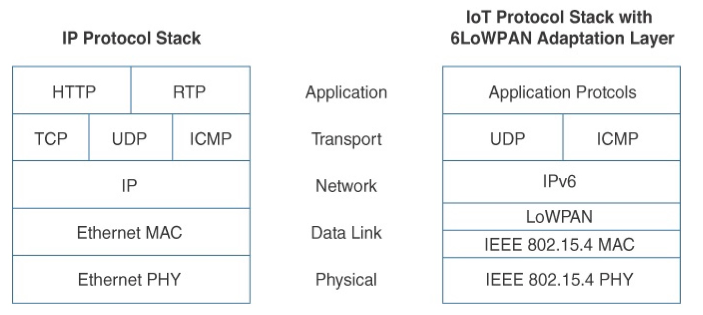
IoT Protocol Stack- IP as the IoT Network Layer
6LoWPAN as IP Adaptation Layer for IoT
* IoT Fundamentals: Networking Technologies, Protocols, and Use Cases for the Internet of Thing, Cisco press, 2017
Notes:
Constrained Networks
In the early years of the Internet, network bandwidth capacity was restrained due to technical limitations. Connections often depended on low-speed modems for transferring data. However, these low-speed connections demonstrated that IP could run over low-bandwidth networks.
Fast forward to today, and the evolution of networking has seen the emergence of high-speed infrastructures. However, high-speed connections are not usable by some IoT devices in the last mile. The reasons include the implementation of technologies with low bandwidth, limited distance and bandwidth due to regulated transmit power, and lack of or limited network services. When link layer characteristics that we take for granted are not present, the network is constrained. A constrained network can have high latency and a high potential for packet loss.
Constrained networks have unique characteristics and requirements. In contrast with typical IP networks, where highly stable and fast links are available, constrained networks are limited by low-power, low-bandwidth links (wireless and wired). They operate between a few kbps and a few hundred kbps and may utilize a star, mesh, or combined network topologies, ensuring proper operations.
With a constrained network, in addition to limited bandwidth, it is not unusual for the packet delivery rate (PDR) to oscillate between low and high percentages. Large bursts of unpredictable errors and even loss of connectivity at times may occur. These behaviors can be observed on both wireless and narrowband power-line communication links, where packet delivery variation may fluctuate greatly during the course of a day. Unstable link layer environments create other challenges in terms of latency and control plane reactivity. One of the golden rules in a constrained network is to “underreact to failure.” Due to the low bandwidth, a constrained network that overreacts can lead to a network collapse—which makes the existing problem worse. Control plane traffic must also be kept at a minimum; otherwise, it consumes the bandwidth that is needed by the data traffic. Finally, you have to consider the power consumption in battery-powered nodes. Any failure or verbose control plane protocol may reduce the lifetime of the batteries.

Slide 74
IoT Protocol Stack- IP as the IoT Network Layer
6LoWPAN as IP Adaptation Layer for IoT
Header compression
Fragmentation
Mesh addressing
* IoT Fundamentals: Networking Technologies, Protocols, and Use Cases for the Internet of Thing, Cisco press, 2017
Notes:
Constrained Networks
In the early years of the Internet, network bandwidth capacity was restrained due to technical limitations. Connections often depended on low-speed modems for transferring data. However, these low-speed connections demonstrated that IP could run over low-bandwidth networks.
Fast forward to today, and the evolution of networking has seen the emergence of high-speed infrastructures. However, high-speed connections are not usable by some IoT devices in the last mile. The reasons include the implementation of technologies with low bandwidth, limited distance and bandwidth due to regulated transmit power, and lack of or limited network services. When link layer characteristics that we take for granted are not present, the network is constrained. A constrained network can have high latency and a high potential for packet loss.
Constrained networks have unique characteristics and requirements. In contrast with typical IP networks, where highly stable and fast links are available, constrained networks are limited by low-power, low-bandwidth links (wireless and wired). They operate between a few kbps and a few hundred kbps and may utilize a star, mesh, or combined network topologies, ensuring proper operations.
With a constrained network, in addition to limited bandwidth, it is not unusual for the packet delivery rate (PDR) to oscillate between low and high percentages. Large bursts of unpredictable errors and even loss of connectivity at times may occur. These behaviors can be observed on both wireless and narrowband power-line communication links, where packet delivery variation may fluctuate greatly during the course of a day. Unstable link layer environments create other challenges in terms of latency and control plane reactivity. One of the golden rules in a constrained network is to “underreact to failure.” Due to the low bandwidth, a constrained network that overreacts can lead to a network collapse—which makes the existing problem worse. Control plane traffic must also be kept at a minimum; otherwise, it consumes the bandwidth that is needed by the data traffic. Finally, you have to consider the power consumption in battery-powered nodes. Any failure or verbose control plane protocol may reduce the lifetime of the batteries.

Slide 75
IoT Protocol Stack- IP as the IoT Network Layer
IP Versions
IPv4
IPv6
* IoT Fundamentals: Networking Technologies, Protocols, and Use Cases for the Internet of Thing, Cisco press, 2017
Notes:
Constrained Networks
In the early years of the Internet, network bandwidth capacity was restrained due to technical limitations. Connections often depended on low-speed modems for transferring data. However, these low-speed connections demonstrated that IP could run over low-bandwidth networks.
Fast forward to today, and the evolution of networking has seen the emergence of high-speed infrastructures. However, high-speed connections are not usable by some IoT devices in the last mile. The reasons include the implementation of technologies with low bandwidth, limited distance and bandwidth due to regulated transmit power, and lack of or limited network services. When link layer characteristics that we take for granted are not present, the network is constrained. A constrained network can have high latency and a high potential for packet loss.
Constrained networks have unique characteristics and requirements. In contrast with typical IP networks, where highly stable and fast links are available, constrained networks are limited by low-power, low-bandwidth links (wireless and wired). They operate between a few kbps and a few hundred kbps and may utilize a star, mesh, or combined network topologies, ensuring proper operations.
With a constrained network, in addition to limited bandwidth, it is not unusual for the packet delivery rate (PDR) to oscillate between low and high percentages. Large bursts of unpredictable errors and even loss of connectivity at times may occur. These behaviors can be observed on both wireless and narrowband power-line communication links, where packet delivery variation may fluctuate greatly during the course of a day. Unstable link layer environments create other challenges in terms of latency and control plane reactivity. One of the golden rules in a constrained network is to “underreact to failure.” Due to the low bandwidth, a constrained network that overreacts can lead to a network collapse—which makes the existing problem worse. Control plane traffic must also be kept at a minimum; otherwise, it consumes the bandwidth that is needed by the data traffic. Finally, you have to consider the power consumption in battery-powered nodes. Any failure or verbose control plane protocol may reduce the lifetime of the batteries.

Slide 76
Contents
IoT Protocol Stack
Physical and Link Layers Protocols
Communication Models
Communication Technologies Criteria
Communication Technologies
IP as the IoT Network Layer
Transport Layer
Application Layer Protocols

Slide 77
IoT Protocol Stack- Transport Layer
Transport Layer
Transmission Control Protocol (TCP)
connection-oriented protocol
User Datagram Protocol (UDP)
connection-less protocol
no guarantee of delivery
* IoT Fundamentals: Networking Technologies, Protocols, and Use Cases for the Internet of Thing, Cisco press, 2017
Notes:
This section reviews the selection of a protocol for the transport layer as supported by the TCP/IP architecture in the context of IoT networks. With the TCP/IP protocol, two main protocols are specified for the transport layer:
Transmission Control Protocol (TCP): This connection-oriented protocol requires a session to get established between the source and destination before exchanging data. You can view it as an equivalent to a traditional telephone conversation, in which two phones must be connected and the communication link established before the parties can talk.
User Datagram Protocol (UDP): With this connection-less protocol, data can be quickly sent between source and destination—but with no guarantee of delivery. This is analogous to the traditional mail delivery system, in which a letter is mailed to a destination. Confirmation of the reception of this letter does not happen until another letter is sent in response.
With the predominance of human interactions over the Internet, TCP is the main protocol used at the transport layer. This is largely due to its inherent characteristics, such as its ability to transport large volumes of data into smaller sets of packets. In addition, it ensures reassembly in a correct sequence, flow control and window adjustment, and retransmission of lost packets. These benefits occur with the cost of overhead per packet and per session, potentially impacting overall packet per second performances and latency.
In contrast, UDP is most often used in the context of network services, such as Domain Name System (DNS), Network Time Protocol (NTP), Simple Network Management Protocol (SNMP), and Dynamic Host Control Protocol (DHCP), or for real-time data traffic, including voice and video over IP. In these cases, performance and latency are more important than packet retransmissions because re-sending a lost voice or video packet does not add value. When the reception of packets must be guaranteed error free, the application layer protocol takes care of that function.
While the use of TCP may not strain generic compute platforms and high data-rate networks, it can be challenging and is often overkill on constrained IoT devices and networks. This is particularly true when an IoT device needs to send only a few bytes of data per transaction. When using TCP, each packet needs to add a minimum of 20 bytes of TCP overhead, while UDP adds only 8 bytes. TCP also requires the establishment and potential maintenance of an open logical channel.

Slide 78
Contents
IoT Protocol Stack
Physical and Link Layers Protocols
Communication Models
Communication Technologies Criteria
Communication Technologies
IP as the IoT Network Layer
Transport Layer
Application Layer Protocols

Slide 79
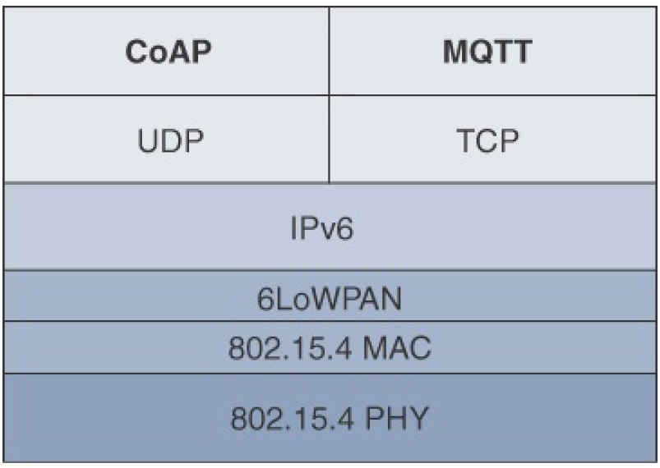
IoT Protocol Stack- Application Layer Protocols
Application Layer Protocols
Constrained Application Protocol
(CoAP)
Message Queuing Telemetry
Transport (MQTT)
* IoT Fundamentals: Networking Technologies, Protocols, and Use Cases for the Internet of Thing, Cisco press, 2017

Slide 80
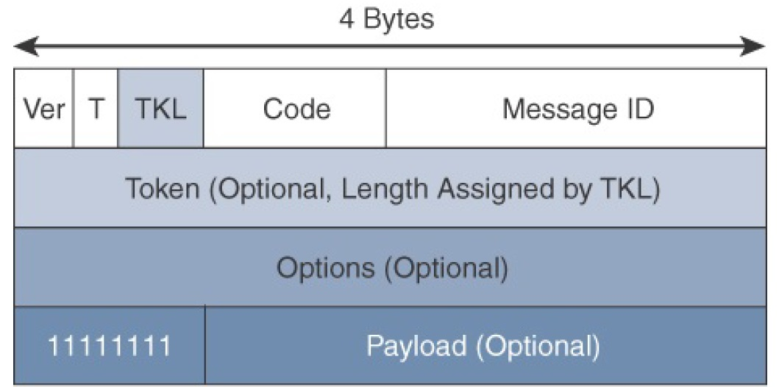
IoT Protocol Stack- Application Layer Protocols
Application Layer Protocols- CoAP
The CoAP framework defines simple and flexible ways to manipulate sensors and actuators for data or device management
CoAP Message Format
* IoT Fundamentals: Networking Technologies, Protocols, and Use Cases for the Internet of Thing, Cisco press, 2017
Notes:
CoAP can run over IPv4 or IPv6. However, it is recommended that the message fit within a single IP packet and UDP payload to avoid fragmentation. For IPv6, with the default MTU size being 1280 bytes and allowing for no fragmentation across nodes, the maximum CoAP message size could be up to 1152 bytes, including 1024 bytes for the payload. In the case of IPv4, as IP fragmentation may exist across the network, implementations should limit themselves to more conservative values and set the IPv4 Don’t Fragment (DF) bit.
While most sensor and actuator traffic utilizes small-packet payloads, some use cases, such as firmware upgrades, require the capability to send larger payloads. CoAP doesn’t rely on IP fragmentation but defines (in RFC 7959) a pair of Block options for transferring multiple blocks of information from a resource representation in multiple request/response pairs.

Slide 81
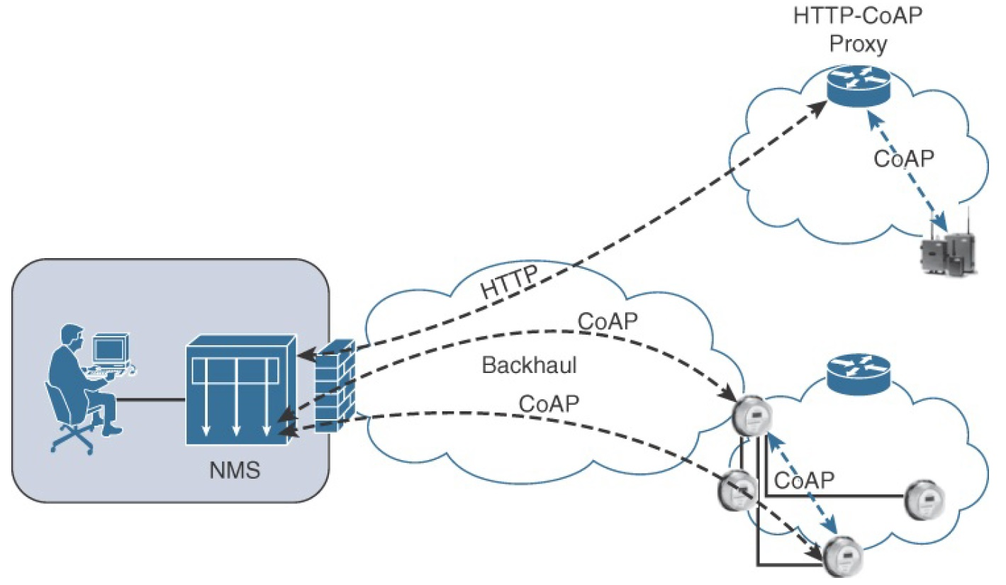
IoT Protocol Stack- Application Layer Protocols
Application Layer Protocols- CoAP
CoAP Communications in IoT Infrastructures
* IoT Fundamentals: Networking Technologies, Protocols, and Use Cases for the Internet of Thing, Cisco press, 2017
Notes:
Connections can be between devices located on the same or different constrained networks or between devices and generic Internet or cloud servers, all operating over IP. Proxy mechanisms are also defined, and RFC 7252 details a basic HTTP mapping for CoAP. As both HTTP and CoAP are IP-based protocols, the proxy function can be located practically anywhere in the network, not necessarily at the border between constrained and non-constrained networks.
Just like HTTP, CoAP is based on the REST architecture, but with a “thing” acting as both the client and the server. Through the exchange of asynchronous messages, a client requests an action via a method code on a server resource. A uniform resource identifier (URI) localized on the server identifies this resource. The server responds with a response code that may include a resource representation. The CoAP request/response semantics include the methods GET, POST, PUT, and DELETE.

Slide 82
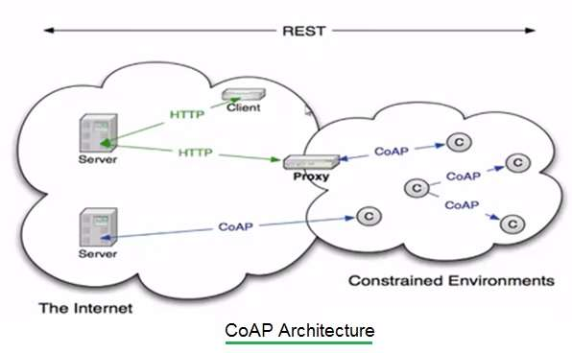
IoT Protocol Stack- Application Layer Protocols
Application Layer Protocols- CoAP
CoAP Architecture
* https://www.rfwireless-world.com/Terminology/Difference-between-CoAP-and-HTTP.html
Notes:
Connections can be between devices located on the same or different constrained networks or between devices and generic Internet or cloud servers, all operating over IP. Proxy mechanisms are also defined, and RFC 7252 details a basic HTTP mapping for CoAP. As both HTTP and CoAP are IP-based protocols, the proxy function can be located practically anywhere in the network, not necessarily at the border between constrained and non-constrained networks.
Just like HTTP, CoAP is based on the REST architecture, but with a “thing” acting as both the client and the server. Through the exchange of asynchronous messages, a client requests an action via a method code on a server resource. A uniform resource identifier (URI) localized on the server identifies this resource. The server responds with a response code that may include a resource representation. The CoAP request/response semantics include the methods GET, POST, PUT, and DELETE.

Slide 83
IoT Protocol Stack- Application Layer Protocols
Application Layer Protocols- CoAP
CoAP Messages Type
Confirmable
a reliable transmission of messages on UDP protocol
basic congestion control with a default time-out
simple stop and wait retransmission with exponential back-off mechanism
detection of duplicate messages through a message ID
Non-Confirmable
not require reliable transmission
Acknowledgement
the recipient must explicitly either acknowledge or reject the confirmable message using the same message ID
Reset
a recipient sends a reset message when can’t process a confirmable or non-confirmable message
* IoT Fundamentals: Networking Technologies, Protocols, and Use Cases for the Internet of Thing, Cisco press, 2017
Notes:
CoAP defines four types of messages: confirmable, non-confirmable, acknowledgement, and reset. Method codes and response codes included in some of these messages make them carry requests or responses. CoAP code, method and response codes, option numbers, and content format have been assigned by IANA as Constrained RESTful Environments (CoRE) parameters.
A message that does not require reliable transmission (for example, each single measurement out of a stream of sensor data) can be sent as a Non-confirmable message (NON). These are not acknowledged, but still have a Message ID for duplicate detection (in this example, 0x01a0); see Figure 3. When a recipient is not able to process a Non-confirmable message, it may reply with a Reset message (RST).

Slide 84
IoT Protocol Stack- Application Layer Protocols
Application Layer Protocols- CoAP
CoAP Messages semantics
Get
Post
Put
Delete
* IoT Fundamentals: Networking Technologies, Protocols, and Use Cases for the Internet of Thing, Cisco press, 2017
Notes:
From RFC-7252
GET
The GET method retrieves a representation for the information that currently corresponds to the resource identified by the request URI. If the request includes an Accept Option, that indicates the preferred content-format of a response. If the request includes an ETag Option, the GET method requests that ETag be validated and that the representation be transferred only if validation failed. Upon success, a 2.05 (Content) or 2.03 (Valid) Response Code SHOULD be present in the response. The GET method is safe and idempotent.
POST
The POST method requests that the representation enclosed in the request be processed. The actual function performed by the POST method is determined by the origin server and dependent on the target resource. It usually results in a new resource being created or the target resource being updated. If a resource has been created on the server, the response returned by the server SHOULD have a 2.01 (Created) Response Code and SHOULD include the URI of the new resource in a sequence of one or more Location-Path and/or Location-Query Options . If the POST succeeds but does not result in a new resource being created on the server, the response SHOULD have a 2.04 (Changed) Response Code. If the POST succeeds and results in the target resource being deleted, the response SHOULD have a 2.02 (Deleted) Response Code. POST is neither safe nor idempotent.
PUT
The PUT method requests that the resource identified by the request URI be updated or created with the enclosed representation. The representation format is specified by the media type and content coding given in the Content-Format Option, if provided. If a resource exists at the request URI, the enclosed representation SHOULD be considered a modified version of that resource, and a 2.04 (Changed) Response Code SHOULD be returned. If no resource exists, then the server MAY create a new resource with that URI, resulting in a 2.01 (Created) Response Code. If the resource could not be created or modified, then an appropriate error Response Code SHOULD be sent. Further restrictions to a PUT can be made by including the If-Match or If-None-Match options in the request. PUT is not safe but is idempotent.
DELETE
The DELETE method requests that the resource identified by the request URI be deleted. A 2.02 (Deleted) Response Code SHOULD be used on success or in case the resource did not exist before the request. DELETE is not safe but is idempotent.

Slide 85
IoT Protocol Stack- Application Layer Protocols
CoAP vs HTTP
CoAP stands for Constrained Application Protocol and HTTP stands for Hyper Text Transfer Protocol.
CoAP is upgraded version of HTTP. It is designed for resource constrained applications such as IoT/WSN/M2M etc.
CoAP is based on UDP. It uses ACK messages so that it will become reliable like TCP.
CoAP has low latency and consumes lesser power compare to HTTP.
* https://www.rfwireless-world.com/Terminology/Difference-between-CoAP-and-HTTP.html
Notes:
From RFC-7252
GET
The GET method retrieves a representation for the information that currently corresponds to the resource identified by the request URI. If the request includes an Accept Option, that indicates the preferred content-format of a response. If the request includes an ETag Option, the GET method requests that ETag be validated and that the representation be transferred only if validation failed. Upon success, a 2.05 (Content) or 2.03 (Valid) Response Code SHOULD be present in the response. The GET method is safe and idempotent.
POST
The POST method requests that the representation enclosed in the request be processed. The actual function performed by the POST method is determined by the origin server and dependent on the target resource. It usually results in a new resource being created or the target resource being updated. If a resource has been created on the server, the response returned by the server SHOULD have a 2.01 (Created) Response Code and SHOULD include the URI of the new resource in a sequence of one or more Location-Path and/or Location-Query Options . If the POST succeeds but does not result in a new resource being created on the server, the response SHOULD have a 2.04 (Changed) Response Code. If the POST succeeds and results in the target resource being deleted, the response SHOULD have a 2.02 (Deleted) Response Code. POST is neither safe nor idempotent.
PUT
The PUT method requests that the resource identified by the request URI be updated or created with the enclosed representation. The representation format is specified by the media type and content coding given in the Content-Format Option, if provided. If a resource exists at the request URI, the enclosed representation SHOULD be considered a modified version of that resource, and a 2.04 (Changed) Response Code SHOULD be returned. If no resource exists, then the server MAY create a new resource with that URI, resulting in a 2.01 (Created) Response Code. If the resource could not be created or modified, then an appropriate error Response Code SHOULD be sent. Further restrictions to a PUT can be made by including the If-Match or If-None-Match options in the request. PUT is not safe but is idempotent.
DELETE
The DELETE method requests that the resource identified by the request URI be deleted. A 2.02 (Deleted) Response Code SHOULD be used on success or in case the resource did not exist before the request. DELETE is not safe but is idempotent.

Slide 86
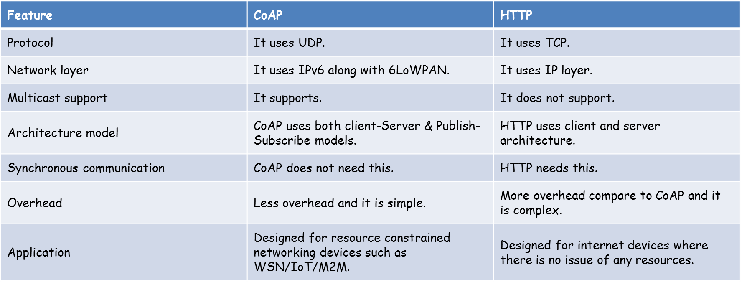
IoT Protocol Stack- Application Layer Protocols
CoAP vs HTTP
* https://www.rfwireless-world.com/Terminology/Difference-between-CoAP-and-HTTP.html
Notes:
From RFC-7252
GET
The GET method retrieves a representation for the information that currently corresponds to the resource identified by the request URI. If the request includes an Accept Option, that indicates the preferred content-format of a response. If the request includes an ETag Option, the GET method requests that ETag be validated and that the representation be transferred only if validation failed. Upon success, a 2.05 (Content) or 2.03 (Valid) Response Code SHOULD be present in the response. The GET method is safe and idempotent.
POST
The POST method requests that the representation enclosed in the request be processed. The actual function performed by the POST method is determined by the origin server and dependent on the target resource. It usually results in a new resource being created or the target resource being updated. If a resource has been created on the server, the response returned by the server SHOULD have a 2.01 (Created) Response Code and SHOULD include the URI of the new resource in a sequence of one or more Location-Path and/or Location-Query Options . If the POST succeeds but does not result in a new resource being created on the server, the response SHOULD have a 2.04 (Changed) Response Code. If the POST succeeds and results in the target resource being deleted, the response SHOULD have a 2.02 (Deleted) Response Code. POST is neither safe nor idempotent.
PUT
The PUT method requests that the resource identified by the request URI be updated or created with the enclosed representation. The representation format is specified by the media type and content coding given in the Content-Format Option, if provided. If a resource exists at the request URI, the enclosed representation SHOULD be considered a modified version of that resource, and a 2.04 (Changed) Response Code SHOULD be returned. If no resource exists, then the server MAY create a new resource with that URI, resulting in a 2.01 (Created) Response Code. If the resource could not be created or modified, then an appropriate error Response Code SHOULD be sent. Further restrictions to a PUT can be made by including the If-Match or If-None-Match options in the request. PUT is not safe but is idempotent.
DELETE
The DELETE method requests that the resource identified by the request URI be deleted. A 2.02 (Deleted) Response Code SHOULD be used on success or in case the resource did not exist before the request. DELETE is not safe but is idempotent.

Slide 87
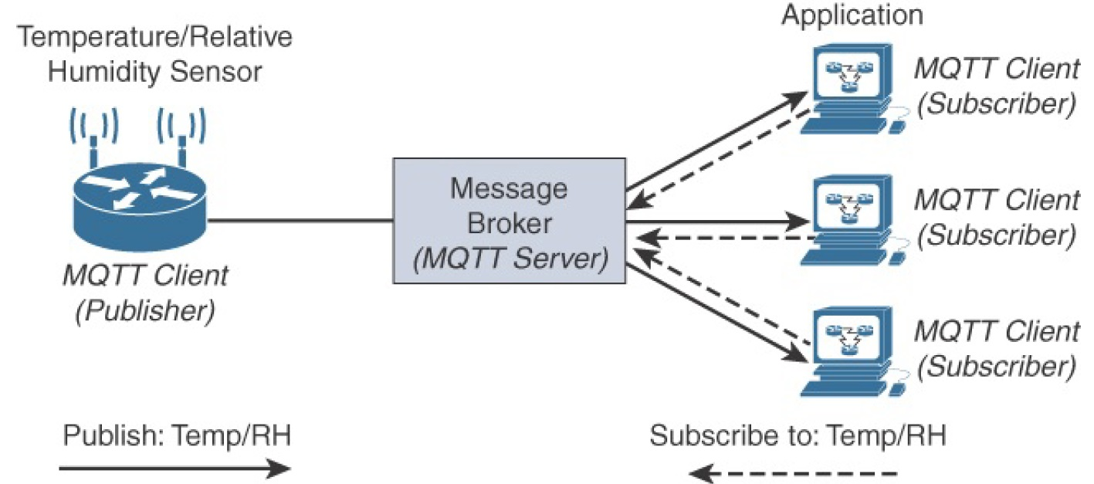
IoT Protocol Stack- Application Layer Protocols
Application Layer Protocols- MQTT
MQTT Publish/Subscribe Framework
* IoT Fundamentals: Networking Technologies, Protocols, and Use Cases for the Internet of Thing, Cisco press, 2017
Notes:
An MQTT client can act as a publisher to send data (or resource information) to an MQTT server acting as an MQTT message broker. In Figure, the MQTT client on the left side is a temperature (Temp) and relative humidity (RH) sensor that publishes its Temp/RH data.
The MQTT server (or message broker) accepts the network connection along with application messages, such as Temp/RH data, from the publishers. It also handles the subscription and unsubscription process and pushes the application data to MQTT clients acting as subscribers.
The application on the right side of Figure is an MQTT client that is a subscriber to the Temp/RH data being generated by the publisher or sensor on the left. This model, where subscribers express a desire to receive information from publishers, is well known.
With MQTT, clients can subscribe to all data (using a wildcard character) or specific data from the information tree of a publisher. In addition, the presence of a message broker in MQTT decouples the data transmission between clients acting as publishers and subscribers. In fact, publishers and subscribers do not even know (or need to know) about each other. A benefit of having this decoupling is that the MQTT message broker ensures that information can be buffered and cached in case of network failures. This also means that publishers and subscribers do not have to be online at the same time.
MQTT control packets run over a TCP transport using port 1883. TCP ensures an ordered, lossless stream of bytes between the MQTT client and the MQTT server. Optionally, MQTT can be secured using TLS on port 8883, and WebSocket (defined in RFC 6455) can also be used.

Slide 88
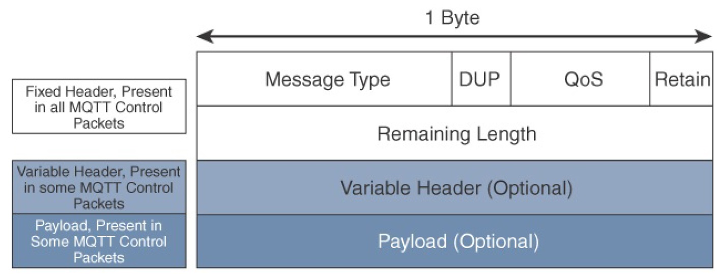
IoT Protocol Stack- Application Layer Protocols
Application Layer Protocols- MQTT
MQTT Message Format
* IoT Fundamentals: Networking Technologies, Protocols, and Use Cases for the Internet of Thing, Cisco press, 2017

Slide 89
IoT Protocol Stack- Application Layer Protocols
MQTT vs HTTP
MQTT is data centric whereas HTTP is document-centric.
HTTP is request-response protocol for client-server computing and not always optimized for mobile devices. Whereas MQTT is lightweight protocol (MQTT transfers data as a byte array) and publish/subscribe model, which makes it perfect for resource-constrained devices and help to save battery.
MQTT has pretty short specification. There are only CONNECT, PUBLISH, SUBSCRIBE, UNSUBSCRIBE and DISCONNECT types that are significant for developers. Whereas HTTP specifications are much longer.
MQTT has a very short message header and the smallest packet message size of 2 bytes
* https://medium.com/mqtt-buddy/mqtt-vs-http-which-one-is-the-best-for-iot-c868169b3105
Notes:
MQTT is data centric whereas HTTP is document-centric. HTTP is request-response protocol for client-server computing and not always optimized for mobile devices. Main solid benefits of MQTT in these terms are lightweightness (MQTT transfers data as a byte array) and publish/subscribe model, which makes it perfect for resource-constrained devices and help to save battery.
Besides, publish/subscribe model provides clients with independent existence from one another and enhance the reliability of the whole system. When one client is out of order the whole system can keep on working properly.
Speed and Delivery
According to measurements in 3G networks, throughput of MQTT is 93 times faster than HTTP’s.
Besides, in comparison to HTTP, MQTT Protocol ensures high delivery guarantees. There are 3 levels of Quality of Services:
- at most once: guarantees a best effort delivery.
- at least once: guaranteed that a message will be delivered at least once. But the message can also be delivered more than once.
- exactly once: guarantees that each message is received only once by the counterpart
MQTT also provides users with options of Last will & Testament and Retained messages. The first means that in case of unexpected disconnection of a client all subscribed clients will get a message from a broker. Retained message means that a newly subscribed client will get an immediate status update.
HTTP Protocol has none of these abilities.
Complexity and Message Size MQTT has pretty short specification. There are only CONNECT, PUBLISH, SUBSCRIBE, UNSUBSCRIBE and DISCONNECT types that are significant for developers. Whereas HTTP specifications are much longer.
MQTT has a very short message header and the smallest packet message size of 2 bytes. Using text message format by HTTP protocol allows it to compose lengthy headers and messages. It helps to eliminate troubles because it can be read by humans, but at the same time it’s needless for resource-constrained devices.

Slide 90
IoT Protocol Stack- Application Layer Protocols
MQTT vs HTTP
According to measurements in 3G networks, throughput of MQTT is 93 times faster than HTTP’s.
Besides, in comparison to HTTP, MQTT Protocol ensures high delivery guarantees. There are 3 levels of Quality of Services:
at most once: guarantees a best effort delivery.
at least once: guaranteed that a message will be delivered at least once. But the message can also be delivered more than once.
exactly once: guarantees that each message is received only once by the counterpart
* https://medium.com/mqtt-buddy/mqtt-vs-http-which-one-is-the-best-for-iot-c868169b3105
Notes:
MQTT is data centric whereas HTTP is document-centric. HTTP is request-response protocol for client-server computing and not always optimized for mobile devices. Main solid benefits of MQTT in these terms are lightweightness (MQTT transfers data as a byte array) and publish/subscribe model, which makes it perfect for resource-constrained devices and help to save battery.
Besides, publish/subscribe model provides clients with independent existence from one another and enhance the reliability of the whole system. When one client is out of order the whole system can keep on working properly.
Speed and Delivery
According to measurements in 3G networks, throughput of MQTT is 93 times faster than HTTP’s.
Besides, in comparison to HTTP, MQTT Protocol ensures high delivery guarantees. There are 3 levels of Quality of Services:
- at most once: guarantees a best effort delivery.
- at least once: guaranteed that a message will be delivered at least once. But the message can also be delivered more than once.
- exactly once: guarantees that each message is received only once by the counterpart
MQTT also provides users with options of Last will & Testament and Retained messages. The first means that in case of unexpected disconnection of a client all subscribed clients will get a message from a broker. Retained message means that a newly subscribed client will get an immediate status update.
HTTP Protocol has none of these abilities.
Complexity and Message Size MQTT has pretty short specification. There are only CONNECT, PUBLISH, SUBSCRIBE, UNSUBSCRIBE and DISCONNECT types that are significant for developers. Whereas HTTP specifications are much longer.
MQTT has a very short message header and the smallest packet message size of 2 bytes. Using text message format by HTTP protocol allows it to compose lengthy headers and messages. It helps to eliminate troubles because it can be read by humans, but at the same time it’s needless for resource-constrained devices.

Slide 91
IoT Protocol Stack- Application Layer Protocols
MQTT vs HTTP
Features |  | HTTP
Full form | Message Queue Telemetry Transport | Hyper Text Transfer Protocol
Architecture | It has publish/subscribe architecture. Here devices can publish any topics and can also subscribe for any topics for any updates. | It has request/response means Client/Server architecture.
Upper layer protocol | It runs over TCP. | It runs over TCP and UDP.
message size | small, . | Large,
Message format | binary with 2Byte header | ASCII format.
Data distribution | 1 to 0/1/N | one to one only , more POST
Data security | Yes, It uses SSL/TLS for security | NO, hence HTTPS is used to provide data security
Complexity | Simple | Client more complex (ASCII parser)
Encryption | It encrypts payload i.e. it is payload agnostic | data are not encrypted before transmission
When to use | if your project is to let the fridge to communicate with the thermometer to adapt the engine pump, you can use the MQTT easily | if you need to collect big data from around the world, then you can think to use HTTP
* https://iotdunia.com/mqtt-and-http/

Slide 92
IoT Protocol Stack- Application Layer Protocols
CoAP vs MQTT
مقدمات اولیه الکترونیک
سیگنال های الکترونیکی
میکروکنترلرها و پلتفرم های سخت افزاری ( رزبری پای – آردینو)
سنسور ها و عملگر ها
مفاهیم ارتباطات بی سیم
دروازه شبکه IoT
Factor | CoAP | MQTT
Main transport protocol | UDP | TCP
Typical messaging | Request/response | Publish/Subscribe
Effectiveness in LLNs | Excellent | low
Security | DTLS | SSl/TLS
Communication model | one-to-one | Many-to-many
Strengths | Lightweight, fast, low overhead, support for multicasting messages | Robust communication, simple management, scalability
Weakness | Not as reliable as MQTT | Higher overhead, no multicasting support
* IoT Fundamentals: Networking Technologies, Protocols, and Use Cases for the Internet of Thing, Cisco press, 2017

Slide 93
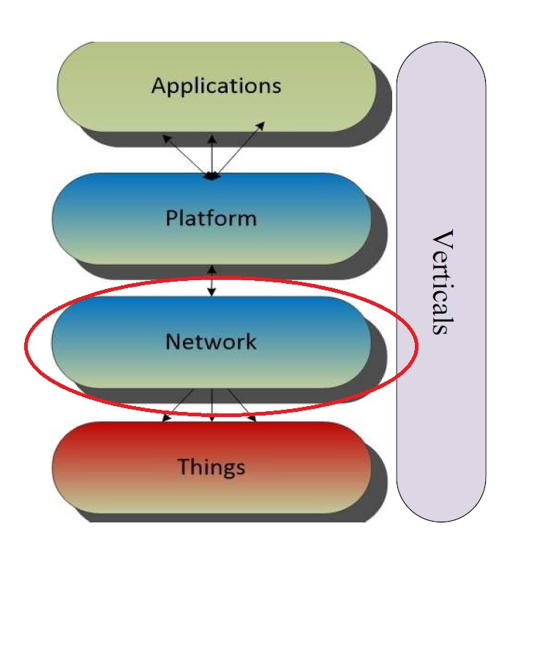
Next Lecture
An overview of
LoRA
LoRAWAN

