Slide 1
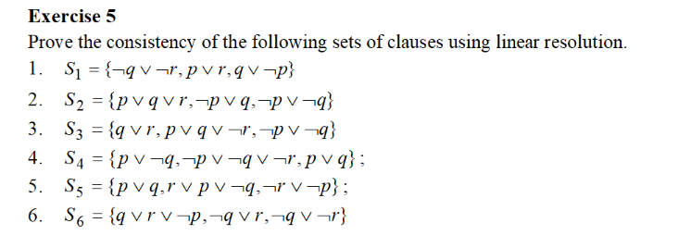
Problem statement

Slide 2

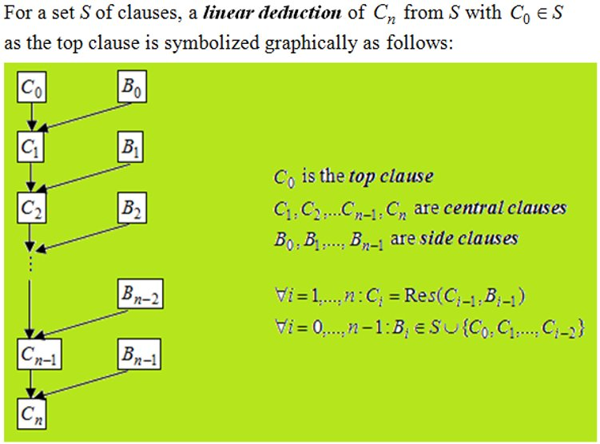
Theoretical results
Linear resolution

Slide 3
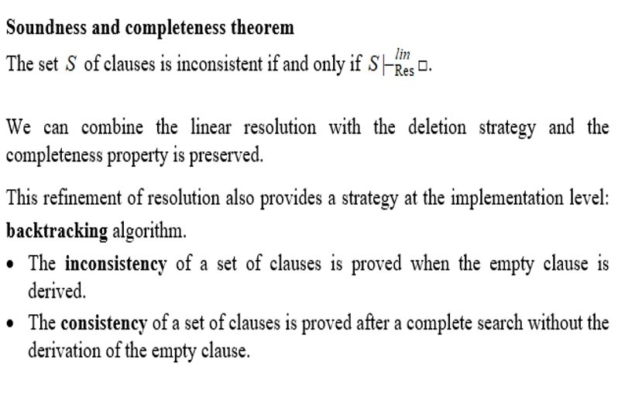
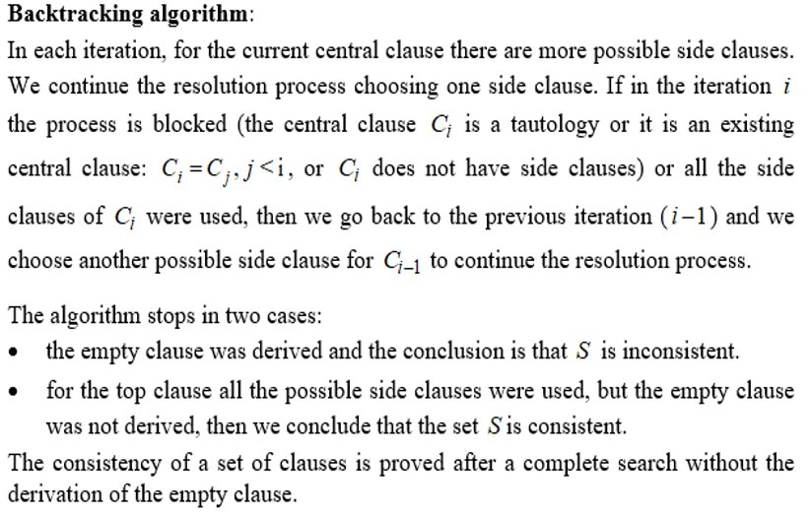

Slide 4
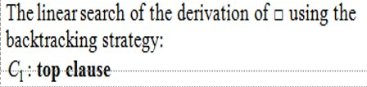
C1= C2= C3=
2)C3 is used as a side clause for C1
1) C2 is used as a side clause for C1
C8=Resq(C1,C3)=p
C4=Resp(C1,C2)= ┐ qV ┐r
C5=Resq(C4,C1)= pV ┐q V ┐r
C9=Resp(C7,C2)= ┐qV ┐r
C10=Resq(C9,C3)=pV ┐r
C11=Resp(C10,C2)= ┐qV ┐r =C9
Process blocked.
C6=Resp(C5,C2)= ┐qV ┐r
C7=Resq(C6,C3)= pV ┐r=C5
Process blocked
C1=top clause
C1
C2,C3
C1
C2,C3
C4
C1
C8
C2
C5
C2
C9
C2
C10
C3
C6
C3
C11=C9
Process blocked.
C7=C5
Process blocked.

Slide 5
Conclusions
A complete linear derivation search was perfomed, but was not derived, so S4 is a consistent set.

