Slide 1
JVM体系结构概述
任富飞 & 冯宏 @2019年08月

Slide 2
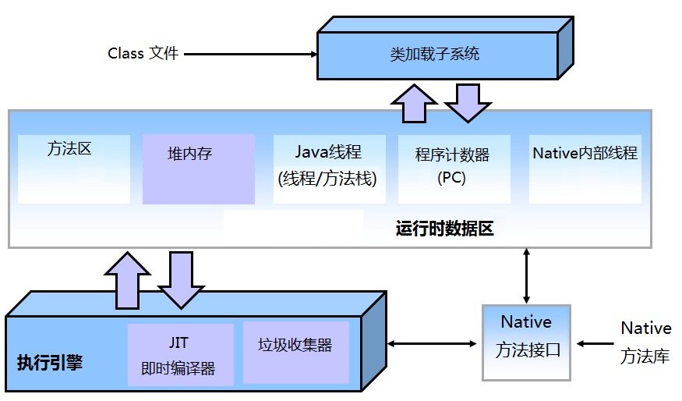
Hotspot JVM 架构

Slide 3
JVM 体系结构
相关术语
运行时数据区
类加载子系统
垃圾收集器
JIT即时编译器

Slide 4
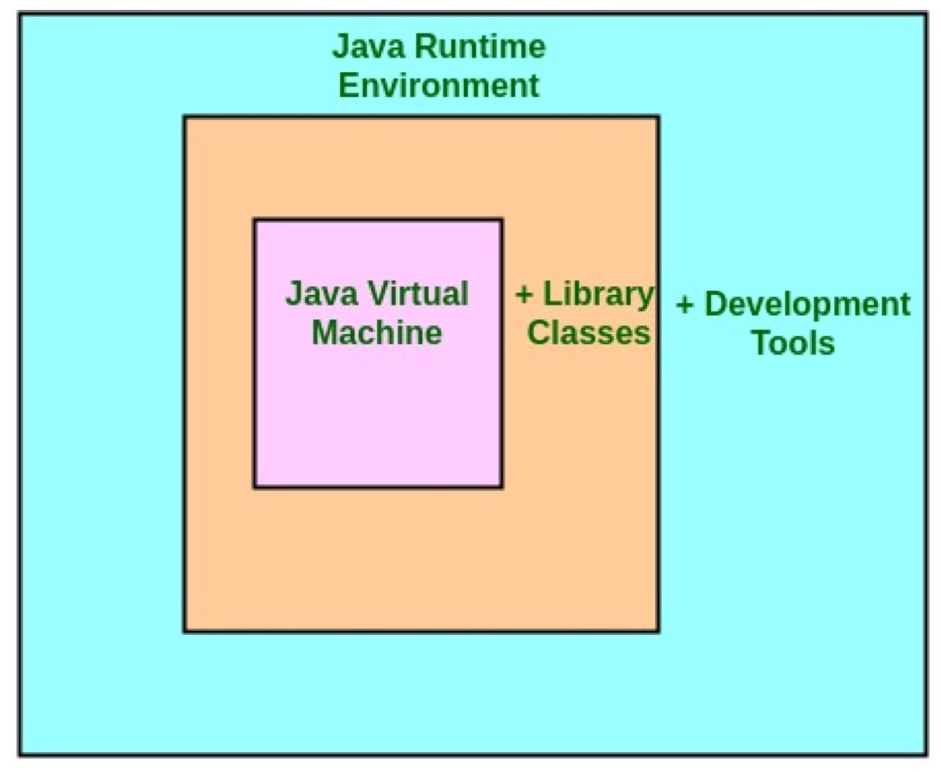
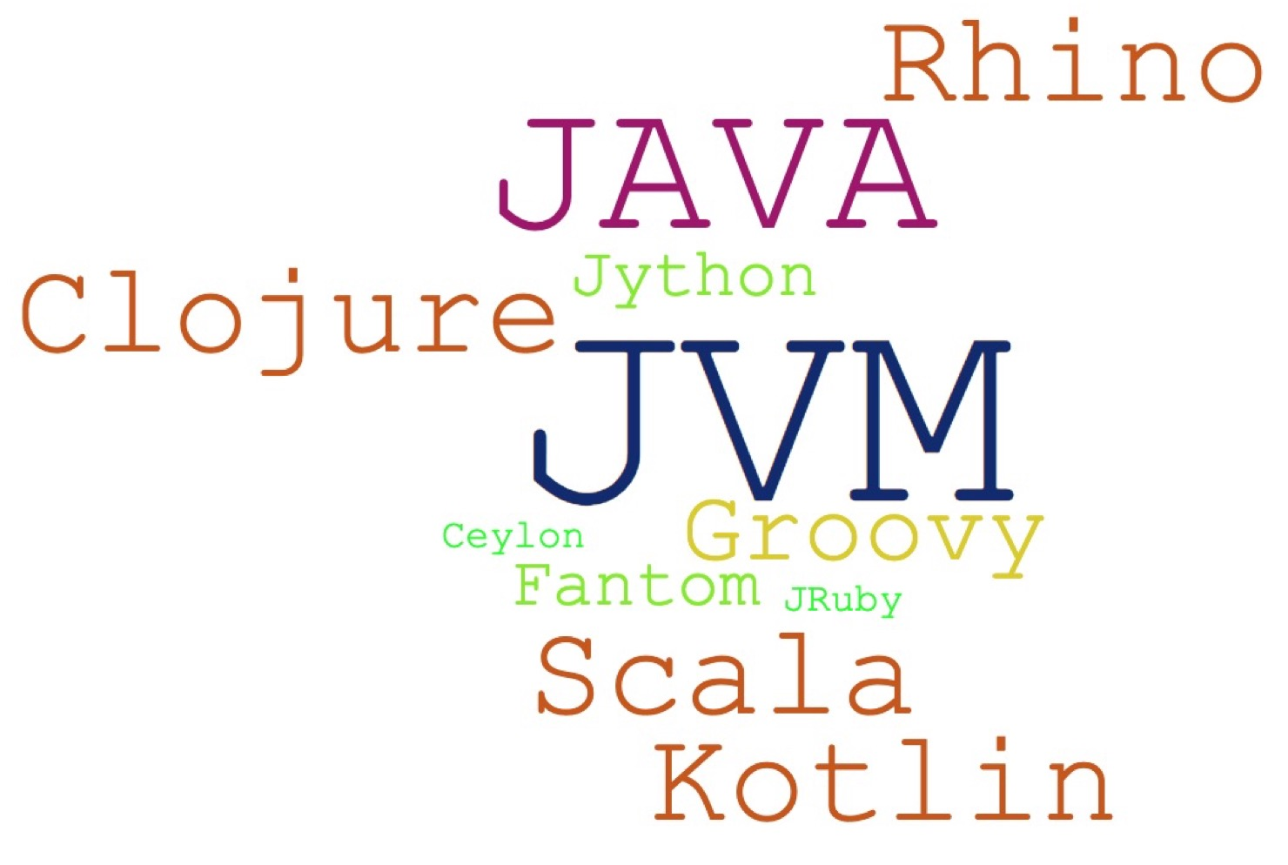
相关术语
JDK & JRE & JVM
讨论: Vendor有哪些?
JVM Languages

Slide 5
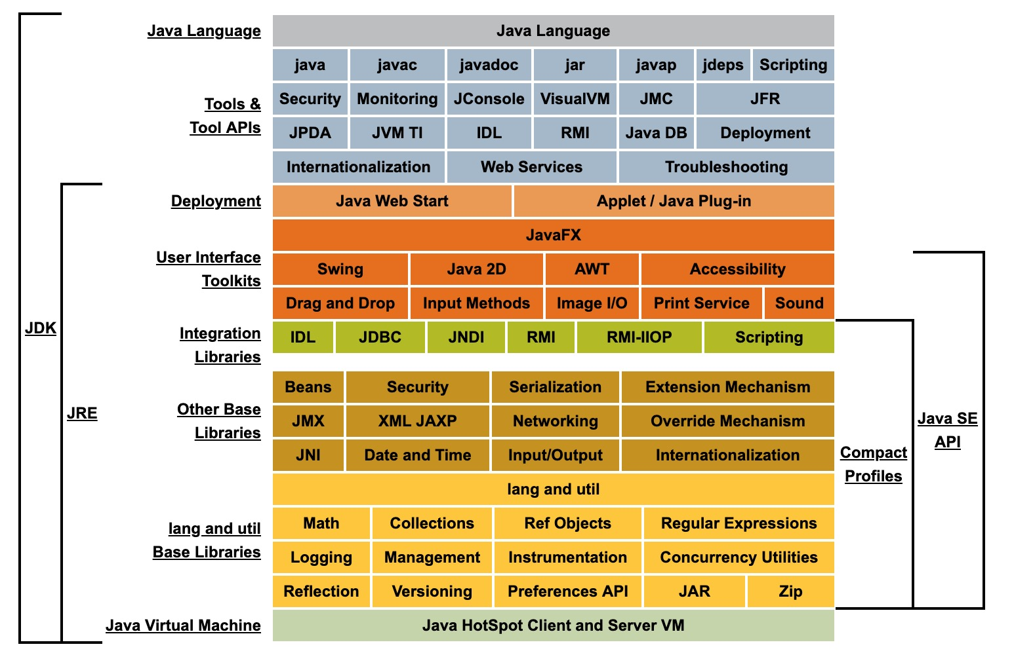
Java 体系 结构
https://docs.oracle.com/javase/8/docs/index.html

Slide 6
运行时数据区
JVM规范中的运行时数据区:
The pc Register
Java Virtual Machine Stack
Heap
Method Area
Run-Time Constant Pool
Native Method Stacks

Slide 7
Hotspot运行时数据区
Java进程
… 其他进程
操作系统
栈
Stack
堆
Heap
非堆
Non-Heap
JVM自身
堆外内存
Direct Buffer
……
线程栈1
年轻代
Young-gen
老年代
Old-gen
元数据区
Metaspace
Compressed Class Space
Code Cache
Frame
方法帧
Frame…
Frame…
JIT
新生代
Eden-Space
S0
S1
方法区
常量池
常量池指针
局部变量表
操作数栈
TLAB
TLAB

Slide 8
pc 程序计数器
program counter register
per Java Thread, Virtual pc
CPU pc
current opcode address
指向方法区的地址值
Java代码对pc无直接影响
JIT代码置换对pc的影响

Slide 9
Java虚拟机栈
Java Virtual Machine Stacks, Java Stack(JDK 1.0)
per thread, private
C Stack
Frame/per method call
StackOverflowError
OutOfMemoryError
启动参数“-Xss1m”
栈
Stack
……
线程栈1
Frame
方法帧
Frame…
Frame…
常量池指针
局部变量表
操作数栈

Slide 10
本地方法栈
Native Method Stacks
"C stacks"
per Thread
JNI方法
fixed or dynamically
StackOverflowError
OutOfMemoryError
JVM规范并未强制要求实现

Slide 11
堆内存(Heap)
GC堆, shared
年轻代
新生代
TLAB
存活区
老年代
OutOfMemoryError
-Xmx16g –Xms16g
堆
Heap
年轻代
Young-gen
老年代
Old-gen
新生代
Eden-Space
S0
S1
TLAB
TLAB

Slide 12
MetaSpace
非堆 Non-Heap
方法区
运行时常量池
Compressed Class Space
Code Cache
元数据区
Metaspace
Compressed Class Space
Code Cache
JIT
方法区
常量池

Slide 13
堆外内存
DirectByteBuffer
MappedByteBuffer
Unsafe
使用场景
优势
示例程序

Slide 14
类加载子系统
Class Loader
class file 格式
Java原生数据类型
JVM数据类型

Slide 15
Class Loader
Bootstrap Class Loader -> display as null
sun.misc.Launcher.ExtClassLoader -> -Djava.ext.dirs
sun.misc.Launcher.AppClassLoader -> -classpath, -jar,
自定义ClassLoader
委托模型: 双亲委派机制? 可见性
举例: Tomcat Context JSP
举例: 自己写一个类 java.lang.HbTempClass

Slide 16
打印 Class Loader
public class PrintClassLoader { public static void main(String[] args) { // null --> bootstrap System.out.println("Object.classloader: " + Object.class.getClassLoader()); // sun.misc.Launcher$AppClassLoader System.out.println("PrintClassLoader.classloader: " + PrintClassLoader.class.getClassLoader()); System.out.println("SystemClassLoader: " + ClassLoader.getSystemClassLoader()); // sun.misc.Launcher$ExtClassLoader System.out.println("PrintClassLoader.classloader.parent: " + PrintClassLoader.class.getClassLoader().getParent()); } }

Slide 17
自定义 Class Loader
import java.io.*; public class HbClassLoader extends ClassLoader { @Override public Class findClass(String name) throws ClassNotFoundException { byte[] b = loadClassFromFile(name); return defineClass(name, b, 0, b.length); } private byte[] loadClassFromFile(String className) { // 换成用密钥从网络上下载试试? // 从自定义的路径查找试试? InputStream inputStream = getClass().getClassLoader().getResourceAsStream( className.replace('.', File.separatorChar) + ".class"); ByteArrayOutputStream byteStream = new ByteArrayOutputStream(); try { int nextValue = 0; while ((nextValue = inputStream.read()) != -1) { byteStream.write(nextValue); } } catch (IOException e) { e.printStackTrace(); } byte[] buffer = byteStream.toByteArray(); return buffer; } }

Slide 18
class file 格式
ClassFile结构定义
class文件示例
major versions简介
Field 描述信息
The Constant Pool
Method
Attribute
Verification of class Files
Constraints on Java Virtual Machine Code
Limitations of the Java Virtual Machine

Slide 19
ClassFile结构定义
ClassFile {
u4 magic;
u2 minor_version;
u2 major_version;
u2 constant_pool_count;
cp_info constant_pool[constant_pool_count-1];
u2 access_flags;
u2 this_class;
u2 super_class;
u2 interfaces_count;
u2 interfaces[interfaces_count];
u2 fields_count;
field_info fields[fields_count];
u2 methods_count;
method_info methods[methods_count];
u2 attributes_count;
attribute_info attributes[attributes_count];
}

Slide 20
class文件示例
javap -c -l com/hb/HelloWorld
Compiled from "HelloWorld.java" public class com.hb.HelloWorld { public com.hb.HelloWorld(); Code: 0: aload_0 1: invokespecial #1 // Method java/lang/Object."<init>":()V 4: return LineNumberTable: line 4: 0 LocalVariableTable: Start Length Slot Name Signature 0 5 0 this Lcom/hb/HelloWorld; public void sayHello(); Code: 0: getstatic #2 // Field java/lang/System.out:Ljava/io/PrintStream; 3: ldc #3 // String Hello 5: invokevirtual #4 // Method java/io/PrintStream.println:(Ljava/lang/String;)V 8: return LineNumberTable: line 7: 0 line 8: 8 LocalVariableTable: Start Length Slot Name Signature 0 9 0 this Lcom/hb/HelloWorld; }
javap
hex

Slide 21
javap -v -c -l -p com/hb/HelloWorld
public class com.hb.HelloWorld minor version: 0 major version: 52 flags: ACC_PUBLIC, ACC_SUPER Constant pool: #1 = Methodref #6.#17 // java/lang/Object."<init>":()V #2 = Fieldref #18.#19 // java/lang/System.out:Ljava/io/PrintStream; #3 = String #20 // Hello #4 = Methodref #21.#22 // java/io/PrintStream.println:(Ljava/lang/String;)V #5 = Class #23 // com/hb/HelloWorld #6 = Class #24 // java/lang/Object #7 = Utf8 <init> #8 = Utf8 ()V #9 = Utf8 Code #10 = Utf8 LineNumberTable #11 = Utf8 LocalVariableTable #12 = Utf8 this #13 = Utf8 Lcom/hb/HelloWorld; #14 = Utf8 sayHello #15 = Utf8 SourceFile #16 = Utf8 HelloWorld.java #17 = NameAndType #7:#8 // "<init>":()V #18 = Class #25 // java/lang/System #19 = NameAndType #26:#27 // out:Ljava/io/PrintStream; #20 = Utf8 Hello #21 = Class #28 // java/io/PrintStream #22 = NameAndType #29:#30 // println:(Ljava/lang/String;)V #23 = Utf8 com/hb/HelloWorld #24 = Utf8 java/lang/Object #25 = Utf8 java/lang/System #26 = Utf8 out #27 = Utf8 Ljava/io/PrintStream; #28 = Utf8 java/io/PrintStream #29 = Utf8 println #30 = Utf8 (Ljava/lang/String;)V

Slide 22
major versions简介
Java SE | Corresponding major version | Supported major versions
1.0.2 | 45 | 45
1.1 | 45 | 45
1.2 | 46 | 45 .. 46
1.3 | 47 | 45 .. 47
1.4 | 48 | 45 .. 48
5.0 | 49 | 45 .. 49
6 | 50 | 45 .. 50
7 | 51 | 45 .. 51
8 | 52 | 45 .. 52
9 | 53 | 45 .. 53
10 | 54 | 45 .. 54
11 | 55 | 45 .. 55
12 | 56 | 45 .. 56

Slide 23
Fields定义
field_info {
u2 access_flags;
u2 name_index;
u2 descriptor_index;
u2 attributes_count;
attribute_info attributes[attributes_count];
}
FieldType term(Descriptor) | Type
B | byte
C | char
D | double
F | float
I | int
J | long
L ClassName ; | reference
S | short
Z | boolean
[ | reference
Access Flag Name | Value
ACC_PUBLIC | 0x0001
ACC_PRIVATE | 0x0002
ACC_PROTECTED | 0x0004
ACC_STATIC | 0x0008
ACC_FINAL | 0x0010
ACC_VOLATILE | 0x0040
ACC_TRANSIENT | 0x0080
ACC_SYNTHETIC | 0x1000
ACC_ENUM | 0x4000

Slide 24
class file中的Constant Pool
Kind | Tag
CONSTANT_Class | 7
CONSTANT_Fieldref | 9
CONSTANT_Methodref | 10
CONSTANT_InterfaceMethodref | 11
CONSTANT_String | 8
CONSTANT_Integer | 3
CONSTANT_Float | 4
CONSTANT_Long | 5
CONSTANT_Double | 6
CONSTANT_NameAndType | 12
CONSTANT_Utf8 | 1
CONSTANT_MethodHandle | 15
CONSTANT_MethodType | 16
CONSTANT_Dynamic | 17
CONSTANT_InvokeDynamic | 18
CONSTANT_Module | 19
CONSTANT_Package | 20
cp_info {
u1 tag;
u1 info[];
}

Slide 25
Methods
Flag Name | Value
ACC_PUBLIC | 0x0001
ACC_PRIVATE | 0x0002
ACC_PROTECTED | 0x0004
ACC_STATIC | 0x0008
ACC_FINAL | 0x0010
ACC_SYNCHRONIZED | 0x0020
ACC_BRIDGE | 0x0040
ACC_VARARGS | 0x0080
ACC_NATIVE | 0x0100
ACC_ABSTRACT | 0x0400
ACC_STRICT | 0x0800
ACC_SYNTHETIC | 0x1000
method_info {
u2 access_flags;
u2 name_index;
u2 descriptor_index;
u2 attributes_count;
attribute_info attributes[attributes_count];
}

Slide 26
Attributes
Exceptions
InnerClasses
EnclosingMethod
Synthetic
Signature
SourceFile
LineNumberTable
LocalVariableTable
LocalVariableTypeTable
attribute_info {
u2 attribute_name_index;
u4 attribute_length;
u1 info[attribute_length];
}

Slide 27
JVM Data Type
Actual type | Computational type | Category
boolean | int | 1
byte | int | 1
char | int | 1
short | int | 1
int | int | 1
float | float | 1
reference | reference | 1
returnAddress | returnAddress | 1
long | long | 2
double | double | 2

Slide 28

垃圾收集器
GC理论
GC算法
CMS
G1
ZGC/C4
内存泄漏vs.内存溢出
相关课程: 参考【GC专题】

Slide 29
即时编译器(JIT)
Just In Time Compiler
C1 -客户端模式
C2 -服务端模式
与解释器的区别
相关启动参数

Slide 30
JIT相关启动参数
-server
-client
-Djava.compiler=NONE
-XX:+PrintCompilation
-Xint

Slide 31
Q&A
自由交流
相关资料

