Slide 1
JMM与线程安全
任富飞 & 冯宏 @2019年08月

Slide 2

JMM与线程安全
Java内存模型
锁的特性分类
Monitor与Lock
CAS-无锁技术
死锁
线程不安全问题
锁优化技术
对象内存布局

Slide 3
Java内存模型
定义: Java语言规范 $17.4章节
JSR-133. Java Memory Model and Thread Specification
多线程执行时的一系列语义规则
计算机程序基本特性: 确定性, 可预测性
指令重排: 编译器优化/处理器优化/load/store
Happens-before
共享内存/局部变量
线程间的交互

Slide 4
JMM情景分析
//并发执行一次Task1和Task2, 是否会出现 “r1=2并且r2=2” private static int flagA, flagB = 0; private static class Task1 implements Runnable { public void run() { int r1 = flagA; // 指令1 flagB = 2; // 指令2 } } private static class Task2 implements Runnable { public void run() { int r2 = flagB; // 指令3 flagA = 2; // 指令4 } }
内存屏障类型
#LoadLoad
#StoreStore
#LoadStore
#StoreLoad

Slide 5
锁的特性分类
可重入锁
公平锁/非公平锁
共享锁/排他锁/互斥锁/读写锁
自旋
乐观/悲观
物理锁/逻辑锁
偏向锁/重量级锁
分布式锁
锁的粒度

Slide 6
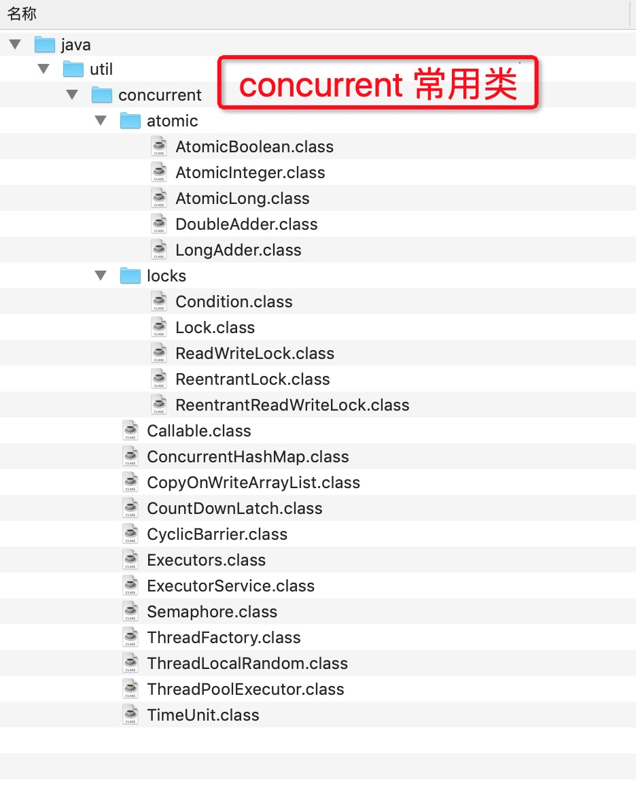
Monitor与Lock
synchronized
Monitor, 管程
java.util.concurrent
java.util.concurrent.atomic
java.util.concurrent.locks

Slide 7
偏向锁的示例
import org.openjdk.jol.info.ClassLayout; import org.openjdk.jol.vm.VM; import java.util.concurrent.TimeUnit; public class JOLSample_13_BiasedLocking { public static void main(String[] args) throws Exception { System.out.println(VM.current().details()); // sleep >5 seconds to pass the grace period of biased locking TimeUnit.SECONDS.sleep(6); final A a = new A(); ClassLayout layout = ClassLayout.parseInstance(a); System.out.println("**** Fresh object"); System.out.println(layout.toPrintable()); synchronized (a) { System.out.println("**** With the lock"); System.out.println(layout.toPrintable()); } System.out.println("**** After the lock"); System.out.println(layout.toPrintable()); } public static class A {// no fields } }

Slide 8
重量级锁示例
import org.openjdk.jol.info.ClassLayout; import java.util.concurrent.TimeUnit; public class JOLSample_14_FatLocking { public static class A { /** no fields */ } public static void main(String[] args) throws Exception { final A a = new A(); ClassLayout layout = ClassLayout.parseInstance(a); System.out.println("**** Fresh object\n" + layout.toPrintable()); Thread t = new Thread(new Runnable() { public void run() { synchronized (a) { try { TimeUnit.SECONDS.sleep(10); } catch (InterruptedException e) {return; }}} }); t.start(); TimeUnit.SECONDS.sleep(1); System.out.println("**** Before the lock\n" + layout.toPrintable()); synchronized (a) { System.out.println("**** With the lock\n" + layout.toPrintable()); } System.out.println("**** After the lock\n" + layout.toPrintable()); System.gc(); System.out.println("**** After System.gc()\n" + layout.toPrintable()); } }

Slide 9
读写锁
分析锁升级的情景
ReadWriteLock接口
ReentrantReadWriteLock实现
ReadLock, 共享
WriteLock, 排他
锁升级与降级
读锁 -> 写锁?
写锁 -> 读锁

Slide 10
CAS-无锁技术
Compare-And-Swap
乐观锁?
Atomic相关类
如何获取Unsafe实例
public static Unsafe getUnsafe(){ Unsafe unsafe =null; try{ Class<?> clazz = Unsafe.class; Field f; f = clazz.getDeclaredField("theUnsafe"); f.setAccessible(true); unsafe = (Unsafe) f.get(clazz); } catch (Exception e) { e.printStackTrace(); } return unsafe; }

Slide 11
线程不安全问题
问题: 什么是线程安全? 什么是线程不安全?
线程间通信
共享与同步
ThreadLocal

Slide 12
线程间通信
共享变量/堆内存
进程级/外部存储
Object#wait/notify/notifyAll
CountdownLatch
CyclicBarrier
FutureTask
Callable
Thread#join()

Slide 13

死锁
多线程
多个资源/锁
进行到一半
怎么协调?
经典案例: 哲学家吃饭问题
讨论: 数据库死锁

Slide 14
案例
自己动手写死锁
Dump线程状态: jstack, jmap, jvisualvm
DeadLockSample2.java
private static Object lock1 = new Object(); private static Object lock2 = new Object(); private static class ThreadTask1 implements Runnable { public void run() { synchronized (lock1){ System.out.println("lock1 by thread:" + Thread.currentThread().getId()); try { TimeUnit.SECONDS.sleep(2); } catch (InterruptedException e) { e.printStackTrace(); } synchronized (lock2){ System.out.println("lock2 by thread:" + Thread.currentThread().getId()); } } } }
jstack -l 51411
Java stack information for the threads listed above: =================================================== "Thread-1": at com.hb.DeadLockSample2$ThreadTask2.run(DeadLockSample2.java:35) - waiting to lock <0x000000076ac0fc88> (a java.lang.Object) - locked <0x000000076ac0fc98> (a java.lang.Object) at java.lang.Thread.run(Thread.java:748) "Thread-0": at com.hb.DeadLockSample2$ThreadTask1.run(DeadLockSample2.java:20) - waiting to lock <0x000000076ac0fc98> (a java.lang.Object) - locked <0x000000076ac0fc88> (a java.lang.Object) at java.lang.Thread.run(Thread.java:748) Found 1 deadlock.

Slide 15
锁优化技术
业务设计角度
程序BUG
性能与粒度
实现成本 vs. 过度优化?

Slide 16
对象内存布局
内容回顾
JVM运行时数据区
Java的原生数据类型
JVM支持的数据类型
Java对象在hotspot中的结构
对象的内存占用
Alignment/Padding

Slide 17
案例
估算BigDecimal对象的内存占用
使用JOL库输出，与估算值进行比较
分析数据量膨胀与内存放大
public class BigDecimal { private final BigInteger intVal; private final int scale; private transient int precision; private transient String stringCache; private final transient long intCompact; // static ...... } // org.openjdk.jol.info.ClassLayout .parseClass(BigDecimal.class) .toPrintable()
OFFSET | SIZE | TYPE | DESCRIPTION
0 | 12 | (object header)
12 | 4 | int | BigDecimal.scale
16 | 8 | long | BigDecimal.intCompact
24 | 4 | int | BigDecimal.precision
28 | 4 | java.math.BigInteger | BigDecimal.intVal
32 | 4 | java.lang.String | BigDecimal.stringCache
36 | 4 | (loss due to the next object alignment)

Slide 18
Q&A
自由交流
相关资料

