Slide 1

MED AI JAM - GROUP 2
VAITALS
Med x Tech
Christina Tse Eiffel Wong
Jon B. Lee Felicity Zhao
Aiyuan Li
Ryan Dang
Shiqi Wu
Shiyu Qiu

Slide 2

67 YEAR OLD MALE STATUS POST HIGH SPEED MOTOR VEHICLE COLLISION. ON EXAM, PATIENT WITH BRUISES TO THE FOREHEAD, PUPILS ARE EQUAL AND REACTIVE TO LIGHT. NEUROSURGERY HAS BEEN CONSULTED.
BLOOD PRESSURE: 149/89
HEART RATE: 73
RESPIRATIONS: 18
THE WORST OUTCOME: HERNIATION
- Occurs due to high pressures in the skull (blood)
- Herniation of the brain has very poor outcomes (1)
- Interventions include: Medications (Mannitol, Saline) and/or surgery (Craniotomy/Burr hole) to reduce the pressure
CLINICAL SIGNS (Physical Exam)
- Early: Headaches, somnolent.
- Late: Obtunded, non-responsive, unilateral dilated pupils, papilledema.
VITAL SIGNS (HR/BP/RR/O2 Sat)
- Cushing's Reflex
Decker, R. & Pearson-Shaver, A. L. Uncal Herniation. in StatPearls (StatPearls Publishing, 2018).

Slide 3


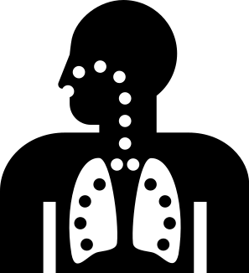

CUSHING'S REFLEX
Tachycardia -> Bradycardia
Hypertension
Irregular Respirations
Fodstad, H., Kelly, P. J. & Buchfelder, M. History of the cushing reflex. Neurosurgery 59, 1132–1137; discussion 1137 (2006).
Kalmar, A. F., Van Aken, J., Caemaert, J., Mortier, E. P. & Struys, M. M. R. F. Value of Cushing reflex as warning sign for brain ischaemia during neuroendoscopy. Br J Anaesth 94, 791–799 (2005).

Slide 4


THE GOLD STANDARD:
Head CT Scans

Slide 5


AI TO DETECT CUSHING'S REFLEX (1)
AI TO DETECT HEMORRHAGE ON CT (2)
- Change in HR >20%
- Change in BP (MAPS) >20%
- Irregular Respirations (Apnea > 5 seconds or respiratory rate >20 bpm)
Demonstrated by Chang et al
Able to detect hemorrhage
Sensitivity: 95%
Specificity: 97%
Yumoto, T. et al. Impact of Cushing’s sign in the prehospital setting on predicting the need for immediate neurosurgical intervention in trauma patients: a nationwide retrospective observational study. Scand J Trauma Resusc Emerg Med 24, 147 (2016).
P.D. Chang, E. Kuoy, J. Grinband, B.D. Weinberg, M. Thompson, R. Homo, J. Chen, H. Abcede, M.Shafie, L. Sugrue, C.G. Filippi, M.-Y. Su, W. Yu, C. Hess, D. Chow Hybrid 3D/2D Convolutional Neural Network for Hemorrhage Evaluation on Head CT. American Journal of Neuroradiology Jul 2018, DOI: 10.3174/ajnr.A5742

Slide 6
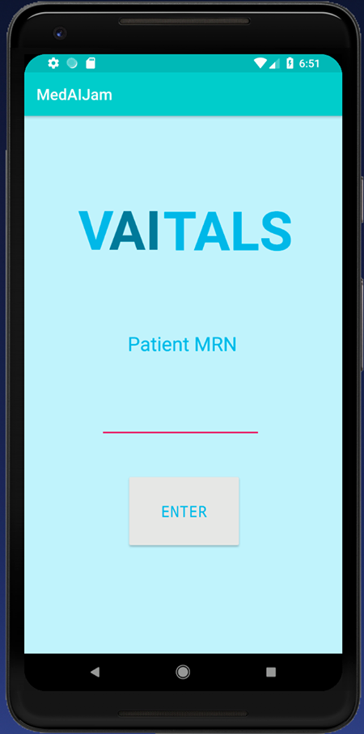
TECHNICAL SOLUTION
AI training
SKLearn Library, Random Forest Classifier
Mobile app programming
SKLearn Porter imported into Android Studio
Notes:
SKLearn library
Used Random Forest Classifier and plugged in data to train model
(handles low volume feature well)
MIT Licensed software - SKLearn Porter, imported into Android Studio

Slide 7
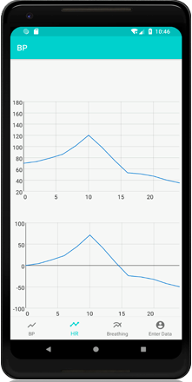
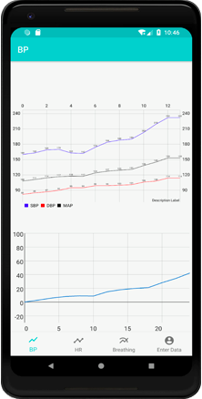

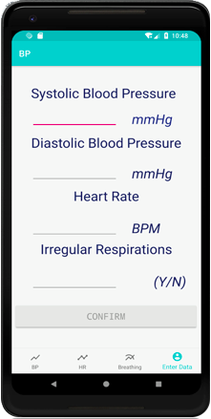

Blood Pressure
MAP
Journal
Heart Rate
Irregular Breathing
% Change
% Change

Slide 8

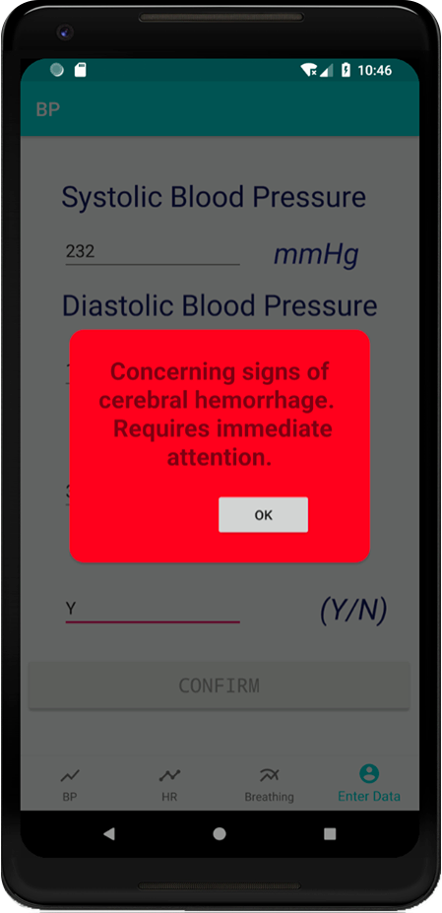

EARLY ALERT SYSTEM

Slide 9
67 YEAR OLD MALE STATUS POST HIGH SPEED MOTOR VEHICLE COLLISION. ON EXAM, PATIENT WITH BRUISES TO THE FOREHEAD, PUPILS ARE EQUAL AND REACTIVE TO LIGHT. NEUROSURGERY HAS BEEN CONSULTED.
BLOOD PRESSURE: 149/89 -> 203/104
HEART RATE: 73 -> 39
RESPIRATIONS: 18 -> Irregular pattern
Without AI
- Patient develops late clinical signs of herniation: unilateral fixed and dilated pupil, papilledema, posturing.
- Burr hole evacuation is attempted, but patient never regains consciousness.
With AI
- Clinicians alerted to early vital sign changes
- Patient is re-evaluated, medical interventions are made to prevent increased intracranial hypertension
- Patient regains consciousness after recovery from neurosurgery.

Slide 10



THE VISION
AI FOR VAITAL SIGN MONITORING
- Cushing's Reflex is well described in the literature, but is there more?
- Discover new subtle vital sign changes to predict a decompensating patient sooner.
- Provide a realistic means of monitoring these subtle changes: offload work from nurses/physicians, earlier and more sensitive detection rates, and improved patient outcomes.

