Slide 1



DEPARTMENT OF ELECTRONICS AND COMMUNICATION ENGINEERING 18ECP103L – MINOR PROJECT 2 METAMATERIAL INSPIRED ANTENNA DESIGN FOR MASSIVE MIMO, 5G COMMUNICATIONS SYSTEM BATCH NO:37
PRESENTED BY:
S.RAGAVI [927621BEC159] GUIDE:
S.REENA [927621BEC164] Mr.T.SIVA KUMAR
S.SARANYA [927621BEC186] Assistant Professor/ECE

Slide 2
CONTENTS
Antenna
Objective
Abstract
Software used
Result and Conclusion
References

Slide 3
Metamaterial
Metamaterial antennas are a class of antennas which use metamaterials to increase performance of miniaturized antenna systems.
Their purpose, as with any electromagnetic antenna, is to launch energy into free space.

Slide 4
Objective :
The main objective of this project is to understand the working and the design of the antenna. Specific Objective:
To design the antenna according to designed specifications.
To be acquainted with some of the characteristics of parasitic antenna element modelling and operations.
To know the antenna radiation pattern.
Test antenna and verify it performs as expected.

Slide 5
ABSTRACT
This project describes a metamaterial-based design of large scale antennas for massive multiple input and multiple output (MIMO) communication systems.
The data link and better performance over modern fifth generation (5G) wireless communication systems is possible with large numbers of such adaptive antennas.
investigate the design of meta-material antennas and analyze the S-parameter, radiation pattern, and define mathematical relationship to find the correlation coefficient and diversity gain.

Slide 6

SOFTWARE USED
Ansys HFSS.
HFSS - High Frequency Structure Simulator.
HFSS is the one of the several commercial
tools used for antenna design,
transmission lines and packaging.

Slide 7
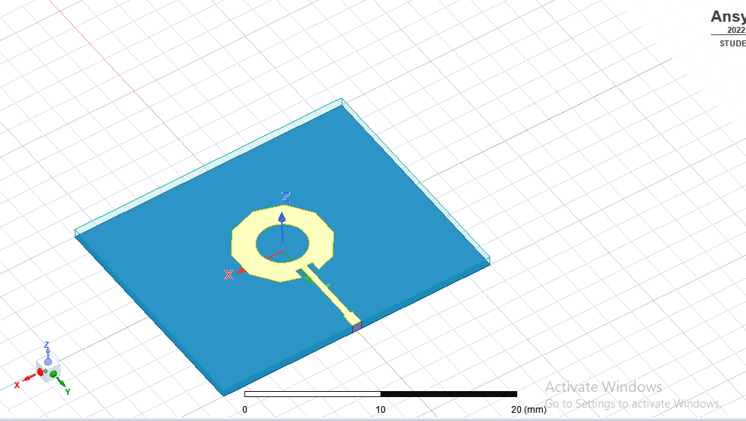
ANTENNA DESIGNED

Slide 8
DESIGN SPECIFICATION :
Substrate material = FR4 epoxy
Dielectric Constant = 4.4
Operating Frequency = 2.8 THz
Impedance = 50 ohms
Length of patch = 30 μm
width of patch = 26 μm

Slide 9
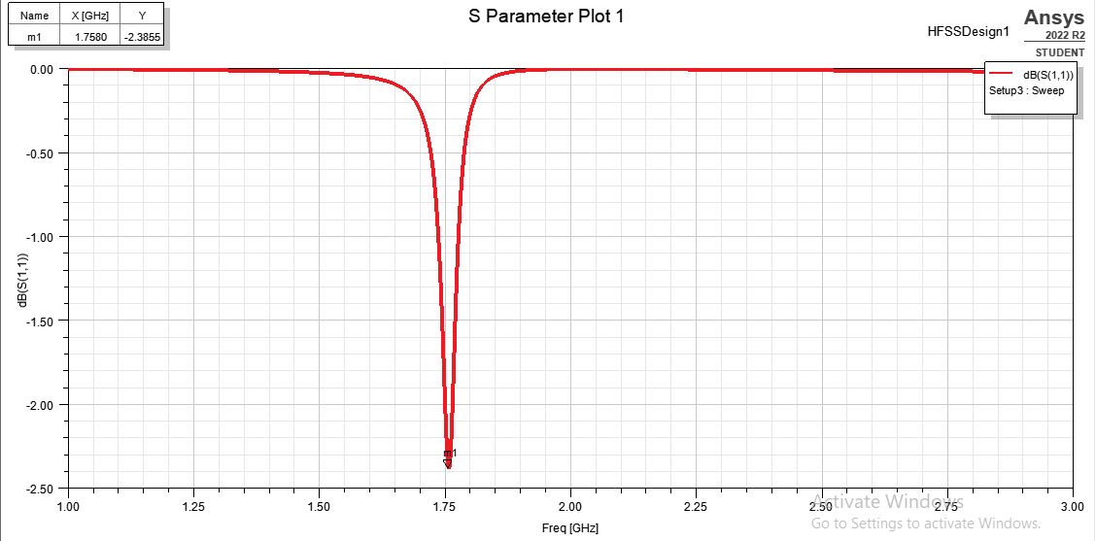
RESULT

Slide 10
S PARAMETER
It is a parameter which indicates the amount of power that is “lost” to the load and does not return as a reflection.
A graph of s11 of an antenna vs frequency is called its return loss curve.
For optimum working such a graph must show a dip at the operating frequency and have a minimum dB value at this frequency.

Slide 11
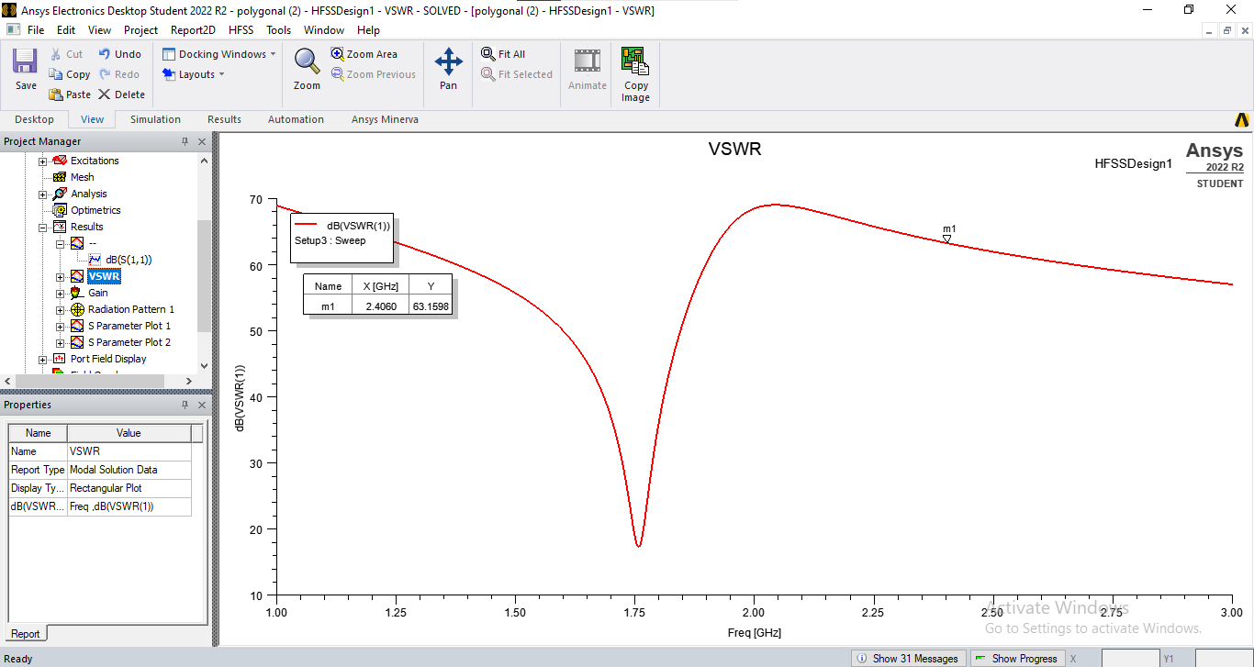
VSWR

Slide 12
VSWR
The VSWR is a parameter that describes how RF power is absorbed by a load in an antenna system.
The VSWR is used to check the working status of the antenna feeder systems. The antenna feeder subsystem includes antenna, feeder line, RF frequency connector, arrester and other accessory equipment.
The maximum transfer of power to the load occurs only when the load impedance perfectly matches the signal source impedance. If not, the signal will be to some degree reflected back to the signal source.

Slide 13

GAIN

Slide 14
GAIN
Gain is a measure of the ability of the antenna to direct the input power into radiation in a particular direction and is measured at the peak radiation intensity.
Gain is achieved by directing the radiation away from other parts of the radiation sphere. In general, gain is defined as the gain-biased pattern of the antenna.

Slide 15
CONCLUSION
We compared many metamaterial.
Antenna with loaded metamaterial has been successfully designed and simulated.
From using the metamaterial we will increase the bandwidth and return of an antenna.

Slide 16
REFERENCES
[1] T. S. Rappaport et al., “Millimeter Wave Mobile Communications for 5G Cellular: It Will Work!,” IEEE Access, vol. 1, pp. 335-349, 2013.
[2] Y. Huo, X. Dong and W. Xu, “5G Cellular User Equipment: From Theory to Practical Hardware Design,” IEEE Access, vol. 5, pp. 13992-14010, 2017.
[3] M. Shafi et al., “5G: A Tutorial Overview of Standards, Trials, Challenges, Deployment, and Practice,” IEEE Journal on Selected Areas in Communications, vol. 35, no. 6, pp. 1201-1221, June 2017.
[4] E. Dahlman et al., “5G Wireless Access: Requirements and Realization,” IEEE Communications Magazine, vol. 52, no. 12, pp. 42-47, December 2014.

Slide 17


