Slide 1



DEPARTMENT OF ELECTRONICS AND COMMUNICATION ENGINEERING MINOR PROJECT -III FINAL REVIEW Turbidity Meter Using Arduino UNO
PRESENTED BY:
S.RAGAVI [927621BEC159] GUIDE:
S.REENA [927621BEC164] Dr.S.VIMALNATH
V.PRITHIGA [927621BEC153] Associate Professor/ECE
S.SARANYA [927621BEC186]

Slide 2
CONTENTS
Introduction
Problem Statement
Objective
Abstract
Existing System
Proposed System
Comparison (With Existing)
Components
Conclusion
References

Slide 3
TURBIDITY
Turbidity is the cloudiness or haziness of a fluid caused by large numbers of individual particles that are generally invisible to the naked eye, similar to smoke in the air. The measurement of turbidity is a key test of water quality.

Slide 4
PROBLEM STATEMENT
Water quality is a critical aspect of environmental health, and turbidity serves as a key indicator of water quality. Turbidity is caused by suspended particles in water, such as silt, clay, and microorganisms, which can affect the clarity of the water and its suitability for various applications. Monitoring turbidity is essential for ensuring the safety of drinking water, assessing the health of aquatic ecosystems, and facilitating industrial processes.

Slide 5
OBJECTIVES
The main objective of this project is to understand the working and the design of the turbidity.
The gravity Arduino Turbidity sensor detects water quality by measuring the levels of turbidity. It uses light to detect suspended particles in water by measuring the light transmittance and scattering rate, which changes with the amount of total suspended solids (TSS) in water.

Slide 6
ABSTRACT
Turbidity is a concept that is significant when discussing liquids since it is crucial to understanding liquid dynamics and is used to assess the cleanliness of the water.
To determine the condition of the water, the Arduino turbidity sensor monitors turbidity. TSS concentration has an impact on light transmittance and scattering rates, which can be employed to find out whether there are any suspended particles in water.

Slide 7
EXISTING SYSTEM
Turbidity meters are devices used to measure the cloudiness or haziness of a fluid caused by large numbers of particles that are generally invisible to the naked eye. They are commonly employed in water quality monitoring and environmental studies. Creating a turbidity meter using Arduino involves measuring the amount of light scattered or absorbed by particles in a liquid.

Slide 8
PROPOSED SYSTEM
Arduino microcontroller - Core controller of the system.
PC system, keyboard command, monitor is not required to operate the system.
The system functions automatically and independently according to the code uploaded to the microcontroller.
The most essential water parameters needed to be monitored by the average users are water pH level, water turbidity.

Slide 9
COMPARISON WITH EXISTING
Turbidity sensors are used in river and stream gaging, waste water and effluent measurements, control instrumentation for settling ponds, sediment transport research, and laboratory measurements.
These are highly useful and effective instruments to identify the clarity and particle content in a solution, like water.

Slide 10
COMPONENTS
Turbidity module
Arduino
16*2 I2C LCD
Common cathode RGB LED
Breadboard
Jumper wires

Slide 11
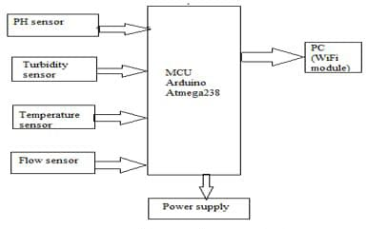
BLOCK DAIGRAM

Slide 12
PROGRAM
const int turbidityPin = 2; // Connect
the signal pin to digital pin 2
void setup() {
Serial.begin(9600); // Initialize serial communication
}
void loop() {
int turbidityValue = analogRead(turbidityPin); // Read the analog value from the turbidity sensor
// You may need to adjust the threshold value based on your sensor and water conditions

Slide 13
int threshold = 500;
// Print the turbidity value for debugging Serial.print("Turbidity: ");
Serial.println(turbidityValue);
// Compare the turbidity value with the threshold
if (turbidityValue > threshold) {
Serial.println("Water is dirty!");
} else {
Serial.println("Water is clean!");
}
delay(1000); // Add a delay to prevent rapid readings}

Slide 14
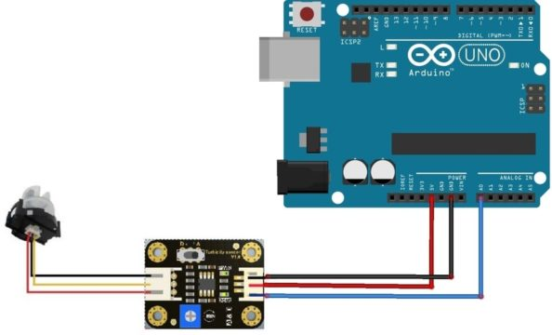
CIRCUIT DESIGN

Slide 15
CONCLUSION
In conclusion, the Turbidity meter using Arduino Uno is a cost-effective and efficient solution for measuring water turbidity. By utilizing the Arduino Uno's capabilities, we were able to create a reliable turbidity measurement device. This project demonstrates the versatility of Arduino for various scientific applications.

Slide 16
REFERENCES
J. G. Andrews, IEEE Journal on Selected Areas in Communications, vol. 32, no. 6, pp. 1065-1082, June 2014.
Z. Ren, A. Zhao and S. Wu, "Dual-Band MIMO Antenna System for 5G Mobile Terminals," 2019 13th European Conference on Antennas and Propagation (EuCAP), Krakow, Poland, 2019, pp. 1-4.
S. Nej and A. Ghosh, "Design of Meander Line Triple Band Antenna for Wireless Applications," 2020

