Slide 1
EMGenius
Portable non-invasive muscle injury monitoring device
Team members :
Nivasan K - 927622BEC139
Pavithra G - 927622BEC143
Prabhavathi K S - 927622BEC145
Prajith Aswin S - 927622BEC148
Praveen Kumar K - 927622BEC149
Ragavi S - 927622BEC158
Guided by :
Dr. V. Mariselvam

Slide 2
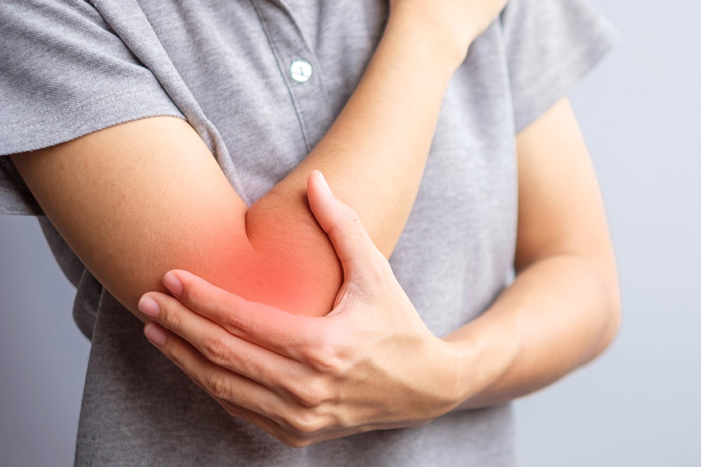
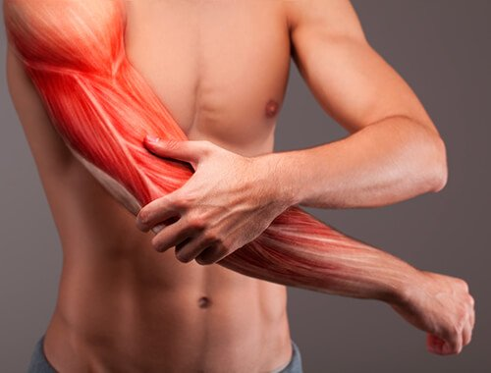
Problem Statement
Early detection of muscle and joint injuries is limited by the lack of affordable, real-time monitoring solutions. A portable, wearable and non-wearable device is needed to enable timely diagnosis, reduce healthcare costs, and improve patient outcomes.

Slide 3


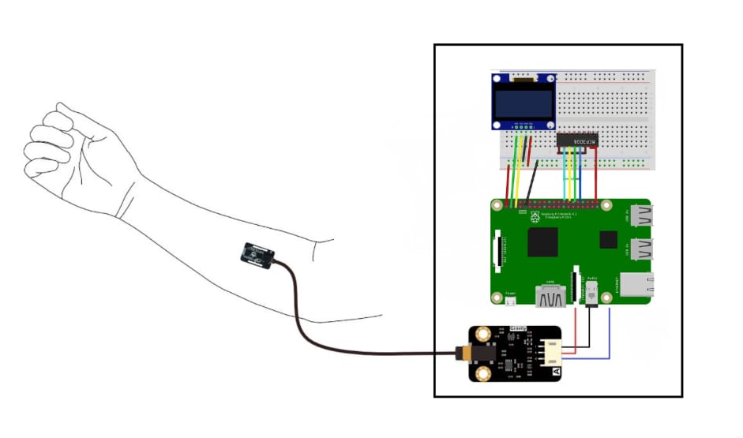
Flow Chart
Proposed Solution
1
Muscle Signal
We propose a low-cost, portable, wearable and non-wearable device using surface EMG sensors to detect muscle and joint pain in real-time.
2
Sensor Amplification
3
ADC Conversion (MCP3008)
4
Raspberry Pi Reads Samples
5
Calculate RMS
6
Compare with Thresholds
Figure 1: Block Diagram of EMG-Based Muscle Injury Detector
7
Show Result

Slide 4
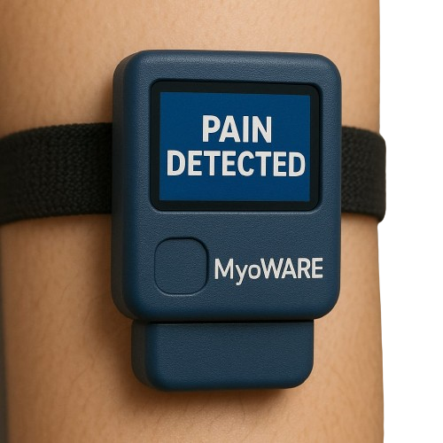
Innovation and Novelty
Low-Cost, Dual Mode Solution (Wearable and Non-Wearable)
Early Pain and Injury Detection
Accessibility for All Age Groups, Including Non-Verbal Individuals
Real-Time Monitoring with Smart Feedback
Figure 2: Protoype

Slide 5
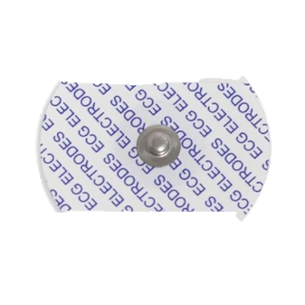
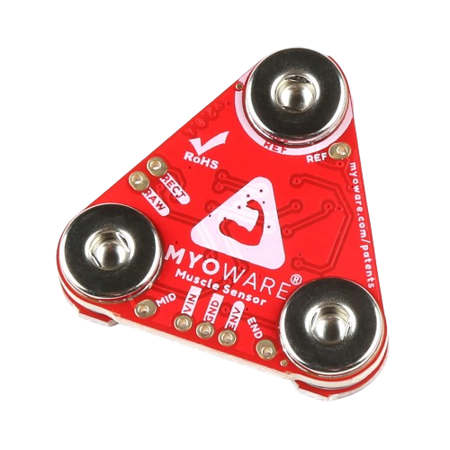
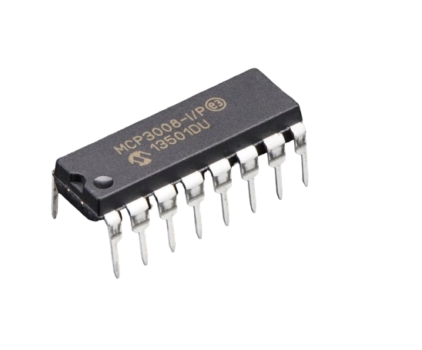
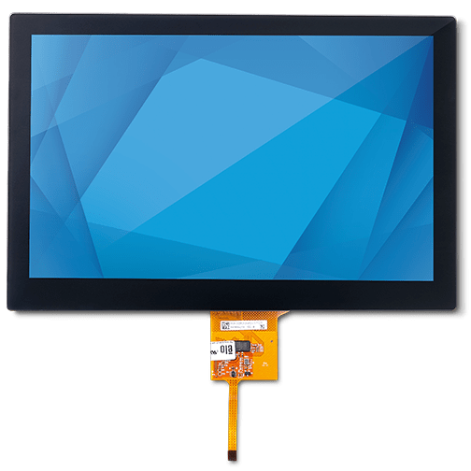
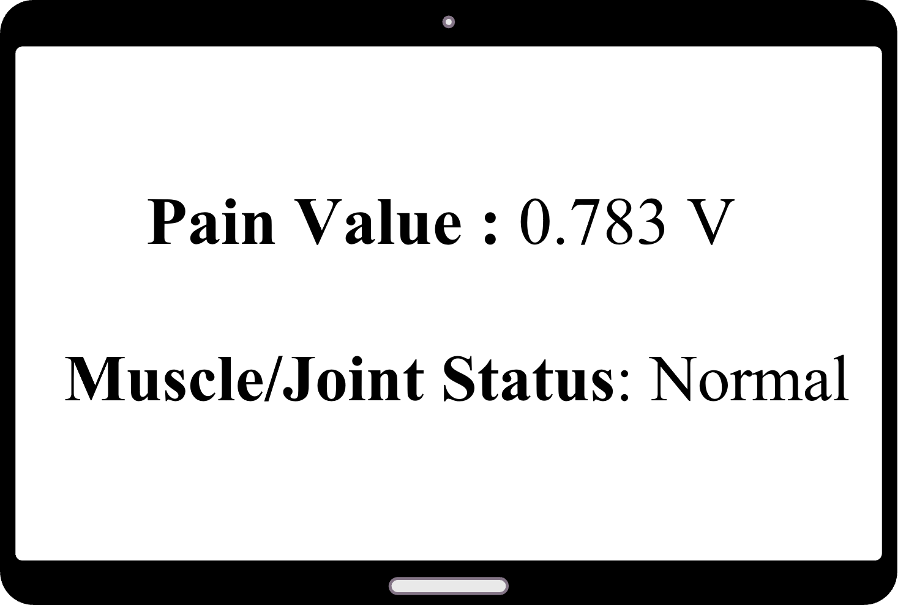
EMG ELECTRODES
Dry surface electrodes are placed near the muscle around the joint to detect electrical muscle activity..
Technical
Approach
STEP 01
EMG SENSOR
The MyoWare EMG sensor amplifies and filters the raw signal from the electrodes.
STEP 02
MOVE GUARD
STEP 03
SIGNAL PROCESSING
The MCP3008 ADC converts the analog EMG signal into digital form. The Raspberry Pi processes the signal to calculate muscle activity and detect abnormalities..
STEP 04
DISPLAY MODULE
The Raspberry Pi analyzes the signal and displays real-time muscle activity data on the OLED/TFT screen..
STEP 05
OUTPUT Abnormal muscle readings (spikes or weakness) indicate possible injury severity, helping doctors decide on further scans.

Slide 6
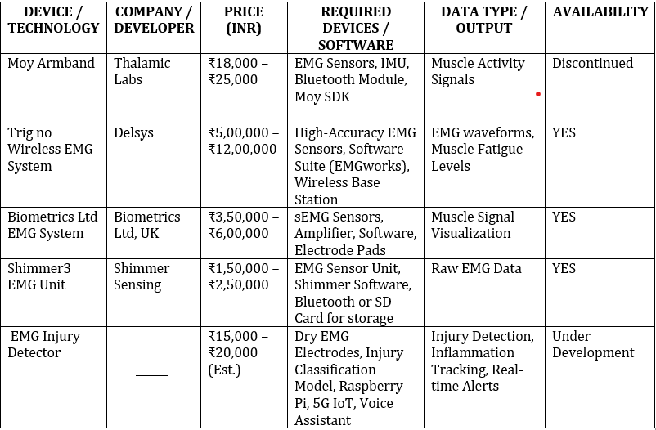
Feasibility
Viability
Components are easily available and low-cost.
Device is compact and fully portable.
Easy to use in clinics, sports centers, or rural hospitals.
No need for external computers or bulky setups.
Scalable to include mobile app, cloud sync, or AI models in the future.
We propose using portable EMG sensing technology to detect musculoskeletal injuries, offering an affordable (₹12k–₹15k) and accurate solution that aligns with our business model goals.

Slide 7
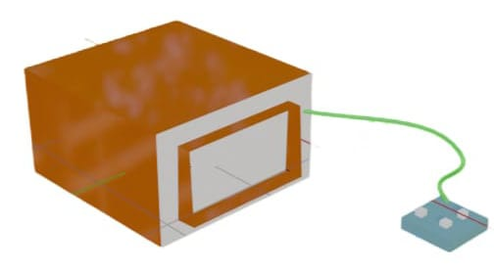
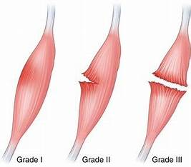
Benefits
Impacts
Simple and Low-Cost Monitoring makes it easy for anyone to use without needing a specialist, making regular muscle/joint health checks affordable.
Real-Time Results provide immediate feedback, helping in early detection and fast action.
Early Detection and Prevention detects muscle or joint issues early, avoiding serious injuries or costly treatments later.
Accessible for Everyone means both athletes and normal users (workers, elderly) can monitor their health easily without hospital visits.
Figure 3: Our 3D Design
Figure 4: Muscle Damage

Slide 8
Business Model
CHANNELS
CUSTOMER SEGMENTS
Athletes & sports trainers
Elderly with joint/muscle issues
Physiotherapist & orthopedic doctors
VALUE PROPOSITION
Early injury detection to reduce costly
Scans (MRI/CT)
Portable , affordable alternative to
Hospital machines
Direct sales to hospitals/clinics/gyms
Medical equipment distributors
B2B sales for physiotherapy chains
CUSTOMER RELATIONSHIP
REVENUE STREAMS
KEY ACTIVITIES
Custom deals for clinics or Sports
Centers (buik pricing)
Service/Maintenance plans
Clinical testing and validation
Marketing & customer outreach
Building partnership with clinics/gyms
Support via app , call center , or Online chat
Feedback-based feature updates
KEY RESOURCES
COST STRUCTURE
Hardware (Myoware sensor , raspberry pi , adc)
Software (signal processing + analysis app)
Sensor and hardware components
Marketing and branding
Manufacturing and packaging

Slide 9
Cost Estimation
SDG Mapping
Component | Cost (₹)
EMG Electrodes | ₹500
MyoWare 2.0 Sensor | ₹4,000
MCP3008 ADC | ₹500
Raspberry Pi | ₹6,000
OLED/TFT Display | ₹1,500
Miscellaneous (Wires, Casing) | ₹2,000
Total | ₹12,000 - ₹15,000
SDG Number | Goal Name | Relation to Your Project
SDG 3 | Good Health and Well-Being | Early detection of muscle injury improves patient health.
SDG 9 | Industry, Innovation, and Infrastructure | Innovative low-cost health device using modern sensors.
SDG 10 | Reduced Inequalities | Makes healthcare accessible for rural/poor people.

Slide 10
Research
References
Studied existing EMG devices and identified the need for a low-cost, portable solution for early muscle injury detection.
Selected and tested components like Myoware EMG sensor and microcontroller to design a compact system.
Researched EMG signal ranges (0.1 mV to 5 mV) to correctly amplify and process the tiny muscle signals.
Designed and validated a simple real-time monitoring system targeting athletes, workers, and elderly users.
https://www.mdpi.com/1424-8220/23/18/7873
https://dl.acm.org/doi/abs/10.1145/3648679
https://physoc.onlinelibrary.wiley.com/doi/abs/10.1113/JP287913

