Slide 1
Editors
Simulator
Web App
Blockly
JavaScript
TypeScript
Metadata generation
Browser compilation
Monaco
STS
IR
Assembly
user
binary
TypeScript
Device
Runtime
Linker
STS
runtime
binary
cached copy
Shim generation
final
binary
C++
runtime
binary
compile
Cloud-based compilation
decompile
link

Slide 2
codal-core
Blockly,
Typescript, Monaco
pxt
uses
references
extends,
implements
codal-atmega328p
pxt-common-packages
references
uses
codal-arduino-uno
uses
codal
(build shell)
uses
pxt-target
extends,
implements
codal-samd21
selects from
uses
codal-circuit-playground
MakeCode web app
Notes:
https://github.com/lancaster-university/codal-adafruit-cplay

Slide 3
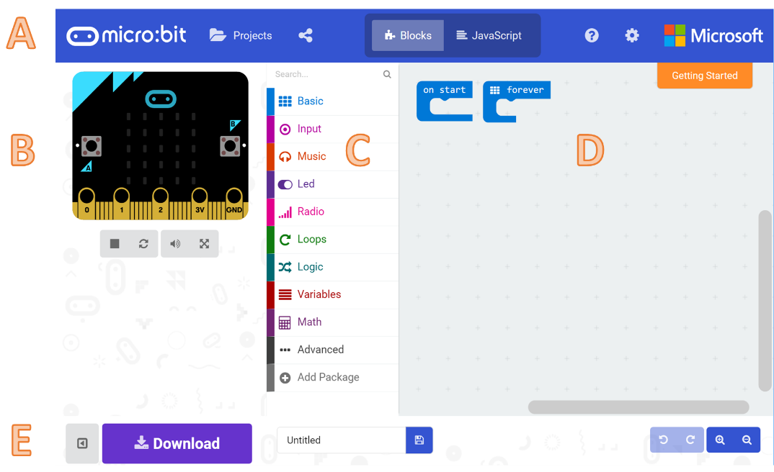

Slide 4
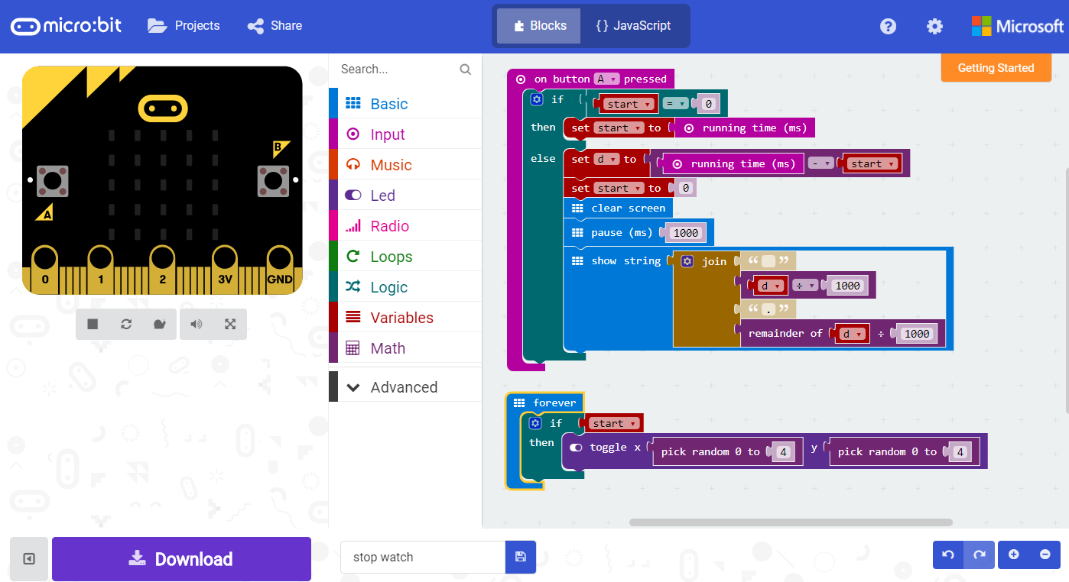
A
B
D
C
E

Slide 5
codal
(build shell)
codal-arduino-uno
codal-circuit-playground
codal-atmega328p
codal-samd21
codal-mbed
codal-core
mbed-classic

