Slide 1
The PLDI Story (in one picture)
The Web
(browser)
Plentiful RAM
World of great frameworks
for beginning programming
(Blockly)
Web App
JavaScript
Single-threaded
Static TypeScript
our contribution
bringing the worlds of
Web and MCU together
WA = integration/entry point
Languages
Compiler
Runtime
CODAL
Reactive/
concurrent
C/C++
Full bare-metal binary
The microcontroller
(MCU)
Little RAM
World of the pro IDE
(Eclipse, VS, VS Code)

Slide 2
Editors
Simulator
Web App
Blockly
JavaScript
TypeScript
Metadata generation
Browser compilation
Monaco
IR
Assembly
user
binary
TypeScript
Device
runtime
Linker
Static
TypeScript
runtime
binary
cached copy
Shim generation
final binary
C++
runtime
binary
compile
Cloud compilation
decompile
link

Slide 3
codal-core
Blockly,
Typescript, Monaco
pxt
uses
references
extends,
implements
codal-atmega328p
pxt-common-packages
references
uses
codal-arduino-uno
uses
codal
(build shell)
uses
pxt-target
extends,
implements
codal-samd21
selects from
uses
codal-circuit-playground
MakeCode web app
Notes:
https://github.com/lancaster-university/codal-adafruit-cplay

Slide 4
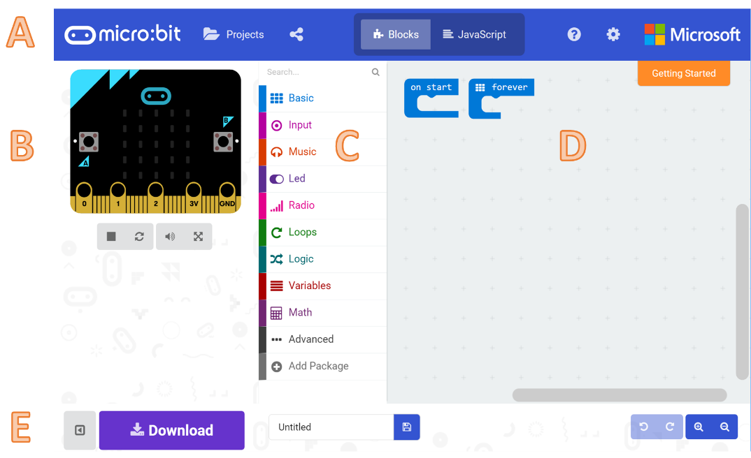

Slide 5
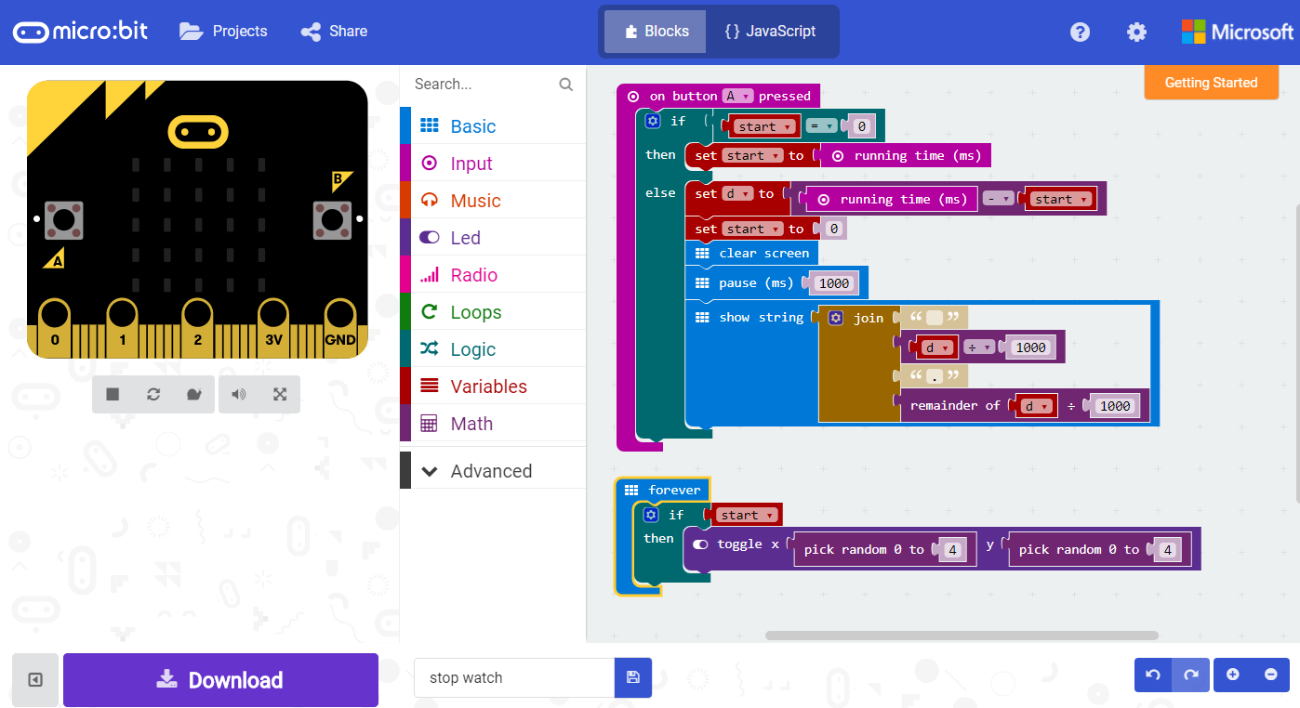
A
B
D
C
E

Slide 6
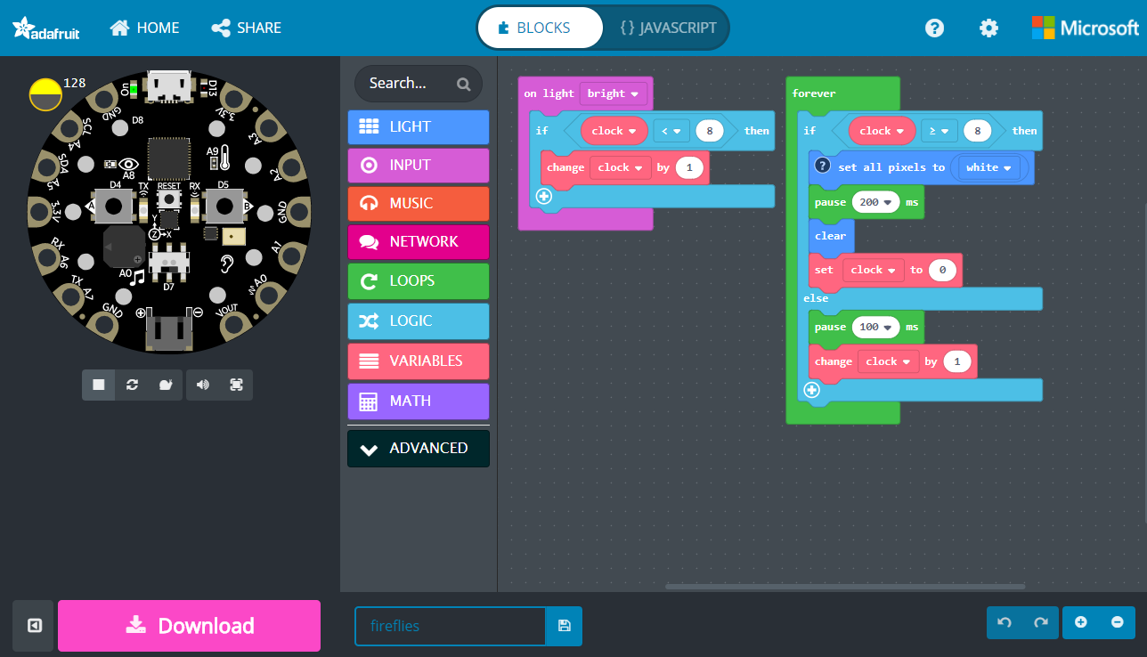
A
B
D
C
E

Slide 7
codal
(build shell)
codal-arduino-uno
codal-circuit-playground
codal-atmega328p
codal-samd21
codal-mbed
codal-core
mbed-classic

Slide 8
RT
(build shell)
RT-arduino-uno
RT-circuit-playground
RT-atmega328p
RT-samd21
RT-mbed
RT-core
mbed-classic

