Slide 1
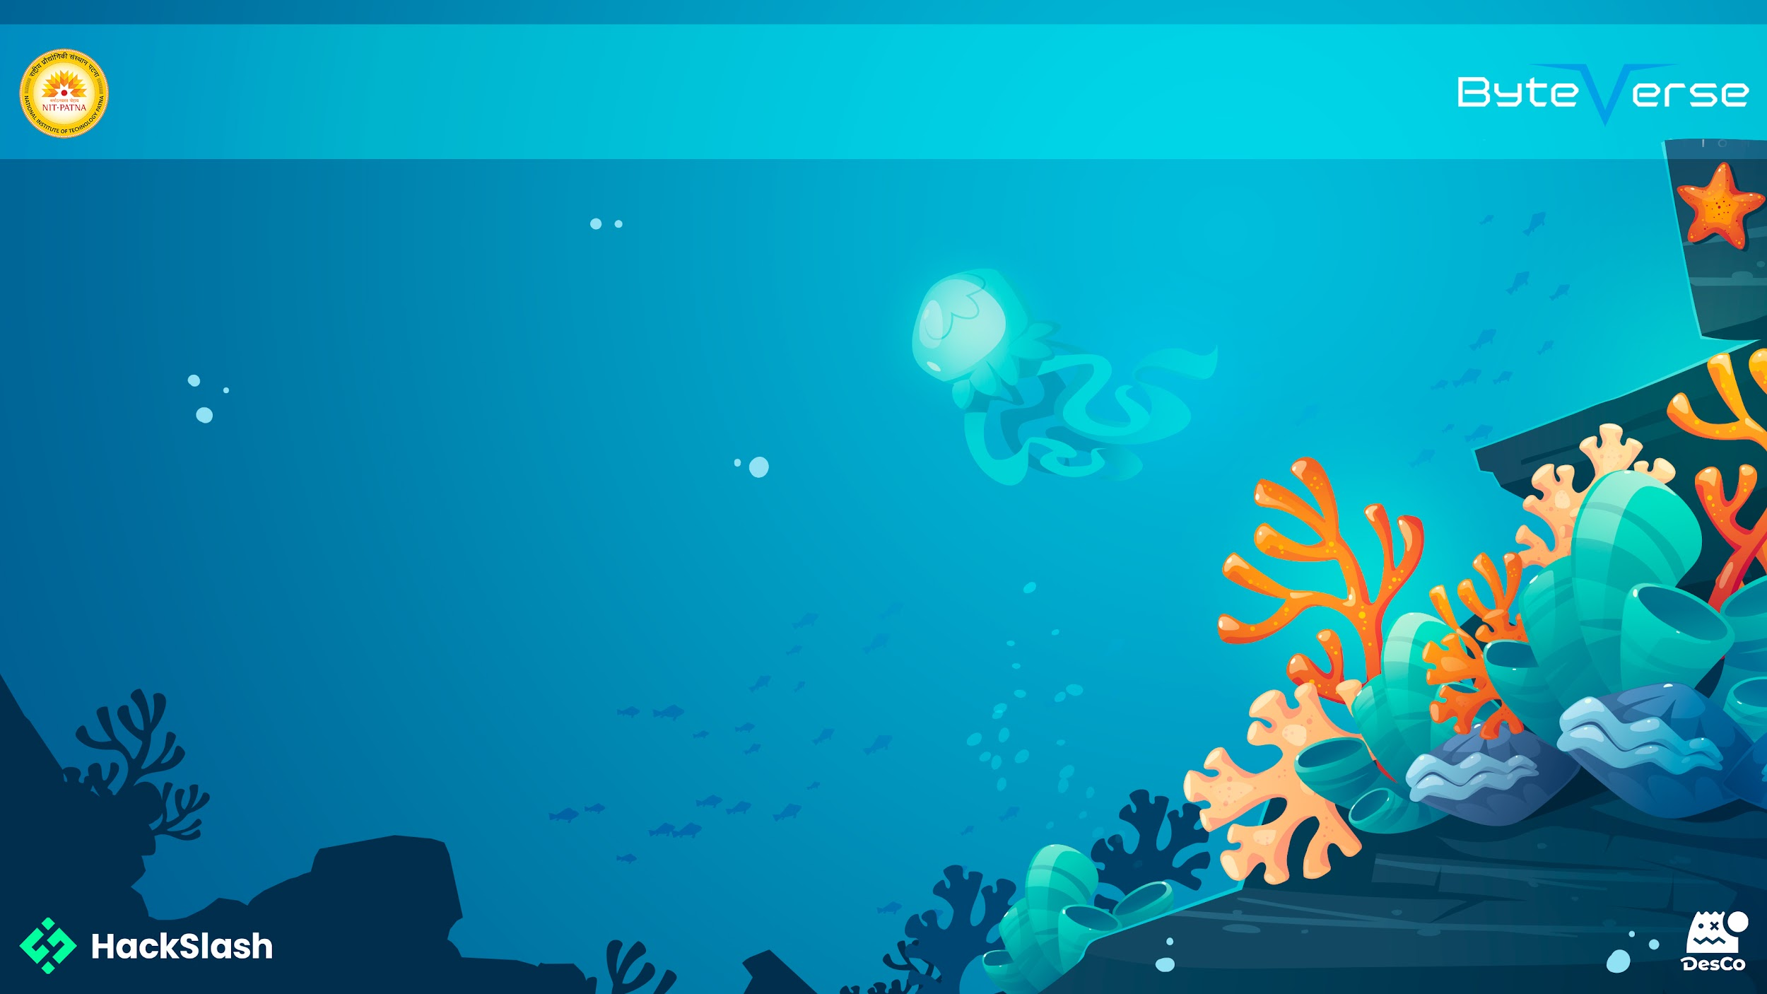
Basic Details of the Team
and Problem Statement
Problem Statement: EduBridge — Personalized Learning Hub
Team Name: The Coder Boys
Institute Name: Kazi Nazrul University, Asansol
Theme Name: Quality Education

Slide 2

Idea/Approach Details
EduBridge – Technology Stack
To build a robust, scalable, and responsive web application, we selected a modern full-stack JavaScript framework, combining efficient front-end interactivity with reliable backend performance.
🖥️ Frontend
React.js: For building a dynamic and component-driven user interface.
Tailwind CSS: For fast and responsive UI design with utility-first styling.
🔧 Backend
Node.js: A lightweight, event-driven runtime to handle asynchronous operations efficiently.
Express.js: A flexible and minimalist backend framework for building RESTful APIs.
🗄️ Database
MongoDB: A NoSQL database to store user data, progress metrics, and learning content with high flexibility.
🤖 AI Assistant (Optional Integration)
OpenAI API: Powers the chatbot for intelligent, real-time assistance and content guidance (optional demo-ready feature).
🚀 Hosting & Deployment
Frontend Hosting: Deployed on Netlify for fast and global access.
Backend Hosting: Deployed on Render for scalable and persistent server-side support.
GitHub: Version control and collaboration.
EduBridge is a web-based platform designed to deliver personalized, engaging, and accessible education for students, especially those in underserved areas. It addresses key gaps in current learning ecosystems by offering a unified digital learning hub that adapts to a learner’s progress and needs.
The platform features:
A personalized learning dashboard that tailors content and tracks progress.
An AI-powered chatbot assistant to resolve doubts and guide learning paths.
Gamification elements like XP points, streaks, and badges to boost engagement.
Progress tracking tools that help students monitor their skills and growth over time.
Built using React, Node.js, Express, and MongoDB, the system is both scalable and open-source. Future versions will include a mobile app, mentor-student pairing, and community learning zones, moving toward a holistic, connected learning experience.

Slide 3
Idea/Approach Details
EduBridge – Use Cases
1. Personalized Learning Experience Students can log in to access a personalized dashboard with curated content based on their skill level, interests, and learning history. This helps them stay on track and motivated.
2. Instant Doubt Resolution With the AI-powered chatbot assistant, students can ask questions at any time and receive quick, relevant answers—eliminating the barrier of waiting for human guidance.
3. Progress Monitoring & Self-Tracking Learners can monitor their academic progress through dashboards displaying completed modules, active streaks, XP earned, and areas that need improvement.
4. Gamified Motivation System Students earn XP, badges, and maintain streaks for consistent learning. This gamification boosts engagement, especially for younger learners or those struggling with self-discipline.
5. Accessible Education for Underserved Areas With a lightweight and responsive web interface, EduBridge is accessible even on low-end devices and limited bandwidth, making quality education more inclusive.
6. Scalable for Institutions Schools or NGOs can adopt EduBridge to onboard multiple students, assign content, monitor progress collectively, and foster a more tech-enabled learning environment.
Dependencies / Show Stoppers
OpenAI API: Required for chatbot; service limits or outages can disrupt functionality.
Hosting Services: Depends on Netlify (frontend) and Render (backend); downtime may affect availability.
MongoDB Atlas: Core database; any service disruption can impact data access.
Internet Access: App requires a stable connection; poor connectivity affects user experience.
Scalability & Cost: High traffic or API usage may cause performance issues and cost overruns.

Slide 4
Team Member Details
Team Leader Name: Suhail Raza
Branch (Btech/BCA etc): Btech Stream (ECE, CSE etc):CSE Year (I,II,III,IV): 4th
Team Member 1 Name: Sudip Kotal
Branch (Btech/BCA etc): Btech Stream (ECE, CSE etc):CSE Year (I,II,III,IV): 4th
Team Member 2 Name: Hemal Baskey
Branch (Btech/BCA etc): Btech Stream (ECE, CSE etc):CSE Year (I,II,III,IV): 4th

