Slide 1
DATA ENGINEERING CASE STUDY

Slide 2
TASKS:
LOAD RAW DATA
CURATION OF RAW DATA
TRANSFORMATIONS OF CURATED DATA

Slide 3
Idea/Architecture we can Use-
EXTRACT
CURATE
TRANSFORM
Load data from AWS bucket using PySpark into Databricks storage
Apply Transformation logics to bring aggregated and meaningful data
Clean raw data using PySpark load into curated layer
LOAD

Slide 4
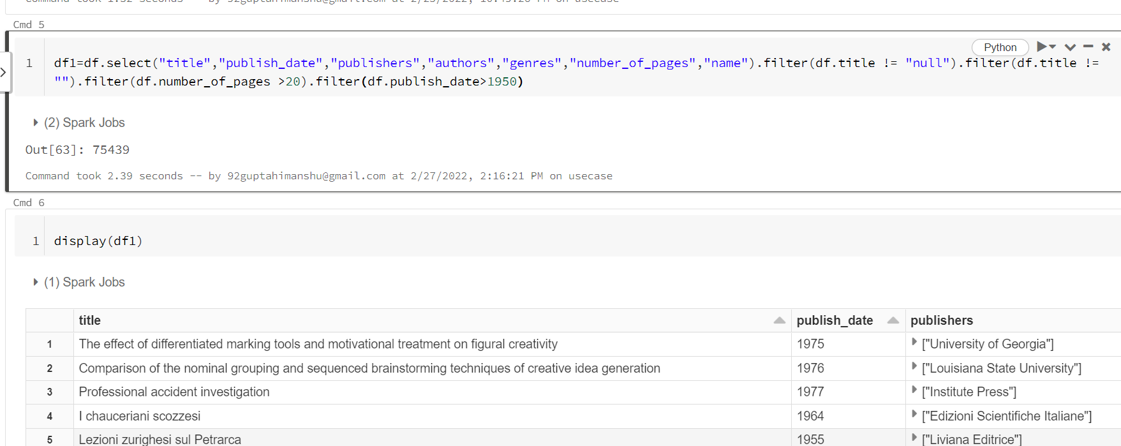
Code Snippet:

