Slide 1
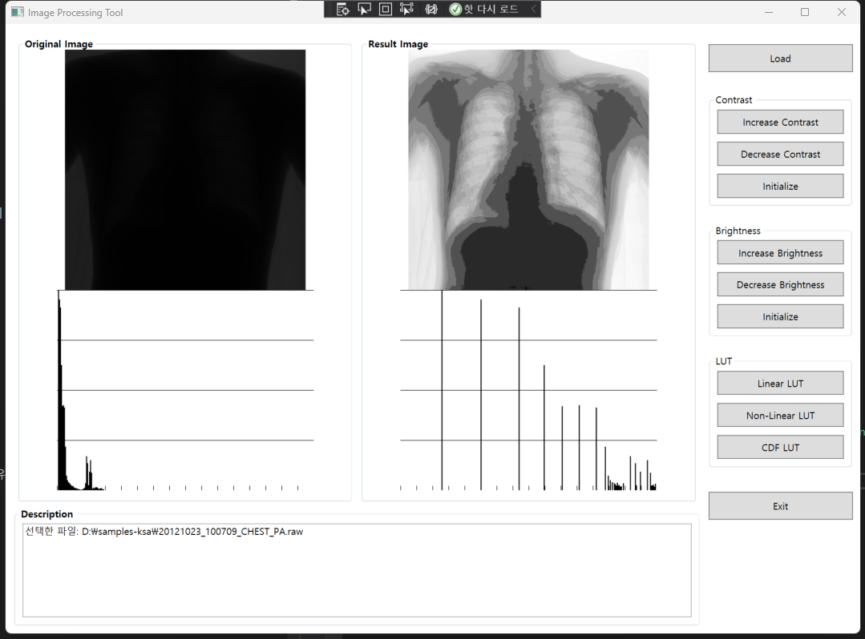
Linear LUT

Slide 2
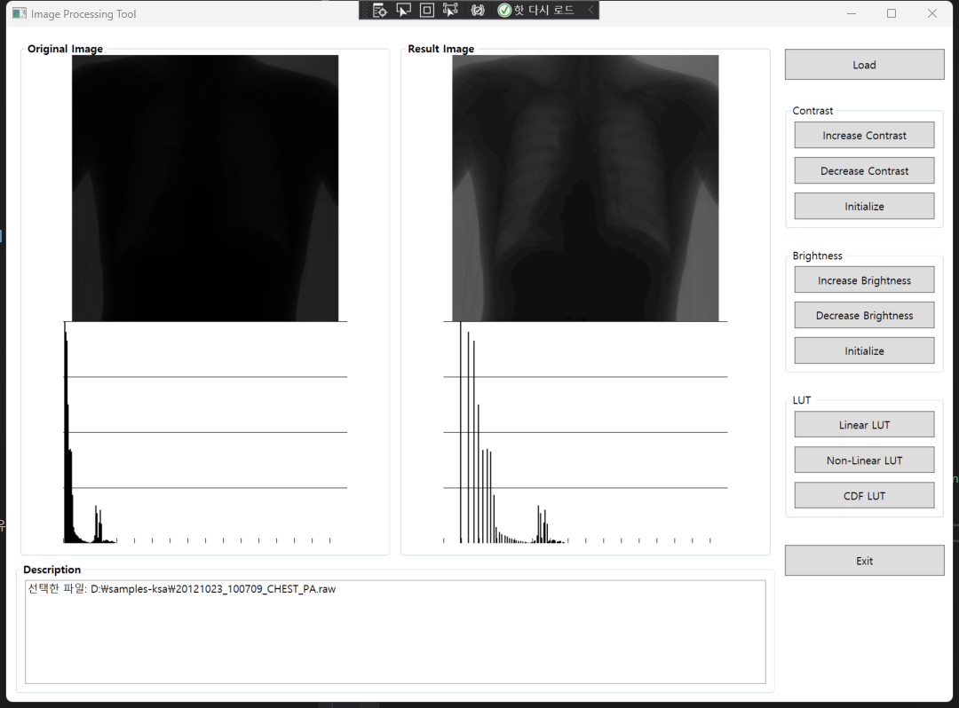
Non-Linear LUT

Slide 3
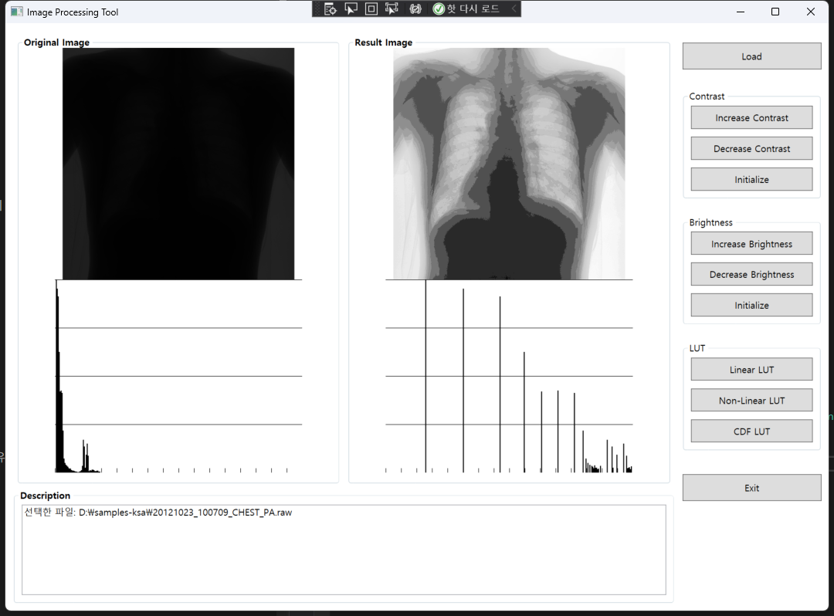
Histogram Equalization LUT

