Slide 1
PERSONA-MH
When is human-like AI behavior appropriate in mental-health counseling?
Focused findings · Human ratings · Profile P and score S
PERSONA-MH
1 / 14

Slide 2
The problem
• Metrics like HuMT measure how human-like a response sounds.
• They do not measure whether the response is appropriate or safe.
• Warm, human-like language can still mislead (false understanding, false care).
• We need dimensions that separate style from appropriateness.
PERSONA-MH
2 / 14

Slide 3
Framework
Profile P and secondary score S
H
E
D
F
Human-likeness (HuMT → 1–5)
Empathic appropriateness
Deception risk
Contextual fit
OA = independent overall appropriateness (locked before E/D/F)
S = (H + E − D + F) / 4
P reports each dimension separately. S is a secondary ranking index — not a replacement for OA.
PERSONA-MH
3 / 14

Slide 4
Study design
220
3
660
5
prompts
models
responses
raters each
• CounselBench Eval + Adv prompts; Claude, Gemini, GLM.
• OA completed and locked before E/D/F.
• E from a second blind round with the same rubric.
• D uses v3.1: highest-severity AI-attributable anthropomorphic cue.
• Evidence spans excluded from analysis.
PERSONA-MH
4 / 14

Slide 5
Annotation reliability
Five raters per response
Dimension
Ordinal α
ICC (avg of 5)
Reading
OA
0.45
0.79
Usable when averaged
E
0.83
0.95
Strong
D
0.73
0.94
Strong
F
0.46
0.78
Usable when averaged
Blind E reannotation substantially improved empathy agreement.
PERSONA-MH
5 / 14

Slide 6
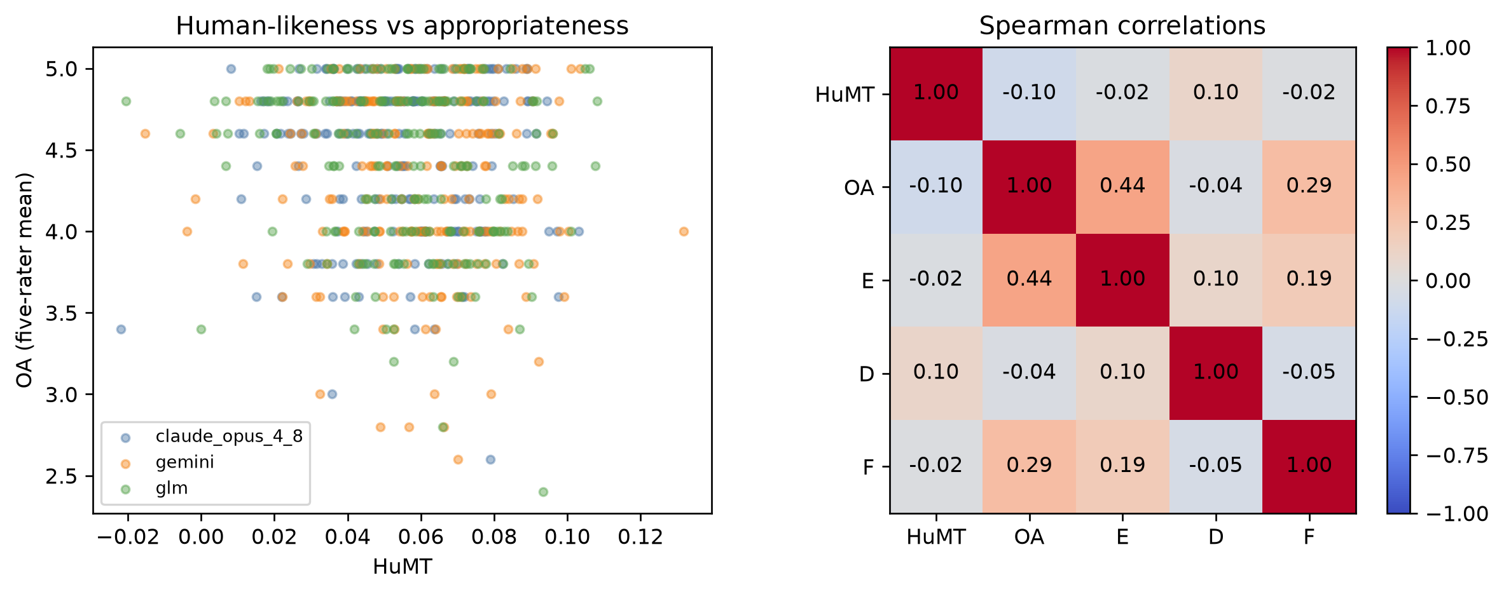
H1 · Human-likeness is not a reliable OA proxy
HuMT–OA ρ ≈ −0.10 HuMT-only CV R² ≈ 0.005
• Almost no useful link to appropriateness.
• Sounding human ≠ being appropriate.
• H1 supported.
PERSONA-MH
6 / 14

Slide 7
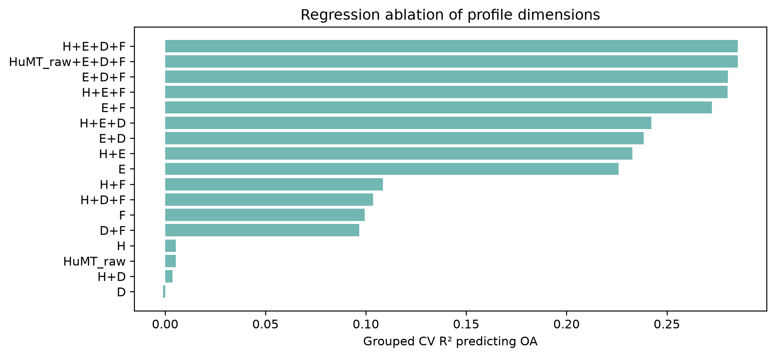
H2 · E/D/F add information beyond HuMT
ΔCV R² ≈ 0.266 over HuMT-adjusted baseline
• PERSONA dimensions explain OA far better than human-likeness alone.
• Joint test strongly supported.
• H2 supported.
PERSONA-MH
7 / 14

Slide 8
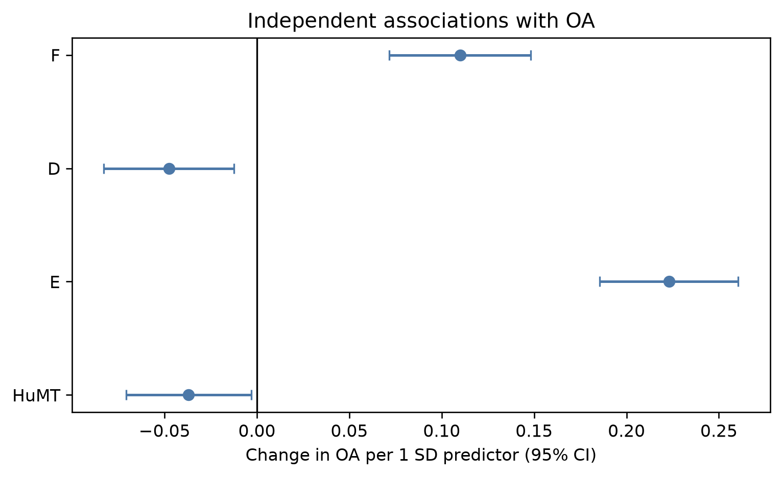
H3 · Directions in the joint model
E ↑ higher OA F ↑ higher OA D ↑ lower OA
• Empathy and fit help.
• Deception risk hurts.
• H3 supported.
PERSONA-MH
8 / 14

Slide 9
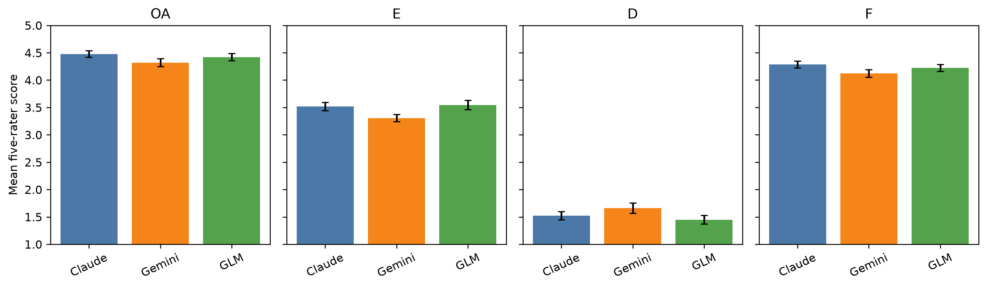
H4 · Models differ in OA / E / F profiles
Differences are real but small.
• Claude tends highest on OA and F.
• Gemini lower on OA/E/F; slightly higher D.
• Not a dramatic winner/loser story.
• H4 supported.
PERSONA-MH
9 / 14

Slide 10
Hypotheses at a glance
H1
HuMT is not a reliable OA proxy
Supported
H2
E/D/F add predictive information beyond HuMT
Supported
H3
E↑ and F↑ with OA; D↓ with OA
Supported
H4
Models differ in OA/E/F profiles
Supported
PERSONA-MH
10 / 14

Slide 11
Score S
Secondary ranking index beside profile P
S = (H + E − D + F) / 4
• H is HuMT remapped to the 1–5 Likert range (corpus min–max).
• Higher E and F raise S; higher D lowers S.
• P keeps the dimensions separate for diagnosis.
• S compresses them for transparent model ranking.
• OA remains the independent human ground truth.
PERSONA-MH
11 / 14

Slide 12
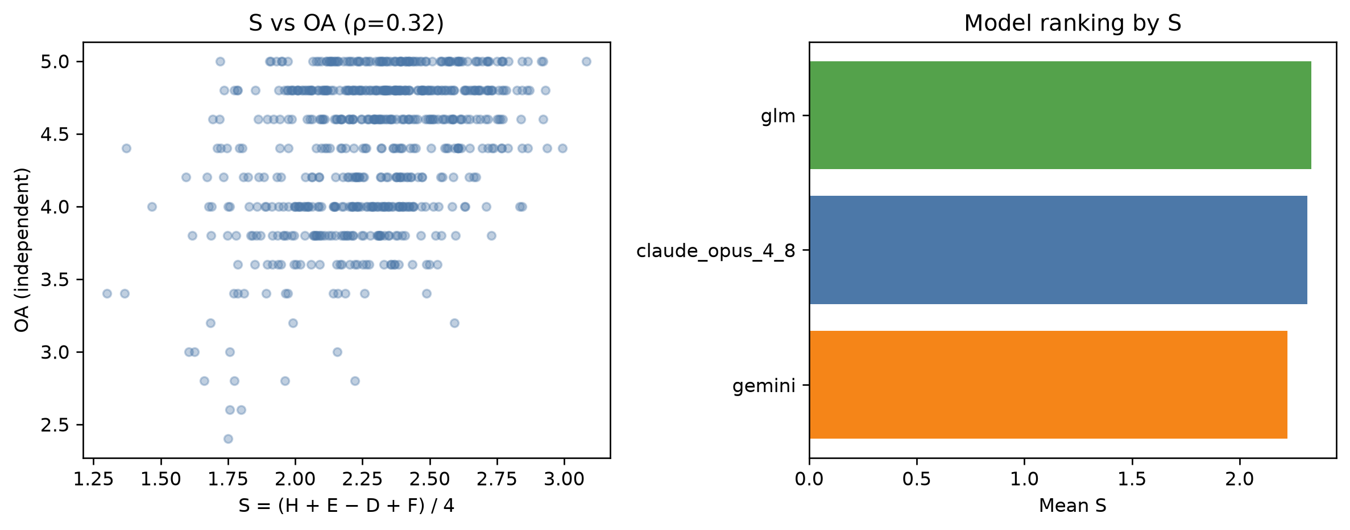
S tracks OA and ranks models
S–OA ρ ≈ 0.33 Without H: S_persona–OA ρ ≈ 0.41
• S is a useful secondary index.
• Dropping H improves tracking — consistent with H1.
• Rank by S: GLM ≳ Claude ≫ Gemini.
• OA rank puts Claude first (related, not identical).
PERSONA-MH
12 / 14

Slide 13
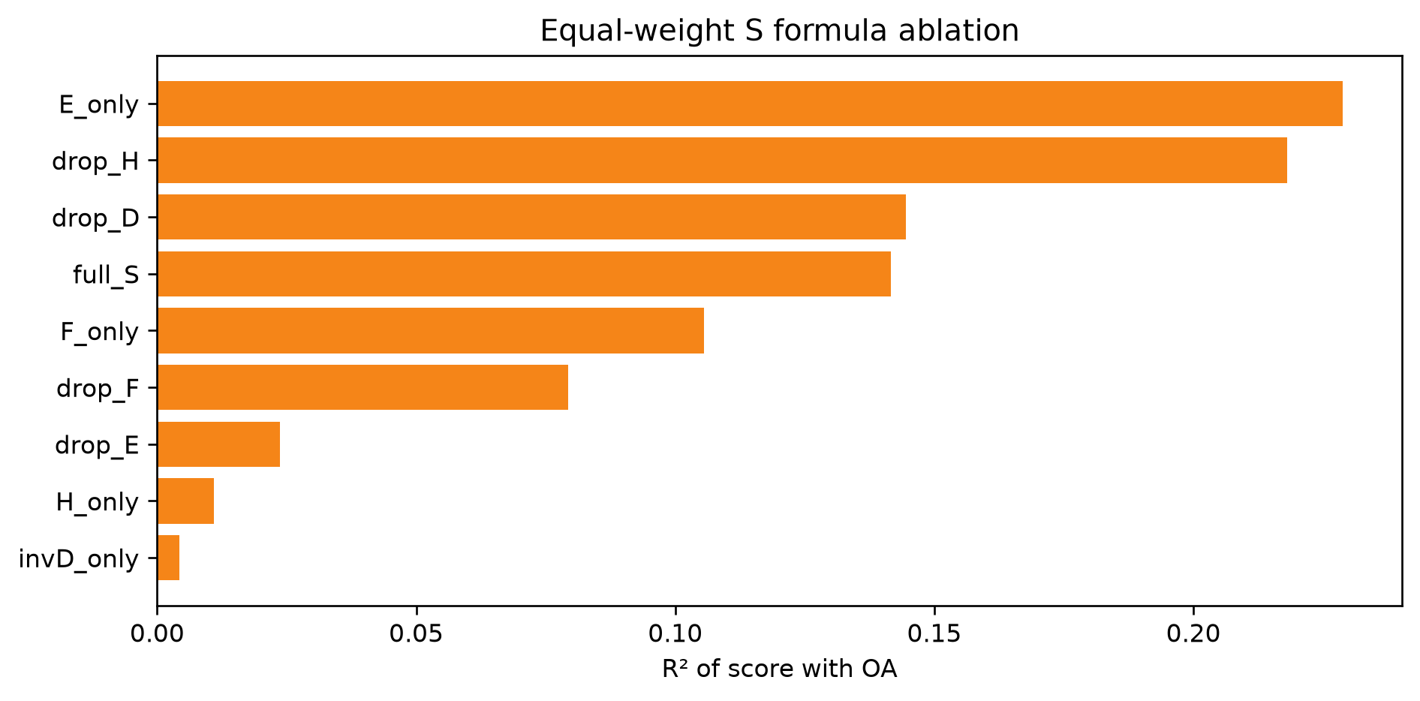
S formula ablation
Which pieces matter for tracking OA?
• E alone is the strongest single piece.
• Dropping H improves the equal-weight score.
• Dropping E or F hurts clearly.
• D alone is weak here (mostly low scores), but still helps in the joint model.
• Ablation supports keeping E, D, F in S; H is optional for ranking.
PERSONA-MH
13 / 14

Slide 14
Takeaways
• Human-likeness is not a reliable proxy for appropriateness.
• E, D, and F jointly explain OA far beyond HuMT.
• Empathy and fit help; deception risk hurts.
• Models differ in OA/E/F, but effect sizes are small.
• Profile P diagnoses; score S ranks — both are useful.
Limits
Ordinal scores · severe D is rare in this corpus · ADV/EVAL prompts are unmatched · S is secondary to independent OA
PERSONA-MH
14 / 14

