Slide 1

Fouling Tendencies of The Denver Nuggets
Spenser White

Slide 2
Purpose
This project was chosen to analyze the behavior of the Denver Nuggets, and to find if there is an undiscovered relation between foul tendency and teams.
This project originally started as a way to investigate referee interference in games but has since morphed into its current version.

Slide 3
Outline
Identifying the question
Getting the data
Analysis
Conclusions

Slide 4
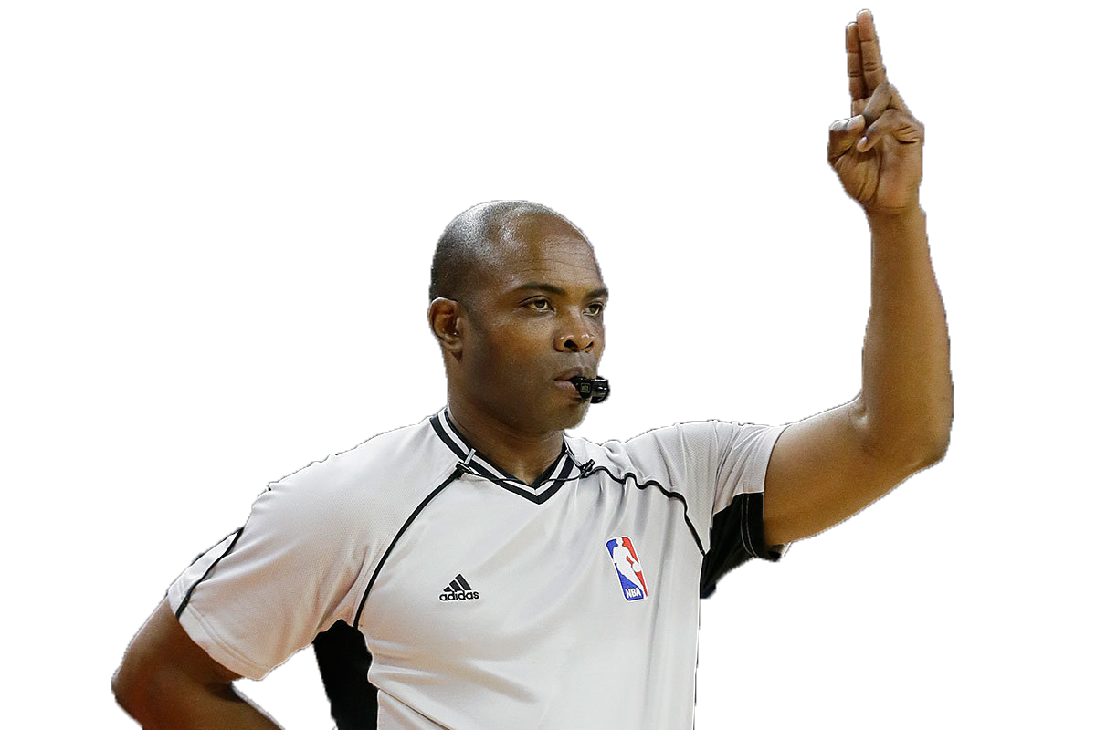
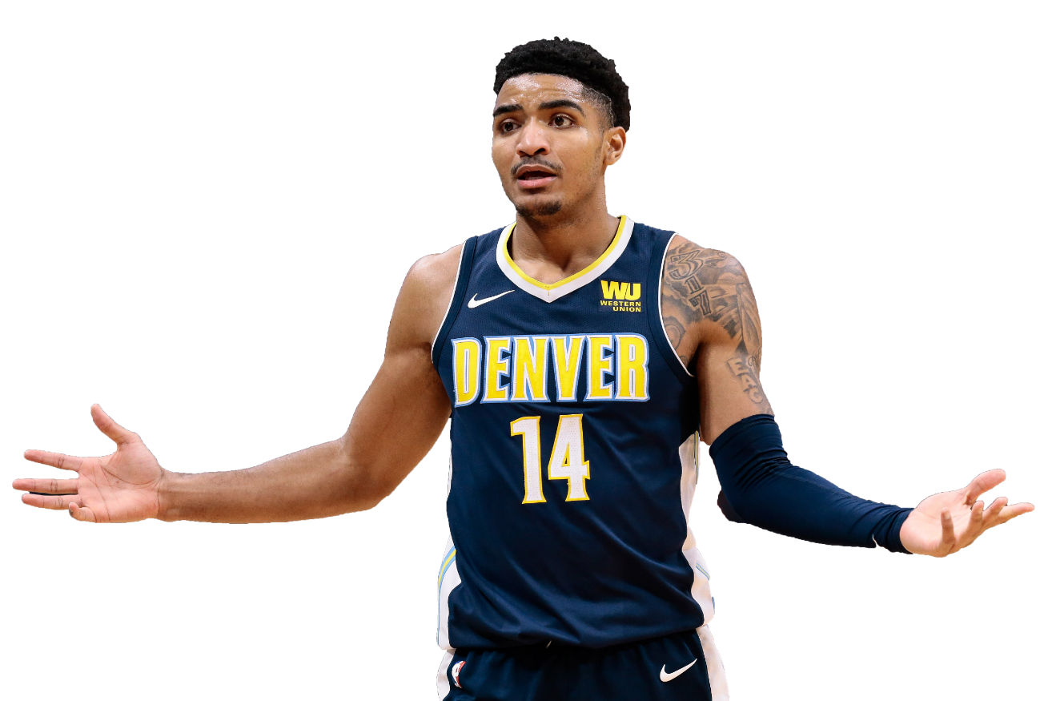
Identifying the Question
A popular idea is that referees, intentionally or not, influence the outcome of a basketball game. I wanted to know if this is true. While this question is too large in scope to completely answer in one semester, I am able to solve the question we can begin with: ‘What is the foul intensity of the Nuggets and the teams they play?’

Slide 5


Getting the Data
Web scraping
File creation
Data cleaning
Analysis

Slide 6
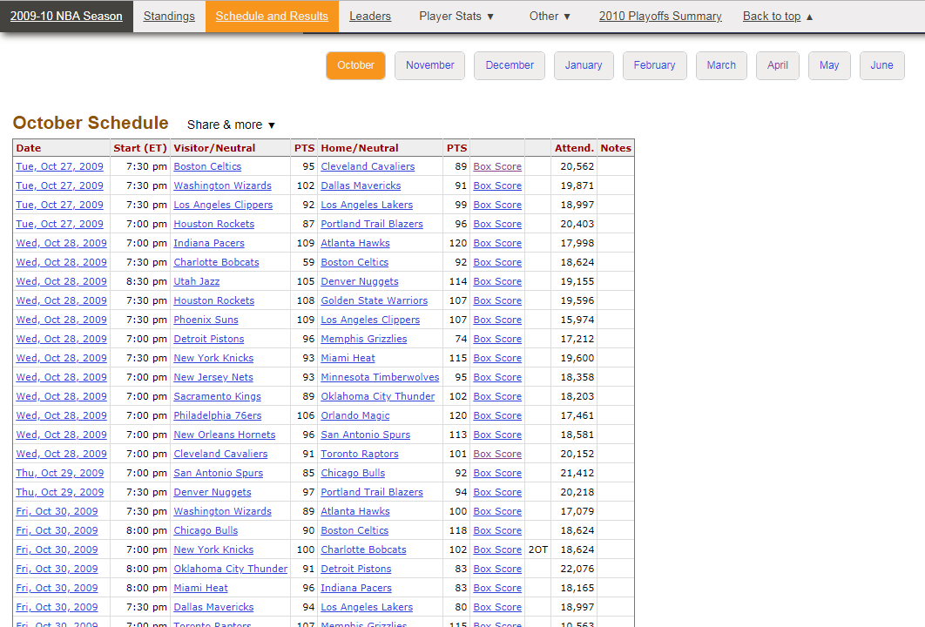

Slide 7
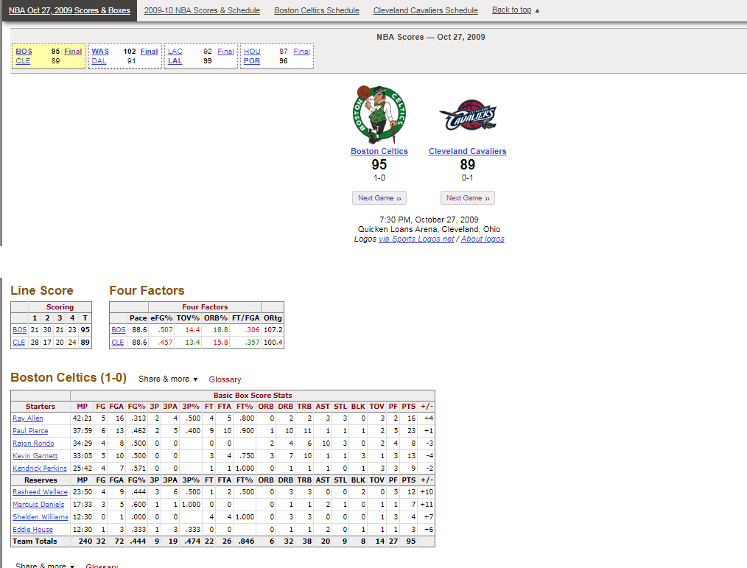

Slide 8
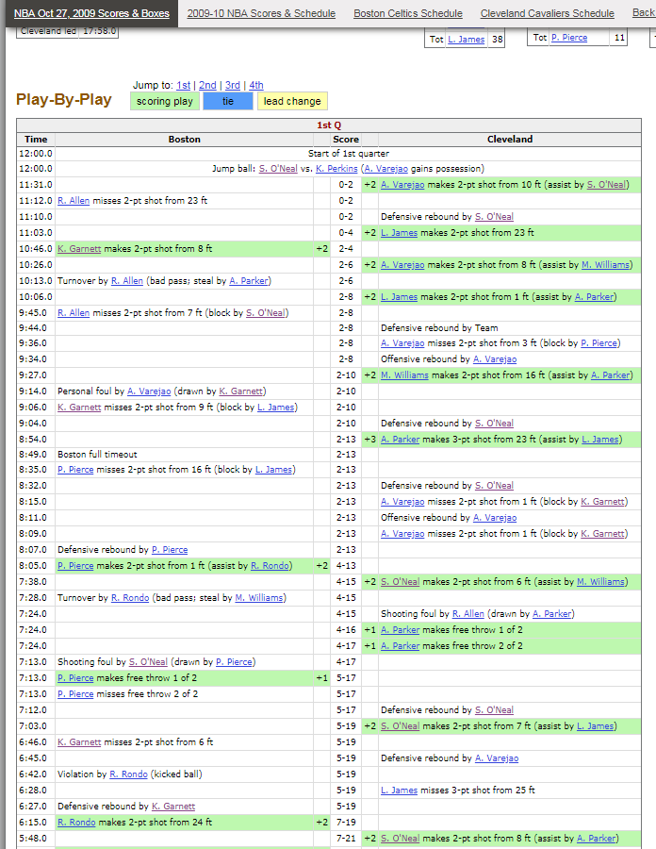
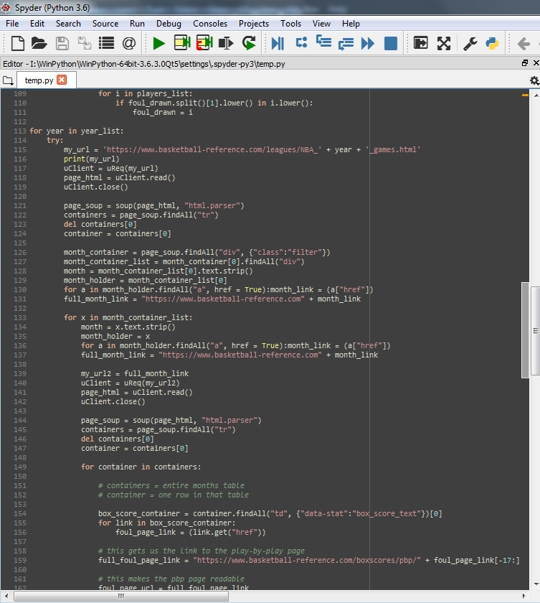

Slide 9
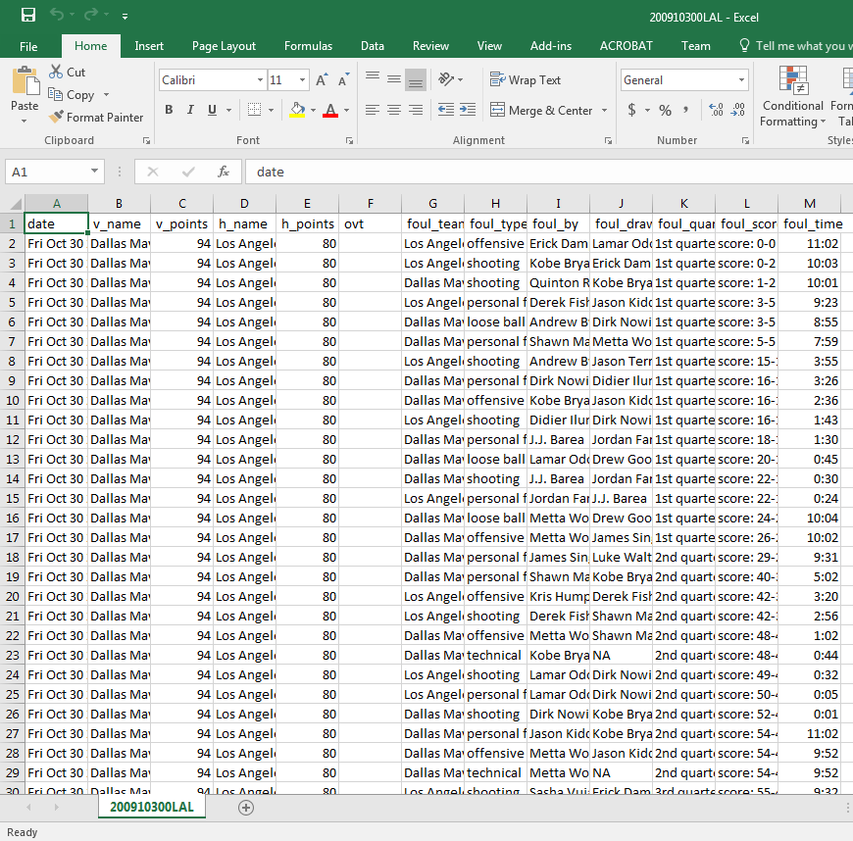
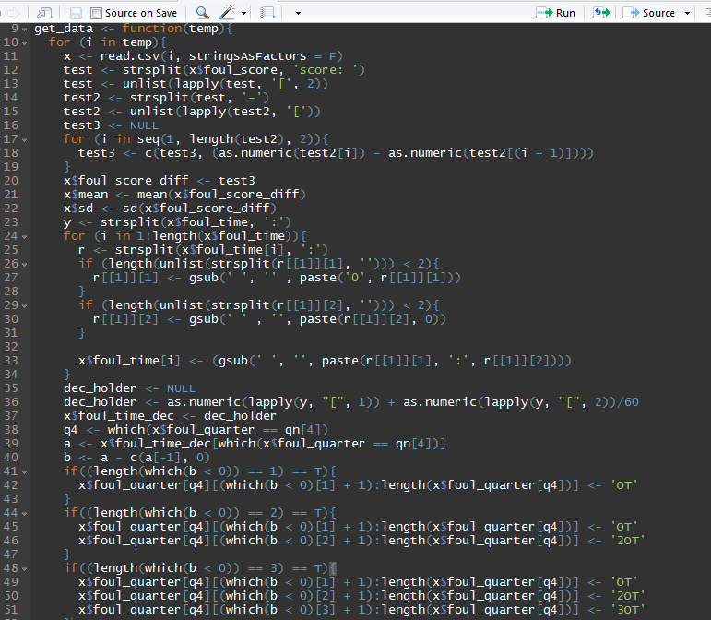
14518 files
625112 rows

Slide 10
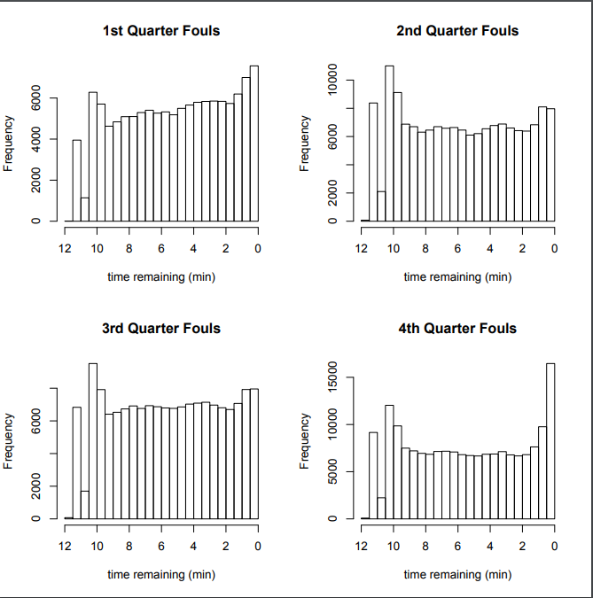
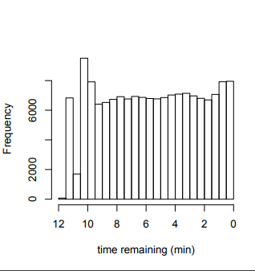
Analysis
Uniform

Slide 11
Assumptions
Counting Model
N(t) ≥ 0
N(t) is integer valued
If s < t, then N(s) ≤ N(t)
For s < t, N(t) – N(s) equals the number of events that have occurred in the interval (s, t)
Poisson Model
N(0) = 0
The process has independent increments.
The number of events in any interval of length t is Poisson distributed with mean λt. That is, for all s, t ≥ 0.

Slide 12
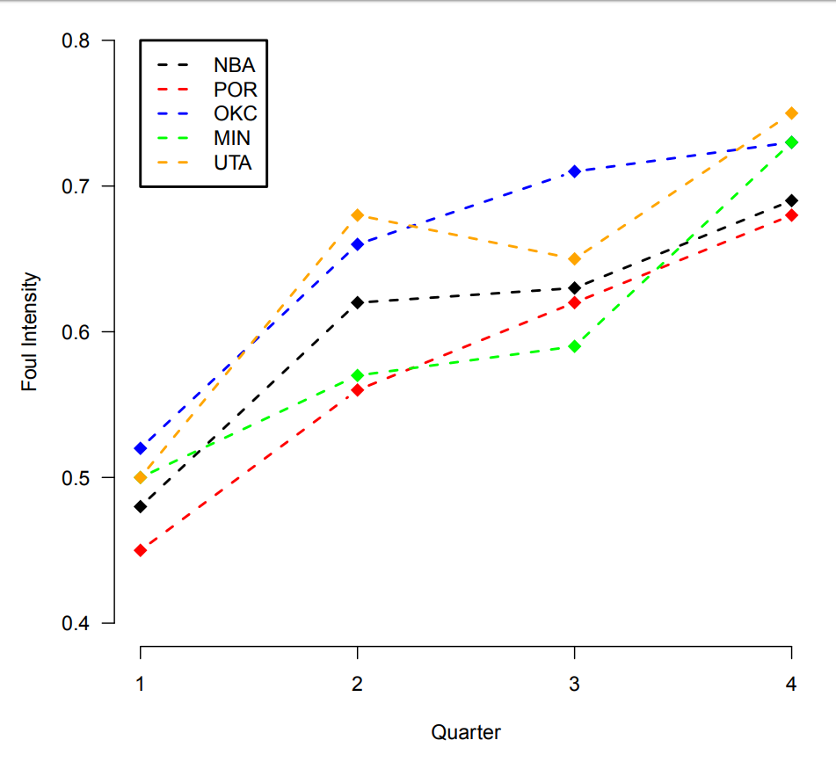
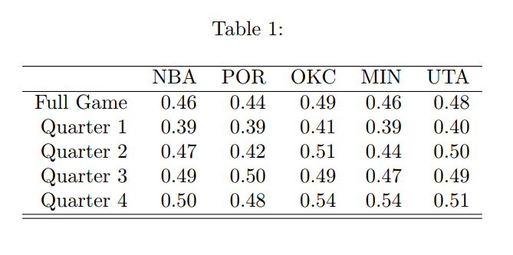

Slide 13
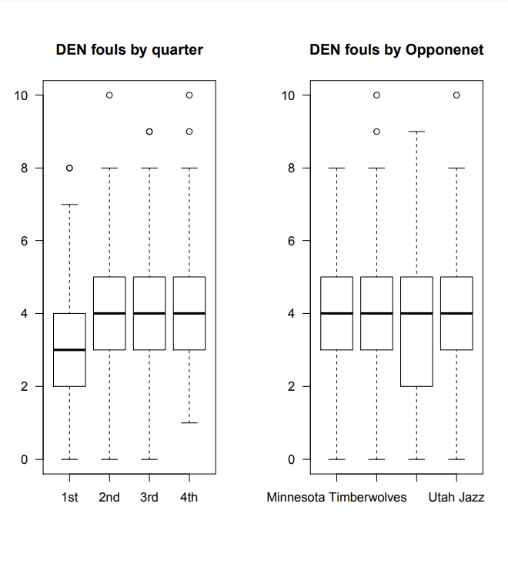
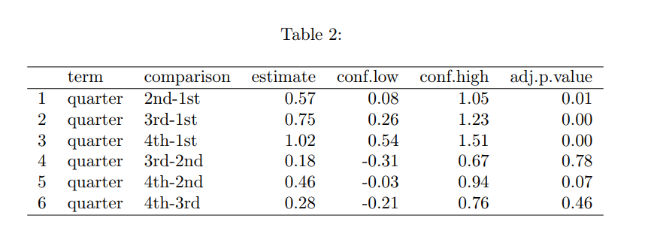
1 2 3 4
────
────

Slide 14

The model
$Y= β_{0}+β_{1}X_{1}$ + $β_{2}X_{2}$ + $β_{3}X_{3}$ + $β_{5}X_{5}$ + $β_{6}X_{6}$+ $β_{7}X_{7}$
Where
$β_{1}$ = $\left\{\begin{aligned}1 if Oppenent is OKC \\ 0 O.W. \end{aligned}\right.$ $β_{2}$ = $\left\{\begin{aligned}1 if Oppenent is POR \\ 0 O.W. \end{aligned}\right.$ $β_{3}$ = $\left\{\begin{aligned}1 if Oppenent is UTA \\ 0 O.W. \end{aligned}\right.$
$β_{5}$ = $\left\{\begin{aligned}1 if 2nd Quarter \\ 0 O.W. \end{aligned}\right.$ $β_{6}$ = $\left\{\begin{aligned}1 if 3rd Quarter \\ 0 O.W. \end{aligned}\right.$ $β_{7}$ = $\left\{\begin{aligned}1 if 4th Quarter \\ 0 O.W. \end{aligned}\right.$
The base model is MIN in the 1st quarter

Slide 15

Diagnostics
Pseudo-$R^{2}$
McFadden:
$R^{2}$ = 1 - $\frac{\ln{(\hat{L}(M_{Full})})}{\ln{(\hat{L}(M_{Intercept})})}$ = 0.0101
Cox-Snell:
1 – ${\text{\{}\frac{\ln{(\hat{L}(M_{Full})})}{\ln{(\hat{L}(M_{Intercept})})}\text{\}}}^{N/2}$ = 0.0394

Slide 16
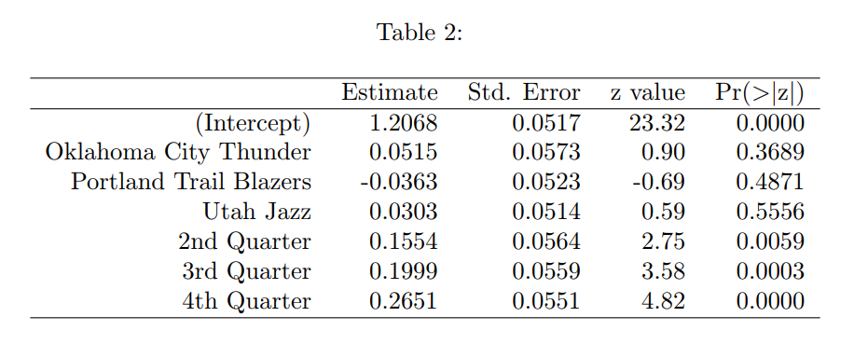
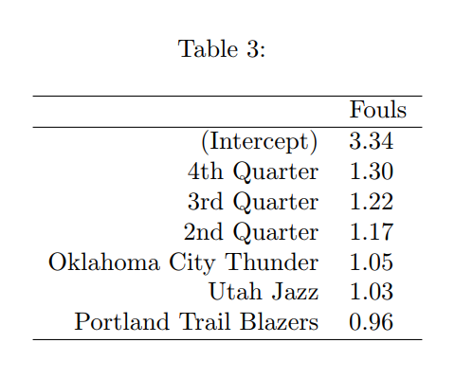
Interpretation

Slide 17
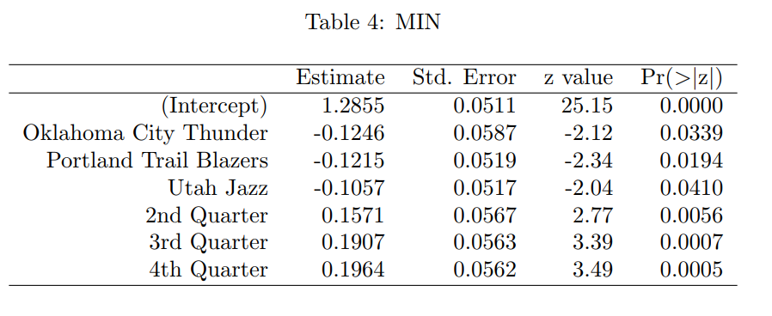
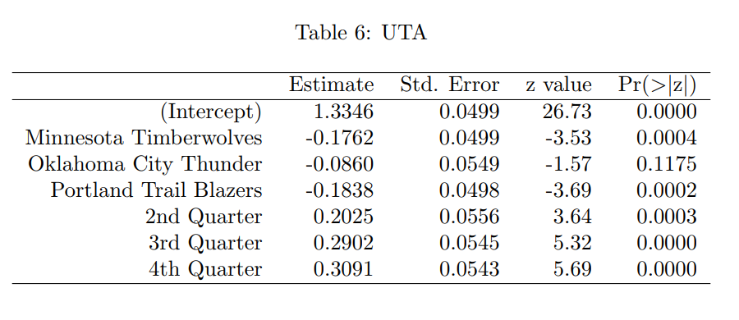
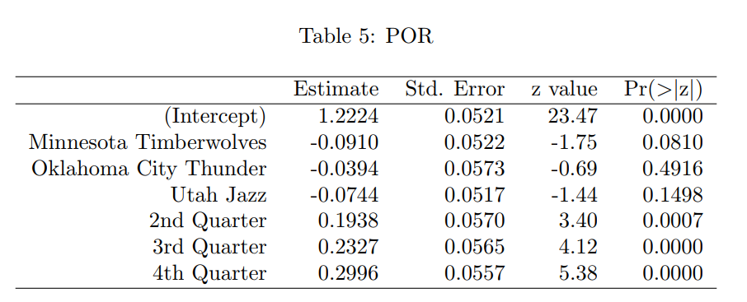
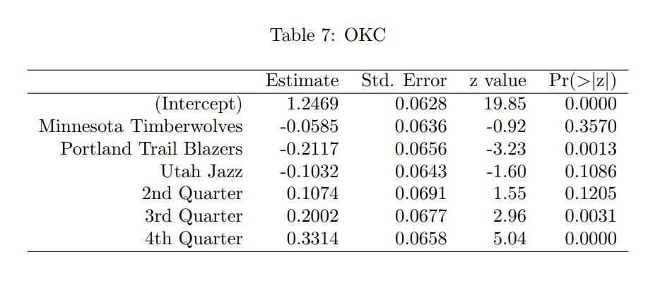
Other NW-Division Teams

Slide 18
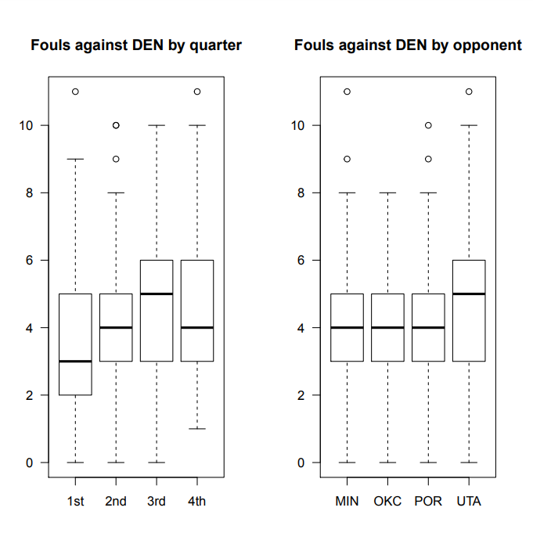
Reversed Model
3 2 4 1
OKC POR MIN UTA

Slide 19
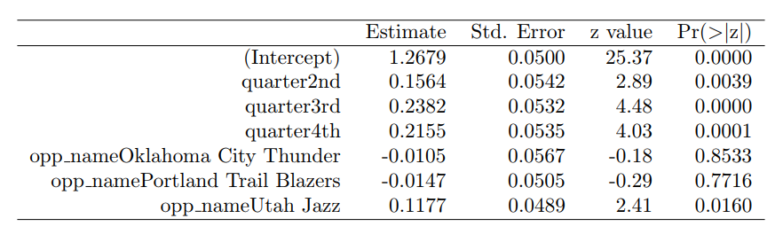
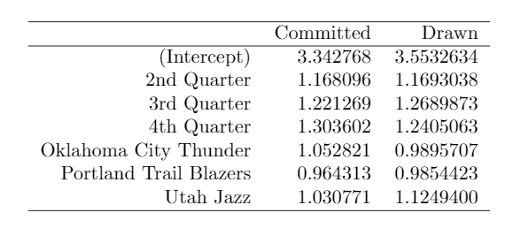
Reversed Model

Slide 20
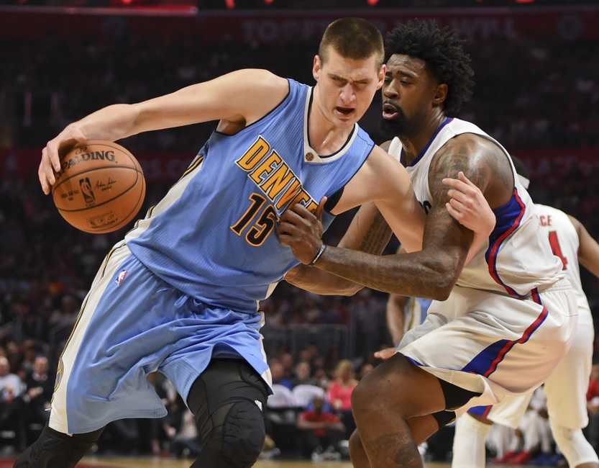
Conclusions

Slide 21

Future Work
A continuation of this process, seeing it through to the end
Video review to catch fouls called to uncalled ratio

Slide 22
Acknowledgements

Slide 23
Additional Links
https://www.basketball-reference.com/
https://github.com/92swhite/NBA-Project

