Slide 1
An End-to-End AI Agent
for Kaggle Competitions
An end-to-end LLM agent benchmarked against two frozen yardsticks on 20 Kaggle competitions
Wei-Hao Huang, National Chengchi University · PI: Dr. Tso-Jung Yen, Institute of Statistical Science, Academia Sinica
Notes:
This is an end-to-end agent for Kaggle competitions: it takes a raw dataset and returns a submission, with no person in the loop. I benchmarked it against two frozen reference agents on twenty competitions, scored on the real leaderboards. (18s)

Slide 2
1 · Motivation
Why these tasks are hard
· A competition demands the whole expert loop — validation design, features, model selection, ensembling — and the top entries separate at the fourth or fifth decimal.
· At that scale local cross-validation is an unreliable compass: a pipeline's own score routinely disagrees with the leaderboard.
Why an AI agent
· Tireless, systematic search: 37–224 candidate configurations per competition, every experiment logged.
· The same disciplined protocol on 20 competitions in a row — a consistency a person cannot hold.
Notes:
Competitions demand the whole expert loop, and the top of the leaderboard separates at the fourth or fifth decimal, so tuning skill distinguishes nobody — and at that scale a pipeline's own cross-validation routinely disagrees with the leaderboard. What an agent brings is tireless, logged search: between thirty-seven and two hundred and twenty-four candidate configurations per competition, and the same protocol run twenty times without drifting. (32s)

Slide 3
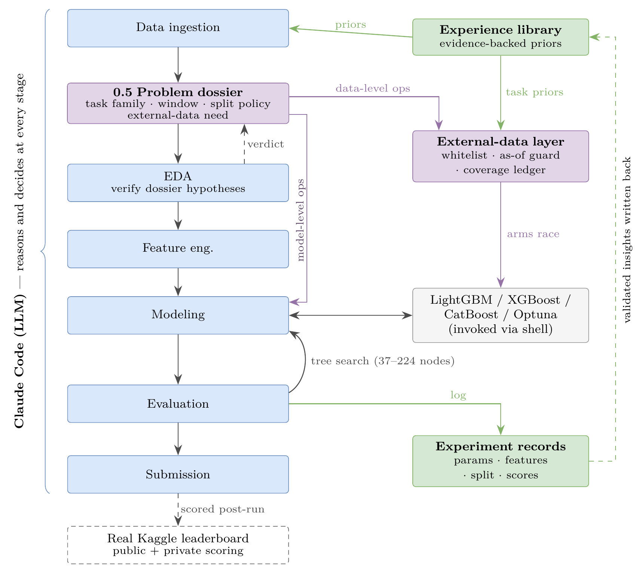
2 · Workflow
The LLM reasons and decides at every stage; gradient boosting does the fitting; a tree search over complete candidate solutions is the optimisation loop.
The problem dossier classifies the task and injects external data upstream, before any modelling.
Lanes hold no Kaggle credentials; submissions are scored post-run on the real leaderboard.
Notes:
The pipeline reads top to bottom. An LLM reasons and decides at every stage, gradient boosting does the fitting, and a tree search over complete candidate solutions is the optimisation loop. The one design decision that mattered is where outside knowledge enters. My first version put it downstream, at the blend — measured, it was worth ten to the minus five. So it moved upstream, into a dossier stage that classifies the task before any modelling. The lanes hold no Kaggle credentials, so nothing inside a run can touch a leaderboard. (40s)

Slide 4
3 · Results
All 20 lanes scored on the real leaderboard; each of the 60 duels judged against the score noise measured on Kaggle's own public/private split — 38 decided, 22 too close to call.
my-agent leads: 16 wins / 8 losses (66.7% of its decided duels) against 42.3% for each frozen yardstick.
Head-to-head best private score
my-agent
10 / 20
NVIDIA
7 / 20
AIDE
3 / 20
Beyond tabular: on three mid-complexity competitions (NLP, physiological time series, medical imaging) my-agent takes the three-way best on all three.
Notes:
Here is the reading. All twenty lanes are scored on the real leaderboard, and every one of the sixty duels is judged against the score noise measured on Kaggle's own split of the test set: thirty-eight decide, twenty-two the data refuses to call. My agent leads — sixteen wins to eight of its decided duels, sixty-six point seven percent, against forty-two point three for each yardstick. It takes the best private score on ten of the twenty competitions, and on three harder competitions outside tabular data it takes the best of the three every time. (45s)

Slide 5
4 · Lessons learned
· Put knowledge injection upstream. At the blend stage it measured near-nothing; moved into problem identification it flags exactly the competitions that need external data.
· Local CV is your only feedback. A competition returns no score until submission, so an error in problem-level judgment leaves CV looking healthy while the leaderboard says otherwise.
· Version the agent itself. An architecture change invalidates every competition that ran before it — start the benchmark over rather than mixing versions in one table.
· Isolate mechanically then audit transcripts — and audit the auditor: ours exempted every command starting with uv, so the one command it existed to catch was never examined.
Notes:
Four things I would tell anyone doing this. Put knowledge injection upstream — at the blend stage it bought nothing. While you iterate, local cross-validation is the only feedback you get, and it can look healthy while the leaderboard says otherwise. Version the agent, not just the code: an architecture change invalidates every run before it. And isolate mechanically, then read the transcripts — including your auditor's: mine was exempting the commands every lane actually issues, so the one command it existed to catch was never examined. (43s)

Slide 6
5 · AI's blind spots
· Engineering judgment is the gap. Nothing in the loop can tell at design time whether an architecture will hold; the flaws surface once it runs, and the debt grows with every competition added.
· Pipelines log success for missing work. Our dossier emitted operators the evaluator had never implemented — no warning, and the ledger recorded it as handled.
· AI writing habits survive review — redundant suffixes, invented terminology, detail in place of the question the reader came for.
github.com/930731haohao-afk/kaggle-agent
Notes:
Where working this way still falls short. Engineering judgment is the gap, not technique: nothing in the loop can tell at design time whether an architecture will hold, and by the time the flaws surface the debt is already there. A pipeline will happily log success for work nothing performed — ours emitted instructions the evaluator had never implemented, and the ledger recorded them as handled. And AI writing habits survive review — redundant suffixes, invented terminology, and detail in place of the question you actually came for. Thank you. (37s)

